Slide 1
MODULE NAME – Problem solving and decision making
MODULE CODE – LCLM4004
STUDENT NAME – Justinraj Francis
STUDENT ID - 2513082
LECTURER – Anita Nan
Assignment 1: Presentation

Slide 2
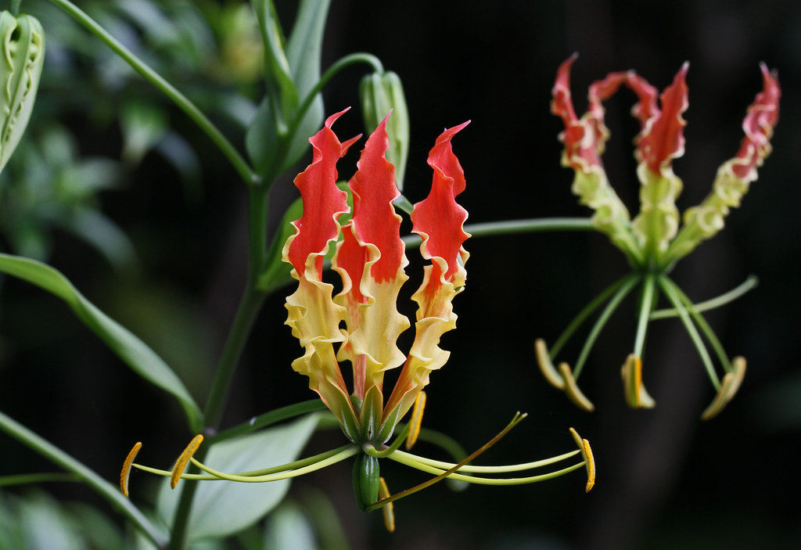

OVERVIEW
Introduction
Company background
Problem: nature and scope
PESTLE ANALYSIS: Green Haven Florists
Cause and effect analysis: Fishbone diagram
Conclusion
References
This Photo by Unknown Author is licensed under CC BY

Slide 3

Introduction
In this presentation, I will discuss Green Haven Florist’s company background.
The florist's problem requires understanding the situation and finding solutions. The 5W2H tool aids in analysing the situation and planning actions by addressing seven key questions to capture essential details (Slack, Brandon‑Jones and Burgess, 2022).
PESTEL Analysis about Green Haven Florist is political, economic, social, technological, legal and environmental(MindTools, 2023).
A fishbone diagram helps teams identify and categories the causes of a problem, leading to better solutions (Goetsch and Davis, 2016).

Slide 4

Company background
Green Haven Florists was founded in 2016.
Owners: Liam and Priya Patel
Sells flowers and has strong ties to the community.
Custom flower arrangements, locally sourced flowers, and eco-friendly packaging.
Use biodegradable wrapping to reduce waste and prioritise local suppliers whenever possible.
Green Haven is facing challenges due to changing consumer behaviour, rising costs, and increased competition both online and locally.
Liam and Priya need to change their business model and improve their online presence to stay competitive in a changing market.

Slide 5

Problem: nature and scope
Who: Liam and Priya Patel
What: Sales in stores are declining, hurting overall profits.
Where: Norwich, UK – facing a decline in high street shops and oversaturation in the local market.
Why: Fewer people are visiting, costs are going up, the digital presence is old, and competition is stronger.
When: In the past year, walk-in sales dropped.
How: We're seeing fewer impulse purchases, limited delivery options, a poor online shopping experience, and rising costs for sustainable materials.
How Much: In-store sales dropped by 30%. Online sales are not growing fast enough to offset these losses. We also face higher costs for flowers and packaging.

Slide 6
PESTLE ANALYSIS: Green Haven Florists
POLITICAL
The price and availability of imported flowers depend on trade rules and policies (Hill and Hult, 2020).
Environmental regulations support sustainable practices that align with Green Haven's values but increase the cost of eco-friendly materials.
ECONOMIC
The prices of flowers, packaging, utilities, and rent have risen due to inflation.
Reduced consumer spending during economic uncertainty means people are buying fewer non-essential items, such as bouquets.
SOCIAL
Online shopping decreases the necessity for physical retail stores.
Younger shoppers are finding florists through social media platforms like Instagram and TikTok. This is changing who the customers are.

Slide 7

PESTLE ANALYSIS: Green Haven Florists
TECHNOLOGICAL
A website that is not up-to-date can cause problems for customers and lead to lower online sales (Nielsen Norman Group, 2020).
Competitors, especially a boutique florist using Instagram, have a strong online presence, raising expectations for visual branding and engagement.
LEGAL
Data protection rules, like GDPR, apply to online orders, customer accounts, and email marketing.
Employment regulations impact staffing costs, especially if a business increases delivery services or hires digital support.
ENVIRONMENTAL
Climate change affects flower-growing areas, leading to unstable supply and higher prices.
Customers are expecting more sustainability from businesses. This puts pressure on companies to use eco-friendly materials, even as costs go up.

Slide 8
Cause and effect analysis: Fishbone diagram
Man
Environment
Many long-time customers now choose lower prices from online flower retailers.
Increased competition from online flower delivery.
Reduced activity due to the closure of the nearby business.
Same-day delivery and frequent discounts.
Income has significantly decreased by 30%.
The shop website is outdated and difficult to navigate.
The price of imported fresh flowers has increased.
Struggled to keep up with digital market trends.
Sustainable materials, wrapping becomes more expensive.
High Pricing
Digital Marketing

Slide 9

Conclusion
Green Haven Florists is experiencing a decline in in-store sales due to rising costs, fewer customers, and increased competition. Despite having a trusted brand and high-quality custom arrangements, their online presence is weak. To remain competitive, they should enhance their online presence, expand delivery and subscription services, and clearly communicate their unique benefits to meet customer needs and support growth.

Slide 10
References
MindTools (2023) PESTEL Analysis: Understanding the external environment. Available at: https://www.mindtools.com (Accessed: 14th March 2026).
Goetsch, D.L. and Davis, S.B. (2016) Quality Management for Organizational Excellence: Introduction to Total Quality. 8th edn. Harlow: Pearson Education.
Slack, N., Brandon‑Jones, A. and Burgess, N. (2022) Operations Management. 10th edn. Harlow: Pearson Education.
Nielsen Norman Group (2020) Website UX: Why outdated design reduces trust. Available at: https://www.nngroup.com (Accessed:14th March 2026).
Hill, C.W.L. and Hult, G.T.M. (2020) International Business: Competing in the Global Marketplace. 13th edn. New York: McGraw‑Hill Education.

Slide 11


Questions

