Slide 1
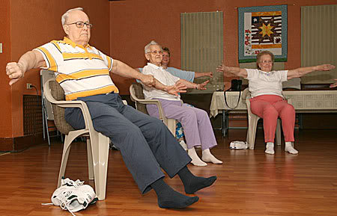
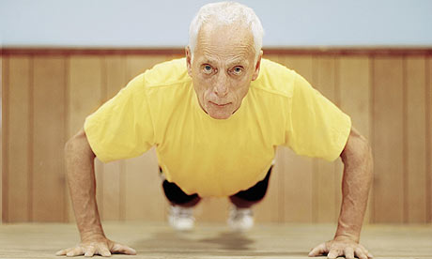
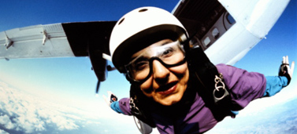
Exercise, Cognitive Development in the Elderly.

Slide 2
http://www.youtube.com/watch?v=5qMCyyM_AtE

Slide 3
Denny’s (1982, 1984) Model of Physical and Cognitive Aging.
Age related changes of physical and cognitive functioning follow a inverted U shaped curved.
Individual differences based on how people “excerise” these skills.
  Not just physical excerise but also mental exercises.
  Unexercised abilities will have a lower peak performance.

Slide 4
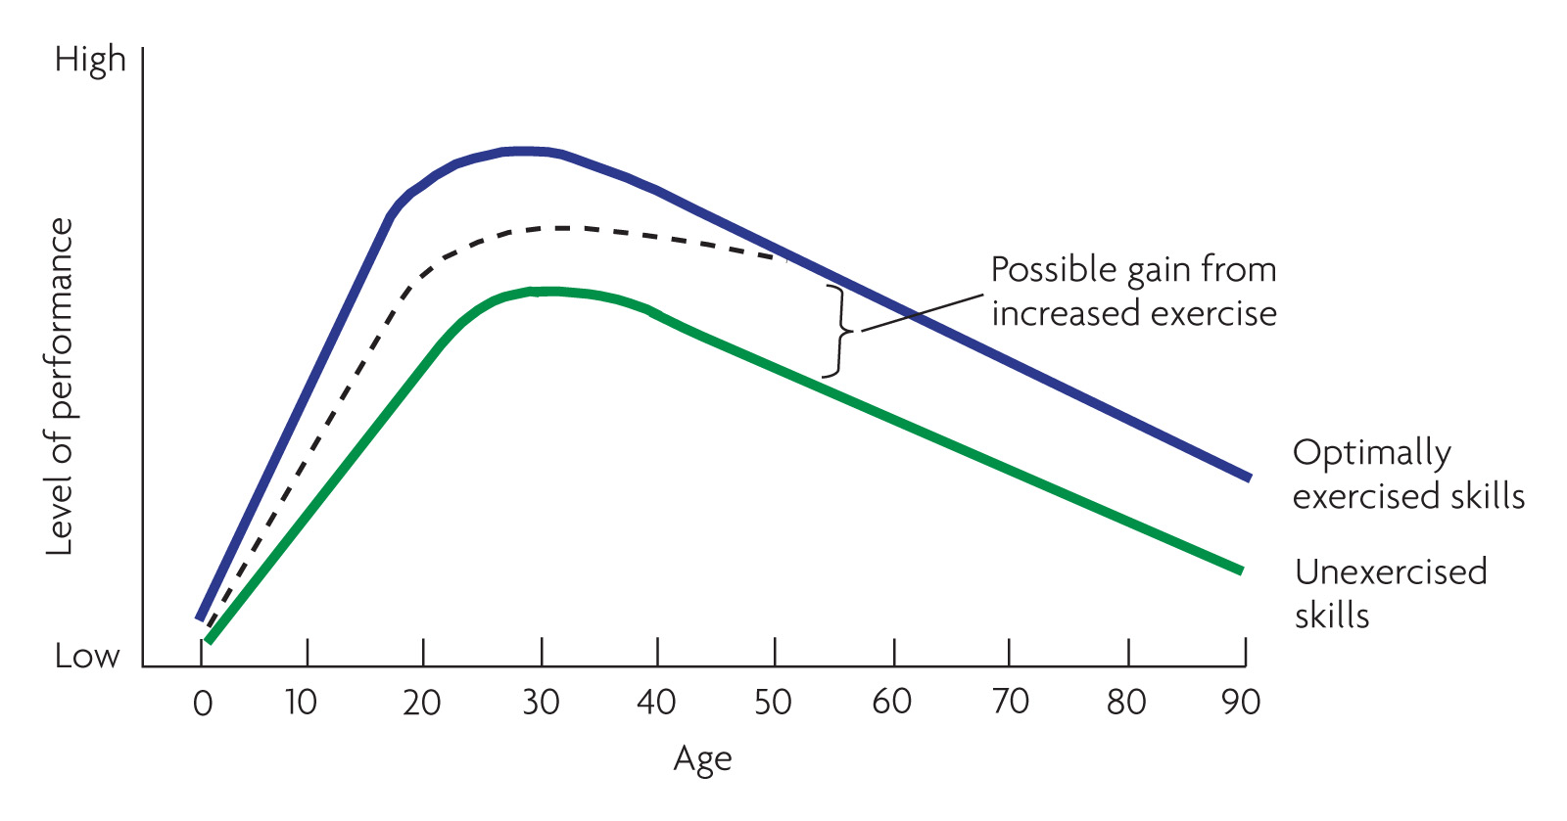
Denney’s Model of Physical and Cognitive Aging
(Denny 1982, 1984)
Notes:
Denny’s model suggests a basic decay curve and a fairly large gap between actual and level of performance on exercised and unexercised abilities

Slide 5
Research
Kramer et al (2002, 2003) observed that long term (over 6 months) training was associated with improved executive functioning in elderly participants (60-75 years).
  Planning
  Scheduling
  Working Memory
  Inhibition.

Slide 6
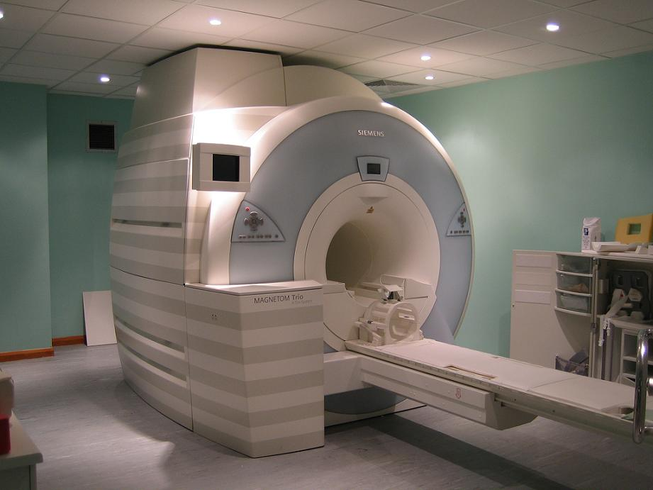
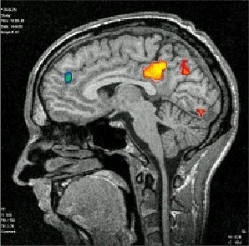
Evidence from Neuroscience
Colcombe et al (2004).
FMRI Study– Functional Magnetic Resonsance Imagining Study.
  Similar findings in terms of performance as Kramer et al’s (2002) findings.
  Brain activation influenced by task requirements.

Slide 7
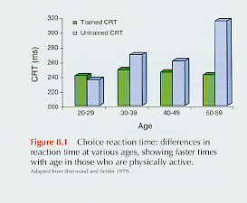
Cognitive Benefits

Slide 8
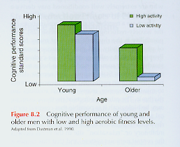
Cognitive Benefits

Slide 9
Exercise and Dementia Risk
Elwood et al (2013) – Cardiff University.
A study of 2,235 men aged 45-59 (Caerphilly) initially commenced in 1979.
  Battery of measures of lifestyle choices.
    Exercise / Physical activity participation
    Diet
    BMI
    Smoking behaviour.
    Cambridge Cognitive Examination
Follow up study – 2004 – On surviving members of initial group.
  Comparison of lifestyle questions
  Cambridge Cognitive Examination
  Medical Records.

Slide 10
Findings
People who engaged in 4 out of the following 5 behaviours in 1979 and stuck at it had a 60% reduced risk of developing dementia.
  Exercise regularly
  No Smoking
  Acceptable BMI
  Low Alcohol Intake (Weekly)
  Healthy Diet.
Those who had seemed to develop significant cognitive impairment in the years between 1979 and 2004 significantly more likely NOT to engage in healthy behaviours.
  Cognitive impairment = scored <83 on Cambridge test OR 10 points less than when measured in 1979.

Slide 11
Findings
Poor cognitive function at middle age was also a big predictor of dementia at old age.
  However, even omitting those people from findings the study showed the impact of exercise and healthy behaviours.
Important to note that despite numerous health promotion initiative in the surrounding area the likelihood of people who move from sedentary (unhealthy behaviours) lifestyle to active into old age was very small.
  Changing behaviour and exercise adherence a huge issues (Elwood et al 2013).

Slide 12
Norton et al (2014)
Meta Analysis study:
Physical Activity is the biggest predictor of dementia.
A third of all dementia COULD be attributed to poor lifestyle choices.
People who do moderate physical activity (such as walking) significantly reduce the links of dementia.
  20 mins a day, 3 days a week.

Slide 13
Lautenschlager et al (2008)
Older adults at “risk” for Alzheimer’s disease.
  Family history
  Cognitive test scores.
Home-based exercise intervention OR educational control intervention.
  6 months.
Adminstered the Alzheimer Disease Assessment Scale (ADAS) at 4 stages.
  Baseline (before intervention)
  Immediately following intervention (6 months after baseline)
  12 months following intervention.
  18 months following intervention.

Slide 14
Findings
Those in the exercise group had better ADAS scores immediately after exercise intervention than those in the control.
This was also reported, although the differences were smaller in the 12 months and 18 month period.
Still could be other confounding variables which might impact on the findings.

Slide 15
More Studies in this field
Adlard et al (2005) study of lab rats:
Demonstrated that five months of exercise decrease amyloid plaques in frontal cortex and hippocampus. Rats also showed enhanced rate of learning on the Morris water maze.

Slide 16
Remembering Erikson et al 2010
Erikson et al (2010).
Randomised Controlled Study of 120 older adults.
1 Group -moderate intensity aerobic exercise 3 days/week pr stretching and toning exercises for one year
MRI pre and post –
Aerobic exercise increased anterior hippocampal volume by 2% after one year leading to improve memory

Slide 17
EXERCISE, Cognitive Function and COPD.

Slide 18
Chronic Obstructive Pulmonary Disease (COPD)
Umbrella term for a number of chronic illness that result in the obstruction of the pulmonary artery or lung.
Chronic and terminal disease – it can never be cured, although medical treatment has made major inroads in quality of life.
  Chronic Bronchitis
  Emphysema
  NOT ASTHMA

Slide 19
Symptoms
Dyspnea (laboured breathing)
Increased risk of infections.
Heightened feelings of insecurity and panic attacks.
  Imagine the feeling that you just get enough oxygen into your body.
Declines in cognitive function – consequence of less oxygenated blood traveling to brain.
  Memory
  Abstract thinking
  Reactions

Slide 20
COPD
Major applied research initiative into exploring the effects of exercise intervention in this field.
Almost universal support into the positive impact of exercise in reducing the physical decline associated with COPD.
What about in relation to cognitive decline?

Slide 21
Emery et al (1998)
Randomised controlled experiment with older COPD participants.
Group 1 (29 participants) – 10 weeks of exercise programme (pulmonary rehab centre) with education and stress management programme.
Group 2 (25 participants) – education and stress management programme alone
Group 3 (25 participants) – waiting list control – not having any intervention.

Slide 22
Emery et al (1998)
Findings
Verbal fluency scores improved for the exercise group compared to the 2 others groups.
However, no significant change between groups 1 and 2 in relation to attention and motor speed.
Preliminary, but limited evidence of exercise-cognition relationship in COPD.

Slide 23
COPD and Acute Exercise
Emery et al (2001)
Short term after-effects of acute aerobic exercise on COPD suffers with aged match (non COPD patient) controls.
Twenty minutes of cycling.
Enhance verbal fluency of those with COPD but no effect on healthy controls.
COPD suffers may be especially sensitive to the benefits of long term and short term exercise.

Slide 24
Emery et al (2003)
28 participants – initially given a 10 week rehabilitation (exercise) programme.
Battery of cognitive tests taken at three different periods.
    Verbal fluency test
    Digit symbol of the Weschler scale (sequencing, implicit memory)
    Trail making test – mental sets (flexbility) as aswell as sequencing.
Baseline, immediately after programme, 1 year programme had stopped.
  Immediately after improvement in all 3 tests.
1 year on interesting –
  Only those that had maintained their exercise activity continued to make gains.

Slide 25
Lecture Conclusion
As research becomes more apparent our understanding on the impact of exercise (and the type of exercise) has on cognitive functioning is becoming clearer.
However caution with some of the findings?
Age of sample, type of exercise and what aspect of cognitive function needs to be clearer.

Slide 26
Lecture Conclusion
We are still a long way to fully understand the workings of the brain, researchers are in a position to begin to infer findings…. However there must still be caution.
Still major issues between the relationship of the environment, exercise and cognitive function.
  What about the social side of exercise?
    How our social environment can shape our cognitive and neural development.

Slide 27
References (not on Moodle)
Mitchell, J. B., Flynn, M. G., Goldfarb, A. H., Ben-Ezra, V., & Copmann, T. L. (1990). The effect of training on the norepinephrine response at rest and during exercise in 5 degrees and 20 degrees C environments. The Journal of Sports Medicine and Physical Fitness, 30(3), 235-240.
Piaget, J. (1936). Origins of intelligence in the child. London: Routledge & Kegan Paul.

Slide 28
Kephart, N. C. (1960). The slow learner in the classroom. Columbus, C. E. Merrill Books.
Jørgensen, L. G., Perko, G., & Secher, N. H. (1992). Regional cerebral artery mean flow velocity and blood flow during dynamic exercise in humans. Journal of applied physiology, 73(5), 1825.
Jacobs, L. A., Klopp, E. H., Seamone, W., Topaz, S. R., & Gott, V. L. (1969). Improved organ function during cardiac bypass with a roller pump modified to deliver pulsatile flow. The Journal of thoracic and cardiovascular surgery, 58(5), 703.

Slide 29
Clarke, H. H. (1958). Physical Fitness Benefits: A summary of research. Education 78: 460-466.
Hams.D.V. (1973) Involvement in Sport: A Somatophysic Rationale for Physical Activity. Philadelphia: Lea and Febiger.
Thomas, K.T. and Thomas, J.R. (1999). What squirrels in the trees predict about expert athletes. International Journal of Sport Psychology, 30, 221–234.

Slide 30
Anthony, J. (1991). Psychologic aspects of exercise. Clinics in sports medicine, 10(1), 171-180.
Weingarten, G. (1973). Mental performance during physical exertion: The benefit of being physically fit. International Journal of Sport Psychology, 4(1), 16-26.

Slide 31
Denny, N.W. (1982). Aging and cognitive changes. In B.B. Wohlman (Ed.), Handbook of Developmental Psychology (pp.807-827). Englewood Cliffs, NJ: Prentice-Hall.
Denny, N. W. (1984). A model of cognitive development across the life span. Developmental Review, 4(2), 171-191.

Slide 32
Sherwood, D. E., & Selder, D. J. (1978). Cardiorespiratory health, reaction time and aging. Medicine and science in sports, 11(2), 186-189.

