Slide 1
Business Management
Managing people

Slide 2


Slide 3
Managing People
Borislava Borisova
Student Number :2114506
Lecture : Nishi Ramsurrun:GP2
Assessment 1 : Individual Presentation
Submission date :24.11.2022

Slide 4

Introduction
Managing people is listening to what they have to say and evaluate the idea, concern and feelings as per making broad observations (Alam and Raut-Roy, 2019).
Notes:
This presentation will highlight about the “flexible working in relation to diversity and inclusion at work and analyze the role of human resources in promoting diversity and inclusion through flexible working (Alam and Raut-Roy, 2019)”.

Slide 5
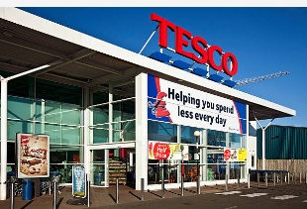
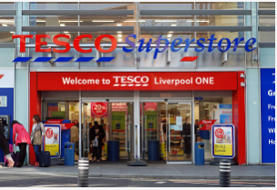
Overview of Tesco
It is a British international vendor which is owned by Tesco Plc from the United Kingdom.
It was developed by Jack Cohen in 1919 and established its first store at 1931 near London, England (Alam and Raut-Roy, 2019).
It is a public limited business which is registered on the London stock exchange.
Notes:
This slide details about the background of Tesco company which is consisting of different brand in various size (Alam and Raut-Roy, 2019). It has opened its various stores in other countries within Europe and Asia. It is one of the third largest retailer all over the globe that is capable to measure all the profits and gain the system as fifth largest by revenue.

Slide 6
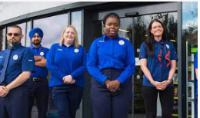


Diversity and Inclusion at Tesco
Every people is welcome at Tesco.
There is creation of inclusive workplace which celebrate the culture, personalities and preference to its staffs.
Everyone here is treated at fair sense and respect (Krummel, 2022).
There is gain in the valuing of individuality and uniqueness .
Notes:
This slide detail about Diversity and inclusion which is at the heart of Tesco (Krummel, 2022). It is linking the activities treat people with equal respect and protection of the staffs and make them feel good at work thereby showing the wider range of commitment to help at the best stage and ease the performance in the values (Krummel, 2022).

Slide 7
Contin…
Tesco group is building a stage of inclusive workplace.
It is actively using all the source to celebrate the culture, personalities and preferences by colleagues.
These help in building success of the business thereby showing all the refection of the diversity in the community.
Notes:
Tesco board is committed in the full sense and stage at the increasing diverse business where there is need to assess the norms and gain the system of raising the equal opportunities with the help of recruitment, learning and development. It is actively using the champion of the support and easily evaluate all the source colleague network and their training showing the importance of Inclusion in the business all over the globe.

Slide 8
Role of Human resources in promoting diversity and inclusion through flexible working
Progress objective decision making processes.
Invent different ways so that there is gain in the address of the workplace bias.
Promoting the inclusive environment and give the opportunities for all employees (Fadeyi, 2020).
Workplace diversity is inclusive in complex and thereby create a simple place in destination of the stage.
Notes:
HR is improving the diversity and inclusion as per the change in the virtual workplace and conduct all the virtual social and team building activities (Fadeyi, 2020). There is offer in the remote employees as per the same types of support with the gain in the location and raises the flexibility by meeting all the definite schedule and deadline thereby maintaining all the health resources (Fadeyi, 2020).

Slide 9

Importance of Managing Diversity at Workplace
It is helpful in knowing about the individual strength of every employee and their potential in the business (Krummel, 2022).
Valuing the difference of others so that there is effective collaboration (Brannen, Mughan and Moore, 2020).
Thriving in the different workplace and give assess to the most fair working culture.
Notes:
A diverse workplace is one of the important asset that is capable to acknowledge all the individual strength of every employee and raise the potential in higher amount (Brannen, Mughan and Moore, 2020). Through this process companies are now able to diversify the term along with the management of staff in more explained version and fulfill the term with the needs to link all the broad customer base. It is respecting there is change in the individual difference and benefit the workplace by creating the competitive edge and increasing work productivity (Brannen, Mughan and Moore, 2020).

Slide 10
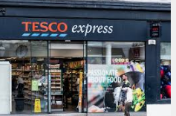
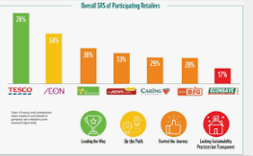
Flexible working environment at Tesco
Blended form of working (Rosnizam et al., 2020).
Change in shift patterns
Job sharing
Phase retirement
Lifestyle break
Notes:
Flexible working is about finding a way which suits both a colleague and Tesco needs (Brannen, Mughan and Moore, 2020). They are allowed to part time work for 26 weeks and consider all the shifts as per their services. One of the most significant motivation to incorporate in the working is responding to the environment diversity in the social vision and link through the wide aspects of people and gain representing higher amount of aptitude and learning environment (Rosnizam et al., 2020). Tesco shifts its employee in flexible nature and bring the statutory rights by law to request the stage after 26 weeks service. After the plan of the strategy to organize the resources and evaluate as per the plan and decision of the firms (Rosnizam et al., 2020).

Slide 11
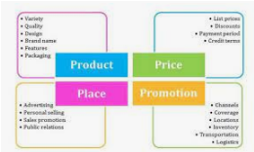
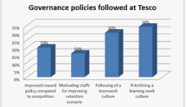
Policy at Tesco
It is enabling the approach to pension and retirement savings.
Payment and rewards.
Inclusive working environment
Harassment and bullying norms and policies (Utami, 2018).
Ensure health and safety in the workplace.
Family leave policy
Notes:
This slide detail about the policy adopted by Tesco and assign all the term which is including as per the value. The group is building the workplace that is actively looking for the community in the serving of the stage (Utami, 2018). It is staging the network with the process of interesting the lives and work at home. It is sourcing out for the people and look for the stage in managing the system and manage with the help of career (Utami, 2018).

Slide 12
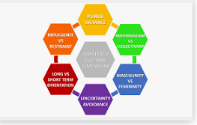
Culture at Tesco
It is relying in the value which people live by and assess all the term with the stage of customers, colleagues and their communities in accepting the better term at everyday functions (Johnson et al., 2020).
It depend on the major aspects that every little makes big difference.
There is no one who tries harder for their customers so Tesco is understanding the range of business values as per the capturing the terms (Utami, 2018).
Notes:
This slide cover the culture adopted by Tesco serving customers, communities and raise the planet in better stage (Johnson et al., 2020). It is staying at the beginning and end of the customers in the perspectives and need as well as expectation. The role played by the community in the thousands of communities by serving the vital and create good jobs. It is supporting through the community program launch and gain the culture (Johnson et al., 2020).

Slide 13
Conclusion
This report analyze the factors that is vital for showing the importance in the business operations.
It discuss HR function which is creating a aerial view of the diversity and inclusion in the term and bring the component of people and management.
It analyze the different source with the flexible working in relation to diversity and inclusion at workplace.

Slide 14
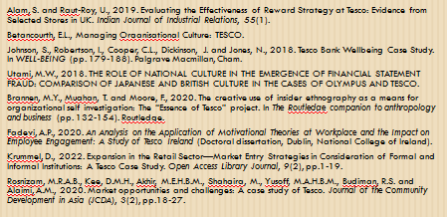
References

