Slide 1
LCBB5015
Principles of Marketing
Week 9 Session 2
Revision Lecture

Slide 2
Task Description
TASK 1 (1000 words)
Situational analysis helps inform a company’s decision-making process by looking at the external and internal factors impacting its overall success. Performing a situational analysis is essential to every project planning process as it helps identify a company’s strengths, weaknesses, and growth opportunities.
Write an INDIVIDUAL report providing a critical analysis and evaluation of the following:
You are a marketing manager hired by your chosen organisation (operating in the UK) and are required to conduct an internal/external analysis of your chosen company.
Choose, apply and critically analyse ONE Situational analysis model from: Pestle analysis, Porter’s Five Forces model OR SWOT analysis.
You should use suitable academic theory and industry examples to support your discussion

Slide 3
Assignment 2 (70%)
Write an INDIVIDUAL report providing a critical analysis and evaluation of the following:
3000-3500 Words
1. Internal and external analysis of a company
Include an introduction
Include a brief definition of the marketing process.
Briefly describe the main stages in the marketing process such as: situational analysis, objectives, strategy, implementation and control.
Choose and relate ANY ONE model from the Macro environment, Porters 5 Forces model or SWOT analysis
Relate the Macro environment or PESTLE factors to your chosen company (political, economic, social/cultural, technological, legal and environmental) and state whether the forces are favourable or unfavourable to the company and why.

Slide 4
Relate the Porters 5 Forces model to the company and state whether each force is high, medium or low and why.
SWOT analysis for the chosen company: determine the main strengths, weaknesses, opportunities and threats for the company.
For higher marks you could state the advantages and disadvantages of either the macro environment, or Porters 5 forces model or SWOT analysis.

Slide 5
The Macro Environment
The macro environment consists of external forces outside of the organisation that can create opportunities and/or threats.

Slide 6
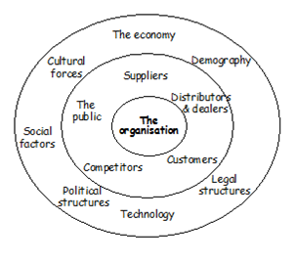
Diagram: The Micro and Macro Environment

Slide 7
The Main Elements in the Macro Environment
Social/Cultural forces
Legal forces

Slide 8
The Main Elements in the Macro Environment
Economic forces
Political forces

Slide 9
The Main Elements in the Macro Environment
Technological forces
Environmental

Slide 10
Conclusion
Environmental scanning
Environmental analysis

Slide 11
Porters 5 Forces Model
Porter's five forces model is used to understand the industry/market which the business is operating within. It can be used to:
a) understand how profitable an industry is to be in which can be used to decide whether to enter or exit the market.
b) by firms operating in that industry to understand the forces impacting upon industry profitability and change how they operate to become more
profitable themselves.

Slide 12
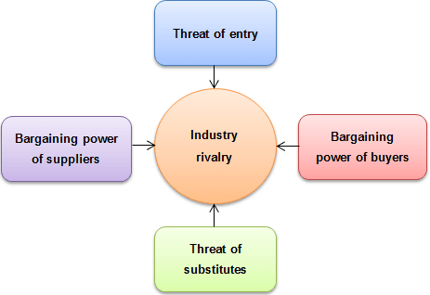
Porters 5 Forces

Slide 13
SWOT Analysis
STRENGTHS
Strong brand name and good reputation.
Patent and copyright protection.
A large amount of financial resources.
A good relationship with suppliers and distributors.
The employees within the organisation.
Economies of scale and experience.

Slide 14
Weaknesses
The strengths can be reversed and become the weaknesses.
Failure to innovate.

Slide 15
Opportunities
Investment in research and development.
Competitor weaknesses.
New rules and regulations.
An unsatisfied customer need.

Slide 16
Threats
Changing customer needs and wants away from the company’s product/service.
Competitors and substitutes.
New rules and regulations.

Slide 17
Conclusion
Recommendations

Slide 18
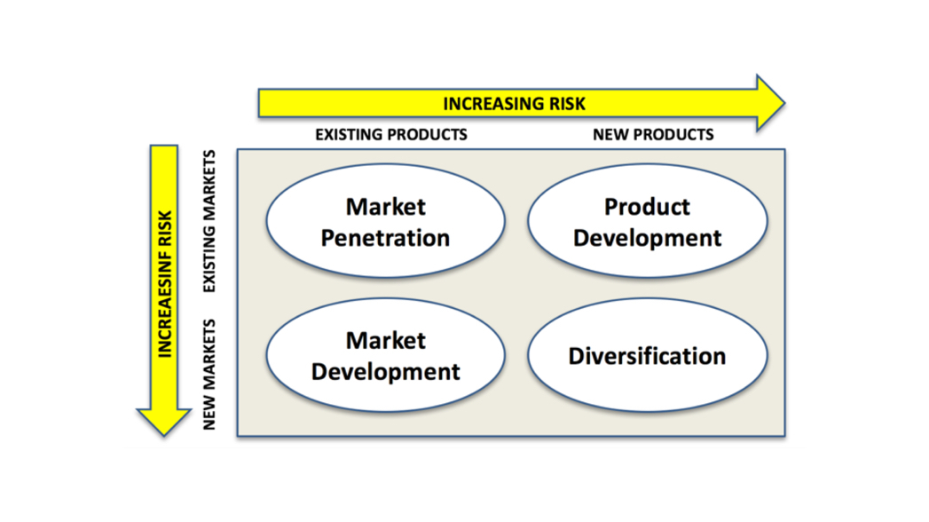
Ansoff Matrix

Slide 19
Assignment 2
TASK 1 (3000 words)
Market Segmentation is the process of dividing a market into distinct subgroups of consumers with distinct needs, characteristics, or behaviour, who might require separate products or marketing mixes. (Kotler 2022)
As part of a group assignment, you are required to choose a well-known company of your choice (operating in the UK) and create a report for your chosen project.
The report should focus on the critical analysis of the main segmentation, targeting and positioning strategies currently implemented by the company and the current marketing mix strategies (4/7Ps) utilised by your chosen organisation.
You should use suitable academic theory and industry examples to support your discussion.

Slide 20
Structure
Include an introduction
Include a definition of segmentation
Include the advantages and disadvantages of the segmentation process.
Identify and apply the different segmentation variables utilised by the company e.g. demographic, geographic, psychographic.
Determine which targeting strategies are implemented by the company e.g. undifferentiated, differentiated or concentrated targeting.

Slide 21
Structure
Include the advantages and disadvantages of the chosen targeting strategy/strategies.
Determine which positioning strategy/strategies are utilised by the company.
Include the advantages and disadvantages of the chosen positioning strategy/strategies.
Include a definition of the marketing mix

Slide 22
Structure
Determine the product, price, place and promotional strategies implemented by the company.
If the company produces a service explain the extended marketing mix strategies e.g. people, process and physical evidence.
Include a conclusion.

Slide 23

Segmentation, Targeting and Positioning

Slide 24
Segmentation
Demographic
Geographic
Psychographic
Socio economic status
Geo demographic

Slide 25
Targeting
Un differentiated
Differentiated
Concentrated

Slide 26
Positioning
Benefit
User
Competitive
Celebrity endorsement
History/Parentage
Pro environment

Slide 27
Product
Family Branding/Corporate Umbrella Branding
The company uses one brand name as the main identifier for the different variety of products produced.

Slide 28
Range Branding
The company uses different brand names for different ranges of products produced.

Slide 29
Individual Product Branding
There is no close connection between the brand and the company. However, the brand is recognised for its own strengths.

Slide 30
Product
Branding Strategies
Line filling
Line extension
Line stretching
Brand extension

Slide 31
Price
Penetration pricing
Price skimming
Differential pricing
Psychological pricing
Economy Pricing
Premium Pricing
Bundle Pricing

Slide 32
Place
Direct channel of distribution
Indirect channel of distribution
Intensive distribution
Exclusive distribution
Selective distribution

Slide 33
Promotion
Advertising
Sales promotion
Public relations
Sponsorship
Direct marketing
Digital marketing

