Slide 1
IRONMAN Wales
Group: Location and Surrounding Area
Joseph Bannister, Dean Cropper and Georgia Thomas

Slide 2
Roles
Joseph Bannister
Creative Director, BTS & Research
Georgia Thomas
Producer & Editor
Dean Cropper
Camera & Sound

Slide 3
The Concept
Why has the client chosen to use Tenby?
What will we do as a team to produce a series of web clips for the client in order to promote IRONMAN and the surrounding area in which it is held.
What type of clips, edits, music or sound will we be able to use to meet our clients expectations?
How are we going to keep in contact with the team/client? It’s important to be constantly connecting and talking with the client.

Slide 4
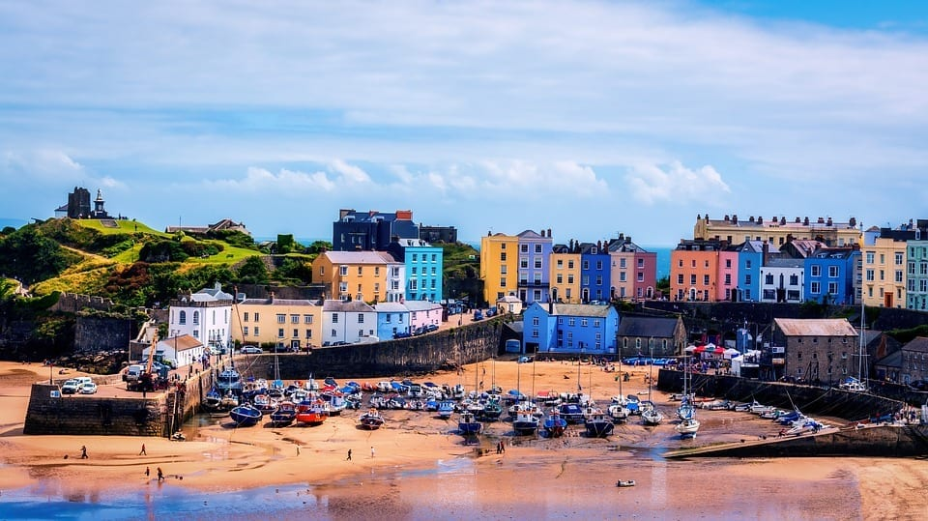

Slide 5
Location
Hosted in Tenby; why? Tenby is a seaside town, easy to get to, navigate around, lovely scenic houses and area, hotels and tourist value (Dinosaur Park, Folly Farm, local castles, etc), A 2 hour drive from Cardiff Airport, mild average air and water temperatures, full of historical value.
Pembrokeshire; what are the pros and cons of Pembrokeshire as opposed to other counties?; There is a great coast, tough hills for cycle route, a smooth but steep running route through town centre including local hill area and Wales’ only coastal National Park.
Notes:
Drone footage

Slide 6
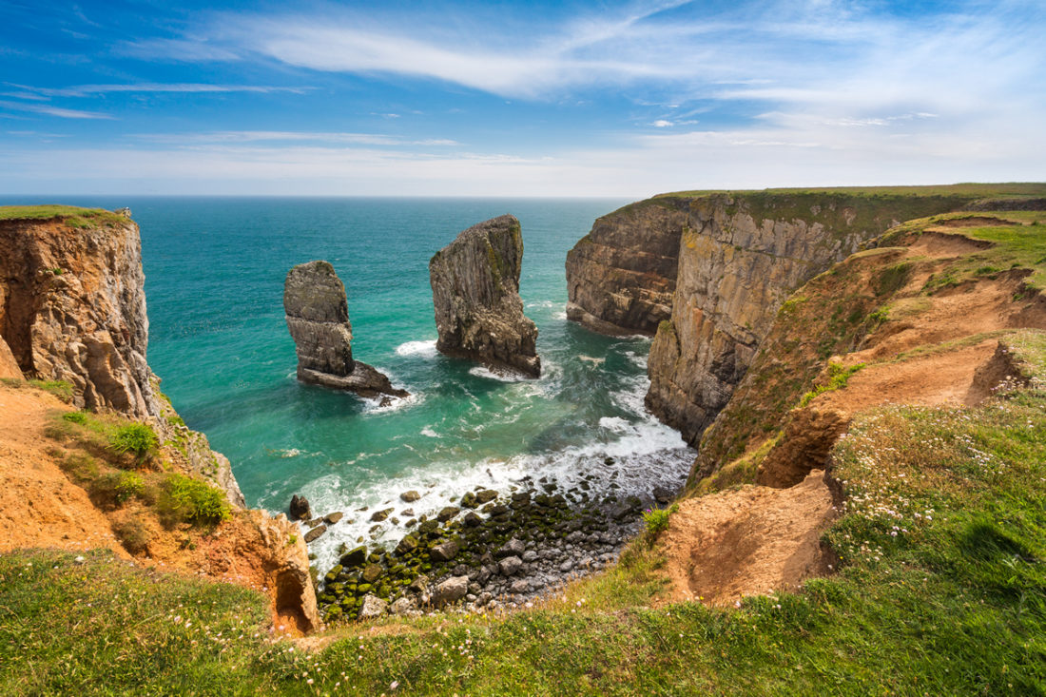
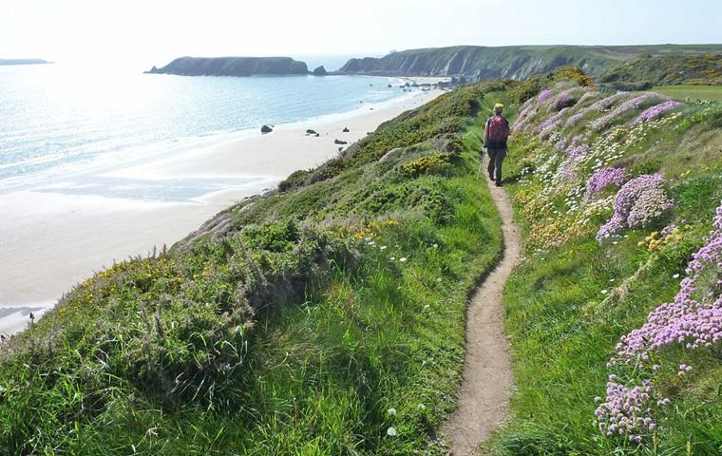
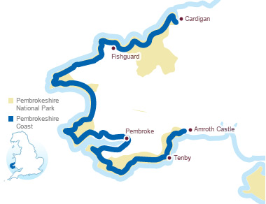

Slide 7
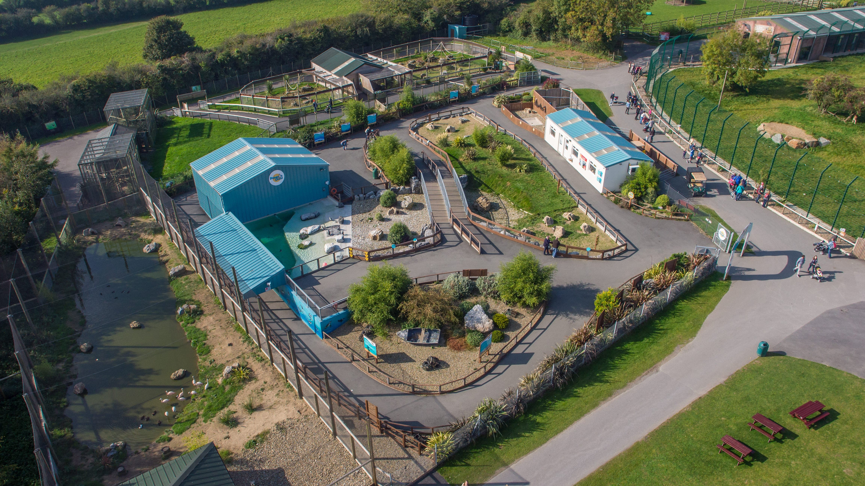
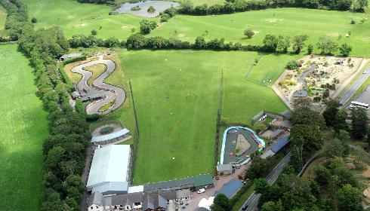
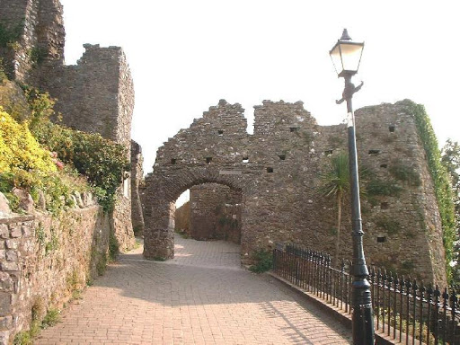

Slide 8
Plan
Our plan is too highlight Tenby as the host town of IRONMAN Wales; we will use footage of the event in town.
We will highlight local places to stay and tourist attractions for people to visit whilst visiting IRONMAN Wales.
We plan to mix potential stock footage of IRONMAN Wales events with new footage that we will film to show off Tenby and the surrounding area, acquiring quality B-roll of Pembrokeshire including the use drone footage (if possible)
We also plan to show off the locations for the triathlon routes- the coast, the cycle track, the running track etc.

Slide 9
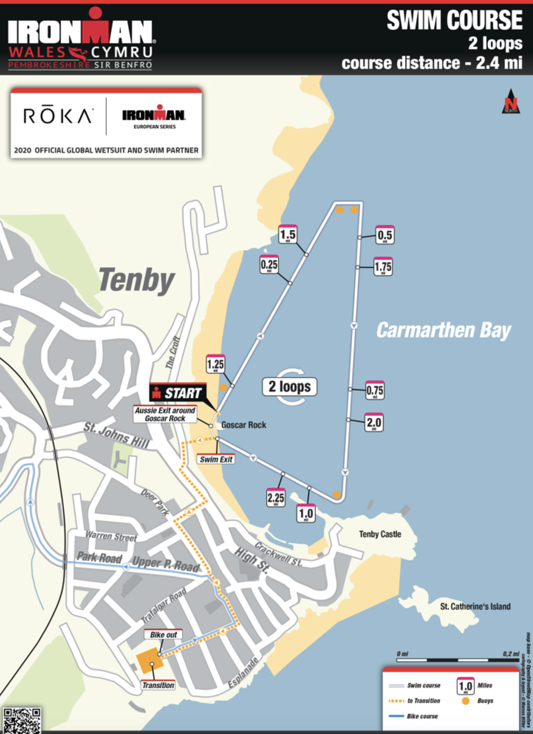
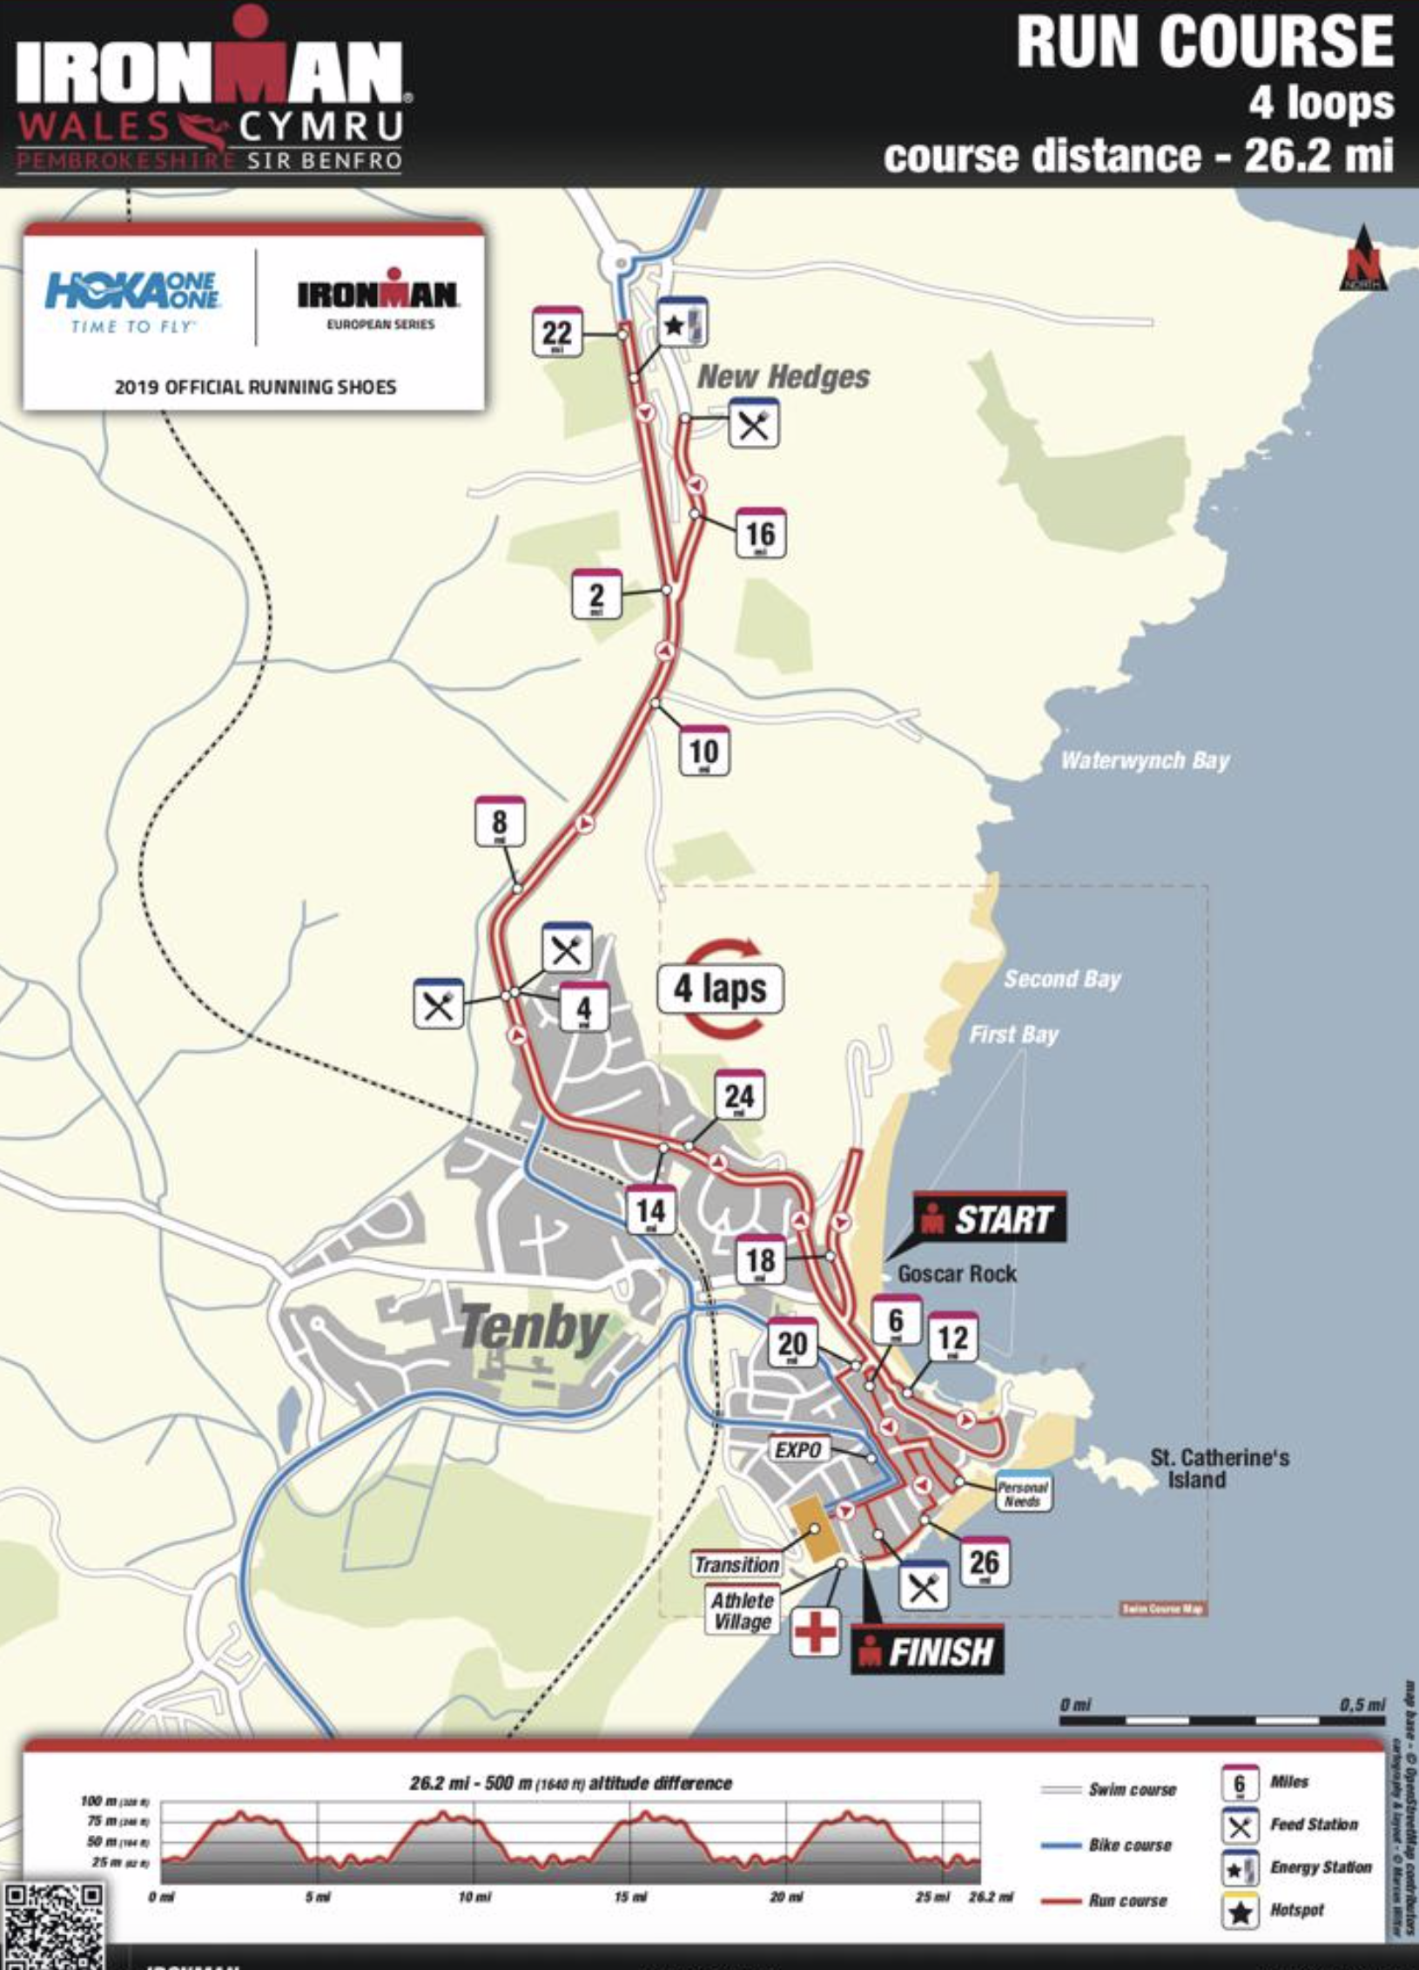
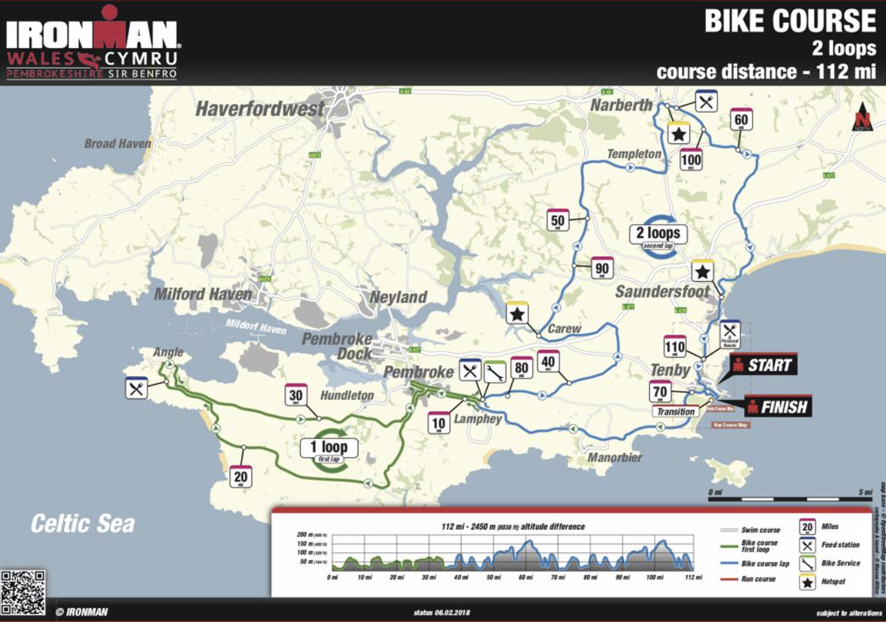
The Course
There is a specific course in which the athletes will follow in order to advertise the course to them we will use vantage points of Tenby to show off the location etc.
Using the course maps from Ironman, we will be able to come up with ideal points of which to film the athletes taking part in the triathlon.

Slide 10
Example Footage
https://www.youtube.com/watch?v=_E68Whtymyc – Tenby Aerial Footage
https://www.youtube.com/watch?v=P8Qcc7HQV-A&feature=emb_title – IRONMAN Wales 2019 Race Movie
Using this type of footage as an example we are going to be able to come up with a complete plan, of what we want to film, how we are going to film it and then actually going out and filming it.

Slide 11
The final outcome
By the end of this projector aim is too release a minimum of 3 web clips that are a minute long maximum, which can be released on social media.
We will advertise Pembrokeshire and Tenby as a whole using b-roll and cinematic footage to add a more professional feel.
Working with the other group we will be able to work together to help each other get the footage etc that we all need, and work alongside each other where needed.
Working together as a team, we won’t just stick to our own individual roles, we will play to our Individual strengths and take over any roles should we need to.

