Slide 1

Programme:- MSc Public Health and Social Care in Practice
Module:- Community Care and Management of Longer-term Conditions
Module code:- LCHS7003
Lecturer:- Muhammad Khan
Name:- Vrutti Pareshkumar Patel
Students Num:- 2541199
Assignment title:- Bipolar Mood Disorder

Slide 2
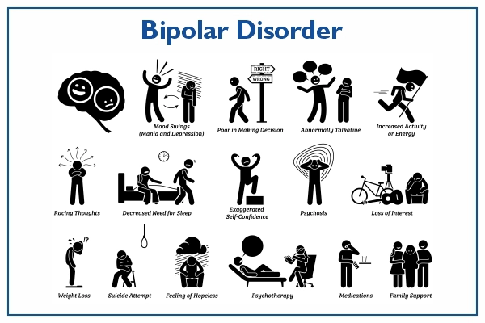
Bipolar Mood Disorder: Diagnosis, Assessment, Management and Personalised Care in the United Kingdom
Audience:
Community Mental Health Nurses (CMHNs)

Slide 3
Overview of Bipolar Mood Disorder
Types
• Bipolar I Disorder
At least one manic episode
Often accompanied by depressive episodes
• Bipolar II Disorder
Hypomanic episodes
Major depressive episodes
No full manic episode
(Gose,2023)
Common Symptoms
Mania
Elevated mood
Reduced need for sleep
Increased energy
Impulsivity
Grandiosity
Risk-taking behaviour
Depression
Persistent sadness
Fatigue
Loss of interest
Poor concentration
Feelings of worthlessness
Suicidal ideation
What is Bipolar Mood Disorder?
Bipolar Mood Disorder (BMD) is a chronic, severe mental health condition characterised by recurring episodes of mania, hypomania and depression, resulting in significant fluctuations in mood, energy, activity levels and cognitive functioning.
It is classified as a long-term condition because symptoms often persist throughout life and require continuous monitoring, pharmacological treatment and psychosocial support.
(Cleveland Clinic,2023)
Why it matters
Without effective treatment, Bipolar Disorder is associated with increased suicide risk, impaired social functioning, reduced employment opportunities and poorer physical health outcomes.
(Dome,Rihmer and Gonda,2019)

Slide 4
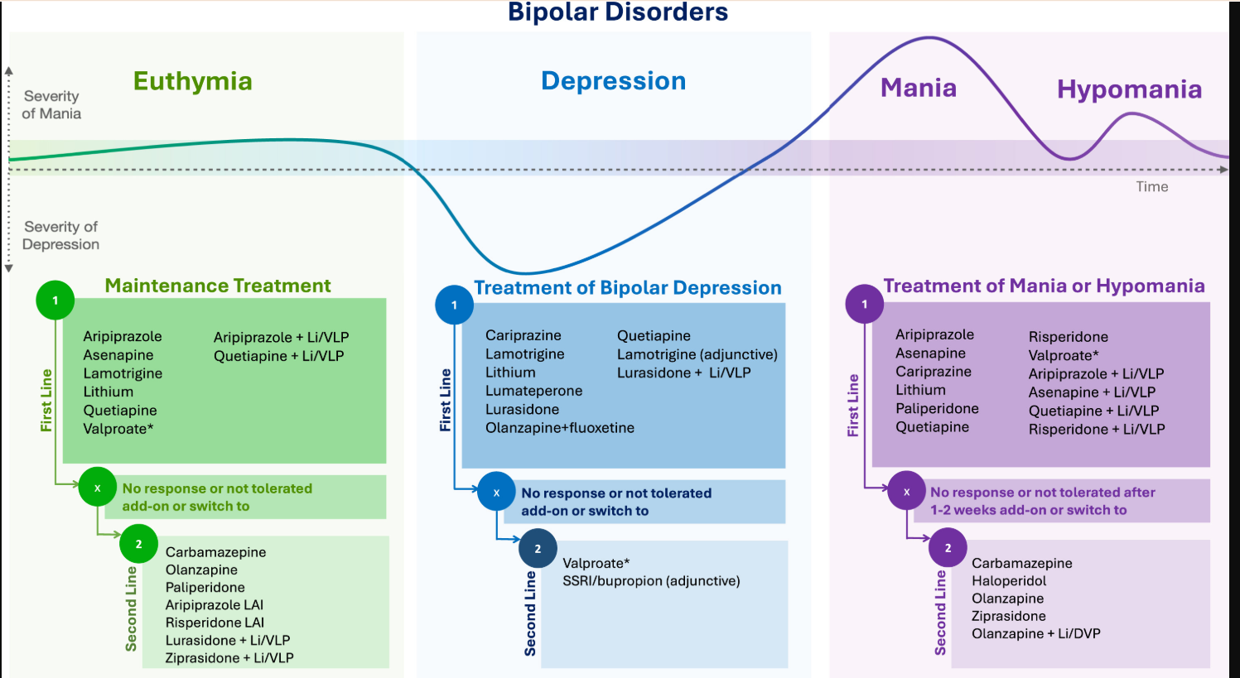
SOURCE :
(Oliva et al., 2024)

Slide 5
Aetiology (Causes) & Risk Factors
What causes Bipolar Mood Disorder?
The exact cause remains unknown; however, evidence supports a biopsychosocial model, where biological, psychological and environmental factors interact.
(Koenders et al,2020)
Biological Factors
Strong genetic predisposition
Neurotransmitter imbalance (dopamine, serotonin and glutamate)
Structural and functional brain abnormalities
Family history significantly increases risk
Psychological Factors
Childhood trauma
Chronic stress
Emotional dysregulation
Personality vulnerability
(Mayo Clinic,2024)
Environmental Factors
Substance misuse
Sleep deprivation
Major life events
Social isolation
Occupational stress
Critical Perspective
Current research suggests that no single factor causes Bipolar Disorder; rather, the interaction between genetic susceptibility and environmental triggers contributes to disease onset and relapse. This supports holistic assessment and multidisciplinary management.
(Fullerton and Tesfaye,2025)

Slide 6
Epidemiology, Economic and Social Burden
Prevalence of Bipolar Mood Disorder
United Kingdom
Approximately 1–2% of the population lives with Bipolar Disorder.
Typically develops between 15 and 30 years of age.
Affects males and females equally.
(Go to Guardian App,2026)
Worldwide
Around 40–60 million people are estimated to live with Bipolar Disorder globally.
One of the leading causes of disability among young adults.
(WHO,2024)
Economic Burden
Bipolar Disorder places substantial pressure on the NHS through:
Hospital admissions
Emergency mental health services
Long-term medication
Community mental health services
Reduced productivity
Unemployment
Disability benefits
Critical Evaluation
Although prevalence is relatively low compared with depression, Bipolar Disorder contributes disproportionately to disability-adjusted life years (DALYs) due to its chronic nature, recurrent episodes and associated physical and psychiatric comorbidities.
Social Burden
Individuals frequently experience:
Relationship breakdown
Social isolation
Educational disruption
Employment difficulties
Housing instability
Stigma and discrimination
Increased suicide risk

Slide 7
Diagnosis and Initial Assessment
Diagnosis of Bipolar Mood Disorder
Diagnosis is based on a comprehensive clinical assessment rather than a single laboratory investigation.
Assessment includes
✔ Comprehensive psychiatric history
✔ Mental State Examination (MSE)
✔ Mood history
✔ Family history
✔ Physical health assessment
✔ Risk assessment
✔ Suicide assessment
✔ Substance misuse assessment (Soreff, 2019)
✔ Functional assessment
Diagnostic Criteria
DSM-5
ICD-11
NICE Guideline NG222 (UK)
(A4 MEDICINE,2023)
Challenges in Diagnosis
Frequently misdiagnosed as unipolar depression
Delayed diagnosis can exceed several years
Overlapping symptoms with ADHD, borderline personality disorder and schizophrenia
Stigma may delay help-seeking
(MacDonald and Sadek,2023)
Assessment Tools
Young Mania Rating Scale (YMRS) (PSYCHLOGY TOOLS, 2026)
Mood Disorder Questionnaire (MDQ) (Mundy et al., 2023)
Hamilton Depression Rating Scale (HDRS) (Hassanzadeh et al., 2024)

Slide 8
Management of Bipolar Disorder (NICE Guideline NG222)
Management Following UK NICE Guidelines
The National Institute for Health and Care Excellence (NICE NG222, 2023) recommends an integrated, person-centred approach involving pharmacological treatment, psychological therapies, relapse prevention, and multidisciplinary care. (NICE,2022)
Acute Mania
First-line: Antipsychotics (Olanzapine, Quetiapine, Risperidone, Haloperidol)
Review within 1–2 weeks
Hospital admission if significant risk to self or others.
(Kishi et a,2-21)
Bipolar Depression
Quetiapine (first-line)
Olanzapine–Fluoxetine combination
Lamotrigine (maintenance)
Avoid antidepressant monotherapy due to the risk of inducing mania. (Yalin. Et al,2026)
Long-Term Maintenance
Lithium remains the gold standard for relapse prevention.
Monitor serum lithium levels every 3–6 months.
Annual renal, thyroid and calcium monitoring.
Psychological Therapies
Cognitive Behavioral Therapy (CBT)
Family Intervention
Psychoeducation
Relapse prevention programmes
Critical Evaluation
While NICE promotes evidence-based care, barriers such as long NHS waiting times, regional inequalities in specialist mental health services, and workforce shortages can delay implementation. Community Mental Health Nurses are central to ensuring continuity of care, medication monitoring and relapse prevention.
(Peters-Corbett et al,2023)

Slide 9
Treatment Options in the United Kingdom
Psychological Interventions
Cognitive Behavioural Therapy (CBT)
Family-Focused Therapy (FFT)
Psychoeducation
Interpersonal and Social Rhythm Therapy (IPSRT)
Mindfulness-based interventions
Medication | Primary Use
Lithium | Long-term relapse prevention
Quetiapine | Mania & Bipolar Depression
Olanzapine | Acute Mania
Lamotrigine | Bipolar Depression
Valproate* | Mania (avoid in women of childbearing potential unless strict pregnancy prevention programme is followed)
Aripiprazole | Acute Mania
Lifestyle Interventions
Regular sleep routines
Physical activity
Healthy diet
Alcohol and substance avoidance
Stress management
Medication adherence
Evidence
Approximately 60–80% of patients experience relapse within 5 years if treatment adherence is poor.
Lithium therapy can reduce suicide risk by approximately 60% compared with untreated bipolar disorder.
(NHS, 2023)

Slide 10
Comorbidities Associated with Bipolar Mood Disorder
Common Comorbid Conditions
Psychiatric
Anxiety disorders (~45%)
Substance use disorders (30–60%)
ADHD
Personality disorders
Eating disorders
Physical
Obesity
Type 2 Diabetes
Cardiovascular Disease
Hypertension
Metabolic Syndrome
Clinical Impact
Patients with bipolar disorder have:
2–3 times higher rates of cardiovascular disease than the general population.
A life expectancy reduced by approximately 10–20 years, largely due to preventable physical health conditions and suicide.
Suicide risk estimated to be 20–30 times higher than in the general population, with around 15–20% dying by suicide over their lifetime if untreated. (Checking your browser-recaptcha,2024)

Slide 11
Prevention and Relapse Prevention
*Preventing Bipolar Relapse
As bipolar disorder is generally not preventable before onset, healthcare focuses on preventing relapse and minimising disease progression.
*Primary Prevention
Public awareness
Early recognition of symptoms
Reducing stigma
Access to mental health services
*secondary Prevention
Early diagnosis
Prompt treatment initiation
Comprehensive risk assessment
Family screening where appropriate
*Tertiary Prevention
Long-term medication adherence
Mood monitoring
Crisis planning
Sleep regulation
Stress reduction
Community Mental Health Team follow-up
*Evidence
Approximately 40–60% of relapses are associated with medication non-adherence.
Structured psychoeducation programmes have been shown to reduce relapse rates and improve adherence.
(Arya Jayasree et al., 2024)

Slide 12
Co-productive Care and the Role of Community Mental Health Nurses
*Delivering Co-Productive Care
Co-production involves healthcare professionals and service users working as equal partners in planning, delivering and evaluating care. (NHS England,2023)
*Skills Required
Active listening
Clinical assessment
Risk management
Shared decision-making
Motivational interviewing
*Professional Behaviours
Advocacy
Effective communication
Collaboration
Reflective practice
Accountability
*Professional Values
Respect
Compassion
Dignity
Recovery-focused practice
Cultural competence
*Role of Community Mental Health Nurses
Conduct comprehensive assessments
Monitor medication adherence and side effects
Deliver psychoeducation
Coordinate multidisciplinary care
Support families and carers
Identify early warning signs of relapse
Facilitate personalised care planning
*Critical Evaluation
Traditional paternalistic models may limit patient autonomy. In contrast, co-productive care empowers individuals to participate in shared decision-making, improving engagement, self-management, treatment adherence and recovery outcomes. This aligns with NHS England's commitment to personalised, recovery-oriented mental health care.

Slide 13
Comprehensive Model of Personalised Care (NHS England)
Using Six Evidence-Based ComponentsPersonalised Care to Improve Outcomes in Bipolar Disorder
The NHS Comprehensive Model for Personalised Care aims to empower individuals to become active partners in managing their long-term condition.
1. Shared Decision-Making
Patients and clinicians jointly select treatment options.
Improves medication adherence and treatment satisfaction.
2. Personalised Care and Support Planning
Individualised recovery plans.
Includes relapse triggers, crisis contacts and long-term goals.
3. Enabling Choice
Choice of psychological therapies, medications and community services.
4. Supported Self-Management
Mood diaries and digital mood tracking.
Psychoeducation and relapse prevention strategies.
5. Social Prescribing & Community-Based Support
Peer support groups.
Employment and housing support.
Exercise and wellbeing programmes.
6. Personal Health Budgets (where eligible)
Enables people with complex needs to tailor aspects of their care. (NHS,England,2022)
*Evidence
NHS England estimates that 2.5 million people in England have benefited from personalized care approaches across health services.
(NHS, England,2019)
*Shared decision-making has been associated with higher treatment adherence and improved patient-reported outcomes in long-term conditions.
*Critical Evaluation
Personalised care shifts bipolar management from clinician-led treatment to recovery-oriented partnership. However, implementation varies across NHS regions because of workforce pressures and unequal access to specialist mental health services.

Slide 14
Co-Production: Skills, Values and Behavior's
*Delivering Co-Productive Care for Bipolar Disorder
Co-production means service users, families and professionals work together as equal partners in planning, delivering and evaluating care.
*Essential Skills
Comprehensive mental health assessment.
Risk assessment and suicide prevention.
Active listening.
Shared decision-making.
Motivational interviewing.
Therapeutic communication.
*Professional Values
Respect.
Compassion.
Dignity.
Recovery-focused practice.
Cultural competence.
Equity.

Slide 15
Continue…
*Professional Behaviours
Advocacy.
Accountability.
Collaborative working.
Reflective practice.
Professional integrity.
*Role of Community Mental Health Nurses
Coordinate multidisciplinary care.
Monitor medication adherence and side effects.
Deliver psychoeducation.
Identify early signs of relapse.
Support carers and families.
Facilitate crisis planning.
*Statistics
Around 50% of people living with severe mental illness report experiencing stigma or discrimination, which can reduce engagement with services.
Strong therapeutic relationships are associated with improved treatment adherence and reduced relapse.
Critical Evaluation
Traditional paternalistic models may reduce patient autonomy. Co-production promotes empowerment, self-efficacy and long-term engagement, which are essential for a chronic relapsing condition such as bipolar disorder (Sturt,2016)

Slide 16
Recommendations for Improving Bipolar Care in the UK
Evidence-Based Recommendations
1. Earlier Diagnosis
Increase screening in primary care.
Improve recognition of hypomania.
Reduce diagnostic delays.
2. Expand Psychological Services
Reduce waiting times for CBT and Family Therapy.
Increase access through Community Mental Health Teams.
3. Strengthen Physical Health Monitoring
Annual cardiovascular and metabolic screening.
Routine monitoring of lithium, thyroid and renal function.
4. Digital Innovation
NHS-approved mood monitoring applications.
Remote consultations.
Digital relapse alerts.
5. Improve Public Awareness
National anti-stigma campaigns.
Mental health education in schools and workplaces.
6. Invest in Community Services
Increase Community Mental Health Nurses.
Expand crisis resolution teams.
Improve continuity of care.
Supporting Evidence
Mental health problems account for approximately 23% of the total burden of disease in the UK.
Community-based mental health services reduce avoidable hospital admissions and support long-term recovery.
(The cost of diagnosed mental health conditions statistics,2022)

Slide 17
Conclusion
Key Messages
Bipolar Mood Disorder is a lifelong, recurrent mental health condition affecting approximately 1–2% of the UK population.
Early diagnosis using structured assessment reduces misdiagnosis and supports timely treatment.
NICE recommends integrated pharmacological, psychological and multidisciplinary management.
Bipolar disorder is associated with substantial physical, psychological, social and economic burdens.
Personalised care and co-production improve engagement, medication adherence and recovery.
Community Mental Health Nurses play a central role in coordinating holistic, person-centred care.
(Humpston, Bebbington and Marwaha, 2020)

Slide 18
Final Take-Home Message
Effective management of bipolar disorder requires evidence-based treatment, multidisciplinary collaboration and personalized care that empowers individuals to manage their condition and improve long-term quality of life.

Slide 19
Reference list
Cha, B., Kim, J.H., Ha, T.H., Chang, J.S. and Ha, K. (2009). polarity of the first episode and time to diagnosis of bipolar I disorder. Psychiatry Investigation, 6(2), p.96. doi:10.4306/pi.2009.6.2.96.
Cleveland Clinic (2022). Bipolar disorder (manic-depressive disorder). [online] Cleveland Clinic. Available at: https://my.clevelandclinic.org/health/diseases/9294-bipolar-disorder [Accessed 29 July 2026].
Dome, P., Rihmer, Z. and Gonda, X. (2019). Suicide risk in bipolar disorder: a brief review. Medicina, [online] 55(8), p.403. doi:10.3390/medicina55080403.
Fullerton, J.M. and Tesfaye, M. (2025). Global diversity in bipolar disorder: the role of cultural and social differences with a view to genomics. Biological Psychiatry, 98(4). doi:10.1016/j.biopsych.2025.02.008.
Go to Guardian App. (2026). [online] Digital.nhs.uk. Available at: https://digital.nhs.uk/data-and-information/publications/statistical/adult-psychiatric-morbidity-survey/survey-of-mental-health-and-wellbeing-england-2023-24/bipolar-disorder [Accessed 29 July 2026].
Goes, F. (2023). Diagnosis and management of bipolar disorders. BMJ, 381(1), p.e073591. doi:10.1136/bmj-2022-073591.
Koenders, M.A., Dodd, A.L., Karl, A., Green, M.J., Elzinga, B.M. and Wright, K. (2020). Understanding bipolar disorder within a biopsychosocial emotion dysregulation framework. Journal of Affective Disorders Reports, [online] 2(100031), p.100031. doi:10.1016/j.jadr.2020.100031.
Mayo Clinic (2024). Bipolar disorder. [online] Mayo Clinic. Mayo Clinic. Available at: https://www.mayoclinic.org/diseases-conditions/bipolar-disorder/symptoms-causes/syc-20355955 [Accessed 29 July 2026].
Oliva, V., Fico, G., De Prisco, M., Gonda, X., Rosa, A.R. and Vieta, E. (2024). Bipolar disorders: an update on critical aspects. The Lancet Regional Health - Europe, [online] 48(101135). doi:10.1016/j.lanepe.2024.101135.
World Health Organization (2024). Bipolar disorder. [online] World Health Organization. World Health Organization. Available at: https://www.who.int/news-room/fact-sheets/detail/bipolar-disorder [Accessed 29 July 2026].

Slide 20
11 . A4Medicine. (2023). [online] A4Medicine. Available at: https://a4medicine.co.uk/chart/details/Depression_:_diagnostic_criterias_ICD_11_and_DSM_V+6584bf574468ca6baca555b8 [Accessed 29 July 2026].
Hassanzadeh, E., Moradi, G., Modabber Arasteh and Moradi, Y. (2024). The effect of repetitive transcranial magnetic stimulation on the Hamilton Depression Rating Scale-17 criterion in patients with major depressive disorder without psychotic features: a systematic review and meta-analysis of intervention studies. BMC Psychology, 12(1). doi:10.1186/s40359-024-01981-6.
Kishi, T., Ikuta, T., Matsuda, Y., Sakuma, K., Okuya, M., Nomura, I., Hatano, M. and Iwata, N. (2021). Pharmacological treatment for bipolar mania: a systematic review and network meta-analysis of double-blind randomized controlled trials. Molecular Psychiatry, [online] 27(2). doi:10.1038/s41380-021-01334-4.
MacDonald, L. and Sadek, J. (2023). Management strategies for borderline personality disorder and bipolar disorder comorbidities in adults with ADHD: A narrative review. Brain Sciences, 13(11), pp.1517–1517. doi:10.3390/brainsci13111517.
Mundy, J., Hübel, C., Adey, B.N., Davies, H.L., Davies, M.R., Jonathan, Hotopf, M., Kalsi, G., Sang Hyuck Lee, McIntosh, A.M., Rogers, H.C., Eley, T.C., Murray, R.M., Vassos, E. and Breen, G. (2023). Genetic examination of the mood disorder questionnaire and its relationship with bipolar disorder. doi:10.1002/ajmg.b.32938.
NICE (2022). Recommendations | Depression in adults: treatment and management | guidance | nice. [online] www.nice.org.uk. Available at: https://www.nice.org.uk/guidance/ng222/chapter/Recommendations [Accessed 29 July 2026].
Peters-Corbett, A., Parke, S., Bear, H.A. and Clarke, T. (2023). Barriers and facilitators of implementation of evidence‐based interventions in children and young people’s mental health care – a systematic review. Child and Adolescent Mental Health, 29(3). doi:10.1111/camh.12672.
Psychology Tools (2026). Young Mania Rating Scale. [online] Psychology Tools. Available at: https://psychology-tools.com/test/young-mania-rating-scale [Accessed 29 July 2026].
Soreff, S. (2019). Bipolar Disorder: Practice Essentials, Background, Pathophysiology. [online] Medscape.com. Available at: https://emedicine.medscape.com/article/286342-overview [Accessed 29 July 2026].
Yalin, N., Yildiz, A., Siafis, S., Vieta, E. and Leucht, S. (2026). Treatment of bipolar depression: results from a comprehensive network meta-analysis and updated systematic review. European Neuropsychopharmacology, [online] 108, p.112818. doi:10.1016/j.euroneuro.2026.112818.

Slide 21
21.Arya Jayasree, Padmavathi Shanmuganathan, Ramamurthy, P. and None Alwar MC (2024). types of medication non-adherence & approaches to enhance medication adherence in mental health disorders: a narrative review. Indian journal of psychological medicine, 46(6). doi:10.1177/02537176241233745.
22. Checking your browser - recaptcha. (2024). [online] Nih.gov. Available at: https://pmc.ncbi.nlm.nih.gov/articles/PMC8551064/ [Accessed 29 July 2026].
23.Humpston, C.S., Bebbington, P. and Marwaha, S. (2020). Bipolar disorder: Prevalence, help-seeking and use of mental health care in England. Findings from the 2014 Adult Psychiatric Morbidity Survey. Journal of Affective Disorders, 282. doi:10.1016/j.jad.2020.12.151.
24. NHS (2023). Your choices in the NHS. [online] NHS. Available at: https://www.nhs.uk/using-the-nhs/about-the-nhs/your-choices-in-the-nhs/ [Accessed 29 July 2026].
25. NHS ENGLAND (2019). NHS England » Universal Personalised Care: Implementing the Comprehensive Model. [online] www.england.nhs.uk. Available at: https://www.england.nhs.uk/personalisedcare/comprehensive-model/ [Accessed 29 July 2026].
26. NHS England (2022). Personalised Care. [online] England.nhs.uk. Available at: https://www.england.nhs.uk/personalisedcare/ [Accessed 29 July 2026].
27.NHS England (2023). Co-production. [online] www.england.nhs.uk. NHS England. Available at: https://www.england.nhs.uk/always-events/co-production/ [Accessed 29 July 2026].
28. Stuart, H. (2016). Reducing the stigma of mental illness. Global Mental Health, [online] 3(17). doi:10.1017/gmh.2016.11.
29. The cost of diagnosed mental health conditions: statistics. (2022). [online] Mental Health Foundation. MHF. Available at: https://www.mentalhealth.org.uk/explore-mental-health/statistics/cost-diagnosed-mental-health-conditions-statistics [Accessed 29 July 2026].
30. University of Oxford (2014). Many mental illnesses reduce life expectancy more than heavy smoking | University of Oxford. [online] www.ox.ac.uk. Available at: https://www.ox.ac.uk/news/2014-05-23-many-mental-illnesses-reduce-life-expectancy-more-heavy-smoking [Accessed 29 July 2026].

