Slide 1

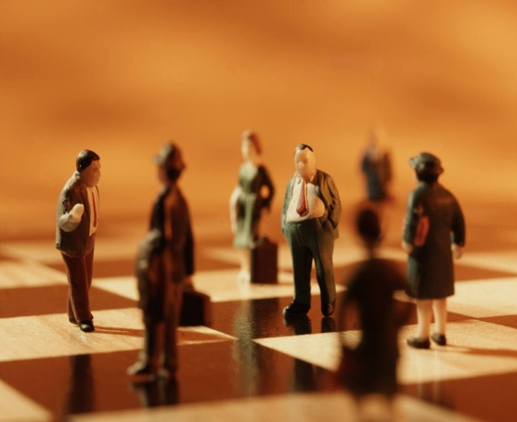



Principles of
Managing Organisations
Lecture 5:
Organisational Culture

Slide 2

Last time we….
Reviewed the concept of organisation structure and the key principles involved
Identified levels of organisation and formal organisational relationships
Explained why a good structure matters and the consequences of getting it wrong
Considered new and emerging organisational structures

Slide 3
Today’s objectives
To define and analyse culture, notably organisational culture
To assess the importance of organisational culture in relation to overall performance

Slide 4
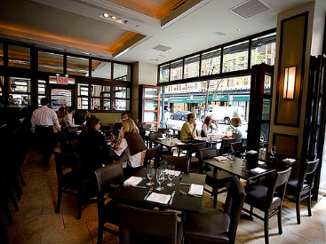
Culture in the news…..
http://www.bbc.co.uk/news/business-38986212

Slide 5

Culture in the news…..
What’s been going on at FIFA?
https://youtu.be/LnJZE8SKXO4

Slide 6
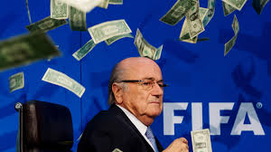
$$$$$$$$$££££££££$$$$$$...
https://youtu.be/O-SO0XZlSdY

Slide 7
Organisational culture: definitions
‘The collection of traditions, values, policies, beliefs and attitudes that constitute a pervasive context for everything we do and think in an organisation.’ (McLean, 1993)
The collective self-image and style of the organisation; its shared values and beliefs, norms and symbols
https://youtu.be/1jn2_nZrivQ
http://youtu.be/kfQFAzsC9r8
Notes:
We don’t work or operate in a vacuum – the way we work and behave is shaped, directed and moderated by the culture of the organisation to which we below.
Organisations are a bit like mini-societies

Slide 8
My favourite: the organisation’s ‘personality’
‘That’s the way we do things around here.’ (Handy, 1987)
Culture Behaviour
Notes:
This simple statement by management guru Charles Handy encapsulates the topic – it says simply that’s the way we do things around here. It’s what’s typical of the organisation; habits, attitudes, what Drennan called the “grown up pattern of accepted behaviour” (Drennan, 1992:3) what’s acceptable and what’s not
Therefore we could infer that Culture shapes Behaviour
This suggests:
There is a right and a wrong way
Some things are acceptable, other things are not acceptable
Some behaviour should be encouraged, some discouraged
Are we friendly or aggressive
Proactive or passive
Concerned or not bothered
Teamworkers or solo players
Rule followers or rule breakers
Organisational culture shapes organisational behaviour

Slide 9

Why is culture important?
Culture shapes behaviour
Friendly or Aggressive
Proactive or Passive
Concerned or Not Bothered
Teamworker or Solo Player
Rule Follower or Rule Breaker.

Slide 10

Organisational Culture
http://youtu.be/9bJBeCI0e3U
Distinctive artefacts…pianos, pool tables and roller hockey
Values of innovation and sharing
Does all this matter- just style or a key determinant of performance?

Slide 11
Positive aspects of culture
When accepted by employees culture increases the authority of management because:
  Employees identify with the organisation
  They internalise the organisation’s values
  They are motivated to achieve organisational objectives
  Cartwright (1999)
https://youtu.be/y5KFfnUcA_4
Notes:
People learn to play by the rules if they accept the culture, making the task of managing them more straightforward – they start to ‘get’ what the organisation’s all about and is trying to do and support its delivery.
It could be argued.......therefore that culture is a device for management control ? Positive or negative thing? It depends.....

Slide 12

So…..
Values, beliefs and assumptions influence behaviour
Culture guides actions but only when strong and unchallenged
Some cultures are better than others
If values, beliefs and attitudes can be learned they can also be changed
Notes:
Changing culture is tricky and difficult but sometimes necessary to make big changes to an organisation which may be in decline or failing- remember all this stuff is about improving organisational efficiency and performance.

Slide 13

Culture as a Liability
Barrier to Change
  Culture is slow to change – even in a dynamic environment
Barrier to Diversity
  Culture seeks to minimise diversity
  Can embed prevalent bias and prejudice
Barrier to Acquisitions and Mergers
  Most mergers fail due to cultural incompatibility

Slide 14

Culture’s 5 Basic Functions
Defines Boundaries
Conveys a Sense of Identity
Generates Commitment Beyond Oneself
Enhances Social Stability
Sense-making and Control Mechanism

Slide 15

Levels of culture: Schein
Shallow to deep as follows:
  Artefacts: physical space and layout, technological output, written and spoken language, overt behaviour of group members
  Espoused values: beliefs which become part of the conceptual process by which groups members justify actions and behaviour
  Basic underlying assumptions: unconsciously held learned responses – the essence/core
Notes:
Surface, middle and core

Slide 16
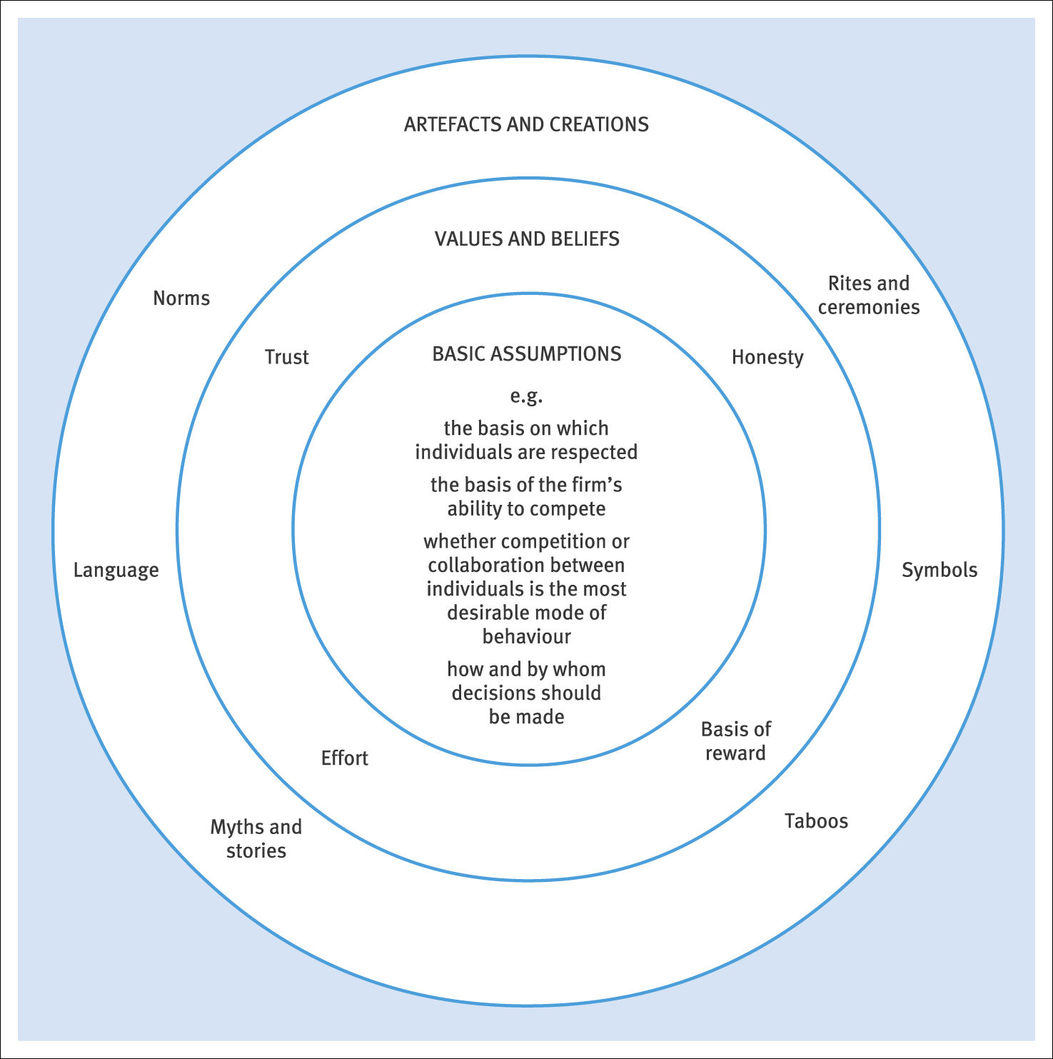
Figure 20.1 Schein’s layered conceptualisation of culture
Notes:
This diagram helps to show that the layered effect of organisational culture – artefacts are things on the surface – symbols, taboos, norms
Values and beliefs go deeper - honesty, trust,
Basic assumptions lie at the core – these guide individual behaviour –commitment to quality, no blame culture, degree of initiative permitted, etc – maybe translated into the type of people who are employed as a result – ‘would they fit?’

Slide 17
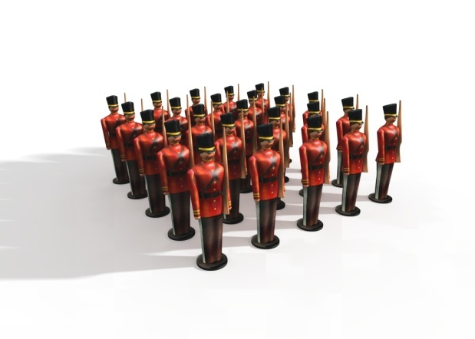
Activity 1
Describe each culture and consider the main differences:
a) a regiment in the army
b) an events agency
Notes:
In groups, work this through please for 5 minutes.

Slide 18

Solution
Army:
Very disciplined
Decision-making by officers
Formal behaviour between ranks
Each regiment has own history
New recruits: tradition
Events agency:
Different mission
More fluid
Individual creativity encouraged
Individual creativity expected

Slide 19
Handy’s 4 types of culture:
  Person – The individual is the central focus.
  Found amongst artists, performers, barristers, architects.
  Power – Power radiates out from the centre like a spider’s web. Control.
  Found in small entrepreneurial companies, family dominated companies
  Role – Found in bureaucracies. T
  The main emphasis is on compliance with rules and procedures.
  Task – The emphasis is on completing the job or project.
  Found in organisations which require teamwork, flexibility and speed, such as events agencies.
Main cultures in the UK = Role and Task
Handy (1986)

Slide 20

Types of culture: Deal and Kennedy
Tough-guy, macho culture
  High risk, quick feedback
Work-hard / play-hard culture
  Low risk, quick feedback
Bet-your-company culture
  High risk, slow feedback
Process culture
  Low risk, slow feedback
Notes:
Another way of classifying culture – this one looks at the degree of risk with the organisation’s activities and how quickly people receive feedback on their decisions.
Tough guy: organisation full of individuals, big risk takers, rapid feedback – high pressure environments can lead to high staff turnover (Examples anyone? - builders, police, surgeons)
Work hard, play hard: fun and action, high level of low risks, quick feedback
Examples – estate agents, McDonalds – highly dynamic organisations – focus on customer needs – team oriented
Bet your company: big stakes here, big decisions but slow feedback
Investment or casino banks, oil companies, - focus on the future and future investment ; top-down hierarchy, meetings,
Can be innovative but slow
Process: low risk slow feedback – people find it hard to measure what they do
Retail banks, insurers, civil service – stakes are low, little feedback – black holes of administration and bureaucracy, formality, perfection - good when we need order and predictability

Slide 21


Types of culture: (ACAS)
Control culture
  Emphasis on rules, procedures, control and compliance.
Quality of working life culture
  Emphasis on core values, mission statements to provide guidance and commitment through shared goals, values and traditions.
  What type is this?
  https://youtu.be/dyiwU0Uq_wI
Notes:
Another way of classifying culture: this again looks at it from the perspective of the organisation not the individual
The layers we discussed earlier can help to define this.
‘corporate image’ plays a part here
Control:
Quality of working life:

Slide 22

Influences on the development of culture
History
Primary function and technology
Strategy
Size
Location
Management and staffing
The environment
Notes:
Handy – cultures are built over the years by the dominant groups in an org
History: why was the organisation established, how long ago, what did its founders want it to do? Mergers can change culture – this very university is the product of various amalgamations and mergers of former institutions, such as UWTSD. Culture evolves each time.
Primary function: impacts on culture
Strategy: goals, objectives and strategies will affect culture – e.g. How risk averse is it? Will vary between public and private sectors
Size: the bigger the organisation the more formal the structure in general – more departments, specialists, multi-site operations, - harder to communicate – changes in size can affect culture
Location: characteristics of the base can affect culture – city centre, countryside
Management and leadership: the influence of top executives – Richard Branson at Virgin is an example – they influence how things are done and give a lead to staff about how they are expected to behave – staff may or not buy in to different degrees as they will have their own cultural influences which they bring to the organisation too.

Slide 23
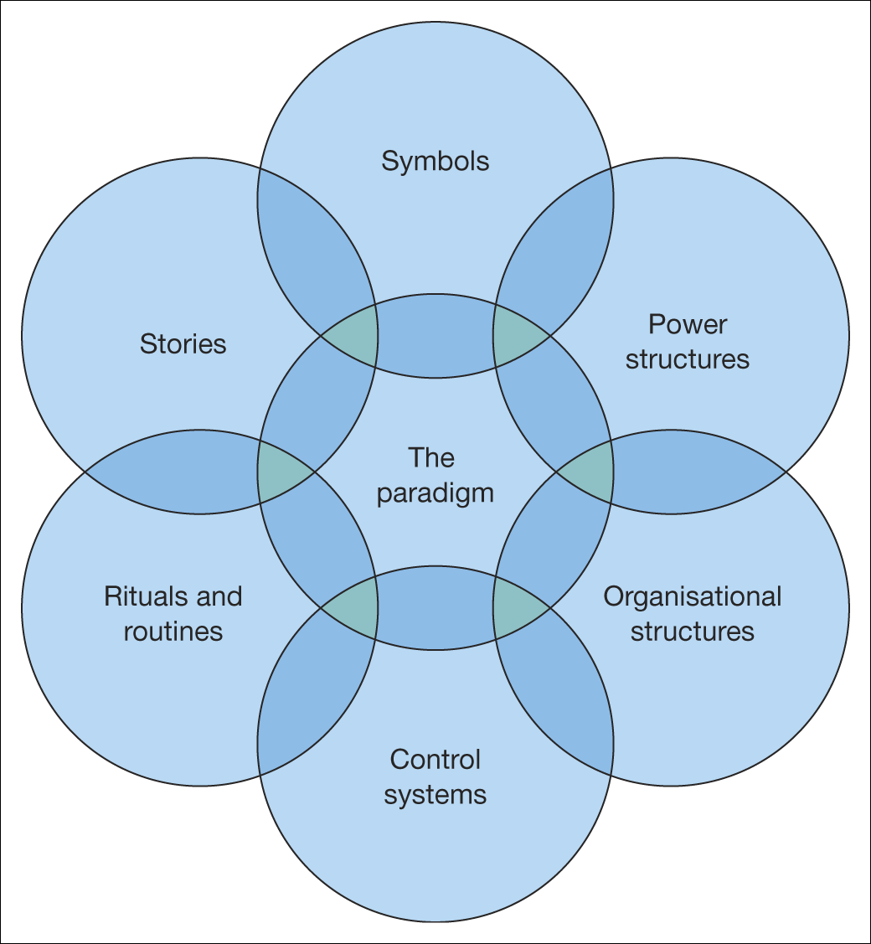
The cultural web http://youtu.be/8lVxC6XRvtY
Figure 19.1 The cultural web of an organisation
Source: Johnson, G., Scholes, K. and Whittington, R., Exploring Corporate Strategy, Seventh Edition, Financial Times Prentice Hall (2005), p. 202.
Reproduced with permission from Pearson Eduction Ltd.
Notes:
How all these things interact affects the overall culture of the organisation. It’s a mish-mash of the lot, a giant bowl of soup consisting of all these different ingredients.

Slide 24

Culture and organisational performance
‘Without exception, the dominance and coherence of culture proved to be an essential quality of the excellent companies.’
Peters and Waterman (1984)
‘There is nothing accidental about cultural strengths.. There is a relationship between an organisation’s culture and its performance.’
Heller
Notes:
Back to the link between organisational culture and performance – it matters.

Slide 25


Managerial tools
To be suitable, a culture must be:
  Strategically relevant
  Strong enough for people to care
  Able to adapt to changing circumstances
Managerial tools to develop culture include:
  Recruitment and selection
  Social tools and training
  Reward systems http://youtu.be/j8hsCx7FFNk
Notes:
Every organisation has a culture – good or bad. Not just about happy employees.
It must do these things to ensure long term performance
Managers need to ensure they employ the right people (who ‘fit’); train and explain people in what is expected
Culture (informal) needs to be linked with formal reward systems e.g. Awards at conferences for top salesmen have a symbolic effect if that’s what the organisation wants to be about.
Culture can be difficult to change – lecture coming up soon about organisational change

Slide 26

Three perspectives on culture
Optimists – culture can be changed, e.g. Peters and Waterman (1982).
Pessimist – culture cannot be changed, e.g. Hatch (1997)
Realists – parts of culture can be changed, e.g. Meek 1988).
Ogbonna and Harris (2002)
Notes:
Jack Welch ex GE President:
“A co can boost productivity by restructuring, removing bureaucracy, and downsizing, but it cannot sustain high productivity without cultural change”
Can we manage it? How people behave/think?
Perhaps mgt can influence behaviour

Slide 27
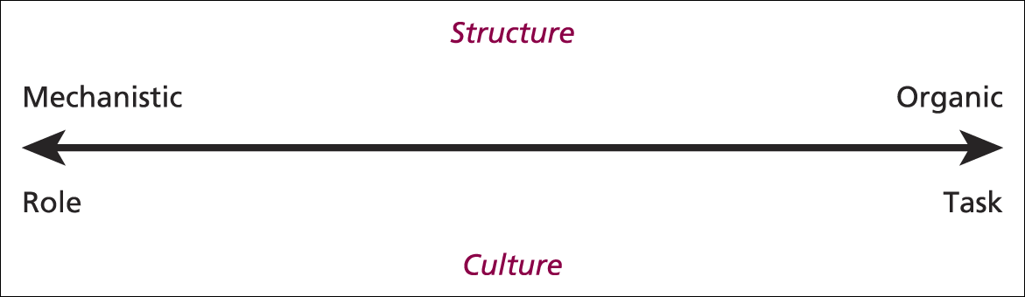
Figure 3 A structure–culture continuum Burnes (2009)
Notes:
Question of ‘fit’ to structure applies here – link to Burns & Stalker’s structural continuum discussed 2 weeks ago
But does Japan ‘fit’ here? Why not?
Companies there – highly structured jobs, hierarchical, deferential but also highly motivated, show initiative and creativity whilst group/team oriented with high autonomy
So we can’t ignore national culture here – more on that later

Slide 28
Dobson’s guide to changing culture
Step 1 Change recruitment, selection and redundancy policies to alter the composition of the workforce so that promotion and employment prospects are dependent on those concerned possessing or displaying the beliefs and values the organisation wishes to promote.
Step 2 Reorganise the workforce to ensure that those employees and managers displaying the required traits occupy positions of influence.
Dobson (1988)
Notes:
Q: why would an org want to change its culture? Can it be changed?
Environmental change – those values/beliefs/norms may no longer be appropriate for a modern org – may no longer match the structure in place
Yes it can – the surface elements can, perhaps even values if people ‘buy in’ and agree
So how?
Sometimes needs a ‘shock’ – banking crisis, recession, etc – moved from lend to everyone to lend to no-one
Dobson’s 1988 survey of the UK’s 1000 largest orgs found these 4 steps to changing culture change involving the beliefs/values/attitudes of employees – BUT is it too simplistic?

Slide 29
Step 3 Effectively communicate the new values. This is done using a variety of methods such as one-to-one interviews, briefing groups, quality circles, house journals, etc. However, the example of senior managers exhibiting the new beliefs and values is seen as particularly important.
Step 4 Change systems, procedures and personnel policies, especially those concerned with rewards and appraisal.
Notes:
All about structure and policies to alter behaviour
Recruit and promote the ‘compliant’ over the ‘non compliant’
Change can be brutal – there are casualties – need to win hearts and minds through persuasion and leadership (more soon) so that people aren’t forced to change – they WANT to change

Slide 30
Guidelines for changing culture
Formulate a clear strategic vision.
Display top-management commitment.
Model culture change at the highest level.
Modify the organisation to support
organisational changes.
Select and socialise newcomers and terminate deviants.
Develop ethical and legal sensitivity.
(Cummings and Worley, 2001: 509 – 511)
Notes:
‘terminate the deviants’
Get rid of people who don’t agree with you – steamroller change through
Not participative but directive –
Sir Stuart Rose when he took over M&S:
“ Stores were run differently by their own management teams….competing departments…..outsiders were strangled at birth…..I got the company by the balls and squeezed very hard until one or two people took notice. I butchered the Board”
If forced, people might resist – subject of a future session – absence of choice for those affected is important here

Slide 31
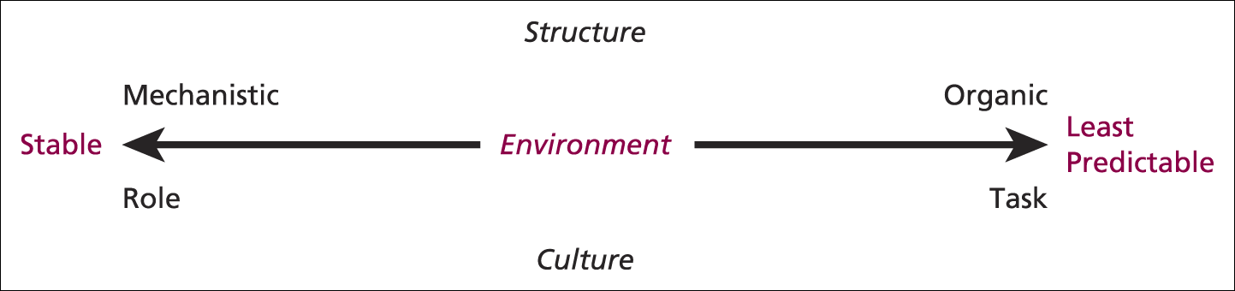
Figure 4 A structure–culture–environment continuum
Notes:
Realignment sometimes necessary

Slide 32
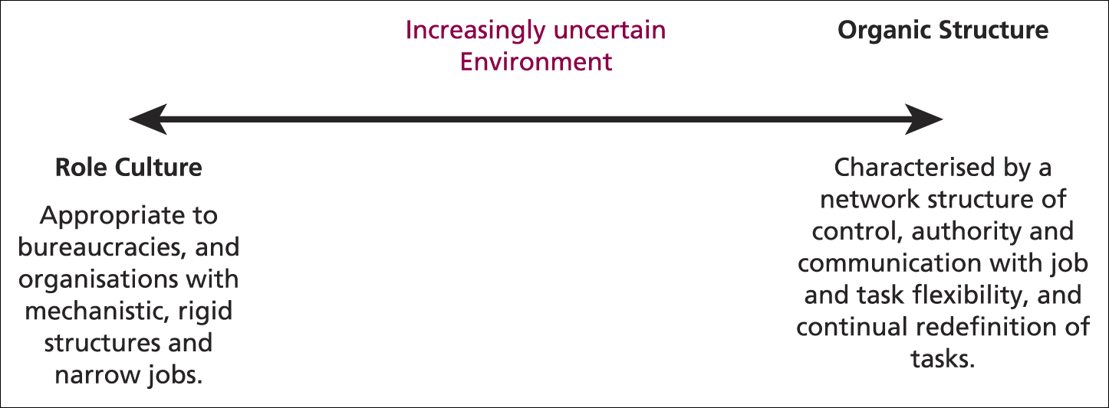
Figure 5 A structure–culture mismatch
Notes:
How predictable is the business environment? Affects decisions about structure and culture
What suited once may no longer work so change is needed
e.g. more market-oriented UK public sector -

Slide 33
National and international culture
Culture:
  Helps to account for variations among organisations and managers both nationally and internationally
  Hofstede’s “software of the mind”
  Helps to explain why different groups of people perceive things in their own way
  Helps to explain why people do things differently
National differences and cultural reasons raise concerns about the transferability of organisational ‘best practice’ across national boundaries.
https://youtu.be/UTE0G9amZNk
Notes:
We’ve looked at organisational culture today but we can’t ignore the wider issue of national and international culture.
France that would be less of an issue. This has a major impact for global or multinational organisations where they may have to adopt localised sub-cultures to operate effectively in local or regional marketplaces. One size therefore does not always fit all.
Does management mean the same thing to everyone? Is it practised the same way around the world? Do we all value the same things?

Slide 34
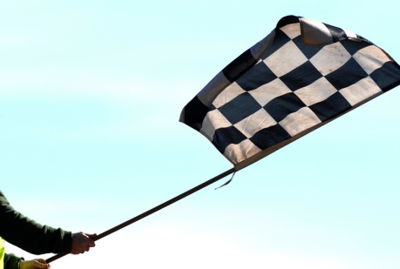
Culture: Conclusions
No clear agreement about the nature or the flexibility of culture.
Managers must make choices based on their own circumstances and perceived options.
Without strong or appropriate cultures, managers may find it difficult to agree among themselves or gain compliance from others.
In such situations, there is a tendency for conflict and power battles to occur.
Notes:
Can it be done without alienating some people? Do we end up with warring camps not a unified body?
End up in power battles and conflict?

Slide 35
Today’s objectives
To define and analyse culture, notably organisational culture
To assess the importance of organisational culture in relation to overall performance
https://youtu.be/IMAPpPzhh1A

Slide 36

Next time:
The Role of the Manager

