Slide 1
Psychology in Health and Social Care
Module code : LCHS4006
Assignment Number: Component 1 part 1
Student Name: Fatima Al Hassan
Student Number: 2129080
Lecturer’s Name: Alice Clayton

Slide 2

Outline

Slide 3


Slide 4
Introduction
This presentation will see the inclusion of two psychological activities for children aged 7 to 12 years based on Piaget and Vygotsky theories
Drawing and painting
Swinging games

Slide 5
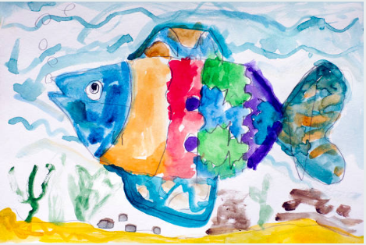
Introduction Cont.…..
Drawing and Painting
Provide youngsters with drawing and painting
Helps them develop pre-writing skills
Fosters self expression
Sensory understanding with the environment
Notes:
Providing children with paints and drawing instruments helps them develop pre-writing abilities while also fostering self-expression and a sensory understanding of the environment. In addition , it serves as a call to study colors, and color combinations.

Slide 6

Introduction Cont.…..
Swinging Games
Tools for swinging to be provided
Taking the risk to swing builds children confidence
Improves motor abilities
Notes:
children often need to be constantly on the go. Providing a safe environment with challenges that are appropriate for their age will encourage children to take risks, which will in turn build their self-assurance and resilience. Also, greatly improved are one's gross motor abilities. Swinging games aids children in developing cognitive abilities.

Slide 7
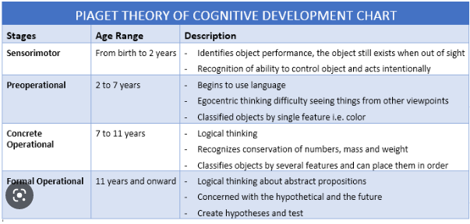
Drawing and painting: Piagent Theory
Emphasizes on four developmental stages:
Sensorimotor
Preoperational
Concrete operational, and Formal operational
Piaget observes drawing and painting as a general cognitive development for children
Child’s ability to convey thought on paper reveal cognitive ability
Notes:
Piaget believed that a child's drawings may be used as a glimpse into their overall cognitive growth rather than as a distinct developmental stage. Instead of revealing a child's developmental level, Piaget believed that a child's ability to convey their thoughts on paper revealed their cognitive capability. Piaget generally agreed with Luquet's thesis, and the two theorists' frameworks for children's drawing development are quite similar. They seem to explain'seeming' stages of acquisition, as shown by Clark (1897), who studied children aged 6 to 16, and had them draw an apple with a hatpin passing through it; the younger children drew a continuous line, while the older children drew only the visible parts of the pin. Similarly, Freeman & Janikoun (1972) studied cups drawn by children and found that the younger children drew a continuous line, while the older children drew

Slide 8

Swinging: Vygotsky.
Vygotsky states that consciousness is created through interacting with the nature.
A nature play with tools are important in developing cognitive strategies
Notes:
A nature play with tools are important in developing cognitive strategies. Vygotsky also thinks that children learn best when they are actively involved in activities in a safe and encouraging learning environment and are given proper direction through the medium of tools (Vygotsky, 1978). To better understand what is meant by "instructional tools," consider the following: "cognitive methods, a mentor, peers, computers, printed materials, or any instrument that organises and offers information for the learner. According to Patsula (1999), " An instructional coach's job is "to organise dynamic support to enable [learners] complete a task near the upper limit of their zone of proximal development and then to systematically withdraw this support as the learner rises to higher levels of confidence.

Slide 9
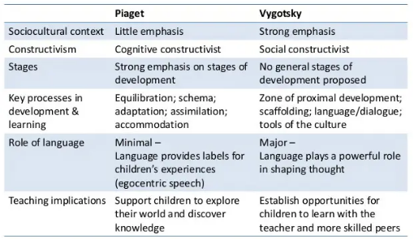
Piagent Vs. Vygotsky Theory

Slide 10
Conclusion
In summary, both Piaget and Vygotsky developmental theories have similarities and differences.
While Piaget’s developmental theory is hinged on environment for children to learn,
Vygotsky bases his arguments on learning through social interactions and their culture.

Slide 11
References
Bradbury, D. E. (1937) “The contribution of the child study movement to child psychology” Psychological Bulletin, 34(1), 21–38. https://doi.org/10.1037/h0059794.
Clark University. (1889) Register and official announcement. Worcester, MA: Author.
Luquet, G.H. (1927) Le dessin enfantin.(Bibliothèque de psychologie de l" enfant et de pédagogie.).
Patsula, P.J. (1999) “Applying learning theories to online instructional design”, Athabasca University, Seoul.[Online] http://www. patsula. com/usefo/webbasedlearning/tutorial1/[9 September,2005].
Verenikina, I. (2003) Vygotsky's socio-cultural theory and the zone of proximal development.
Vygotsky, L. (1978) Mind in Society. Cambridge, MA: Harvard University Press
Young, J.L. (2016) “G. Stanley Hall, child study, and the American public”, The Journal of genetic psychology, 177(6), pp.195-208.

