Slide 1
Modul: International Business Communications LCBB6001
Date: 09.08.2024
Name:Tanya Garabinska ID2129044
University: UW Trinity St David
Lecturer: Alfred Mensah

Slide 2
Table of contents
Introduction
German culture
Cultural sensitivity
Hofstede cultural dimensions
Recommendations
Conclusion

Slide 3

Introduction
Sainsbury's planned extension into Germany
The company desired to increase its market share by entering a new place with possible retail opportunities
Expanding the German market provides potential revenue opportunities due to high customer spending
Notes:
SN,
In this presentation, I will discuss about my selected multinational company, Sainsbury and its expansion in Germany retail sector. The main reason behind choosing Sainsbury is its low market presence outside UK and Ireland. The company is initiating to extend its business into Germany which is the largest and profitable retail market. Objectives comprise increasing market share enhancing brand presence and diversifying revenue streams. The possible advantages are revenue growth, a competitive advantage in the European market, and an increase in overall brand recognition as well as value across the industry.

Slide 4
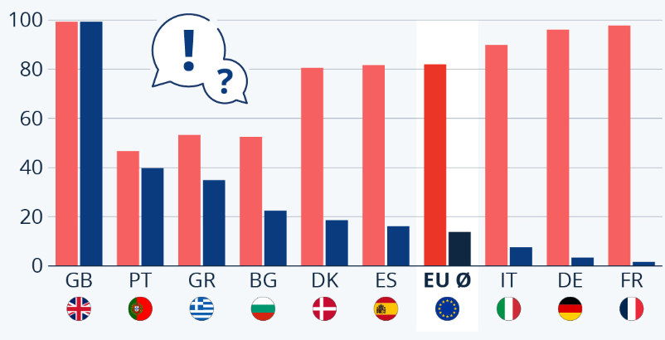
German Culture - Language and Ethnic Makeup
In Germany, almost 96% of population are communicate in German and 3.38% use the English language (statista.com, 2023)
German culture follows ethnic diversity
Implications for communication
Notes:
Germany's main language is German, while the UK mainly speaks in English. These language distinctions demand effective localisation and translations for Sainsbury's business expansion. The country has various ethnic populations with various communities. Comprehending this diversity is critical for Sainsbury to improve its communication strategies guaranteeing cultural sensitivity and inclusivity.

Slide 5
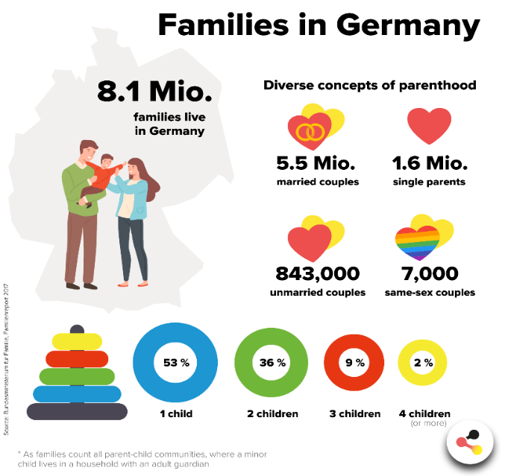
German Culture - Social Structures
The social culture in Germany focuses on family importance
Social hierarchy is the main cornerstone of German culture
Community engagement is also a potential part of German culture
Notes:
Families play a significant role in German culture which influences purchasing decisions among consumers. Hierarchy in this country it is respected with specific distinctions in responsibilities and roles. Community engagement is equally valued along with local events and gatherings are common. This social structure influences customer behaviour highlighting long-term relationships and trust in business.

Slide 6
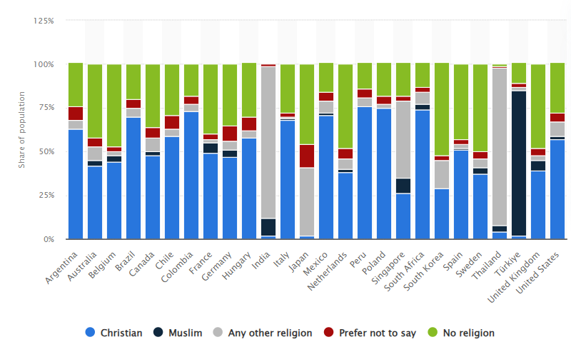
German Culture - Religious Values
In Germany 47% of people are Christian and 35% of people have no religion (Statista.com, 2024)
Germany has predominant religions
Jamun culture influence on holidays and business practices
Notes:
Christianity mainly Protestantism and Catholicism, is the predominant religion in Germany. Religious holidays such as Easter and Christmas influence business operations with multiple businesses closing during these events. Cultural norms regarding religion such as influence customer behaviour, and respect for community values and traditions which impact cells and marketing strategies.

Slide 7
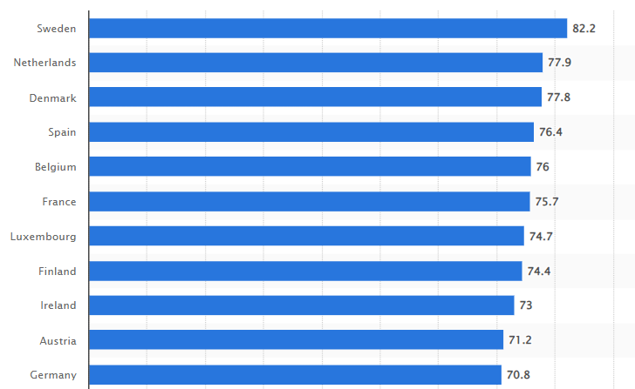
Cultural Sensitivity - Work-related Attitudes
Ethics in business organisations help to develop a more culturally sensitive and socially conscious business culture (Tanveer et al. 2021)
Germany ranks 11th on the EU gender equality index (statista.com, 2023)
German has preferred to walk like a balance
Notes:
The work ethics in Germany are characterised by punctuality, diligence and precision compared to the UK's more flexible approach. Germany mainly values a clear difference between personal life and work facility in a balanced work-life climate. Professionalism is highly regarded with formal communication business regulation which is critical in German business culture.

Slide 8
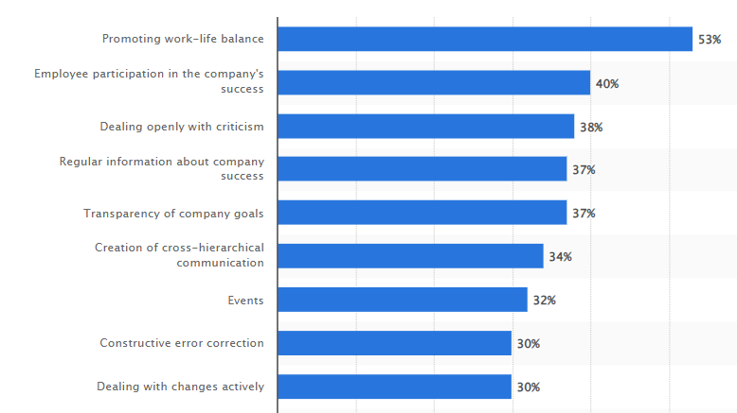
Cultural Sensitivity - Business Protocol
Business Protocol directs to accepted rules for communication and behaviour in a professional environment (Asatiani et al. 2021)
In Germany, 53% of individuals stated that the most essential aspect which contributes to retaining workers is the facility in a work-life balance (Statista.com, 2024)
Communication styling in Germany is to the point and direct
Notes:
German business Protocol highlights formal greetings and punctuality. Communication approaches are to the point and direct compared to the UK where communication style depends on indirect approach. In Germany decision-making procedures are mainly consensus-given and methodical, demanding respect and preparation for hierarchal structures. Comprehending these aspects is critical for successful business interactions.

Slide 9
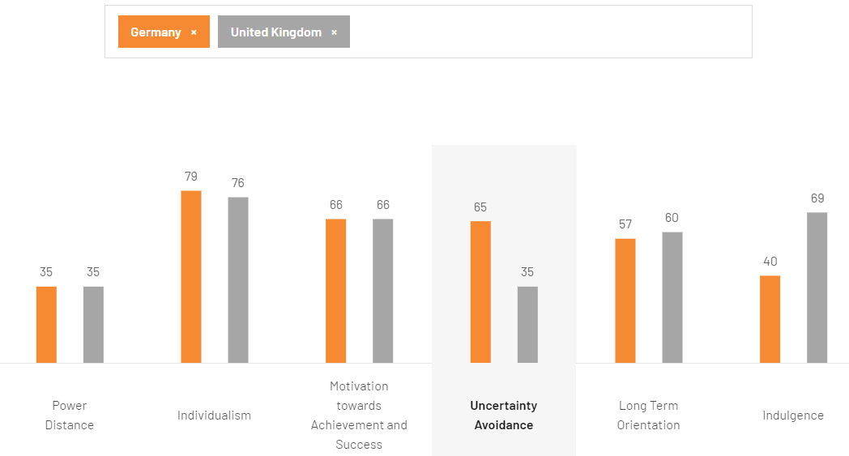
Hofstede Cultural Dimensions (Part 1)
The UK has a higher PDI and is open to hierarchical structures also Germany has a higher PDI and supports equal power distribution (hofstede-insights.com, 2024)
Germany combines individualism and collectivism, whereas the UK is highly individualistic.
The UK, on the other hand, prioritizes immediate results while Germany prioritizes long-term planning.
Notes:
Germany's higher PDI demonstrates an inclination for equivalent power conveyance contrasted with the UK's higher PDI, which acknowledges various balanced structures. Germany exhibits a balance between individualism and collectivism, valuing group cohesion as well, whereas the UK is highly individualistic (high IDV), emphasizing personal accomplishments. In contrast to the UK's short-term orientation, which places an emphasis on immediate gains and results, Germany's long-term orientation (LTO) emphasizes perseverance and future rewards. Both countries' business and organizational strategies are affected by these differences.

Slide 10
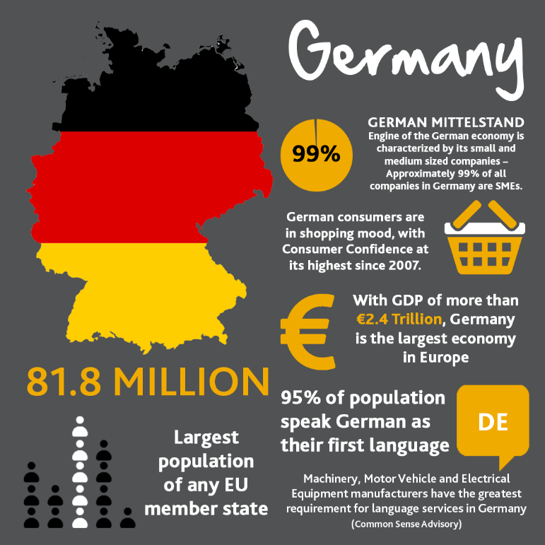
Hofstede Cultural Dimensions (Part 2)
The UK accepts hierarchical structures while Germany Favors equality in organizations with a higher PDI.
Germany combines individualism and collectivism, whereas the UK is very individualistic (hofstede-insights.com, 2024)
Germany has a long-term focus, while the UK inclines toward transient results.
Notes:
In contrast to the UK, which has a higher PDI and is willing to accept more hierarchical roles, Germany's lower PDI suggests a preference for equality and flatter organizational structures. While Germany's balanced IDV reflects a mix of individual and group interests, the UK's high IDV places an emphasis on individual accomplishments and independence. Germany's drawn-out direction (LTO) focuses on future-arranged arranging and tirelessness, standing out from the UK's momentary direction, which centres around prompt outcomes and fast returns. These aspects shape how every nation approaches business and hierarchical procedures.

Slide 11
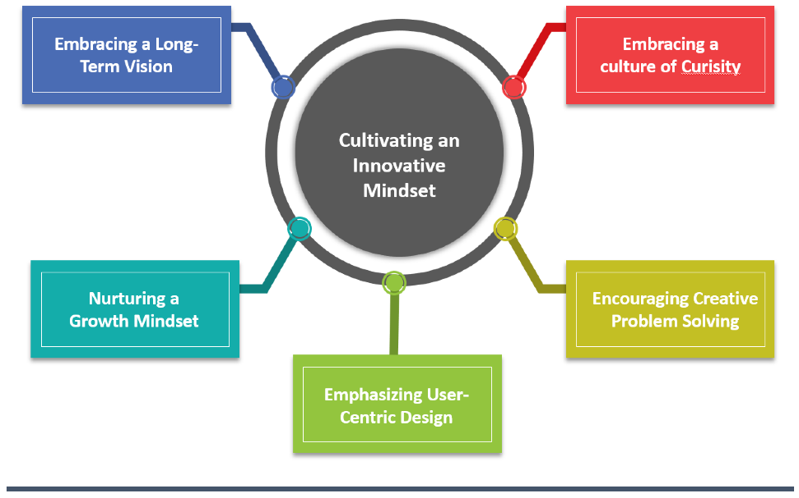
Recommendations (Part 1)
Developing effective marketing campaign which highlights depend ability and quality along with demonstrates German values (Chen et al. 2021)
Transform products strategies to mitigate the German consumers’ needs as well as local demands
In terms of attain valuable understanding regarding the market cooperation with local suppliers and businesses is extremely important
Notes:
Sainsbury's business organisation have to focus on developing marketing campaign which is extremely important to improve quality and dependability as per German values. In addition developing and transforming product of a ring based on German customer needs and preferences as well as local demand is critical for successfully finding its business organisation in German. Understanding marketing trends and customer preferences is critical which is gained by partnership with local businesses and suppliers.

Slide 12
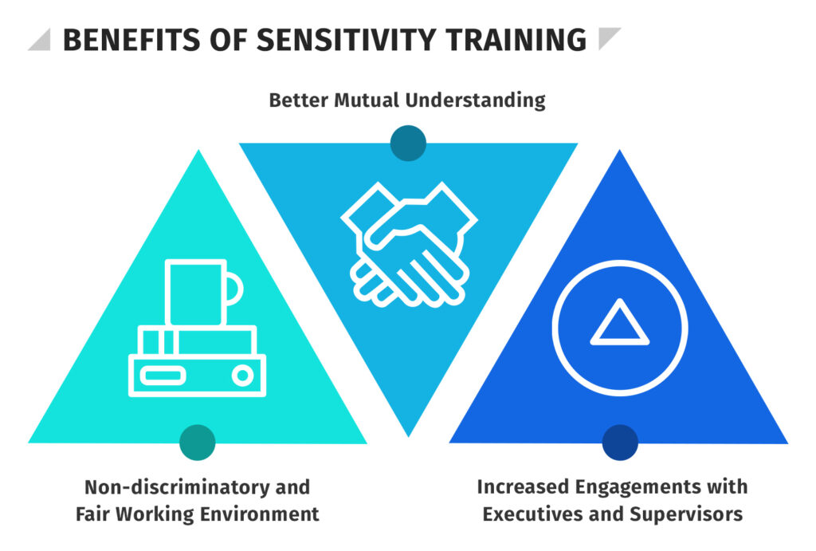
Recommendations (Part 2)
Providing proper training regarding cultural sensitivity in German is effective to improve business visibility (Johnson et al. 2023)
In order to improve brand visibility it is important to be involved in German local events
Execute regular analysis of customer trends and market circumstances
Notes:
In order to improve brand visibility it is important to be involved in German local events spending business organisation in any area it is important to understand its local culture and needs. In terms of communicating and relating with customers it is important to understanding their culture and communication style. This contacts cultural sensitivity training programs is essential for successful expanding since beauties business organisation in German. Participating in local events can help to improve brand visibility and customer awareness.

Slide 13
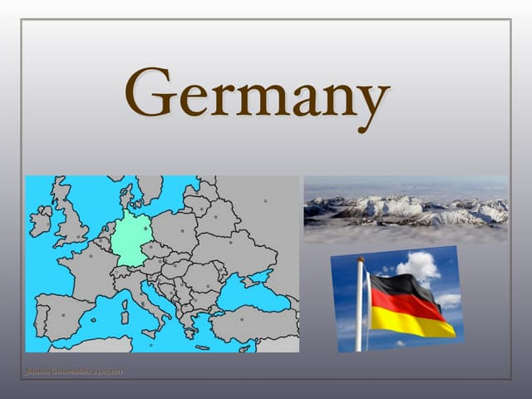
Conclusion
The presentation summarized the understanding of German culture and statistical recommendations
The presentation highlighted the significance of adopting to German culture
The presentation emphasizes the requirement for continuous engagement and adaptability for sustained success
Notes:
Business organisation mention into Germany needs a in death understanding of its social structure and work ethical balances. The presentation has concluded religious values, language and ethnic makeup which is equally valued along with local events and gatherings in this country. The presentation has also highlighted the business protocols in Germany where most of the population stated that work life balance is extremely important to retail employees. The Hofstede cultural dimensions have analysed properly comparing UK and Germany based on business compatibility. Recommendation based on marketing campaign and cultural sensitivity has also critically provided in terms of permitting the opportunity to this company for successful expansion in Germany.

Slide 14
References
Asatiani, A., Hämäläinen, J., Penttinen, E. and Rossi, M., (2021). Constructing continuity across the organisational culture boundary in a highly virtual work environment. Information systems journal, 31(1), pp.62-93.
Chen, Y., Kwilinski, A., Chygryn, O., Lyulyov, O. and Pimonenko, T., (2021). The green competitiveness of enterprises: Justifying the quality criteria of digital marketing communication channels. Sustainability, 13(24), p.13679.
hofstede-insights.com, (2024). COUNTRY COMPARISON TOOL. Available at:https://www.hofstede-insights.com/country-comparison-tool?countries=germany%2Cunited+kingdom [Accessed on: 15.07.2024]
Johnson, C.S., Sdunzik, J., Bynum, C., Kong, N. and Qin, X., (2023). Learning about culture together: enhancing educators cultural competence through collaborative teacher study groups. In Leading Socially Just Schools (pp. 183-196). Routledge.
Statista.com, (2023). Diversity in the workplace in Germany - statistics & facts. Available at: https://www.statista.com/topics/11460/diversity-in-the-workplace-in-germany/ [Accessed on: 15.07.2024]
Statista.com, (2023). Local Languages Are Crucial for Migrants to Master - Statista. Available at: https://www.statista.com/chart/31222/share-of-online-job-postings-in-local-language-and-english/#:~:text=In%20Germany%2C%20approximately%2096%20percent,required%20as%20a%20second%20language. [Accessed on: 15.07.2024]
Statista.com, (2024). Religious beliefs in selected countries worldwide 2023 - Statista. Available at: https://www.statista.com/statistics/1387259/religious-beliefs-world/ [Accessed on: 15.07.2024]
Tanveer, M., Ahmad, A.R., Mahmood, H. and Haq, I.U., (2021). Role of ethical marketing in driving consumer brand relationships and brand loyalty: A sustainable marketing approach. Sustainability, 13(12), p.6839.

