Slide 1
ORGANISATIONAL CHANGE CASE STUDY
WESTERN UNION
WARUNA GALAGEDARA
2206302
CHANGE AND STABILITY MANAGEMENT
BMMB 7000

Slide 2
Contents
What is Change Management?
About Western Union (WU)
What happened in WU?
Application of Lewin’s Theory
Force Field Analysis of change in WU
Conclusion

Slide 3
What is Change management?
The broad strategy used to transition from the present to a desired future state utilising a coordinated and structured approach in partnership with stakeholders (Association for Project Management, 2023)
Change Management Learning Centre defines change management as
“The process, tools, and techniques to manage the people-side of business change to achieve the required business outcome and to realise that business change effectively within the social infrastructure of the workplace.” (Michigan State University, 2021)

Slide 4

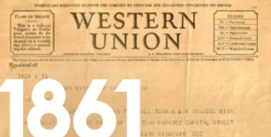

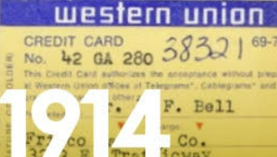


About Western Union (WU)
The 10-year-old Western Union Telegraph Company Completes the first Transcontinental Telegraph line and begins carrying messages from one end of North America to the other.
The company introduces its money transfer service, enabling people and businesses to send and receive money anywhere along its extensive telegraph network.
Western Union offers the first Charge Card to consumers
Having shifted its focus from communications to cross-border money transfers, Western Union becomes a publicly trading company.
Western Union offers money transfer services to every country on earth except Iran and North Korea, combining a 500.000+ agent retail network with a digital platform averaging 24 transactions each second (Western Union, 2023).

Slide 5
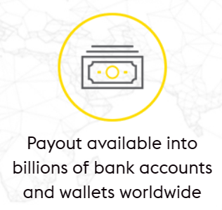
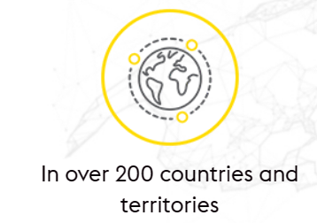
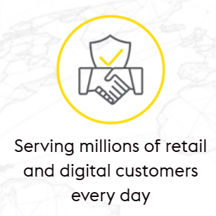
About Western Union (WU) - Contd..
$ 5 B+
USD Equivalent turnover in 2021
50 M
Receive customers
Customer service in 38 Languages
140+
Currencies
40 M
Send customers
Western Union is a global leader in cross-border, cross-currency money movement and payments (Built In, 2023).

Slide 6
What happened in WU
On August 1, 2019, the Company’s Board of Directors approved a plan to change
the Company’s operating model and improve its business processes and cost structure by reorganising the Company’s senior management, including those managers reporting to the Chief Executive Officer (“CEO”), reducing its headcount, and consolidating various facilities.
Significant investments in its tech team, both through internal development and bringing on new team members.

Slide 7
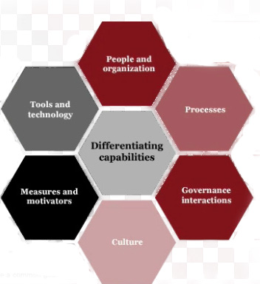
Operating Model

Slide 8
Application of Lewin’s Theory
Lewin believed a successful change project involved three steps:
Unfreezing, Changing, and Freezing.
Unfreezing: Communicated with the staff about the change.
Reduced head count. Paid $ 110 mn compensation to the staff.
Changing: Training and coaching programs implemented.
Recruiting staff with talents in the cloud, data architecture,
and cyber security.
Keep communicating a clear picture of the desired change.
Freezing: Due to the Russian and Ukraine wars and the Global
economic crisis change is still happening in the WU.

Slide 9
Key factors for change and against change
Drivers for Change
Status Quo
Resisters of Change
Ability to adopt new technology (5)
Change of Operating model and Improve business process and cost structure
Downsize of staff (5)
Increasing regulations – (Money laundering, Frauds) (5)
Global Economic Downturn (4)
A decline in In-Person transactions (5)
Slower growth or declines in money transfers (3)
Robust competition in the C 2 C Money transfer industry (4)
Data privacy laws (Customers data) (3)
Total 19
Total 15
The company adopted the planned organisational change.

Slide 10
Conclusion
Implementing the change will face many challenges, uncertainties, and anxieties involved in implementing and sustaining the change. All the stakeholders, including senior managers who were involved, have effects on the implementation of the change in one way or the other.
To implement change need to follow structured steps.
In this research, I will apply Lewin’s Theory, Kotter’s theory, and Force field analysis to analysis the change.

Slide 11
References
Association for Project Management (2023) What is change management and organizational change? Available at: https://www.apm.org.uk/ resources/what-is-project-management/what-is-change-management (Accessed on 05th February 2023).
Built In (2021) 22 companies spearheading digital innovation in their industries in 2021Available at:https:// builtin.com/ company/western-union (Accessed: 01st February 2023).
Built In (2023) Western Union Available at: https://builtin.com/company/western-union (Accessed: 07th February 2023).
Burnes, B. (2004) ‘Kurt Lewin and complexity theories: back to the future’, Journal of Change Management, 4(4), pp. 309-25 Available at : https://www.tandfonline.com/do i/full/10.1080/ 1469701042000303811?casa _token=7y7Dqz8FadYAAAAA%3A_5tq4s5gDkmUhU8WfvO9JmepddAFjv7sRb4AUQM2Gx2c7HfAWADzWOzfvAqKGxAFvTGfSXdCRj6I (Accessed: 18th February 2023).
Michigan State University (2021) Change management Defined Available at: https://www.michiganstateuniversityonline.com/ resources/leadership/what-is-change-management/ (Accessed on 05th February 2023).
Money transfer comparison (2021) Most popular money scams Available at: https:// moneytransfercomparison.com /scams/ (Accessed: 06th February 2023).

Slide 12
References Contd..
Money transfer comparison (2022) Western Union (WU) Money Transfer Review Available at: https:// moneytransfercomparison.com /westernunion/#alternatives (Accessed: 06th February 2023).
Ololade, Jimoh. (2022). ‘Change Management -An application of Kotter's change management theory in implementing the Finance Business Partnering Model in a not-for-profit organisation -a case study of Organisation-QF’. Research Gate Available at: https://www.researchgate.net/ publication/ 364337304_ Change_Management_ An_application_ of_Kotter's_change_management _theory_in_implementing_the_Finance_ Business_ Partnering _Model_in_a_not-for-profit_ organisation_-a_case_study_of_Organisation-QF/citations (Accessed: 18th February 2023).
Western Union (2023) About us, Available at:https://corporate.westernunion.com (Accessed on 05th February 2023).
Western Union (2023a) 2021 Annual Report and 2022 proxy statement Available at : https://ir. westernunion.com/investor-relations/financial-information/annual-reports/default.aspx (Accessed on 05th February 2023).
Western Union (2023b) Environmental, Social and Governance https://corporate.westernunion-microsites.com/wp-content/uploads/2022/06/WU-ESG-Report-2021.pdf (Accessed: 08th February 2023).

Slide 13
Thank You

