Slide 1


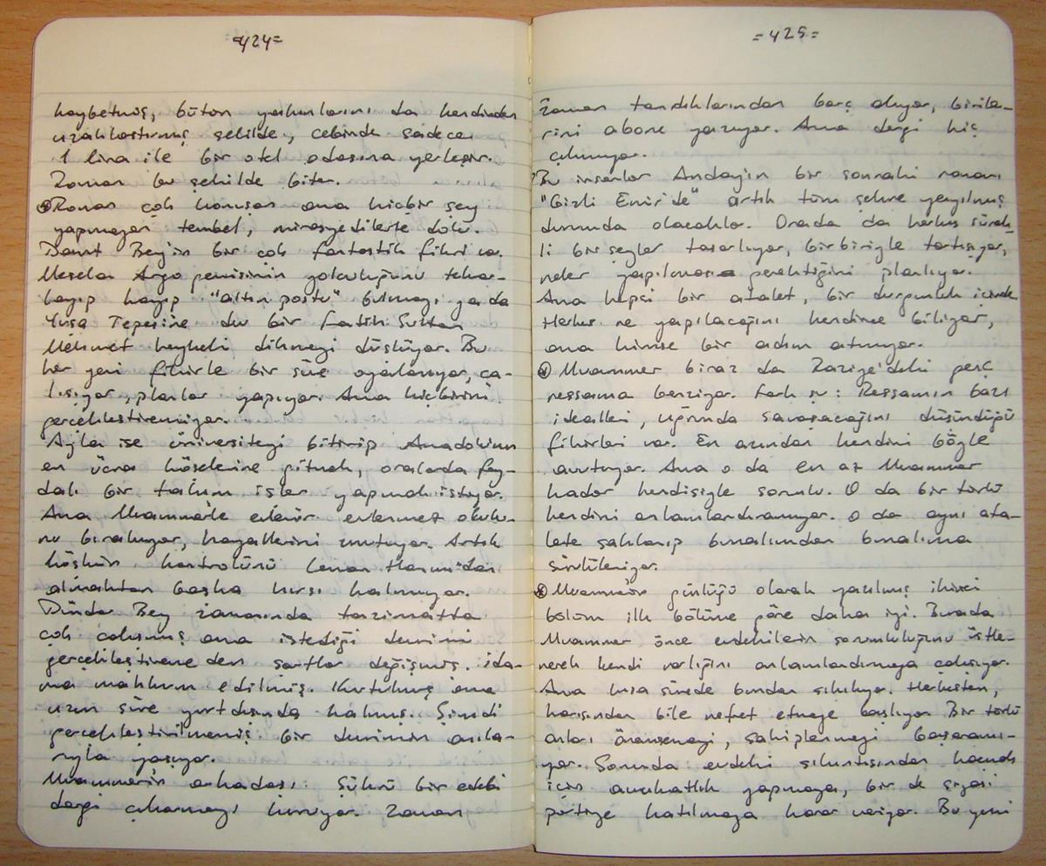
Principles of Professional Legal Practice
Week 11 - File notes

Slide 2
Aims
Understand the need for good file management

Slide 3

Types of memoranda
Attendance notes
Telephone attendance notes
File notes
Internal memoranda
Matter creation forms

Slide 4

Why are notes important?
Vital foundation document for files
Provides a record of what the client said and what the lawyer agreed to do
What if the note is handwritten and illegible?
What if the note is incorrect?
Must be accurate and detailed or it could lead to embarrassment, wasted time and possibly professional negligence

Slide 5

Consequences of poorly drafted/no notes
You may have to call the client to ask about some details you need – embarrassing!
Your client may have asked you to do something which you didn’t record – uh-oh!
You may spend time doing work the client didn’t ask you to do – you may not be able to charge for your time!
Professional negligence claim – not good!

Slide 6
Attendance notes
Put on a file as a record of an oral discussion, transaction or agreement
Must be clear and accurate in case of a dispute
Essential for anyone who takes over the file or did not attend the meeting/call
Needed for bill preparation as part of the record of chargeable time

Slide 7
Drafting the attendance note
Don’t delay!
Read through the notes you made during the meeting/call
Identify a logical pattern
Organise the material
Use headings and paragraphs
Exclude irrelevant or contradictory information

Slide 8
Drafting the attendance note continued
Record the precise legal advice given
Describe what was said
Outline the agreed next steps
Record the time you spent

Slide 9
Internal Memorandum
Keep it brief and business-like
Take care with tone
Format: -
Memorandum
From:
To:
Fee Earner’s Reference:
Date:
Client’s Name:
Client’s Matter:

Slide 10
Matter creation forms
Completed as soon as the initial instructions have been received
Information will be used to set up the client’s case on the firm’s database
Need full names with correct spelling
National Insurance number
Preferred contact method – clients may express a preference
Case type
ID type
Name of opponent
Mode of address for letters
Marketing Information

Slide 11


Tutorial
See separate handout

