Slide 1


Systemic Failures in Quality Assurance: A Root Cause and Policy Analysis of the Shrewsbury and Telford Hospital NHS Trust Maternity Scandal
Module: Quality Assurance and Service Improvements (LCHS7006)
Student Name: Md. Shohel Hossen
Student ID: 2433869
Lecturer: Dilhara Mampitiya

Slide 2
Introduction to the Maternity Scandal
The Shrewsbury and Telford Hospital NHS Trust maternity scandal represents one of the most severe quality assurance failures in the history of the UK National Health Service. Between the 1970s and 2019, hundreds of avoidable neonatal and maternal deaths, stillbirths, and injuries occurred due to deep-rooted systemic inadequacies. The failures were not isolated incidents but rather the product of a long-standing, defensive culture that consistently prioritised institutional reputation over patient safety (Lakasing, 2025).
Governance Collapse
Culture of Denial
Absence of robust clinical governance structures and accountability mechanisms across the Trust (Newburn, 2022).
A pervasive culture of deflection, preventing honest recognition of recurring clinical failures (Ames et al., 2020).
Accountability Avoidance
Failed Investigations
Chronic resistance to external scrutiny and regulatory oversight over several decades (Newburn, 2022)..
Systemic failure to investigate clinical incidents appropriately or transparently (Dyer, 2020).

Slide 3
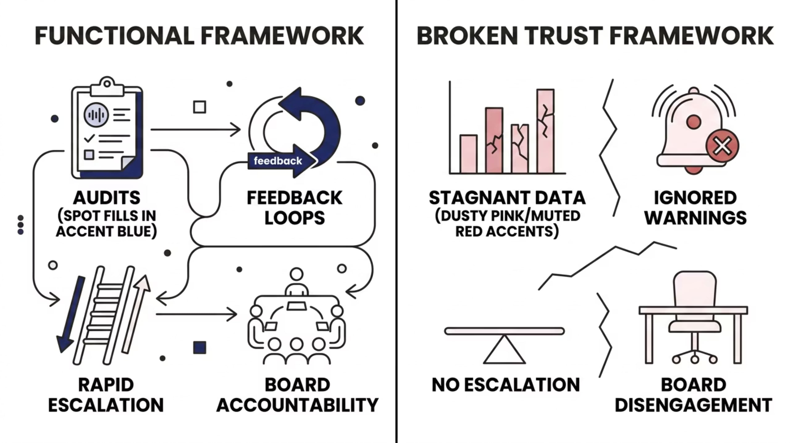
Breakdown in Clinical Governance
Clinical governance is the framework through which NHS organisations are held accountable for continuously improving the quality of their services (Dyer, 2020).
At the Shrewsbury and Telford Trust, this framework collapsed entirely. Independent reviews found that essential corrective actions across the maternity service were critically delayed or entirely ignored, leading to compounded and ultimately fatal clinical failures (Dyer, 2020).
Figure 1: Functional Framework and Broken Trust Framework (Dixon-Woods, 2024).

Slide 4
Systems-Based Safety: The Swiss Cheese Model
James Reason's Swiss Cheese Model provides a systems-based framework for analysing the root causes of the scandal.
Systems failures occur when multiple defensive layers fail simultaneously, allowing hazards to pass through (Reason, 2016).
Shifts focus from individual blame to latent organisational conditions (Ames et al., 2020).
Layer 1: Clinical Guidelines
National protocols and evidence-based standards of practice.
Layer 2: Incident Reporting
Internal audit and near-miss reporting systems.
Layer 3: Board Oversight
Executive governance and regulatory accountability.
(Lakasing, 2025)

Slide 5
Applying the Swiss Cheese Model to the Trust
Mapping the Swiss Cheese Model onto the Shrewsbury and Telford Trust reveals a multi-layered, simultaneous breakdown across every defensive stratum.
Layer 1 Failure — Clinical Guidelines Bypassed
Layer 2 Failure — Internal Audits Ineffective
Layer 3 Failure — Board Oversight Compromised
Protocols for fetal heart rate monitoring and caesarean section thresholds were routinely disregarded (Gillespie and Reader, 2018).. An informal institutional policy of suppressing caesarean rates directly contradicted national safety standards.
Audit processes failed to flag alarming mortality trends. Adverse outcomes were not systematically reviewed, leaving "unknown unknowns" entirely invisible to the organisation (Attenberg, Ipeirotis and Provost, 2015).
Executive leadership adopted a defensive posture. Latent organisational errors thus created the conditions in which active clinical errors were both inevitable and fatal (Reason, 2016).

Slide 6

The Donabedian Framework: Structure, Process, Outcomes
The Donabedian Model offers a structural lens for evaluating healthcare quality across three interconnected domains (Newburn, 2022).. Applied to the Trust, each domain reveals a distinct failure that collectively generated catastrophic patient outcomes.
Structure
Process
Profound staffing deficits and inadequate equipment characterised the physical and organisational environment (Reason, 2016)..
Flawed care delivery: complex pregnancies were routinely not escalated to senior obstetricians.
Outcomes
Unacceptably high rates of maternal and neonatal morbidity and mortality..

Slide 7

Disregarding Patient Complaints as a Root Cause
The Critical Failure
Poor Communication
Patient complaints reveal critical hot spots and blind spots in quality and safety (Gillespie and Reader, 2018).
Families raising concerns were routinely ignored or blamed.
Treating complaints as administrative burdens rather than quality intelligence neutralised the Trust's primary mechanism for service improvement.
Families reported being excluded from clinical decisions and kept uninformed during obstetric emergencies.
Lack of Compassion
Complaints regarding dismissive and insensitive treatment of bereaved parents were filed but not actioned (Dyer, 2020)
Clinical Errors
Recurring complaints about clinical misjudgements were categorised as administrative matters rather than patient safety signals (Ames et al., 2020).

Slide 8
Leadership, Culture, and Toxic Environments
The culture within the Shrewsbury and Telford Trust was fundamentally toxic. An organisation's leadership directly dictates the efficacy of its safety culture: when leadership adopts a defensive posture, it actively discourages transparency, suppresses incident reporting, and cultivates an environment in which systemic errors remain hidden (Dixon-Woods, 2024).
Defensive Adjudication of Errors
Suppression of Transparency
Normalisation of Deviance
Substandard practices became embedded as routine (Dyer, 2020). Over time, dangerous deviations from clinical standards were accepted as the norm, compounding harm across generations of patients.
The Trust effectively resisted acknowledging its own failures, treating internal reviews as reputation-management exercises rather than genuine quality improvement processes (Ames et al., 2020).
Staff who raised concerns encountered institutional resistance. The absence of a psychologically safe reporting environment meant that active failures went undocumented and unresolved (Lakasing, 2025).

Slide 9
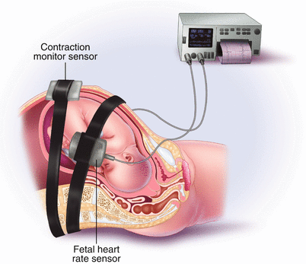

Policy Issues: Non-Adherence to Clinical Guidelines
Fetal Heart Rate Monitoring
Caesarean Section Thresholds
National CTG protocols routinely bypassed, with abnormal readings underplayed or ignored during labour (Dyer, 2020)
An institutional drive to reduce operative delivery rates overrode clinical judgement, delaying life-saving interventions (Reason, 2016).
Escalation Protocols
National vs. Local Disconnect
High-risk pregnancies were not consistently referred to senior obstetricians, violating established escalation frameworks (Dixon-Woods, 2024).
Figure 3- Fetal Heart Rate Monitoring (Lakasing, 2025)
Local informal practices were allowed to diverge significantly from NICE and Royal College guidance without external challenge (Lakasing, 2025).
Suppressing caesarean rates to meet institutional targets was a direct and lethal policy failure.

Slide 10
Impact on Service Provision and Workforce
The root causes identified had a devastating and measurable impact on service provision. The Ockenden Report confirmed that chronic understaffing and inadequate continuous professional development were central to the crisis. Resolving these structural deficiencies requires proper, system-wide investment in workforce planning not merely superficial local management restructuring (Newburn, 2022).
1,500+
201
Families Affected
Avoidable Deaths
Estimated number of families impacted by avoidable harm identified in the Ockenden Report (Lakasing, 2025)
Babies whose deaths were identified as potentially avoidable had the Trust followed national guidance (Lakasing, 2025)..

Slide 11


Policy Interventions and the Legal Framework
Systemic QA failure necessitates external legal and policy intervention (Gillespie and Reader, 2018).
Administrative mechanisms struggle to balance institutional defence with victims' rights (Ames et al., 2020).
Prolonged delays in justice expose critical inadequacies in regulatory frameworks.
Regulatory inertia itself becomes an instrument of continued harm to affected families (Dixon-Woods, 2024).
Delayed regulatory intervention compounds the original harm by denying families timely recognition and redress.
Figure 2: Policy Interventions (Newburn, 2022)

Slide 12

Structuring Component 2: The Written Report
Building upon the foundational analysis presented here, the forthcoming Component 2 written report will delve deeper into specific restorative models and actionable strategies.
Evaluating No-Fault Compensation
Comprehensive Policy Overhauls
A critical evaluation of "No-Fault" compensation approaches within the NHS, aiming to foster transparency and rapid learning (Macleod and Hodges, 2022).
Proposing essential policy overhauls required to mend the broken maternity care system across the broader healthcare landscape (Lakasing, 2025).
From Analysis to Action
Transitioning from root cause analysis to proposing actionable, systemic solutions for sustainable change (Dyer, 2020).

Slide 13
Recommendations for Sustainable Quality Assurance
To prevent the recurrence of such tragedies, the following systemic recommendations must be adopted across NHS maternity — and broader healthcare — services.
1
2
Mandatory External Auditing
Empowering Patient Voices
Transition from self-regulation to rigorous, unannounced external clinical audits (Lakasing, 2025)
Integrate patient and family complaints directly into executive-level risk management dashboards, treating them as first-order quality intelligence rather than administrative correspondence (Gillespie and Reader, 2018).
3
4
Cultural Realignment — Just Culture
Workforce Investment
Foster an environment where staff can report active failures without fear of punitive consequence, addressing the latent organisational variables identified by accident theory (Reason, 2016; Dixon-Woods, 2024).
Commit to sustained, ring-fenced funding for workforce planning, training, and continuous professional development across all NHS maternity services (Newburn, 2022).

Slide 14

Conclusion
The scandal represents a comprehensive QA failure- not isolated clinical errors, but the product of toxic organisational culture, wilful blindness to complaints, and defiance of national policy directives.
Addressing root causes demands fundamental, nationwide transformation in healthcare leadership, workforce investment, and regulatory accountability.
Only systemic change can ensure equitable, safe, and compassionate maternity care for all future families.
Figure 4- Hospital NHS Trust Maternity Scandal (Lakasing, 2025)

Slide 15
References
Ames, D., Handan-Nader, C., Ho, D.E. and Marcus, D., 2020. Due Process and Mass Adjudication. Stanford Law Review, 72(1), pp.1–78.
Attenberg, J., Ipeirotis, P. and Provost, F., 2015. Beat the machine: Challenging humans to find a predictive model's "unknown unknowns". Journal of Data and Information Quality, 6(1), pp.1–17.
Dixon-Woods, M., 2024. Report to the Thirlwall Inquiry: addressing Part C of the Terms of Reference. Expert report (INQ0102624).
Dyer, C., 2020. Maternity care: services across England require "immediate and essential actions". BMJ, m4797.
Ennker, J. and Walker, T., 2017. Principles of Quality Assurance and Risk Management. In Cardiac Surgery (pp.67–84). Springer.
Gillespie, A. and Reader, T.W., 2018. Patient-centred insights: using health care complaints to reveal hot spots and blind spots in quality and safety. The Milbank Quarterly, 96(3), pp.530–567.
Huq, M.S., et al., 2016. The report of Task Group 100 of the AAPM: Application of risk analysis methods to radiation therapy quality management. Medical Physics, 43(7), pp.4209–4262.
Kerr, J., 2022. How evidence-based clinical practice guidelines for Venous Leg Ulcers impact on patient safety (Doctoral dissertation).
Lakasing, L., 2025. Delivering the Truth: Why NHS maternity care is broken and how we can fix it together. Right Book Press.
Macleod, S. and Hodges, C., 2022. No-Fault Approaches in the NHS.
Newburn, M., 2022. Ockenden report shows need for proper investment in workforce planning. BMJ, o1119.
Reason, J., 2016. Managing the Risks of Organisational Accidents. Routledge.

