Slide 1

Research on image-oriented adversarial sample attack and defense algorithms
Institute/Academic Discipline/Centre：Wales Institute of Science and Art
Supervisor: Michael Dacey
Reporting Person：HongLiang Yu
Time：09/2023
Notes:
Good morning teachers, I am the respondent XX, the title of my thesis is Research on image-oriented adversarial sample attack and defense algorithms.

Slide 2
CONTENTS
1
2
3
4
Background and significance of the study
white box attack algorithm
black box defense algorithm
Summary and outlook
Notes:
My presentation will be divided into the following four sections, namely Background and significance of the study、white box attack algorithm
、black box defense algorithm、Summary and outlook

Slide 3
1
Background and significance of the study
Notes:
The background and significance of the study will be presented first.

Slide 4
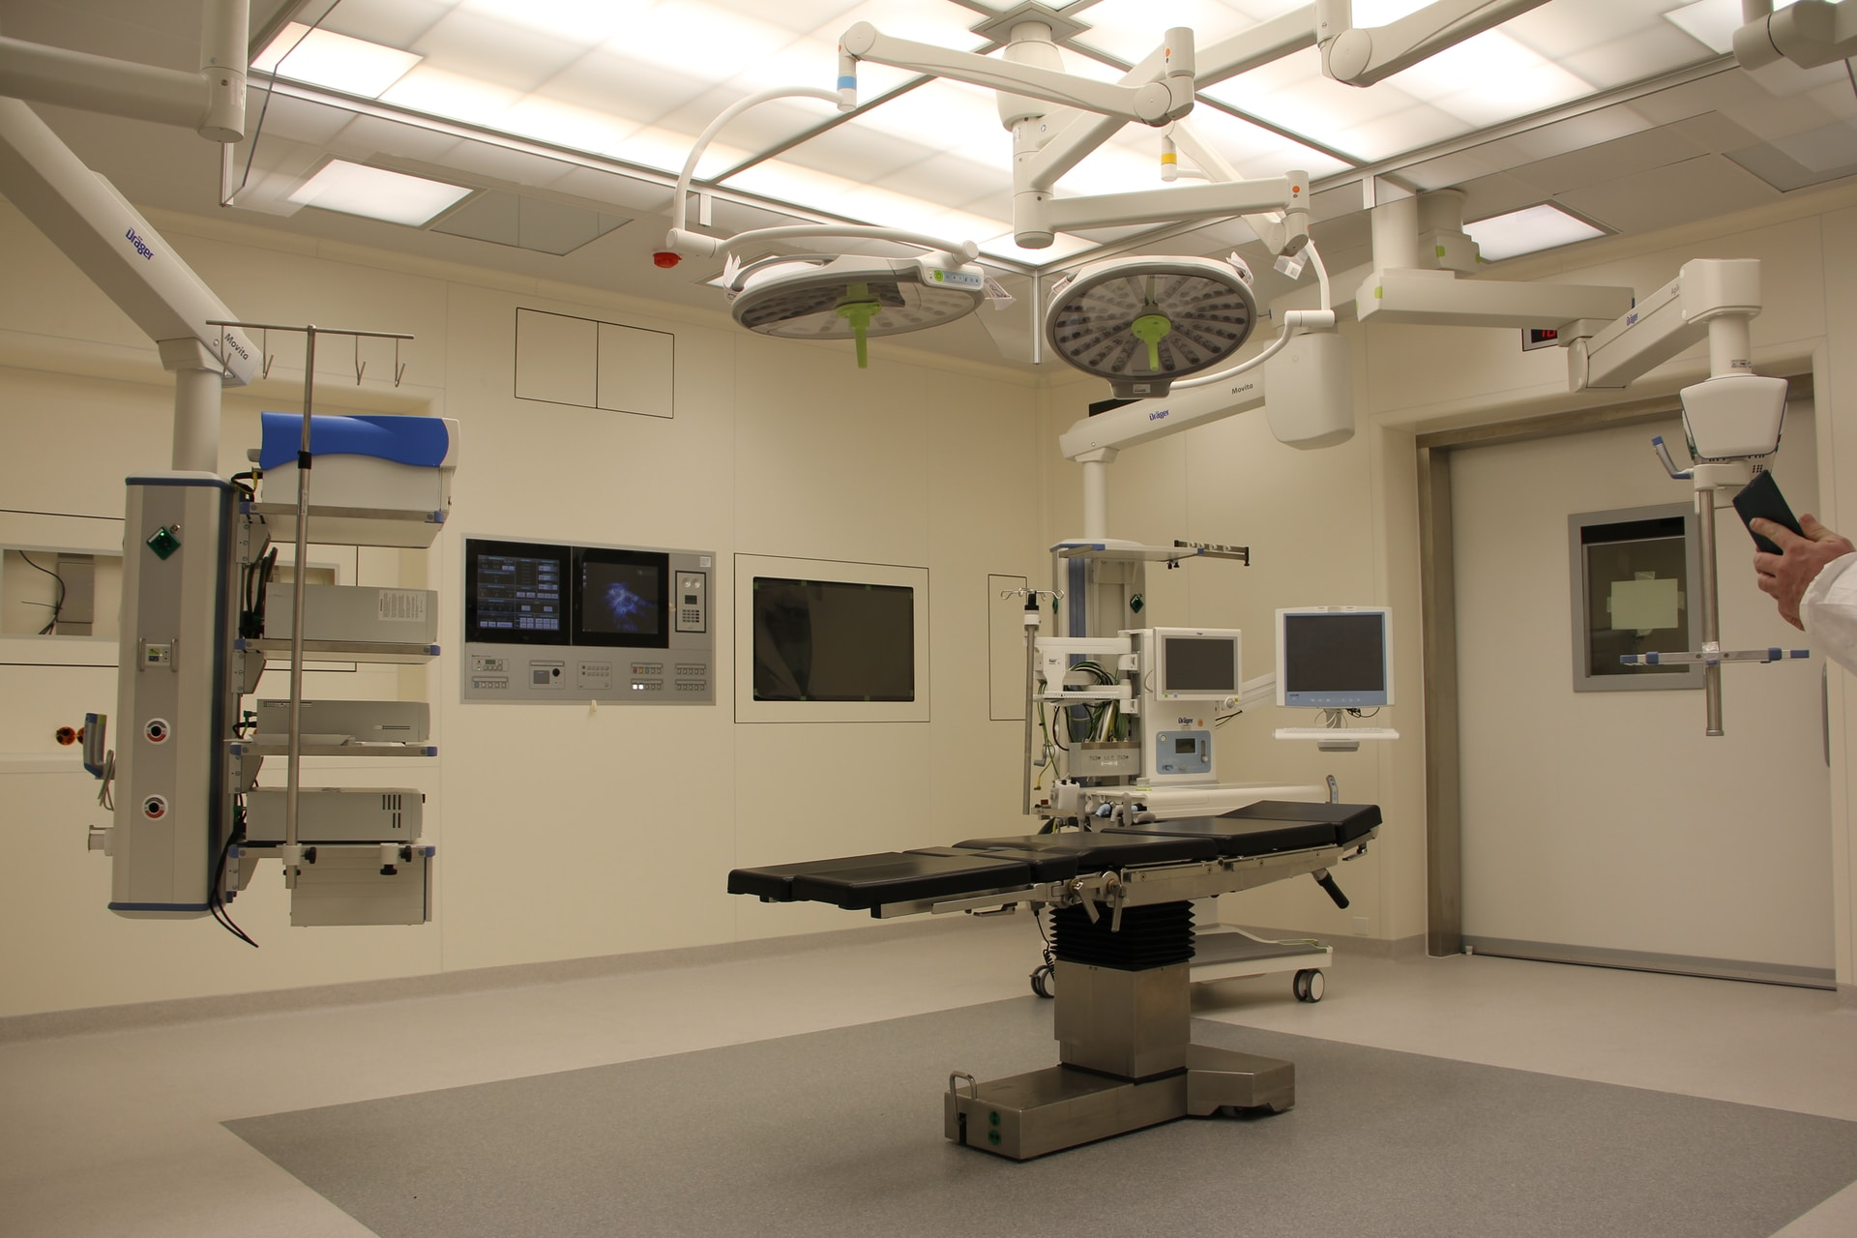
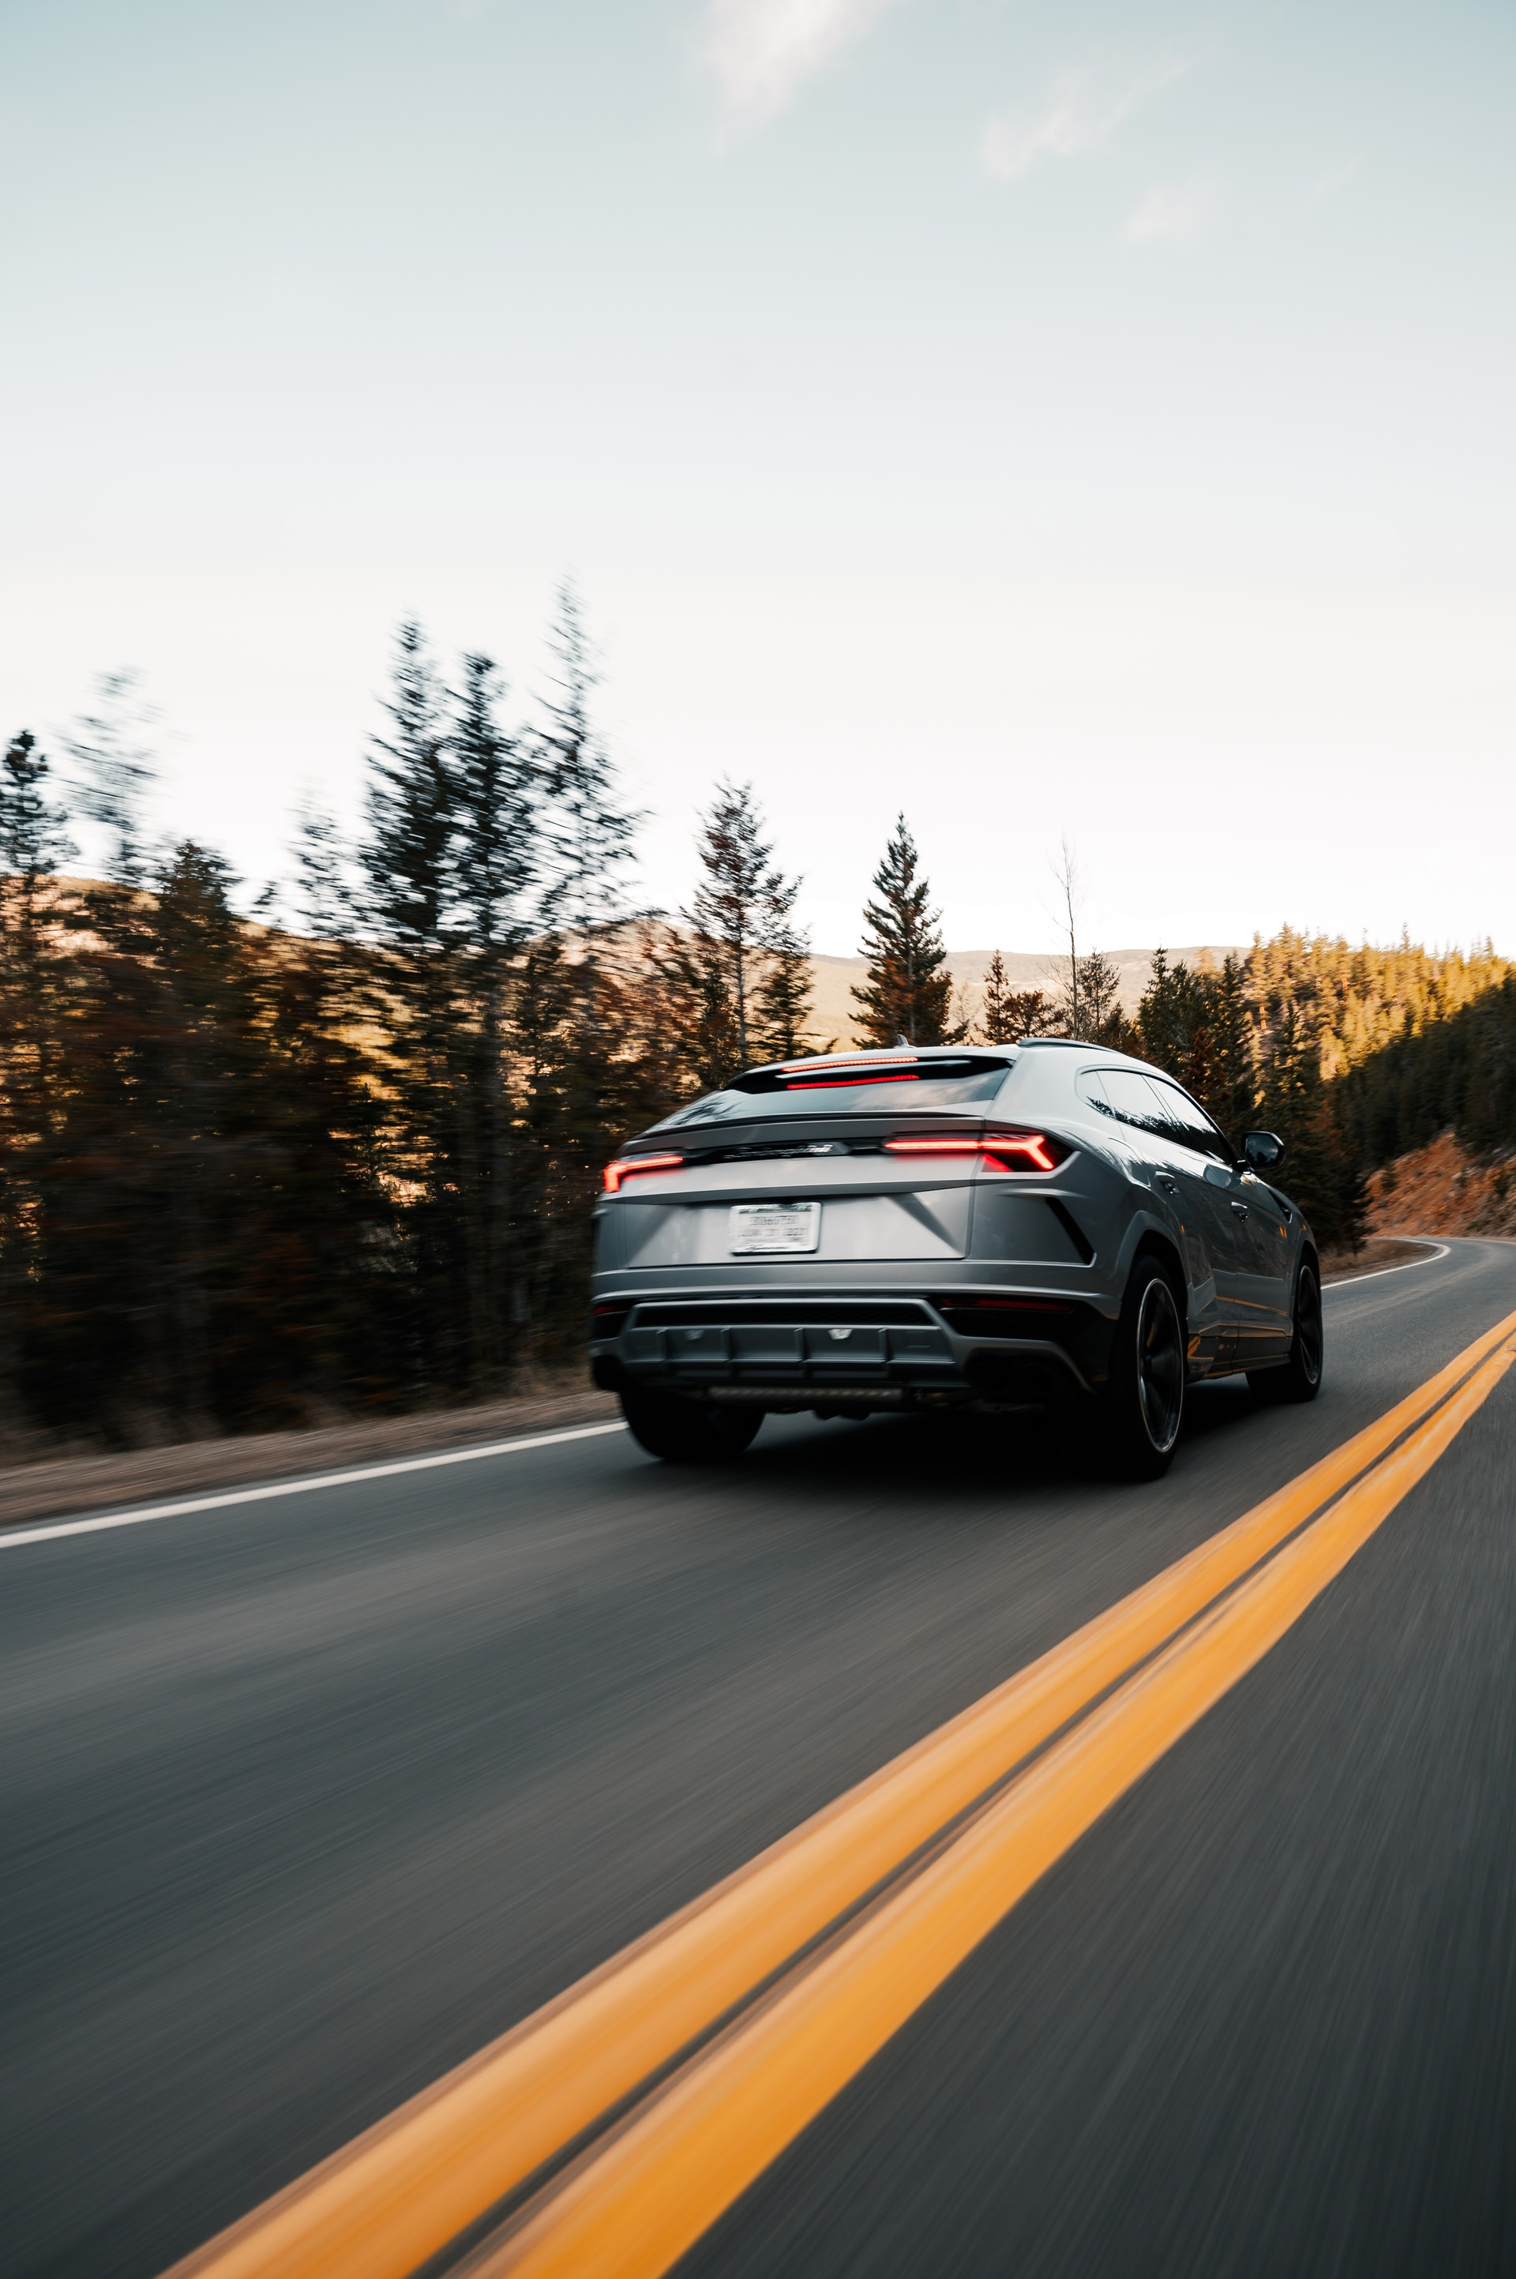

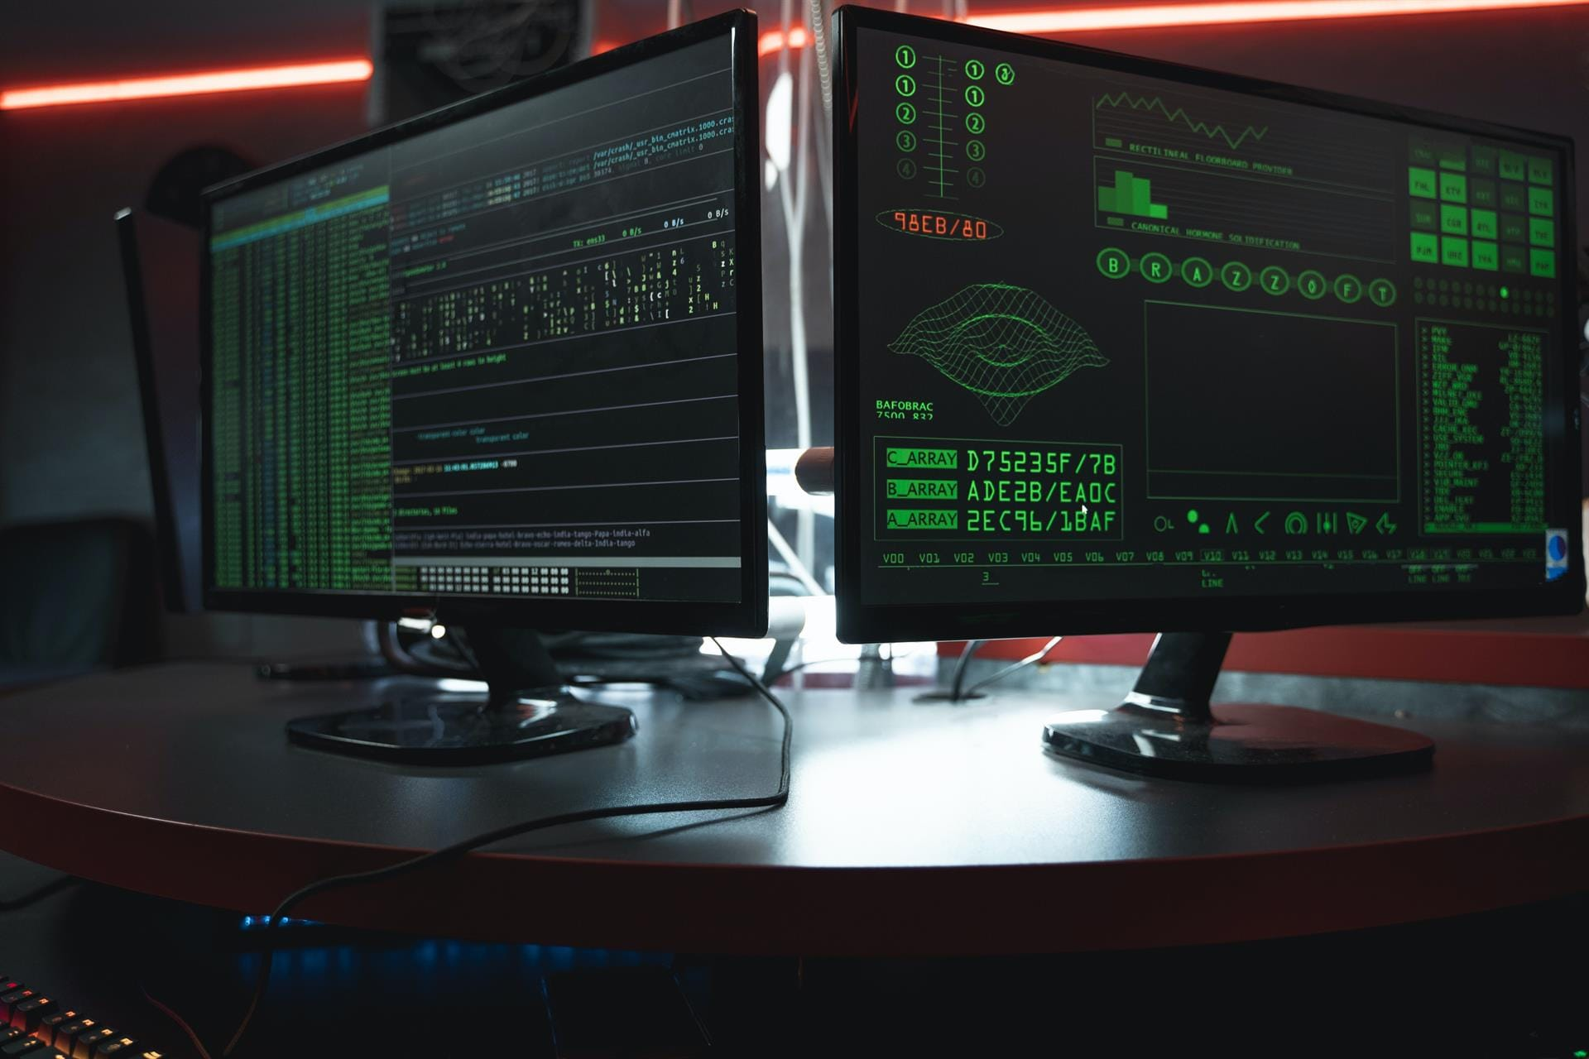
  1.1 Background and significance of the study - Background of the study
Adversarial example ：A kind of fake data that can deceive deep neural network models.
It poses a huge threat in a number of fields, including computer vision, autonomous driving, and natural language processing.
medical diagnosis
automatic driving
banking supervision
network security
Covert
Attack success rate
indicators
Simultaneously achieving high concealment and high attack success rates
…
…
?
Defense Success Rate
Notes:
In recent years, with the development of computer technology and network technology, artificial intelligence systems based on neural network models have experienced rapid growth. AI systems based on neural networks require a large amount of data to train the models, and the widespread use of the Internet has made data acquisition easier. Furthermore, advancements in hardware technology and improved high-performance computing frameworks have made deep neural network models with millions of parameters increasingly common. Deep neural networks have quickly become a focal point of attention due to their excellent performance. Compared to traditional machine learning methods based on manually designed features, deep neural network models demonstrate superior performance. In recent years, adversarial samples have become a hot topic of research. Researchers are exploring the security of neural networks from two different aspects. On one hand, they investigate how adversarial samples can better attack deep learning models in various scenarios. On the other hand, they design corresponding algorithms to detect and mitigate adversarial attacks. Researchers have shown great interest in the mechanisms of neural network models from both attack and defense perspectives. They aim to enhance the stealthiness and generalizability of adversarial samples at the attack level, and to make defense models more universal at the defense level. Research in these two aspects mutually reinforces each other, driving the study of robustness in neural network models. The goal is to improve the security of current neural network models, reduce the impact of adversarial samples on real-world applications and daily life. Additionally, this research contributes to researchers' understanding of the mechanisms of deep learning models, providing better explanations and improvements in the robustness of deep learning models. It further advances the field of artificial intelligence and holds significant importance for the development and application of deep learning technology in real-world scenarios. Research on adversarial samples has mainly focused on their concealment, attack success rate and defense success rate.

Slide 5
  1.1 Background and significance of the study - Research status
gradient method
FGSM,FGM,PGD, BIM,……
Adversarial
attack
heuristic approach
GAN、 non-P-paradigm constraints,……
Research status
Adversarial
defense
Detection Methods
CNN,Based on and density
,……
Methods of defense
input reconstruction, data compression,……
Notes:
In the direction of adversarial samples, it can be roughly divided into two aspects of research: adversarial attack and adversarial defense. Gradient-based attack methods are the more common attack methods. In addition to this, heuristic attack methods are included. Defense methods are mainly divided into two methods such as detection methods and defense methods. Above are some common algorithms.

Slide 6
1
2
Color space based algorithm for white box adversarial sample generation
Notes:
The next section describes Color space based algorithm for white box adversarial sample generation

Slide 7
  2 Color space based algorithm for white box adversarial sample generation
  - Research motivation
Intention
Global perturbation brings a large number of inefficient pixels, which can lead to large changes in the image structure and is more easily detected by the human eye's visual system
Traditional gradient methods
Problems solved
Reduce the distortion of perturbed images by selecting antagonistic samples that conform to the visual system of the human eye
Methods of use
Pixel value mapping function
Eigen ternary loss function
Notes:
In the previous sections of this paper, we introduced classical gradient-based attack methods that are simple and efficient and have obtained good attack rates. These methods, although effective, counter perturbations to the image superposition are only global perturbations to the output of the last layer of the neural network model. The global perturbation brings a large number of inefficient pixels, which in the case of a large perturbation step leads to a large change in the image structure and will be more easily detected by the human eye visual system. In the traditional method, the imperceptibility is limited by the Lp paradigm of the perturbation in the RGB space, and the generated antagonistic samples constrain the maximum value of the distance of the perturbation to a certain range, after such a limitation, the amplitude of the perturbation will be limited, and the strength of the attack is very dependent on the amplitude of the perturbation, and the limitation of the amplitude of the perturbation makes the performance of the attack greatly reduced.
Our choice of color space is motivated by the fact that global perturbation by traditional methods brings a large number of inefficient pixels, which can lead to large changes in the image structure. To address these issues, we attack the samples with a non-paradigm attack method that is more compatible with human eye vision to further enhance the amount of perturbation against the attack. High concealment and high attack success rate are realized at the same time.

Slide 8
  2 Color space based algorithm for white box adversarial sample generation
  - Algorithmic structure
Block diagram of the overall structure of the algorithm
substructure function
Color domain mapping: a fixed-pixel adjustment function that obtains a two-by-two mapping relationship between pixel values, sufficient to modify the pixel values of the sample substantially.
Feature similarity editing: finding semantically aware adversarial samples from the feature space.
Notes:
In the color mapping stage, the pixel adjustment function is selected to change the pixel values; in the feature similarity editing stage, the features in the feature space layer are separated; in the composite adversarial attack stage, it is proposed to add two different adversarial perturbations to generate an adversarial perturbation that combines the advantages of both adversarial samples and outputs them for the adversarial attack.The counter-attack algorithm in the white-box counter-attack scenario aims to improve the stealth of the algorithm and still maintain a better attack effect, this paper proposes to introduce two modules such as pixel-domain mapping, feature similarity editing, and so on, which will combine the localized perturbation counter-attack and pixel-transformation unrestricted attack to improve the effectiveness of counter-attacking the samples, and in the following this paper, we will respectively introduce each of the two sub-modules of the individual functions:"Color Domain Mapping Module": In classification recognition tasks, whether for human eye vision system or artificial intelligence recognition system, features such as contour and shape play a crucial role, while color is only an auxiliary feature. From the perspective of visual recognition preference, the human eye is insensitive to the change of color compared with the change of image structure, and the change of pixel value relationship can also achieve a good observation effect. Therefore, this paper proposes the "Color Domain Mapping Module", which is able to obtain rich transformed samples that meet the vision of the human eye by setting the pixel adjustment function and obtaining the two-by-two mapping relationship between the pixel values, and by drastically modifying the pixel values of the samples. "Feature Similarity Editing Module": In order to meet the requirements of the "Pixel Domain Mapping Module", we propose the "Feature Similarity Editing Module", which is designed to meet the requirements of the human eye while significantly modifying the pixels. Therefore, this paper proposes the "feature similarity editing module", which extracts the sample image into the feature space. By making full use of the feature representation of the least similar samples in the feature space, narrowing the feature gap between the antagonistic samples and the least similar samples, and enlarging the feature gap between the antagonistic samples and the normal samples, the normal samples and the antagonistic samples can be distinguished more clearly in the feature space, so that the semantically-aware antagonistic samples can be searched for directly from the feature space in this way.

Slide 9
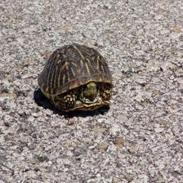
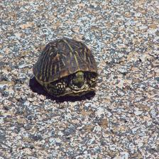
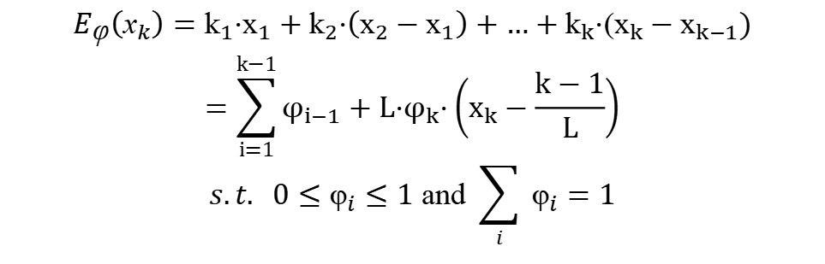





  2.2 Color space based algorithm for white box adversarial sample generation
  - Algorithmic workflows
Color Field Mapping Algorithm
$$\begin{matrix}E_{\text{φ}}\left({\text{x}}_{k}\right)={\text{k}}_{1}·{\text{x}}_{1}+{\text{k}}_{2}·\left({\text{x}}_{2}−{\text{x}}_{1}\right)+…+{\text{k}}_{k}·{\text{(}\text{x}}_{k}−{\text{x}}_{k−1}) \\ \begin{matrix}=\sum_{i=1}^{k−1}{φ_{i−1}}+L·φ_{k}·\left(x_{k}−\frac{k−1}{L}\right) \\ s.t. 0≤{\text{φ}}_{i}≤1 \text{and} \sum_{i}{ }{\text{φ}}_{i}=1\end{matrix}\end{matrix}$$
Using a mapping algorithm, a hermitian space model has been developed that enables the transformation of pixels in the image color space, and the relevant expressions are as follows:
Pixel domain mapping function
Principle of Pixel Domain Mapping
$$E_{\text{φ}}(x)$$
1
$${\text{φ}}_{4}$$
$${\text{φ}}_{3}$$
$${\text{φ}}_{2}$$
像素域映射
$${\text{φ}}_{1}$$
0
1/4
2/4
3/4
1
x
Notes:
In order to fully modify the pixel value of the sample, the pixel value of the sample is fully modified substantially by setting the pixel adjustment function and obtaining the two-by-two mapping relationship between the pixel values, and the related expression is as follows. Where, ${\text{x}}_{1}$ to ${\text{x}}_{n}$ are the values of each pixel point, in order.
, $φ_{1}$ to $φ_{n}$ denote the pixel values after pixel adjustment in turn. More intuitively, the algorithm utilizes a pixel tuning function, which is a two-dimensional linear segmented function with different hyperparameters controlling the slope of each segmented value, and the value of each pixel point is mapped by the function to other different pixel values. Since the 8bit normal image pixel values ranging from 0-255 are mapped to 0-1 in the neural network model computation, the pixel adjustment function divides the 0-1 values into L intervals of equal length, each of which has a slope determined by the hyperparameter ${\text{φ}}_{i}$ . Because the range of intervals of pixels before and after the function mapping does not change, the sum of L hyperparameters ${\text{φ}}_{i}$ is 1. The more the number of segments is, the finer the mapping of the color model is, and it is easier to fit the original image smoothly. It can be seen that in different segments controlled by different hyperparameters, the pixels change in the color space.In order to apply the color domain mapping algorithm in this paper to counter attacks, the functions and steps of the color mapping algorithm are further explained. The algorithm is a mapping algorithm that enables the transformation of pixels in the color space of an image, and establishes a model of the hidden space so that the adversarial samples can be found in this hidden space. Meanwhile, its constituent functions are a series of microscopic hyperparameters, which can be used in conjunction with gradient descent to update the values of the hyperparameters, and then invert the final hyperparameters to find out the final antagonistic samples obtained.

Slide 10
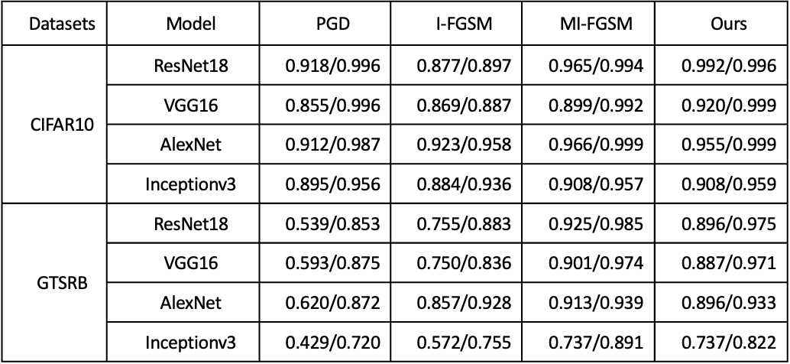
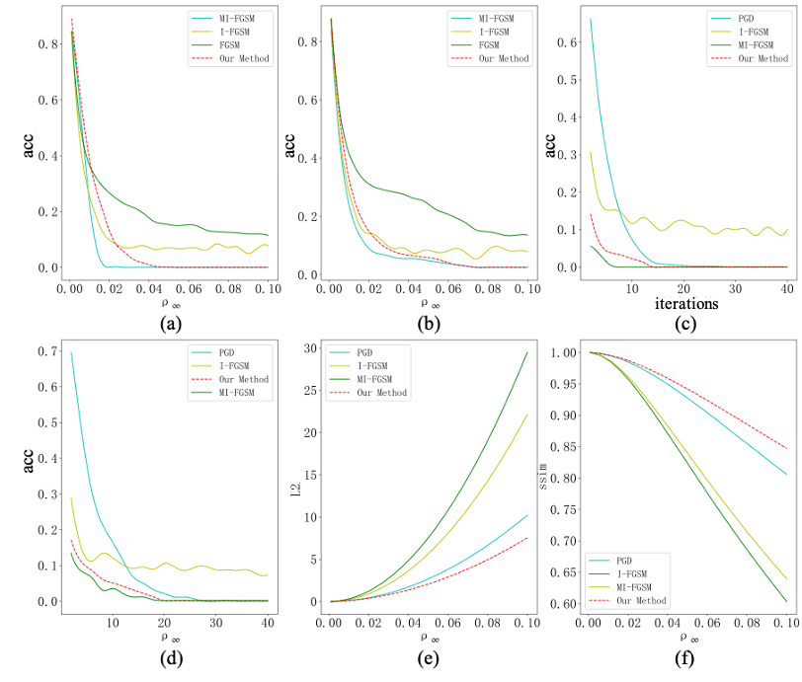
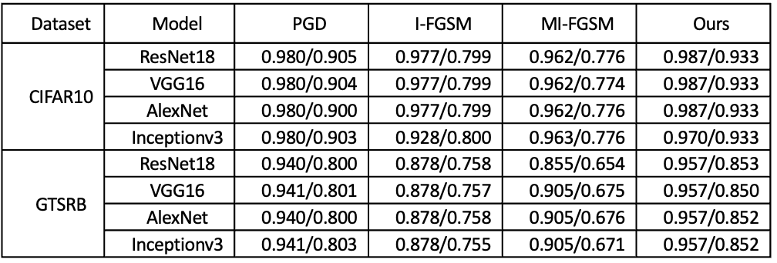
  2.2 Color space based algorithm for white box adversarial sample generation
  - Experimental results and analysis
Experimental results of attack success rate
CIFAR10 experimental results graph
Experimental results on image structure similarity
Notes:
it can be seen that for different datasets and models, the methods proposed in this paper can all achieve better attack results. Under the same perturbation intensity, the achieved attack performance is better than that of PGD and I-FGSM which are also based on gradient optimization. The method in this paper is improved from MI-FGSM, and due to the sacrifice of the perturbation range, it will lead to a less successful attack rate than that of MI-FGSM on some models. The attack performance of the various attack algorithms on the CIFAR10 dataset is significantly better than that on the GTSRB dataset, and the reason is that although the GTSRB dataset is not the most popular dataset, it is not the most popular dataset in the world. It is because the GTSRB dataset is a color image but has simpler data categories, and the neural network models are sufficient to fit distinct decision boundaries by learning the low-frequency structural information, resulting in a less effective attack than the CIFAR10 dataset.

Slide 11
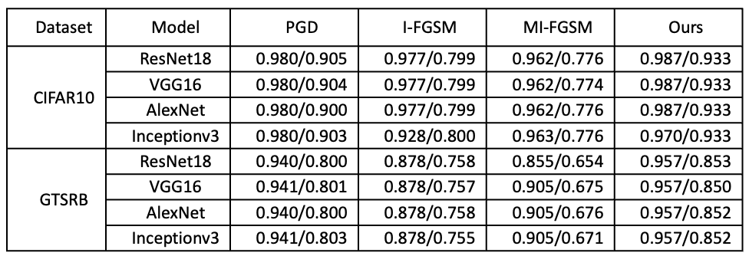
  2.2 Color space based algorithm for white box adversarial sample generation
  - Experimental results and analysis
L2 distance experiment results
GTSRB experimental results graph
Conclusion: The algorithm is able to outperform most algorithms in terms of attack success rate when the number of iterations and the paradigm distance are large enough, and generates clearer adversarial images.
Notes:
Next comes the experimental part, where we conduct multiple sets of attack experiments on two datasets and four models and record the results. The algorithm is able to outperform most algorithms in terms of attack success rate when the number of iterations and the paradigm distance are large enough, and generates clearer adversarial images.

Slide 12
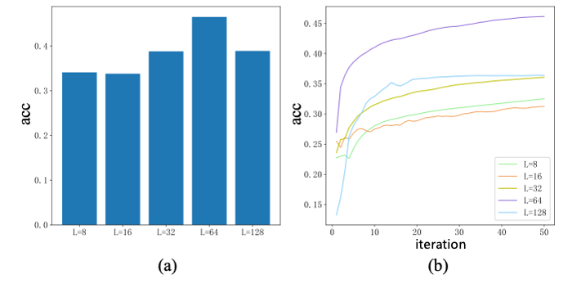
  2.2 Color space based algorithm for white box adversarial sample generation
  - Experimental results and analysis
Attack effect of different segments of the pixel adjustment function, number of iterations vs. segments ：
Conclusion: In the color domain mapping algorithm, the attack success rate is highest when the segmentation L=64.
Notes:
In the figure, it can be seen that in the case of the same number of iterations, the attack success rate is highest when the segmentation L=64, and can be higher than the other segmentation results in 10% attack success rate. Moreover, when the segmentation is fixed, with the increase of iteration number, the attack success rate under each segmentation increases sequentially and tends to stabilize, in which the attack success rate is the highest when the segmentation L=64.

Slide 13
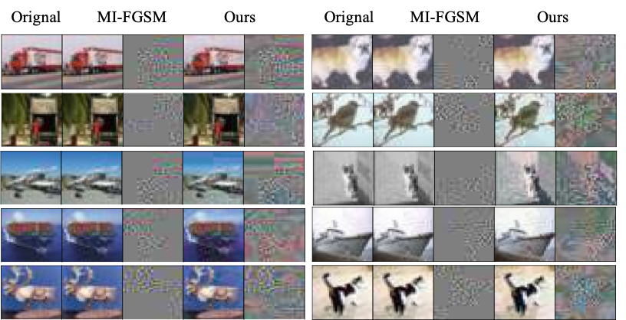
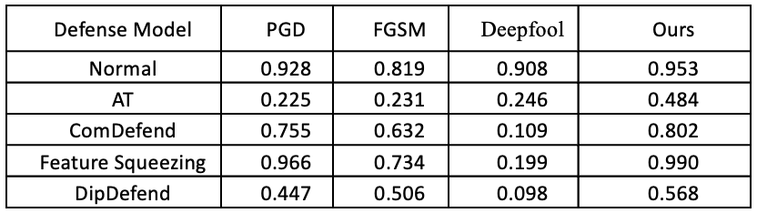
  2.2 Color space based algorithm for white box adversarial sample generation
  - Experimental results and analysis
Spoiler effect diagram
Attack performance of different algorithms on defense systems
Conclusion: The best attack results were obtained on the defense model.
Notes:
The following shows shows the results of the attack accuracy comparison of the related algorithms on the CIFAR10 dataset against each defense model. As can be seen from the table, on the non-defense model, the classification accuracies between the algorithms are similar. However, on the defense model, AT is trained by the PGD algorithm, which robustly fits the adversarial distribution space generated by the gradient attack algorithm, and has similar defense effects against several attack algorithm models. For the two compression defense strategies ComDefend, Feature Squeezing lose more image information during image compression, so they also do not produce a better defense effect.DipDefend can produce the best defense effect. Compared with PGD and FGSM algorithms, this paper's algorithm has close attack strength on the original model, which is ten percentage points higher than other attack methods, and obtains the best attack effect on the defense model.On the right are some samples of the adversarial samples, on the left are the perturbations generated by the MIFGSM algorithm and on the right are the perturbations generated by our algorithm.

Slide 14
1
3
Adversarial Sample Defense Algorithm Based on Feature Denoising
Notes:
The next section describes Adversarial Sample Defense Algorithm Based on Feature Denoising

Slide 15
  3 Adversarial Sample Defense Algorithm Based on Feature Denoising
  - Research motivation
Intention
Existing defense algorithms use the difference in pixel values between the denoised image and the original image as a loss function, and after noise reduction in this way there are tiny residual noises in the image, which are progressively amplified in each layer of computation of the classification network.
Problems solved
Removing depth noise by more efficient means
denoise
Methods of use
Mask=1
Perturbed dissolved layer
Advanced Perceptual Feature Extraction Network
Mask=0
Traditional denoising methods
Notes:
Our choice of Adversarial Sample Defense Algorithm Based on Feature Denoising was motivated by Existing defense algorithms use the difference in pixel values between the denoised image and the original image as a loss function, and after noise reduction in this way there are tiny residual noises in the image, which are progressively amplified in each layer of computation of the classification network. To address these issues, we propose a more reasonable feature denoising approach to remove the deep noise.

Slide 16
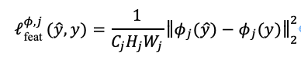
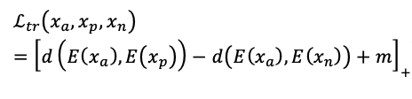

  3 Adversarial Sample Defense Algorithm Based on Feature Denoising
  - Algorithmic structure
the overall structure of the algorithm
The total loss function of the generative network is as follows:
Notes:
The specific design of the algorithm is introduced next
The transformation function in this paper is divided into three parts: noise dissolution network, image reconstruction network, and advanced perceptual feature network, as shown in the following figure.
Adversarial samples are obtained through multiple iterations of pixel-level tiny perturbations rather than based on semantic changes, which have a strong vulnerability while guaranteeing concealment, and the noise dissolution network is a random mask network, and the random mask network is able to destroy the adversarial perturbations well, and lays the foundation for the reconstruction task afterward by destroying the adversarial perturbations. The image reconstruction network is based on Conditional Generative Adversarial Neural Network (CGAN), for the mask reconstruction problem, because the mask map is also a kind of conditional input, this paper improves the traditional CGAN, so that it can take the mask map as the input, and output the complete reconstruction map. It transforms the input adversarial sample 𝑥^′ into the reconstruction image 𝑥^′ through a feature mapping layer. In order for the reconstruction network to perform better on the adversarial sample defense task and avoid the error amplification effect, we incorporate a perceptual loss to measure the high-level feature differences between the reconstructed image and the original image. And we used a pre-trained image classification network Ф to and we used a pre-trained image classification network.
The total loss function of the generative network is as follows:
The loss function provides us with the critical part in image reconstruction mission. The pixel-level mean squared error (MSE) is one of the most widely used loss functions, but with the deepening of the network, some of the noise that has not been removed will have a large difference in the features of the middle layer due to the error amplification effect. The lack of semantic information cannot guarantee the quality of image restoration. We hope that the denoised image is similar to the original image in terms of visual effect, so we choose to use both $L_{1}$ and $L_{feat}$ to measure gap between features. To further constrain adversarial examples in the latent space, we use triplet loss to provide more effective and stronger constraints in adversarial training.

Slide 17
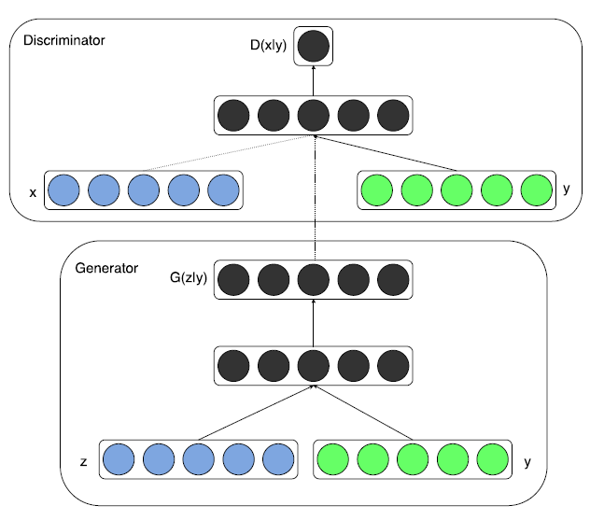

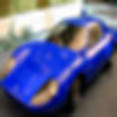
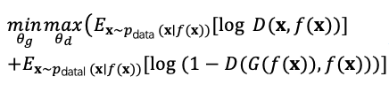
  3 Adversarial Sample Defense Algorithm Based on Feature Denoising
  - Algorithmic workflows
Generator design based on cgan
the objective function of CRGAN is as follows:
Notes:
The GAN network used in this paper is an improvement on the traditional CGAN, which uses labels as conditional inputs and the inputs are vectors and labels
Similarly mask map is a conditional input. We improve the network to be able to take mask map and original map as inputs, The main structure of CRGAN includes generator and discriminator. The data sent to the generator is the image denoised by the random mask network. The purpose of the G is to learn the relationships between real data and mask data and to further remove noise to generate as accurate as possible normal data. D attempts to determine whether the conditional fake image G(f(x)) reconstituted into normal samples. G(f(x)) can be correctly identified by the trained model. We define the objective function of CRGAN as。。

Slide 18
  3 Adversarial Sample Defense Algorithm Based on Feature Denoising
  - Experimental results and analysis
Experimental results on cifar10
Defense Model | Clean | FGSM | PGD | Deepfool | C&W
Normal | 0.93 | 0.18/0.13 | 0.00/0.00 | 0.09/0/09 | 0.00/0.00
AT | 0.76 | 0.26/0.16 | 0.03/0.03 | 0.80/0.79 | 0.77/0.68
ComDefend | 0.88 | 0.59/0/48 | 0.80/0.79 | 0.80/0.80 | 0.61/0.37
Feature Squeezing | 0.83 | 0.26/0.16 | 0.03/0.01 | 0.80/0.79 | 0.45/0.33
Ours | 0.93 | 0.88/0.70 | 0.93/0.91 | 0.93/0.93 | 0.93/0.93
Experimental results on GTSRB
Defense Model | Clean | FGSM | PGD | Deepfool | C&W
Normal | 0.98 | 0.28/0.10 | 0.69/0.36 | 0.11/0.00 | 0.98/0.94
AT | 0.95 | 0.88/0.71 | 0.90/0.89 | 0.95/0.93 | 0.95/0.95
ComDefend | 0.95 | 0.88/0.86 | 0.89/0.88 | 0.95/0.95 | 0.96/0.96
Feature Squeezing | 0.51 | 0.42/0.32 | 0.50/0.44 | 0.47/0.39 | 0.51/0.51
Ours | 0.98 | 0.91/0.69 | 0.97.0.96 | 0.98/0.98 | 0.98/0.98
Conclusion: Our proposed algorithm has better defense.
Notes:
Next comes the experimental part, where we conduct multiple sets of attack experiments on two datasets and multiple algorithms, shows the results of our experiments. Comparing with other deep learning based models, we can find that the proposed method has an excellent performance. The CRGAN can achieve nearly 80% accuracy under various attack types and strengths. In addition, the performance of is CRGAN is better than other preprocessor based defense methods such as Feature Squeezing , ComDefend. By contrast, our model can better reconstruct the important features of the image and has better robustness. The experiment shows that when the clean sample is passed through the reconstruct model CRGAN, the classification accuracy did not decrease too much, cifar-10 remained at 89.9%, and GTSRB remained at 98.0%.

Slide 19
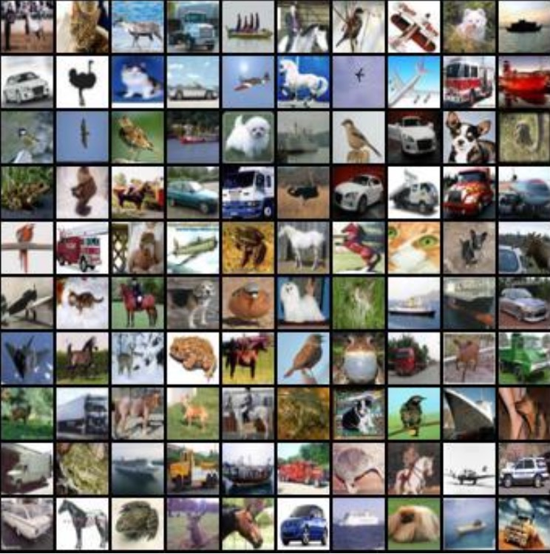
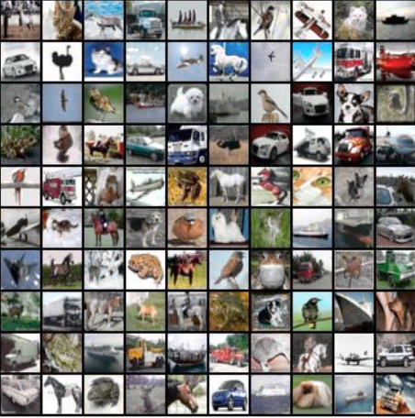
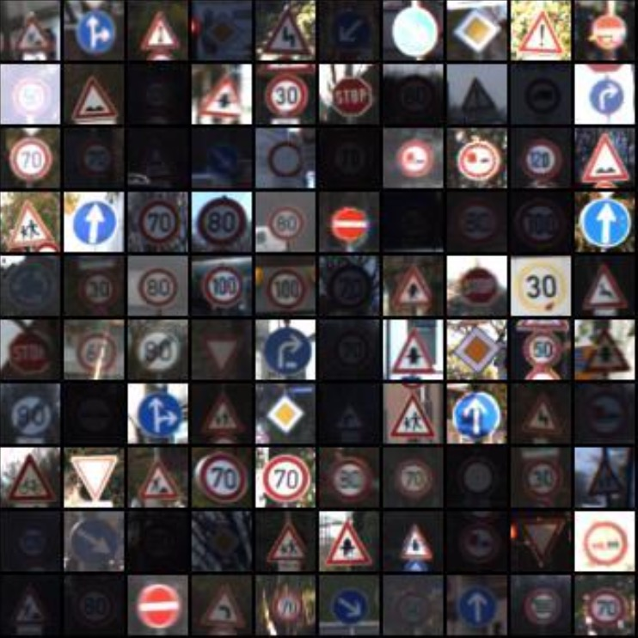
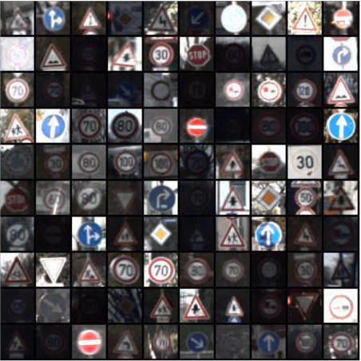
  3 Adversarial Sample Defense Algorithm Based on Feature Denoising
  - Experimental results and analysis
Image after defense algorithm
Orignal
Ours
Orignal
Ours
Notes:
Finally, the experimental results are shown, where the left side is the original image and the right side is the image after reconstruction, and the reconstructed image is not much different from the original image. It shows the experimental effect graphs after the defense algorithm, it can be seen that after our defense algorithm the original image will have part of the saturation degradation, and the denoising algorithm removes part of the original information.

Slide 20
1
4
Summary and outlook
Notes:
Finally, there is a summary and outlook section.

Slide 21
  4 Summary and outlook
1、Color space based algorithm for white box adversarial sample generation is proposed, and its effectiveness and feasibility are verified by experiments.
Summary
2、Adversarial Sample Defense Algorithm Based on Feature Denoising is proposed and its effectiveness and feasibility are verified through experiments.
请在这里添加相应的文字内容，请在这里添加相应的文字内容。
1、Other denoising techniques that do not require large-scale training and at the same time map the image to the appropriate hidden space will be explored in the future.
outlook
2、A more practical approach to black-box counterattacks, going for a cross-domain approach to approximate the problem of attacks in real-world scenarios.
请在这里添加相应的文字内容，请在这里添加相应的文字内容。
Notes:
The algorithms proposed in this paper aim to address the problem of defending against adversarial sample attacks in two different scenarios based on deep learning security. However, there are still many research directions in the field of neural network security that are worth exploring in depth. From the experimental results, certain results have been achieved, but future research can be continued in the following areas:
1) In this paper, an encoder is trained to map the original sample space to the hidden space of the image, which is combined with a GAN to continuously update the network during the training process, which takes a long time and is complicated to train , so other compression techniques that do not require large-scale training while being able to map the image to the corresponding hidden space will be explored in the future.
2) More practical black-box counter attack methods. In practical application scenarios, AI service providers do not disclose the parameters and datasets for model training, it is difficult to obtain pre-trained models and the same datasets with similar structural variability as the target model, how to obtain an effective alternative model through pre-training is an important test, to address these issues, we can start from the high-dimensional spatial boundaries of the data and the intrinsic mechanism of the model, and seek to approximate the practical cross-domain methods for attack problems in scenarios.

Slide 22

Thanks
Notes:
The above is my full report, I am sorry for the correction of teachers

