Slide 1

Internal Displacement

Slide 2
Internally Displaced Person (IDP) or Refugee?
United Nations guiding principles and legal frameworks
Guiding Principles on Internal Displacement 1997: ‘For the purposes of these Principles, internally displaces persons or groups of person who have been forced or obliged to flee or to leave their homes or place of habitual residence, in particular as a result of or in order to avoid the effects of armed conflict, situations of generalized violence, violations of human rights or natural or human-made disasters and who have not crossed an internationally recognized State border.’ (OCHA, 1997, p.3). Guiding Principles on Internal Displacement | OCHA
Refugee Convention 1951: ‘owing to well-founded fear of being persecuted for reasons of race, religion, nationality, membership of a particular social group or political opinion, is outside the country of his nationality and is unable or, owing to such fear, is unwilling to avail himself of the protection of that country; or who, not having a nationality and being outside the country of his former habitual residence as a result of such events, is unable or, owing to such fear, is unwilling to return to it’ (UNHCR, 1951, p.14). The 1951 Refugee Convention | UNHCR UK
Extra reading: Cheung (2020) Samuel-Cheung_Internal-Displacement-UNHCR-and-the-International-Community.pdf
Internally Displaced Person (IDP) | Refugee
Forced to flee their place of habitual residence | Forced to flee their place of habitual residence
X Have not crossed an internationally recognised State border | X Have crossed an internationally recognised state border
Notes:
This slide provides the UN definitions internally displaced persons and refugees, taken from legal frameworks. Links to the Guiding Principles on Internal Displacement 1997 and the Refugee Convention 1951 have been provided for students to use as references in their assignment. The differences between the definitions are highlighted in green and the similarities are highlighted in yellow to emphasise the connection between IDPs and refugees whilst pointing out the fundamental differences between the two. It should also be noted that the Guiding Principles are not binding, therefore, it is not a requirement for countries to follow their guidance.
Extra content: the term ‘internal displacement’ was first used when negotiating the Refugee Convention 1951 (Cheung, 2020). However, IDPs were recognised as a separate problem, separate to refugees so were excluded from the convention (Cheung, 2020). This was because the Refugee Convention was primarily concerned with individuals who crossed borders to escape life threatening circumstances during the Second World War (UNHCR, 1951). Therefore, it was the international aspect of refugee protection which was focused on. As a result, it wasn’t until the 1990s (OCHA, 1997) that the international community began to recognise that equally vulnerable IDPs were experiencing similar human-rights violations to refugees and required protection and assistance.
Discussion point for the class: The refugee convention was written to deal with the refugee crisis Europe post world war 2 with the intention of being updated in the future to meet new demands as global politics evolved. 80 years later, it is still relied on to determine refugee status. However, in the modern world, should there be changes within the convention to better encompass the demands of our new world? Should the convention be expanded to require internal and international protection of IDPs as well as refugees? Should internally displaced people also be classified as refugees? Students should consider political, social and logistical barriers to the expansion of the Refugee Convention in expanding its protections to more people.

Slide 3
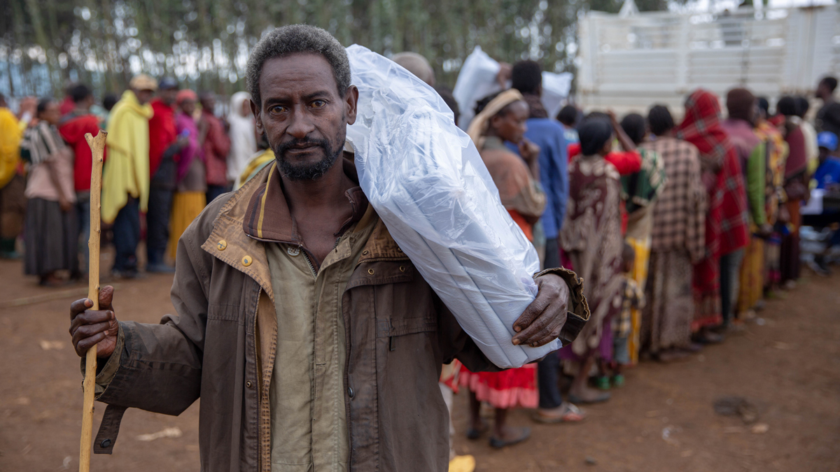
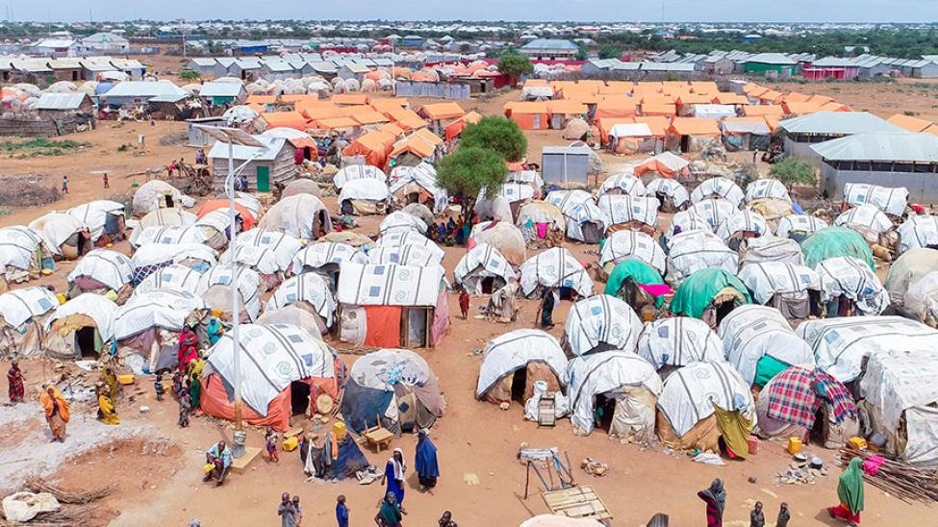
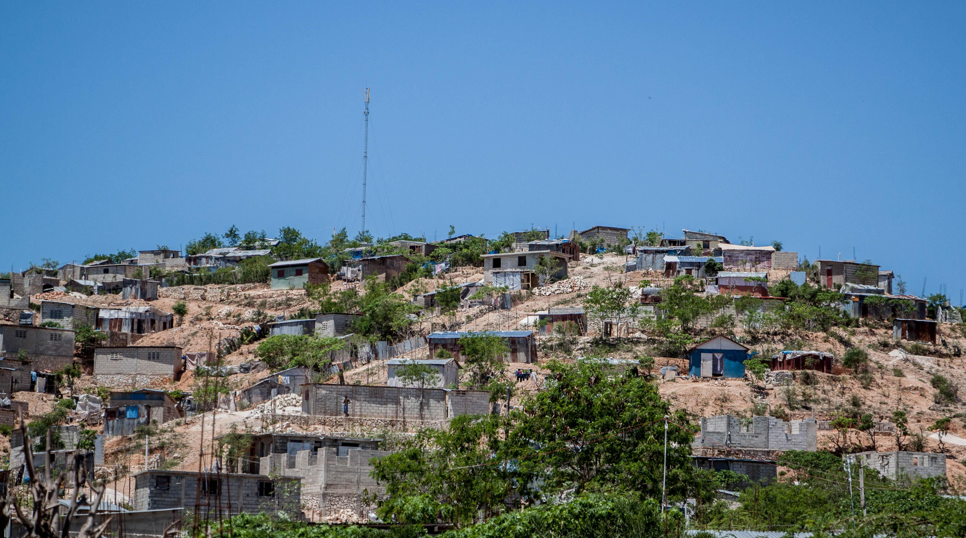
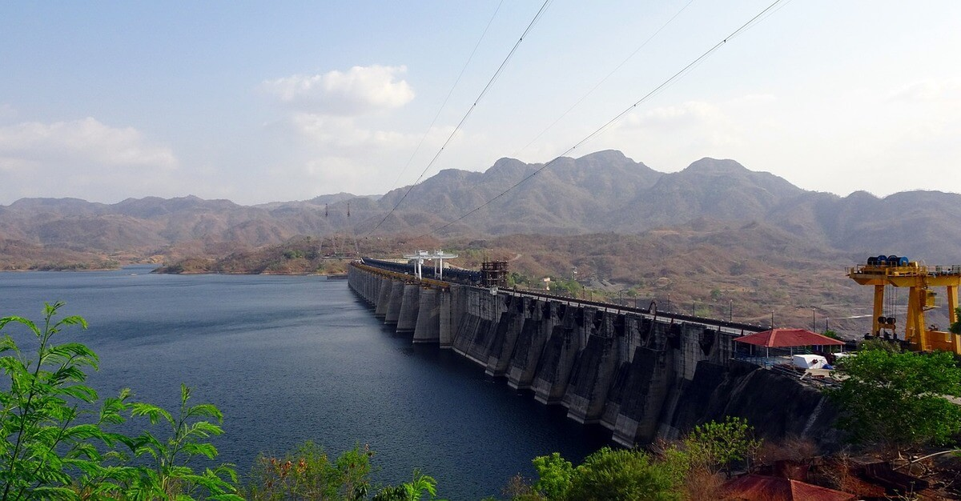
Conflict-Induced: Ethiopia
Environmental-induced: Somalia
Causes of internal displacement
Disaster-induced: Haiti
Development- induced: India
Notes:
The purpose of this slide is to show students that there are many causes on internal displacement by focusing on four major causes of internal displacement: conflict, environment, disaster and development. To each of these causes I have attached to a case study to broaden students' perspective on internal displacement.
Ethiopia
Internal communal violence and conflict led by youth groups who attack villages, kill innocent people and burn down houses within Ethiopia has led to rising internal displacement in Ethiopia (Tesfaw, 2022). Although some perpetrators of the violence were arrested, the conflict reemerged in June 2018. Since 2018, over 1 million Ethiopians have become displaced in zones West-Guji and Gedeo zones and over 2.9 million across the whole of Ethiopia due to internal conflict (Tesfaw, 2022).
Somalia
Extreme weather events in Somalia such as droughts and floods between 2016-2019 led to increase internal displacement within the country (Momeni et al, 2022). As a result, 2.6 million Somalians were internally displaced in 2019 (News-Global, 2019). However, environment-induced displacement within Ethiopia did not stop in 2019. Droughts and floods continued to plague the country in 2023 where over 1 million Somalians, mainly from the Hiraan and Gedo regions became internally displaced (UNHCR, 2023). This but pressure on already overcrowded urban areas and made Somalian IDPs vulnerable to gender-based violence and family separation (UNHCR, 2023).
Haiti
Haiti suffered disaster-induced internal displacement due to the 2010 earthquake which hit the island (Benet, 2020). As a result, around 1.5 million Haitians became internally displaced (Benet, 2020) because homes, infrastructure and public services were destroyed. In 2020, over 30,000 Haitians remained internally displaced, 10 years after the initial disaster due to poor governance, lack of international aid and the deteriorating economic situation within Haiti (Benet, 2020). The prolonged displacement on Haitians is known as protracted displacement, where individuals or communities remain displaced for extended periods of time.
India
The Narmada River Valley Project in 1946 aimed to build dams to produce power that would benefit drought prone areas such as Gujarat (Maitra, 2009). This led to the displacement of thousands, mainly indigenous groups. However, the project went ahead because the long-term benefits outweighed the consequences associated with internal displacement (Maitra, 2009).

Slide 4
Internal and International Aid for Internally Displaced Persons
Internal Aid
Guiding Principles on Internal Displacement 1997: Principle 3 – ‘National authorities have the primary duty and responsibility to provide protection and humanitarian assistance to internally displaced persons within their jurisdiction’ (OCHA, 1997, p.3).
International Aid
Guiding Principles on Internal Displacement 1997: Principle 25 – ‘International humanitarian organisations and appropriate actors have the right to offer their services in support of the internally displaced. Such an offer shall not be regarded as an unfriendly act or an interference in a State’s internal affairs’ (OCHA, 1997, p.10).
State Sovereignty
Because IDPs have not cross a recognised international border, state sovereignty still applies to internal displacement (Cheung 2020).
Notes:
Internal Aid
Since IDPs have not crossed a recognised international border, they remain under the care of the state which they are displaced within. Therefore, it is the government where internal displacement occurs who have the primary responsibility for IDPs (OCHA, 1997, p.3). In some ways this is good for IDPs because they are entitled to the same rights and protections as everyone else in the country. However, in some cases it is the government who is supposed to protect IDPs is the same government who displaced them. For example, development-induced displacement in India for the Narmada River Valley Project in 1946 was permitted by the Indian government (Maitra, 2009). Therefore, if a government is willing to allow internal displacement to occur, are they likely to provide adequate support for IDPs to eliminate their vulnerability?
International Aid
To maintain state sovereignty, the Guiding Principles specify that international humanitarian organisations can only ‘offer’ their assistance to states containing IDPs (OCHA, 1997, p.3). This allows the state to maintain authority in self governance without external interference, balancing humanitarian assistance and sovereignty. State sovereignty applies to IDPs because they are members of the state in which they are displaced (Cheung, 2020). Therefore, humanitarian organisations are not entitled to provide their services to aid IDPs in the same way that they can for refugees.
Group discussion: students should form groups of 3-4 to discuss if international humanitarian aid should be able to bypass the principle of sovereignty to provide assistance to IDPs. 10-minute discussion in groups will be followed by feedback to the class.

Slide 5
Expansion of International Aid and Protection Available to IDPs
Kampala Convention 2009 - builds on the UN 1998 UN Guiding Principles on Internal Displacement but mandates protection for IDPs for all African countries that have ratified the convention (UNHCR, 2019).
Cartagena Declaration 1984 – does not expressly mention refugees but does acknowledge the broader concepts of displacement in the Americas. It emphasises the need for protection and humanitarian aid in situations of persecution, violence or disasters which are issues which also impact IDPs (Reed-Hurtado, 2013).
Guiding Principles on Internal Displacement 1997 – sets clear guidelines for the protection and assistance of IDPs to emphasise the responsibility of governments to deal with and prevent displacement (OCHA, 1997).

Slide 6
Reference list
Benet, J. (2020) Behind the numbers: the shadow of 2010’s earthquake still looms large in Haiti. Available at: Behind the numbers: the shadow of 2010’s earthquake still looms large in Haiti | IDMC - Internal Displacement Monitoring Centre (Accessed: 22 December 2024).
Cheung, S. (2020) Internal Displacement, UNHCR and the International Community. UNHCR. Available at: Samuel-Cheung_Internal-Displacement-UNHCR-and-the-International-Community.pdf (Accessed: 22 December 2024).
Maitra, S. (2009) ‘Development Induced Displacement: Issues of Compensation and Resettlement – Experiences from the Narmada Valley and Sardar Sarovar Project’, Japanese Journal of Political Science, 10(2), pp.191-211. Available at: Development Induced Displacement: Issues of Compensation and Resettlement – Experiences from the Narmada Valley and Sardar Sarovar Project | Japanese Journal of Political Science | Cambridge Core (Accessed: 22 December 2024).
Momeni, R., Bircan, T. and King, R. (2022) Environmental-Induced Displacement and Migration: Drivers, Impacts, and Policy Responses. Hummingbird. Available at HIVA Paper A4_Engels (Accessed: 22 December 2024).
News-Global (2019) Somalia’s 2.6m Internally Displaced Citizens in Need of Water, Shelter and Health. Available at: Somalia’s 2.6m Internally Displaced Citizens in Need of Water, Shelter and Health | International Organization for Migration (Accessed: 22 December 2024).

Slide 7
Reference list
OCHA (1997) Guiding Principles on Internal Displacement. Available at: Guiding Principles on Internal Displacement | OCHA (Accessed: 22 December 2024).
Reed-Hurtado, M. (2013) The Cartagena Declaration on Refugees and the Protection of People Fleeing Armed Conflict ans Other Situations of Violence in Latin America. Legal and Protection Policy Research Series. Available at: No. 32 Final word version of Reed-Hurtado (Accessed: 22 December 2024).
Tesfaw, T. A. (2022) ‘Internal Displacement in Ethiopia: A Scoping Review of its Causes, Trends and Consequences’, Journal of Internal Displacement, 12(1), pp. 2-31. Available at: 114-Article Text-399-1-10-20220125.pdf (Accessed: 22 December 2024).
UNHCR (2019) 2009 Kampala Convention on IDPs. Available at: UNHCR (Accessed: 22 December 2024).
UNHCR (1951) The 1951 Refugee Convention. Available at: The 1951 Refugee Convention | UNHCR UK (Accessed: 22 December 2024).
UNHCR (2023) Over 1 million people internally displaced in Somalia in record time. Available at: Over 1 million people internally displaced in Somalia in record time | UNHCR (Accessed: 22 December 2024).

Slide 8
Images
Ethiopia Placing IDPs on the Map in Ethiopia and Beyond | IOM Blog
Somalia Somalia’s 2.6m Internally Displaced Citizens in Need of Water, Shelter and Health | International Organization for Migration
Haiti Behind the numbers: the shadow of 2010’s earthquake still looms large in Haiti | IDMC - Internal Displacement Monitoring Centre
India The Narmada Dam Project - Was Medha Patkar Wrong? - either/view

