Slide 1

Sustainability in Hospitality and Tourism
Student name: Raluca Florina Istrate
Student number: 2120535
Lecturer name: Ernest Balutie Wavei

Slide 2

Introduction
Sustainability is directly associated with operational efficiency, customer loyalty and brand reputation
Environmental issues awareness are the most common trends in the Hospitality sector
This sector contributes to the carbon emission and need to focus on sustainability
Hospitality needs to focus on implementing innovative and practical sustainability initiatives

Slide 3
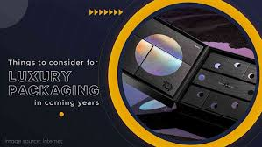
Literature Review: “Concentrating on eco-friendly luxury”
Tourism and hospitality sustainability describes the integration of sustainable principles into luxury services (Legrand et al., 2022)
Modern day luxury hotels and resorts are incorporating solar energy technologies (Baloch et al., 2023)
Some companies are now leading this new wave, proving that sustainability increases guest satisfaction.

Slide 4
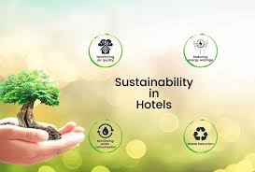
Literature Review: Environmentally conscious Products
the environmentally friendly products in tourism and hospitality has revealed the increased consciousness of adopting sustainable tourism
the importance of Certifications such as LEED and Green key in positioning businesses to adopt sustainability best practices (Amoako et al., 2024)
practice is beneficial as the efficient use of biodegradable materials, the reduction of plastic products, has become popular.

Slide 5

Literature Review: Current Research and Patterns
Research on climate-smart luxury travel is centered around a shift in consumer consumption in luxury travelling
Trends suggest an increase in demand for sustainability in the hotel industry is by achieving the use of renewable energy
the extent of how social media affects travellers to engage in environmentally sustainable travel experiences

Slide 6
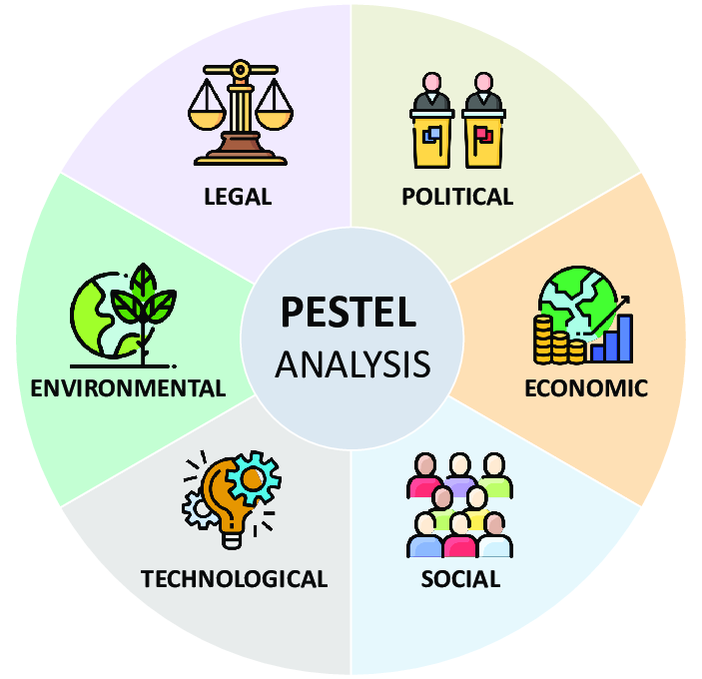
Application to the Hotel and Hospitality Sector
The UK Government has enacted and implemented various regulations that aim at promoting sustainability (George, 2021)
In the UK hotels investing in sustainability practices can potentially reduce their operational costs by 20-25%
Changing consumer trends have driven the UK hospitality industry toward more sustainable options

Slide 7
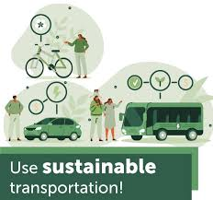
Evaluate Future Policy and Management Options
Concern for water and energy is crucial in the sustainable tourism and hospitality
Sustainable Transportation information is the combination of the use of low impact technologies to achieve a greener, cleaner and environmentally friendly form of transport (Almeida and Silva, 2020)
Certification and Standards is considered fit for the labour market with Certification and Standards identified

Slide 8

Conclusion
Sustainability is critical in shaping hospitality and tourism sector.
Integration of sustainable practices for long-term growth and competitive advantage
Sustainability can be implemented by employee training, technology integration, local collaboration and incentive policies.
Sustainability can be outlined as a transformative potential.
Hospitality industry should embrace their responsibility to lead the industry towards a greener and sustainable future.

Slide 9
References
Baloch, Q.B., Shah, S.N., Iqbal, N., Sheeraz, M., Asadullah, M., Mahar, S. and Khan, A.U. (2023) ‘Impact of tourism development upon environmental sustainability: a suggested framework for sustainable ecotourism’, Environmental Science and Pollution Research, 30(3), pp.5917-5930.
Legrand, W., Chen, J.S. and Laeis, G.C. (2022) Sustainability in the hospitality industry: Principles of sustainable operations. Routledge.
George, R. (2021) The Tourism and Hospitality Marketing Environment. Springer International Publishing. (pp. 183-219).
Tirpáková, M., Blišťanová, M., Ondicová, M. and Galanda, J. (2023) ‘Environmental Analysis as a Part of the Context in the Risk Management Process’, TEM Journal, 12(1).

