Slide 1
The Marriot Hotel and operations
Student name: Jackie Beckford- 1818143
Lecturer name: Dr. Jahanzeeb Qurashi

Slide 2
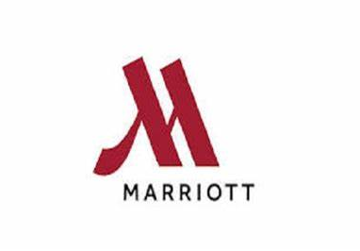
The Marriot Hotel and operations

Slide 3
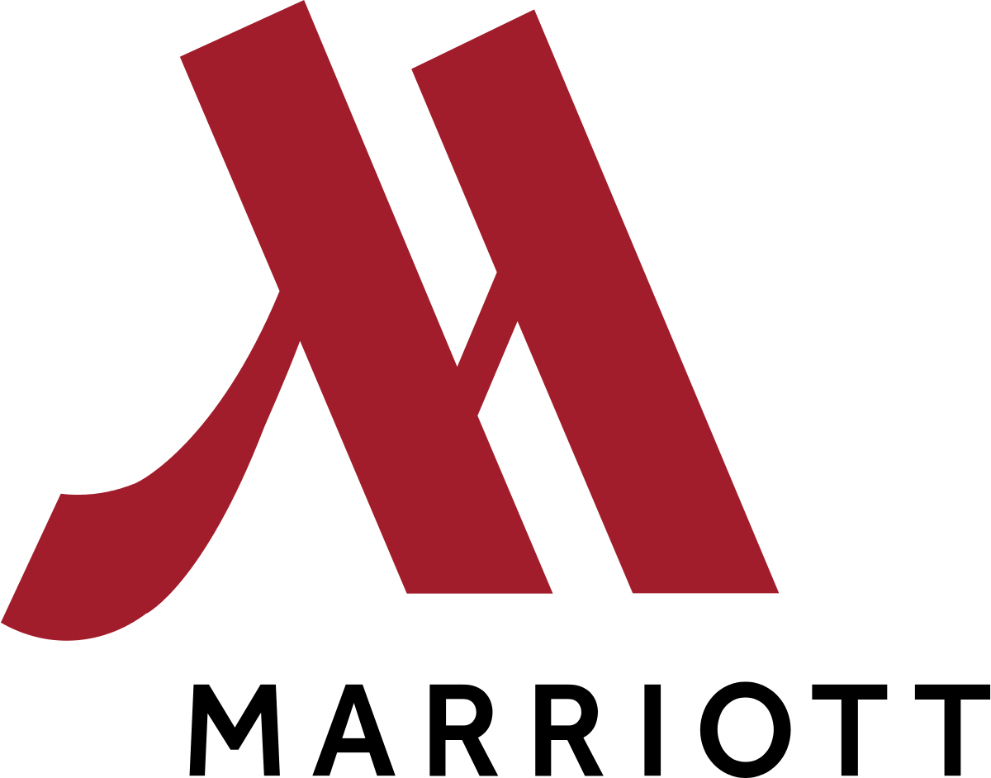
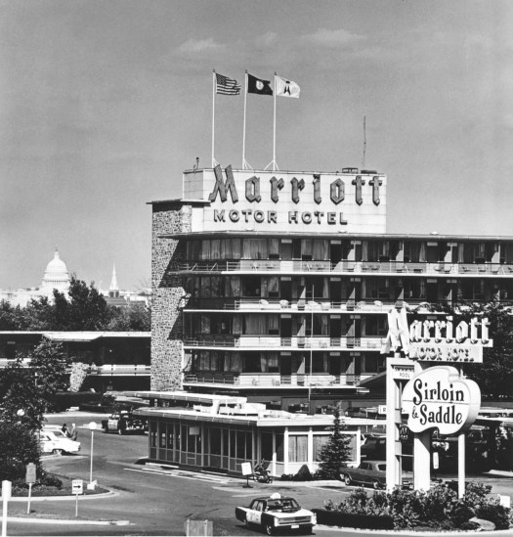
History of the Marriott
This company was a beer stand opened 1927 by Mr. Marriott and Alice Marriot this company is an international company in the hotel industry. Looking at the history of the Marriott hotel the doors were first open in 1927 by Mr. J Marriott Along Side his Partner Alice.

Slide 4
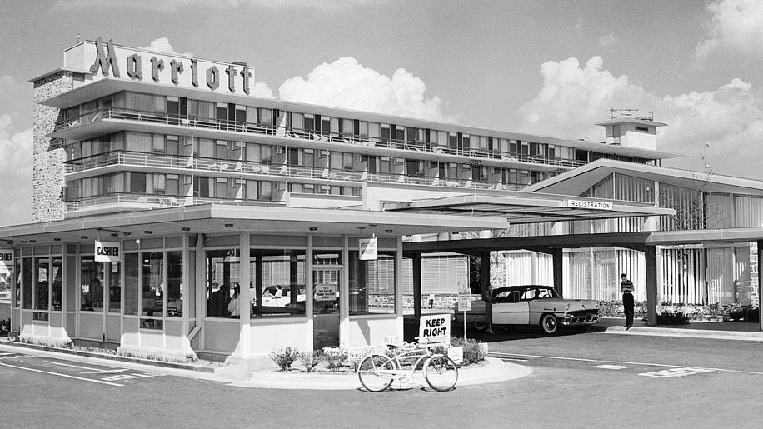
More history
1957-1988 a hotel was open in Virginia and was run by Marriott son.
1969 the first international hotel was opened .
2012 and beyond Marriott are shaping travel by being a part of guest's portfolio that is transforming travel experience.

Slide 5
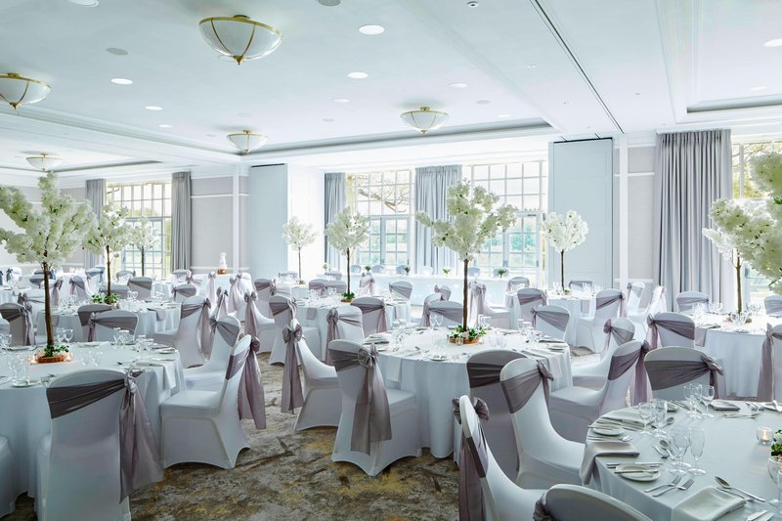
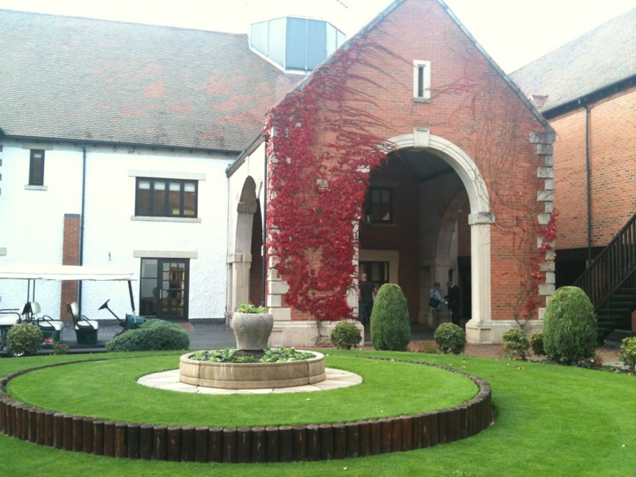
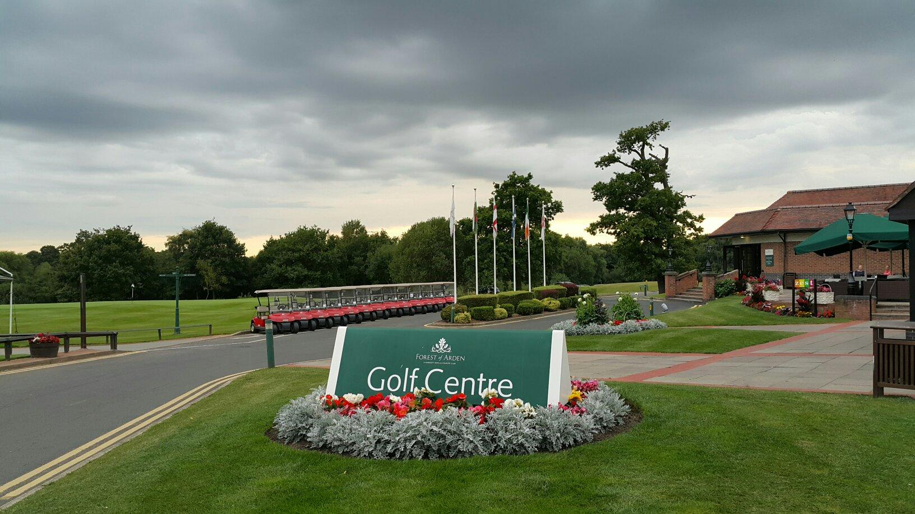
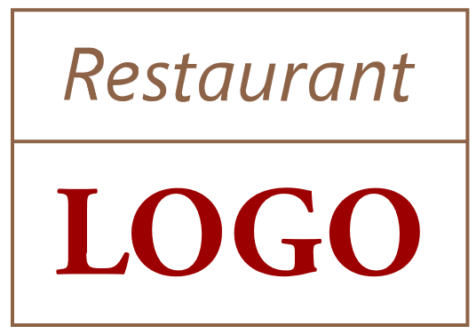
Forest Of Arden Marriott Hotel & Country Club
The Marriott forest of Aiden country club is located in a woodland, where deer are often seen. Its is also near to Birmingham airport.
Marriott has around 80 resorts Globally which also provides Golf courses for new beginners interested in golf.
This hotel as 240 rooms, it has a housekeeping department and an excellent front of house. This hotel also has a fitness centre a pool and spa. Furthermore, the Marriott hotels function rooms are used for wedding and business meetings.

Slide 6
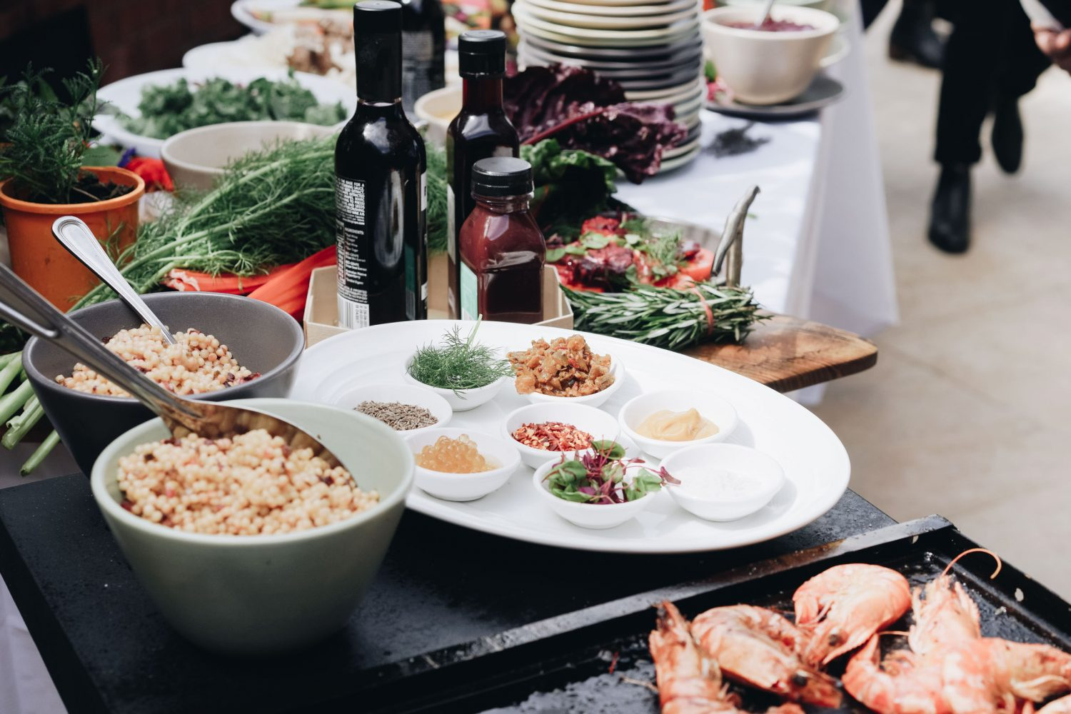
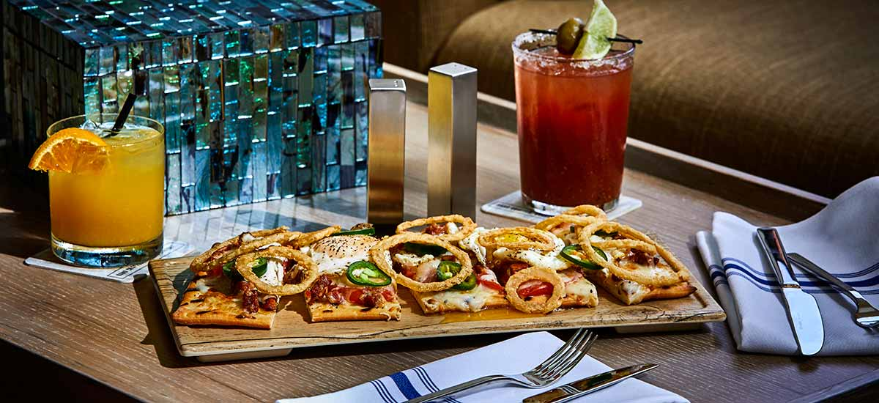
Food and Beverage at the Marriott
Food And Beverage
There are two types of food and beverage service here at the Marriott hotel
Table service is one style which is of an English style. With this service guest would be seated at the table and their order will be taken.
Thompson (2010) new opportunities abound through diversification and ethnic restaurants food carts and trucks and agritourism and other culinary forms part of Marriots operation. Also at the Marriott in terms of food and beverage they offer a French cuisine
Negi Ritushka Gunti (2013) said food and beverage is a multifaceted sector of the hospitality industry. There is a niche for all types of food and beverage businesses within this segment of catering the food and beverage industry .

Slide 7
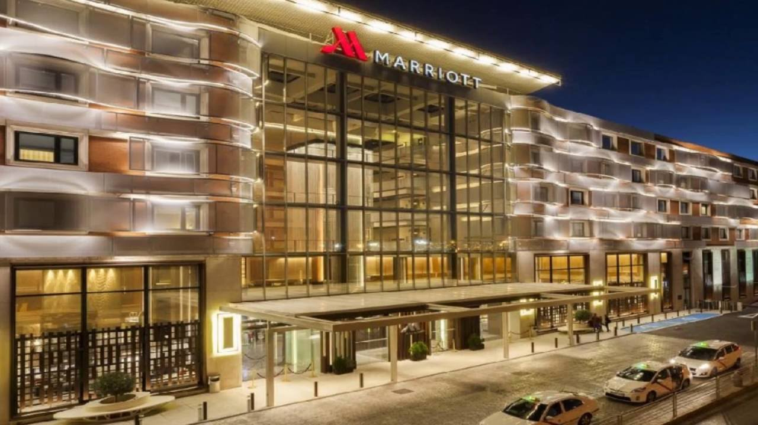
Marriott Aims
The Mission For Marriott is to be the worlds favorite hotel company putting people first.
With an emphasis on training their employee in excellent customer care.

Slide 8
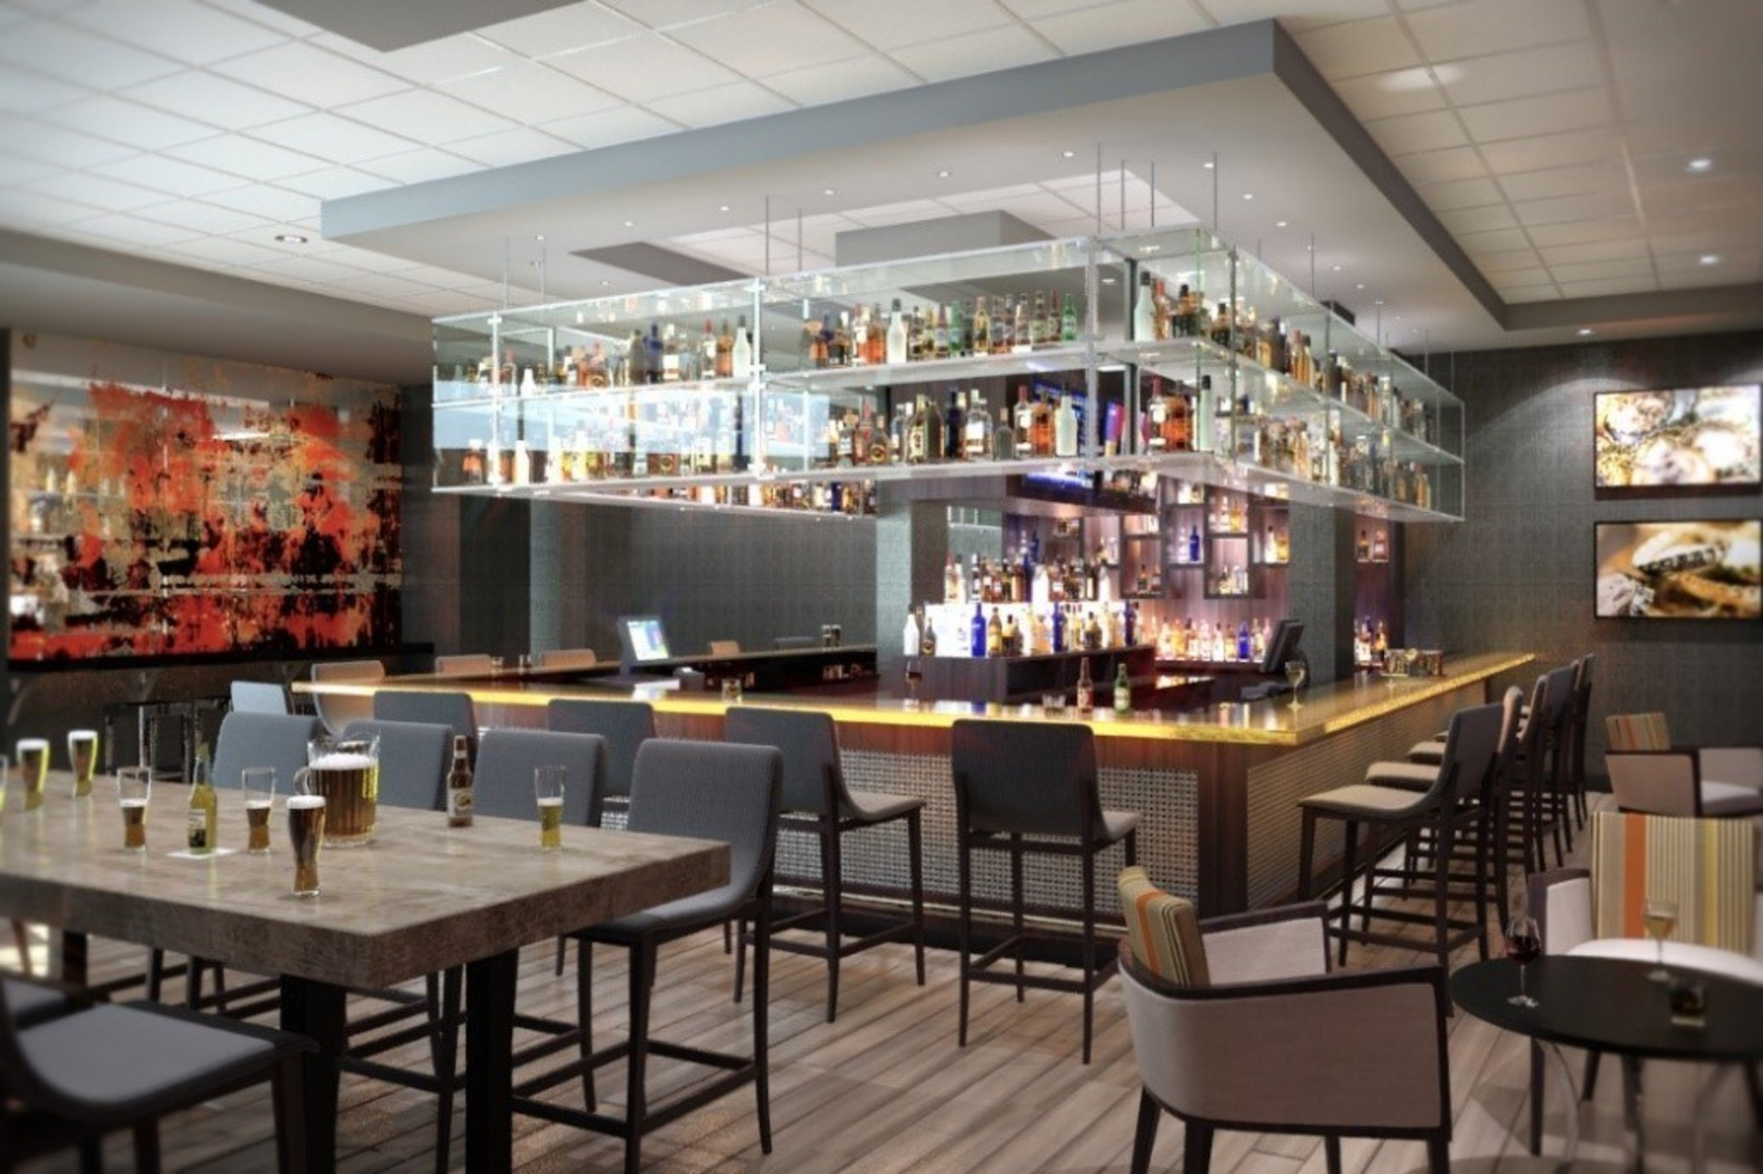
BUSINESS MODEL
The Business model is that of the Luxury industry.
The Cuisines lounge is where an afternoon tea service is made available giving their guest that dining experience. The restaurant also offer breakfast buffet to guests. also a room
service is available for breakfast at the Marriott hotel

Slide 9
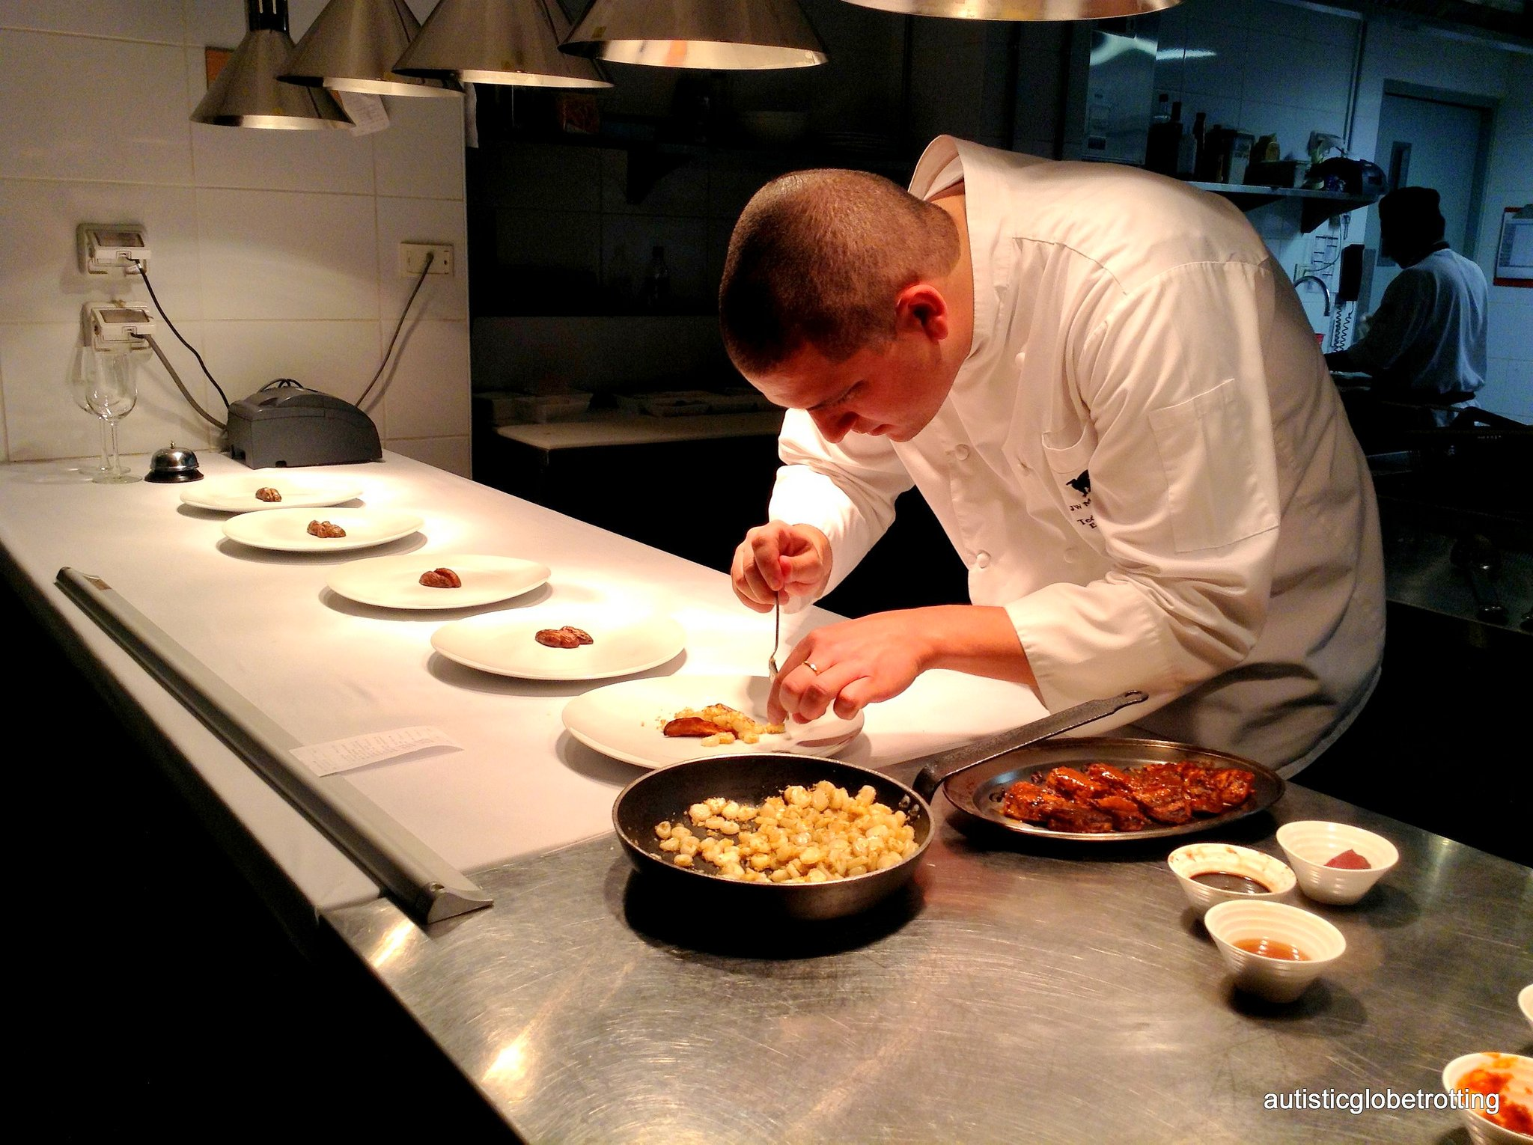
Food hygiene at the Marriott
The Marriot has a food hygiene rating of five star. At the Marriot food samples are tested every 4 weeks.
This hotel ensure that HACCP Control are reviewed and keep on file.
Safety inspections are carried out once a week for food control.
All reviews can be seen on the Marriot website. The hygiene standard reaches guests expectations.

Slide 10
Marketing at the Marriott
Marketing Marriot
Hart (2016) Marriot is going after the business travel segment from a marketing perspective. We are targeting business travelers who have more opportunity to travel for business and to experience our brand.
Marriot through its marketing segment target travelers. However they still attract general public. Through its food and beverage.
Dalton (2004) Acknowledge the guest know the standards they require. That any guest entering a food and beverage outlet must be greeted by the host- hostess within 30 seconds of arrival. This is an excellent way to start selling services.

Slide 11
Conclusion
Conclusion
This as been a perfect study for myself as I look into the history of the Marriot hotel and the service that they offer today.
I do feel that Marriot hotel has accomplished its goals for the guest within their operations. Each department plays a significant role within the hotel. By recognizing guests needs and giving them that away from home experience.
This study highlights the importance of food and beverage within the hotel industry, along side food hygiene and food safety.
I believe Marriot marketing does well for the hotel bringing in customer from all works of life. From luxury experience to a golfing weekend. The high level of service given to guest at they hotel is an attraction.
A more refined insight has been given as one realizes the impact that food and beverage can have on the guest
To conclude the Marriot offers guests luxury in relation to the bedrooms, restaurant and wellbeing that is available..

Slide 12
THANK YOU!

Slide 13
Reference
Reference
The food and beverage handbook Tracey Dalton (2004) published (2004) south Africa page 26 )
History of the Marriot .com /about/culture and valves/history
Marriott. Com/explore-and plan/golf

Slide 14
Reference
Reference
Bing. Com search/ food and beverage given to guest
Career opportunities in the food and beverage/ industry Thompson Kathleen (2010)
Publishing (2010) new York page (3)
Modules Marriott/ .com/ hotel food and beverage (2020)
Food and beverage service operation Dr Jagmohn Negi Gaurad M. J. Ritushka and Sunhi (2013)
Published in new Delhi (2013) page 1)
Food- hygiene org UK the Marriott hotel (2020)
Hittps / www. TripAdvisor . UK show-user. Reviews
Skift.com/2016/ Marriott tries- storytelling

