Slide 1
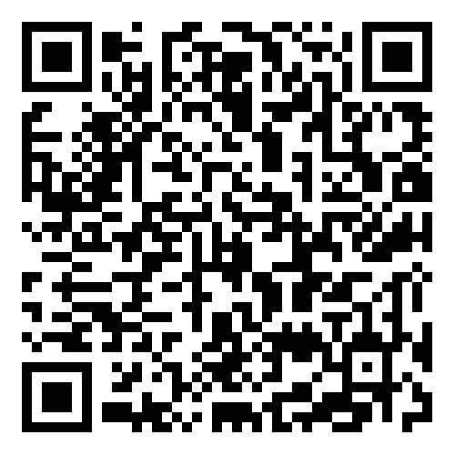

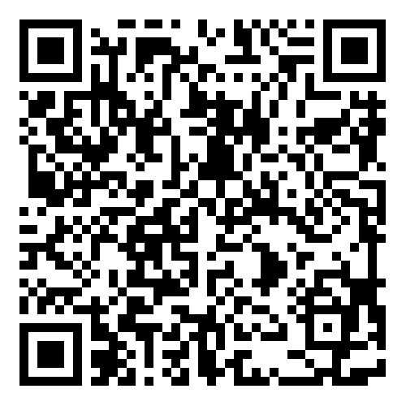

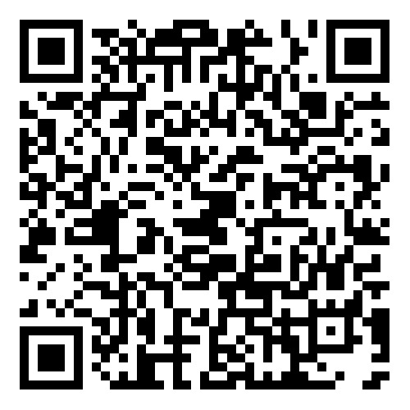


EXTENSIVE
ACADEMIC
PRACTICE
BOOSTER SESSIONS
SCAN THE QR CODE OR CLICK ON LINK (IN POWERPOINT DESKTOP VERSION) TEN MINUTES BEFORE THE SESSION
Click Here to Join the Session
Friday 19th June 2026, 11-12PM (Week 6)
Advanced Research Refresher (Level 5 and 6)
Lecturer: Olivia Edmonds
Thursday 18th June 2026, 11-12PM (Week 6)
Academic Writing (Paragraph Structure) (Level 7/ Masters)
Lecturer: Bianca Dodgen
Saturday 20th June 2026, 10-11AM (Week 6)
Academic Writing (Paragraph Structure) (Level 7/ Masters)
Lecturer: Bianca Dodgen
Click Here to Join the Session
Click Here to Join the Session
University of Wales
Trinity Saint David
BIRMINGHAM

