Slide 1
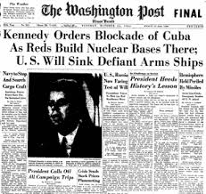
Sustainable Development in an Era of Globalisation? HPAN4008 Part 6
Post-1945: Eastern Europe and the Cold War

Slide 2
Post-1945: Eastern Europe and the Cold War
The Era of Imperialism, Wars and Revolutions
Towards a system of “World Order” in the 20th century?

Slide 3
Countdown to World War
1870-1871 Franco-Prussian War and unification of Germany under Bismarck
1884-85 Congress of Berlin
Interlocking alliances prior to 1914

Slide 4
The Great War 1914-1918
1917 Revolutions in Russia
1918 Kiel mutiny in Germany; Workers’ and Soldiers’ Councils in Berlin 1918-1919
Freikorps v Spartakusbund and USPD: emergence of Weimar Germany
1919 Treaty of Versailles (and related Treaties)
1920 League of Nations (minus the USA)

Slide 5
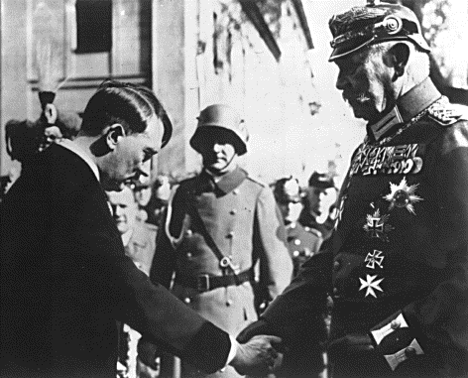
The instability of the Weimar Republic
Legacy of Versailles: a peace of the victors
Unemployment and Hyper-inflation
Division of workers’ movement; rise of Nazism
Hitler becomes Chancellor in January 1933

Slide 6
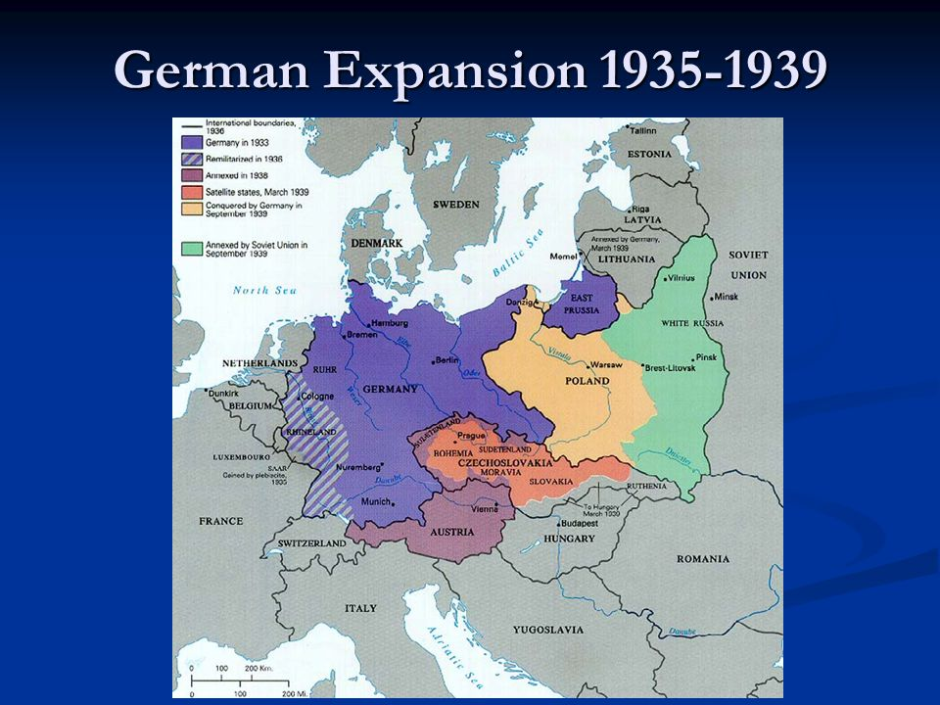
Hitler: internal repression and foreign expansion

Slide 7
Meanwhile, Stalin’s foreign policy 1933-1939
“Third Period” 1928-1933: Division of workers’ movement
Popular Frontism 1934-1939: attempts to sign a security pact with Britain and France fail
1939-41: Hitler-Stalin Pact
June 1941: Operation Barbarossa

Slide 8
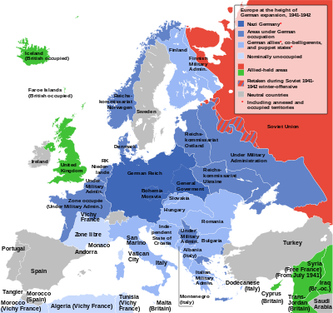
Nazi domination of Europe at its peak (1940-42)

Slide 9
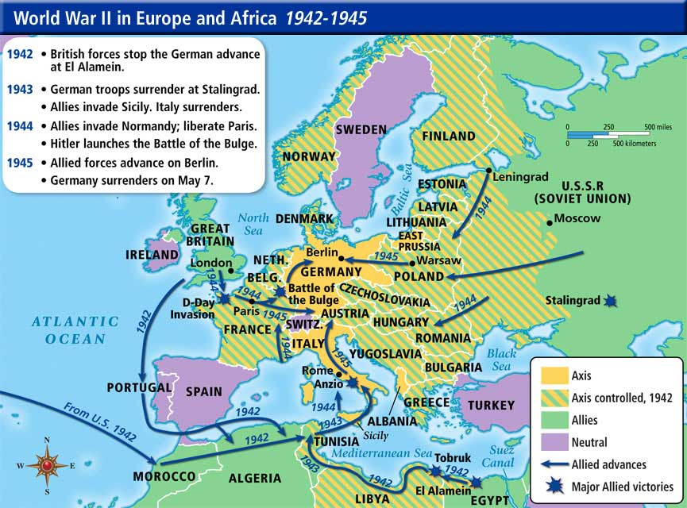

Slide 10
Post-1945: Eastern Europe and the Cold War
…

Slide 11
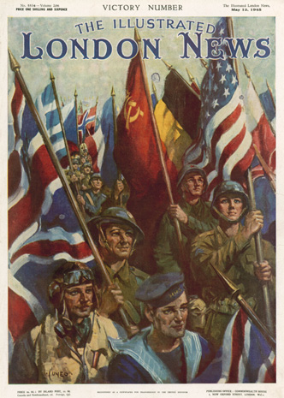
May 1945: VE Day
August 1945: VJ Day

Slide 12
May 1945: VE Day
August 1945: VJ Day
Unconditional surrender of Germany and Japan
Exhaustion of European combatants
Emergence of USA as most powerful nation – economically, financially and militarily
BUT ALSO…
Strengthening of Soviet Union: satellite states in Eastern Europe
Origins of the “Cold War”

Slide 13

The Cold War
Developments in Eastern Europe 1944-1948
The Iron Curtain
NATO (1949) and the Warsaw Pact (1955)
COMECON (1949-1991) and the European Coal and Steel Community (1951) – beginnings of the European Project
Counter-narrative: Revolts in E Europe: East Germany 1951, Poland and Hungary 1956, Czechoslovakia 1968, Solidarnosc in Poland throughout the 1980s

Slide 14

US Global strategy post-1945
Initial focus on UNO and UNRRA: mass migrations in Europe at the end of the war
Initial focus of IBRD and IMF: reconstruction loans
But, by 1948, change of course:
Marshall Aid to Europe and Japan
Re-building German and Japanese economies
(See Yanis Varoufakis, The Global Minotaur)
Consequent change of role for IBRD (World
Bank) and IMF

Slide 15
De-Colonisation and the UN
1947-48: India, Pakistan, Burma, Ceylon
1952: Egypt
1956: Sudan
1957: Ghana
1958: Malaya and Singapore; Tunisia
1960: 17 countries in Africa win independence from Britain, Belgium and France*
1962: Algeria
A new bloc in the UN General Assembly, especially after 1960…
* Independence in 1960: Nigeria, Cameroon, Senegal, Togo, Burkina Faso, Central African Republic, Congo, Congo (Brazzaville), Somalia, Madagascar, Ivory Coast, Chad, Gabon, Mali, Niger, Mauretania, Benin…and Cyprus

Slide 16
The Non-Aligned movement
The organization was founded in Belgrade in 1961, and was largely conceived by India's first prime minister, Jawaharlal Nehru; Indonesia's first president, Sukarno; Egypt's second president, Gamal Abdel Nasser; Ghana's first president Kwame Nkrumah; and Yugoslavia's president, Josip Broz Tito. All five leaders were prominent advocates of a middle course for states in the Developing World between the Western and Eastern Blocs in the Cold War. The phrase itself was first used to represent the doctrine by Indian diplomat V. K. Krishna Menon in 1953, at the United Nations.
The Non-Aligned Movement (NAM) continues. As of 2012, the movement had 120 members.

Slide 17
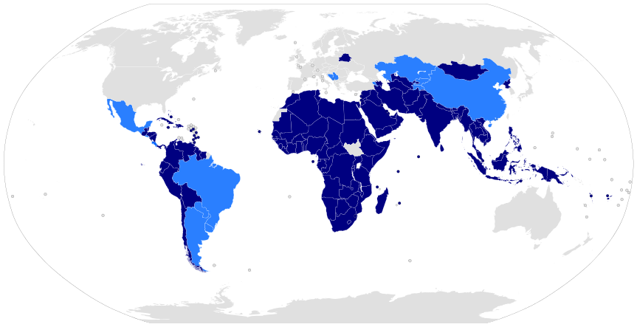
Non-Aligned Movement members and associates (2012)

Slide 18
From Cold War to Détente and Peaceful Co-existence (and back again)
1962 Cuban missile crisis
Sino-Soviet split in 1965
SALT talks (1969-1979) and détente (1971): Nixon visits China in 1972
1975 Helsinki Accords and CSCE (Commission on Security and Co-operation in Europe)
BUT…
New rivalries in Angola and Mozambique 1974/5
Russian invasion of Afghanistan 1979 and collapse of détente
Reagan’s election in 1980

Slide 19
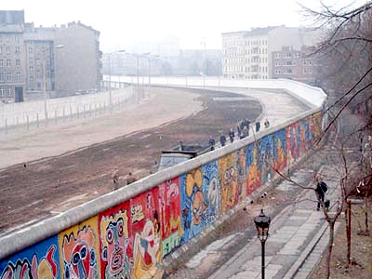
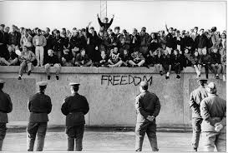
Gorbachev, Perestroika and Glasnost
1989: change in eastern Europe; fall of the Berlin Wall; the year of revolutions
1990: German reunification
1991: Collapse of the Soviet Union

Slide 20
Fukuyama and “The End of History”
Article in The National Interest, Summer 1989
The definitive End of the Cold War
Afghanistan and afterwards
Collapse of the USSR
“Only one game in town”: Neo-liberalism, Structural Adjustment Programmes – the new orthodoxy
Other polarities?
Russia and the CIS; China; The Non-Aligned Movement…

