Slide 1

Sunrise Residential Care Home
Module Name and Code:
Digital Skills and Research Methods (LCHS4007_BIRM)
Lecturer: Masud Siddiqui
Presented By:
Shazia Kausar (2512942)
Razwana Ifthkar (2511282)
Azra Munirali. Habib (2507358)
Salma Shahzad (2332701)

Slide 2




Introduction
Using Microsoft Excel (Shazia Kausar 2512942)
Using MS Teams (Razwana Ifthkar 2511282)
The impact of limited digital skills (Azra Munirali. Habib 2507358)
A checklist for digital safety practices (Salma Shahzad 2332701)

Slide 3
Case study
Sunrise residential care home is a medium-sized facility providing long-term care for older adults, many of whom live with dementia, mobility issues, or long-term health conditions.
The care home has around 35 residents and a team of nurses, care workers, administrators, and visiting health professionals.
In recent years, Sunrise has begun introducing digital tools to improve the quality and efficiency of care.
The home has access to the Microsoft 365 suite, but staff are still developing confidence in using its full range of applications.

Slide 4
Use of Excel in
Sunrise Residential Care Home
Excel is used to:
Track residents' medication schedules
Manage staff rotas (UMATechnology, 2025)
Monitor resident health data e.g. weight, BP
Identify trends with formulas and charts (Microsoft, 2023)
Budgeting and financial planning (Skills for Care, 2022)

Slide 5
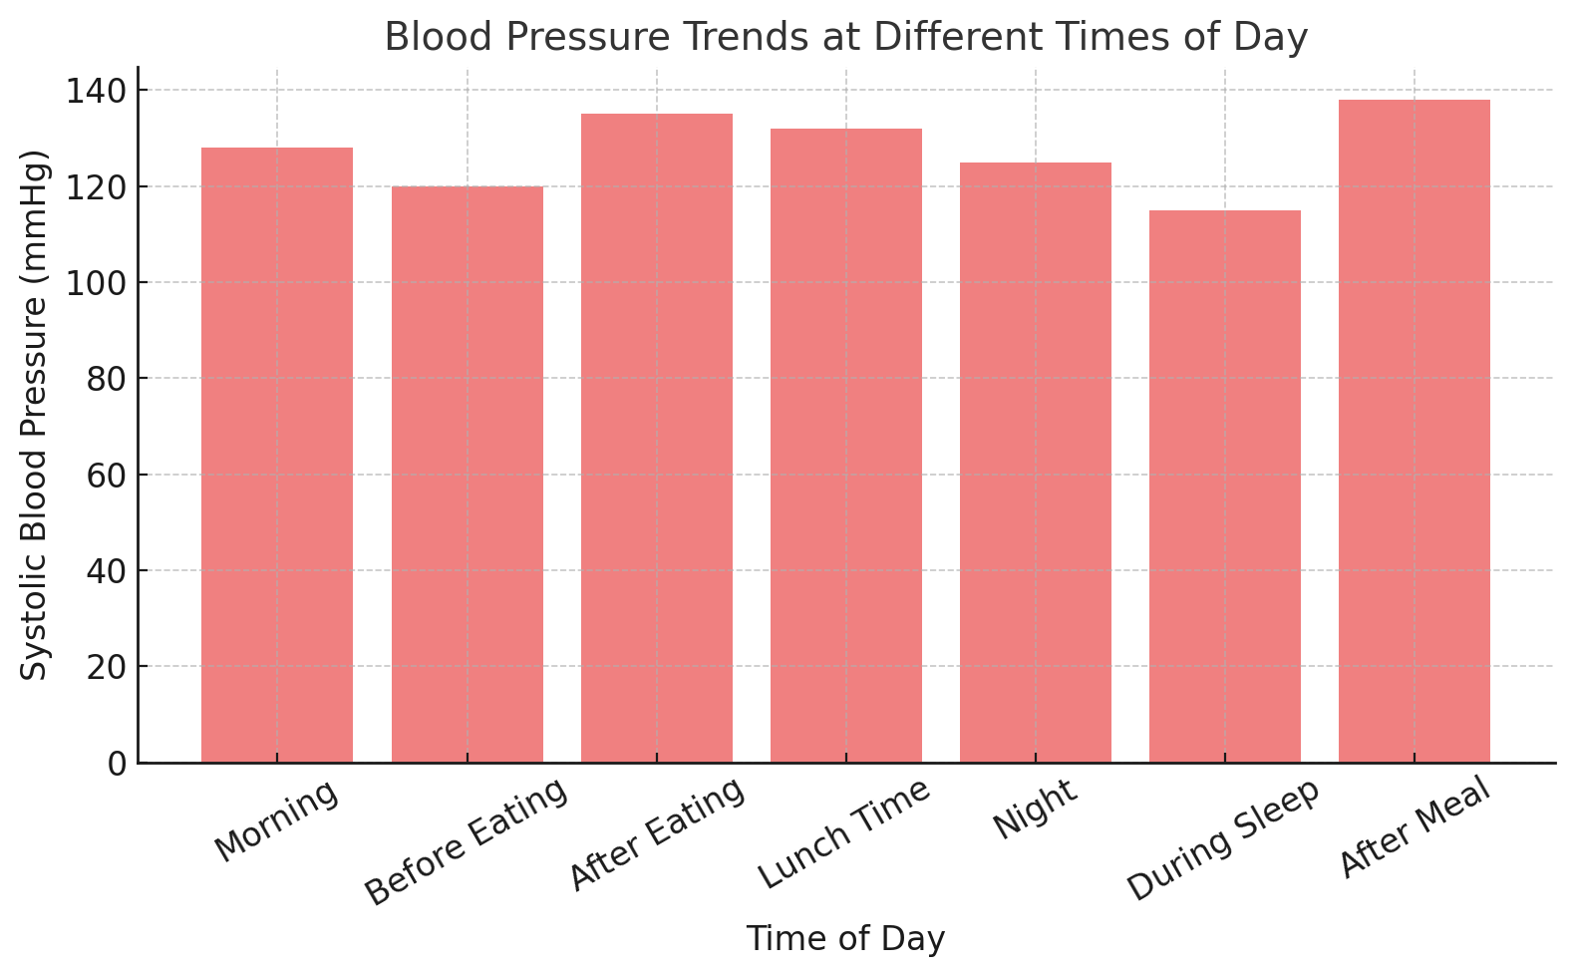
Feature of excel
The chart makes it easy to spot patterns – for example, blood pressure is higher after meals.
Patient data can be filtered, sorted, and analysed instantly to support better clinical decisions.
This helps staff save time, reduce errors, and identify risks quickly.

Slide 6

Microsoft Excel at
Sunrise Residential Care Home
Benefits and Limitations

Slide 7

Benefits of Excel
Organises large amounts of information into structured spreadsheets
Quickly identifies trends and patterns (Microsoft, 2023)
Supports financial planning through cost analysis (Skills for Care, 2022)
Increases efficiency and care quality (Mehar, 2023)
ThePhoto by PhotoAuthor is licensed under CCYYSA.

Slide 8

Limitations of Excel
Possibility of human error in data entry (UMATechnology, 2025)
May lack security (Microsoft, 2023)
Risky to rely on Excel alone for sensitive health data
Should be assisted with specialised care management systems

Slide 9
Addressing the limitations
Training costs: Staff need regular training to use Excel properly, especially for more advanced features like formulas or charts. This can take time and cost the care home money.
Takes time to learn: Some employees may find Excel complicated and need extra support before they feel confident using it for everyday tasks.
Different skill levels: Not all staff have the same level of computer knowledge, which can lead to mistakes, slower work, or inconsistent record keeping.

Slide 10
Conclusion
Microsoft Excel helps Sunrise Residential Care Home complete tasks more efficiently by keeping residents’ details, staff schedules, and budgets well organised in one place.
It reduces mistakes and supports better decisions by using automatic calculations and simple data analysis tools.
Excel’s benefits depend on staff digital skills and how safely they handle residents’ information and other sensitive data.
With the right training, staff can use Excel confidently to improve accuracy, teamwork, and coordination in daily care tasks.

Slide 11
References
Mehar, A. (2023) What are the advantages and disadvantages of Ms Excel. Available at: https://www.almabetter.com/bytes/articles/advantages-and-disadvantages-of-ms-excel (Accessed: 01 October 2025).
Microsoft (2023) Overview of Excel features. Available at: https://support.microsoft.com/en-gb/excel (Accessed: 25 September 2025).
Skills for Care (2022) Effective use of digital technology in social care. Available at: https://www.skillsforcare.org.uk (Accessed: 25 September 2025).
UMATechnology (2025) How is Microsoft Excel used in the Medical Field. Available at: https://umatechnology.org/how-is-microsoft-excel-used-in-the-medical-field/ Accessed: 25 September 2025).

Slide 12

DO YOU HAVE ANY QUESTIONS?
Presented by Shazia Kausar (2512942)

Slide 13

The role of collaboration tool Microsoft Teams
In enhancing the efficiency of Sunrise Residential Care Home​

Slide 14

What is MS Teams:
Microsoft Teams is a collaboration and communication platform in the Microsoft 365 suite, that serve as a central hub for communication, meetings, file sharing and app integration.

Slide 15

Use of MS Teams in Sunrises Residential Care home.
Virtual consultation enables staff to connect the doctors via video call for quick consultation. (Warmoth et al, 2022)
All staff communicate and share information on a single unified platform.

Slide 16
Staff meetings and virtual trainings can be held through MS Teams.
Residents of Sunrise care home can connect with family and friends through Ms Teams.
Families can participate in virtual appointments with care provider.
Management can share important announcements with all staff at once.
Teams can be created for different departments(e.g nursing, kitchen,
house keeping).

Slide 17
Benefits of using a Ms Teams ​
Using MS Teams can increases the efficiency and reduce
the time (NHS England,2023).
Centralised documents and records.
Teams integrate deeply with other Ms 365 applications.
MS Teams can help to reduce the administrative load on
staff (Kwan et al,2025).
Record sessions for those who can't attend live.
Cuts down on printing, travel and physical meetings time.
Encourage staff to share ideas for improving care.

Slide 18
Limitations and issues.
VPN constraints causing delays during video calls and file transfers
(Foster & Charnok,2024).
Care home staff may have limited experience with technology. This can
make challenging to use Ms Teams (Warmoth et al, 2022).
There is risk of unauthorised disclosure of patient's sensitive
information.
In care home many patients deal with dementia, they cannot use MS
Teams independently.
Before introducing MS Teams in care home, it is essential to assess the digital readiness (Kwan, et al,2025).

Slide 19
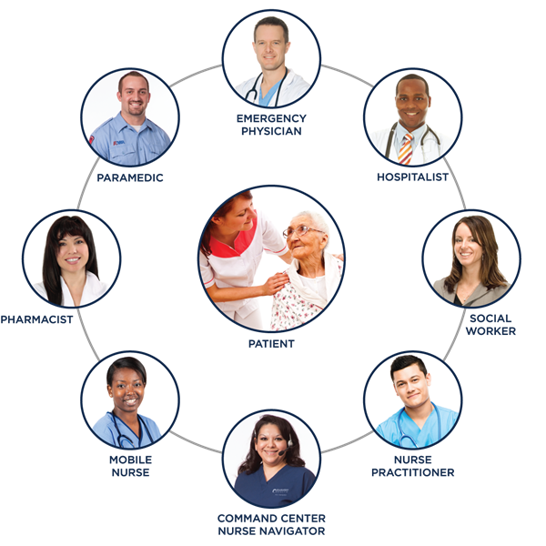
Conclusion
Introducing of MS Teams in Sunrises residential care home
can improve the communication and teamwork.
It can support virtual meetings and trainings.
It can make sharing information and update quicker.
Strengthens collaboration between staff, management and
families.
The benefits of using MS Teams depend on the staff's
digital skills.

Slide 20
References
Foster, G. and Charnock , R. (2024) To make the most of Microsoft Teams for better patient care, users need to tackle some important issues or challenges. Available at: https://centricconsulting.com/blog/microsoft-teams-and-healthcare-lessons-learned-from-early-adopters/ (accessed 27th Sep 2025).
Kwan, B., Dickins, M., Batchelor, F., Williams, S., Hwang, K., Fulford, K., Walsh, T., Jakupovic, H. and Davison, T.(2025) 'Digital readiness of the in‐home aged care workforce: A latent profile analysis', Australasian Journal on Ageing, 44(1), p.e70010.

Slide 21
References (Cont.)
NHS England(2023)Microsoft Teams and remote working. Available at: https://www.england.nhs.uk>long_read>microsoft-teams (accessed 26th Sep 2025).
Foster, G. and Charnock , R. (2024) To make the most of Microsoft Teams for better patient care, users need to tackle some important issues or challenges. Available at: https://centricconsulting.com/blog/microsoft-teams-and-healthcare-lessons-learned-from-early-adopters/ (accessed 27th Sep 2025).

Slide 22


Thank you for listening. Do you have any questions?
Presented by Razwana Iftkhar (2511282)

Slide 23

Impact of Limited Digital Literacy Among Staff in Residential Care
Sunrise Residential Care Home – Effects on Care Delivery, Communication, and Teamwork
Presented by: Azra Habib
Date: 11/10/2025
Student number: 2507358

Slide 24
Context & Overview
Sunrise has ~35 residents with complex needs (dementia, mobility, chronic conditions)
Staff team: care workers, nurses, admin, visiting professionals
Microsoft 365 suite introduced to improve care
Staff confidence in digital tools varies
This presentation explores:
- Care delivery impact
- Communication challenges
- Teamwork effects
- Solutions

Slide 25

What is Digital Literacy in Health & Care?
Ability to confidently and safely use digital tools in care settings
Includes: care records, Teams, SharePoint, mobile apps, data protection
Enables better coordination, faster decisions, accountability, safety

Slide 26

Evidence of Digital Literacy Gaps in Staff
53% of care workers lack digital confidence (KCL, 2023)
Barriers: lack of training, fear, complex systems
Outcomes: low adoption, fragmented data, slow communication
Sources: Kuek & Hakkennes (2020), Skills for Care (2022), Frontiers (2023)

Slide 27

Impact on Care Delivery
• Delays in documentation = errors, outdated info
• Underuse of monitoring tools
• Missed updates is a possibility which may lead to poor decision-making
• Outcomes: medication errors, missed appointments, inefficiency

Slide 28
Effects on Communication & Coordination
• Missed emails or unread messages
• Poor handover due to weak digital reporting
• Visiting professionals expect digital updates
• Lack of transparency and audit trail

Slide 29
Digital Literacy as a Central Hub
• Staff digital skills influence:
- Care quality
- Communication
- Team collaboration
- Innovation, efficiency, safety
• Improving skills lifts all areas

Slide 30
Sunrise Example Scenarios
Missed medication update due to paper-based note
Exercise plan emailed but unread ? no therapy given
Preventable incidents caused by poor digital confidence

Slide 31

Solutions – Improving Digital Skills
Assess skills baseline: surveys + observations
Tailored, role-based training (e.g. Teams, care plans)
Peer learning and digital champions
Guides, cheat sheets, safe space to learn
Protected training time + leadership engagement
Celebrate progress

Slide 32
Sunrise Digital Skills Plan (Example)
1. Skills audit
2. Focus on key tools
3. Assign digital champions
4. Practical group + 1:1 training
5. Create supportive culture
6. Review in 3 months
7. Expand to new tools

Slide 33

Resources & Further Reading
?? Studies:
• Kuek & Hakkennes (2020), Frontiers (2023)
• JMIR Nursing (2025), KCL Mindset Report
• Skills for Care Digital Capabilities Guide
?? Support:
• Microsoft 365 Training Center
• Digital Literacy Toolkit – HEE

Slide 34
Final Summary & Takeaways
Digital tools are essential for care
Limited skills = care risks and communication issues
Training + support = stronger team, safer care
Confidence leads to better outcomes for staff and residents

Slide 35
Sunrise Digital Safety Checklist
SALMA SHAHZAD ( 2332701 ) –LCHS4007
Activities | Options | ✓
Secure logins (Microsoft 365) | MFA turned on for all staff accounts (admins first).
 | No shared or generic logins; each user has a unique account.
 | Disable leavers’ accounts the same day and remove from all groups.
 | Review privileged roles monthly; audit admin actions.
Email Safety (Outlook / Teams) | Treat unexpected links or attachments as suspicious; verify via a known contact.
 | Forward suspicious emails to report@phishing.gov.uk and delete.
 | Microsoft 365 anti-phishing and Safe Links policies enabled.
Safe Document Storage (SharePoint / OneDrive) | Store resident info only in approved SharePoint/OneDrive libraries.
 | Apply Sensitivity Labels (e.g., “Highly Confidential—Patient”).
 | Use DLP (Data Loss Prevention) policies for identifiers such as NHS numbers or DOBs.
Patient Confidentiality (Day-to-Day) | Share the minimum necessary information with verified recipients.
 | Lock screens (Win + L); avoid discussing residents in public areas.
 | Use only approved devices/apps (no WhatsApp or personal accounts).
Governance, Training & Incidents | Staff complete annual data security training (phishing, sharing, labels).
 | DSPT self-assessment completed yearly; evidence retained.
 | DPIA completed for new digital tools or process changes.

Slide 36



Secure
Logins
Every staff member must use a unique Microsoft 365 account with multi-factor authentication (MFA) to prevent unauthorised access (NCSC, 2024).
Accounts should never be shared, and any leaver’s account must be disabled immediately (ICO, 2023).
Use strong passphrases, block common passwords, and monitor all sign-in activities (NCSC, n.d.).Review administrator roles and sign-in reports regularly to keep permissions up to date (NCSC, n.d.).
These controls ensure compliance with GDPR Article 32, which demands appropriate technical and organisational safeguards (GDPR, 2016/2018).

Slide 37


Safe Document Storage
Store all resident records in approved SharePoint or OneDrive folders with restricted access (ICO, 2023).
Avoid saving confidential data on local drives or USB sticks to prevent loss or theft (ICO, 2023).
Apply Sensitivity Labels in Microsoft 365 to encrypt and classify documents (Microsoft, 2025).
Enable Data Loss Prevention (DLP) policies to detect identifiers like NHS numbers and block unauthorised sharing (Microsoft, 2025).
Test version-history and recovery options regularly to ensure data can be restored if damaged, meeting GDPR availability and resilience standards (GDPR, 2016/2018).

Slide 38


Email Safety
Phishing is the most common cyber-attack route; always verify before opening links or attachments (NCSC, n.d.).
Report suspicious emails to report@phishing.gov.uk and delete them immediately (GOV.UK, n.d.).
Never send resident information from personal or unencrypted email accounts (ICO, 2023).
Microsoft 365 provides anti-phishing and Safe Links features that automatically scan messages for malicious content (Microsoft, 2025).
Regular training and awareness sessions are essential because phishing tactics evolve rapidly (NCSC, n.d.).

Slide 39

Patient Confidentiality and Governance
Always share the minimum necessary information and verify the recipient’s identity (ICO, 2023).
Lock screens when unattended and avoid discussing residents in public spaces (ICO, 2023).
Use only approved devices and work applications; never use WhatsApp or personal accounts for care data (ICO, 2023).
Complete the Data Security and Protection Toolkit (DSPT) each year as required by NHS and CQC (Digital Care Hub, n.d.).
If a data breach occurs, report, contain, assess, and notify the ICO within legal time limits (GDPR, 2016/2018).

Slide 40
Conclusion
Strong digital safeguards like MFA, encryption, and DLP uphold GDPR and protect sensitive resident information.
Staff awareness and compliance through regular training and adherence to security protocols prevent data breaches.
Consistent governance and monitoring ensure accountability, system resilience, and trust in digital care operations.

Slide 41
References
Digital Care Hub. (n.d.). Data Security and Protection Toolkit (DSPT) for adult social care providers. https://www.digitalcarehub.co.uk
GOV.UK. (n.d.). Avoid and report internet scams and phishing. https://www.gov.uk
Information Commissioner’s Office. (2023, May 19). A guide to the data protection principles (UK GDPR). https://ico.org.uk
Information Commissioner’s Office. (2023). Principle (f): Integrity and confidentiality (security). https://ico.org.uk
Microsoft. (2025, July 17). Learn about sensitivity labels (Microsoft Purview Information Protection). https://learn.microsoft.com
Microsoft. (2025, August 7). Enable sensitivity labels for files in SharePoint and OneDrive. https://learn.microsoft.com
Microsoft. (2025, July 2). Anti-phishing policies in Microsoft 365. https://learn.microsoft.com
Microsoft. (2025, May 9). Safe Links policies in Microsoft Defender for Office 365. https://learn.microsoft.com
National Cyber Security Centre. (2024, September 26). Recommended types of multi-factor authentication (MFA). https://www.ncsc.gov.uk
National Cyber Security Centre. (n.d.). Multi-factor authentication for your online services. https://www.ncsc.gov.uk
National Cyber Security Centre. (n.d.). Phishing: Spot and report scam emails, texts, websites and calls. https://www.ncsc.gov.uk
General Data Protection Regulation (GDPR). (2016/2018). Article 32 — Security of processing. https://gdpr-info.eu/art-32-gdpr

Slide 42


THANK YOU
ALL OF YOUR TIME AND ATTENTION
ON BEHALF OF MY GROUP
DO YOU HAVE ANY QUESTIONS?
PRESENTED BY SALMA SHAHZAD 2332701

