Slide 1

Programme: MSc Public Health and Social Care in Practice Module: Practice-Based Research
LCHS7008 Component 1: Poster Presentation
Lecturer name: Oluwadamilola Tayo
Student ID: 2244841
Student name: Galina Bleidere
Acknowledgement of the use/non-use of AI:
I confirm that I have not used any AI tools in the research and creation of this assignment. I confirm that I have not presented any AI-generated materials as my work. I confirm that I have copies of my drafts, notes, and other resources I used, which I may be asked to provide as evidence.

Slide 2

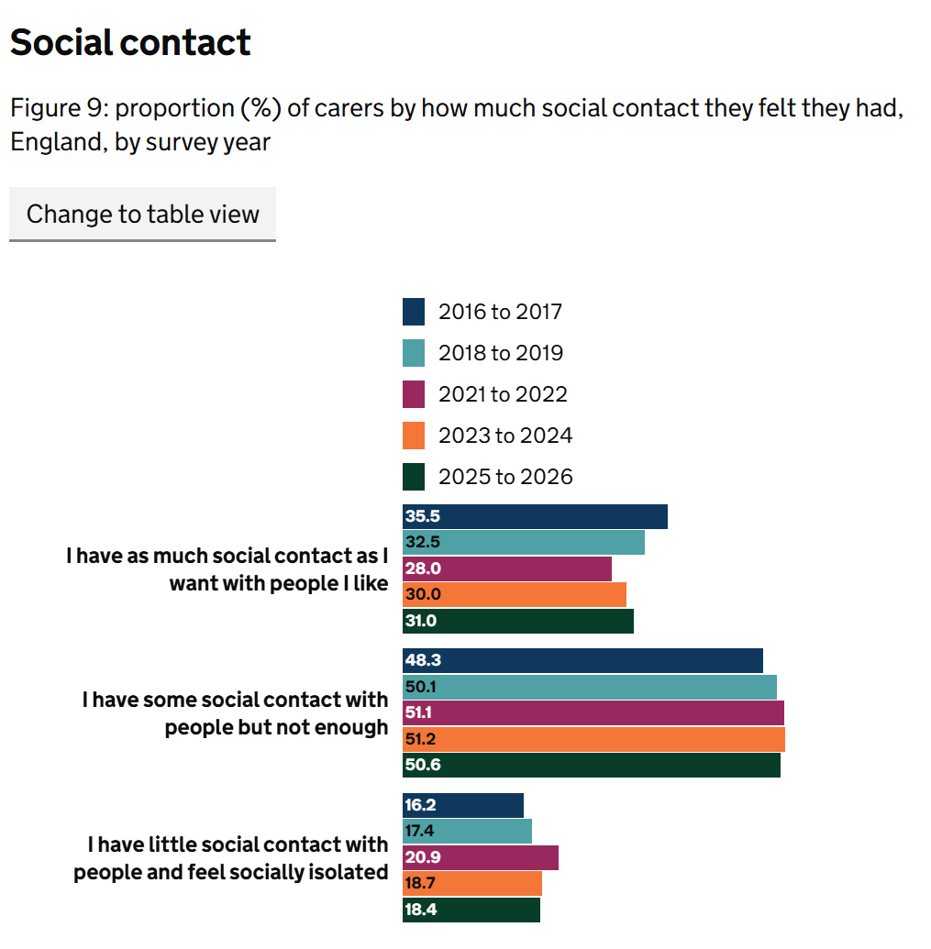
The Role of Community Support in Addressing Social Isolation Among Unpaid Carers of People with Autism and Learning Disabilities
Programme: MSc Public Health and Social Care in Practice/ Module: LCHS7008 Practice-Based Research student name: Galina Bleidere/ Student email: 2244841@student.uwtsd.ac / Supervisor: Oluwadamilola Tayo
Rationale
Unpaid carers are people who look after a family member, partner or friend who needs help because of a disability or additional care needs, without being paid (Carers UK, 2025).
Approximately 5.8 million people provide unpaid care in the UK (Office of National Statistics, 2023; Carers UK, 2025).
An estimated 1.2 million autistic people and 1.5 million people with learning disabilities live in the UK (Fletcher, 2023; Sparkes, 2024).
Caring responsibilities may affect carers' social lives, limiting opportunities to maintain relationships and take part in social activities (Galpin et al., 2018; Family Fund, 2023).
Social isolation and reduced access to support can affect families' emotional wellbeing and leave them feeling disconnected (Disabled Children's Partnership; Griffin and Gore, 2023).
Community support, such as peer groups, local organisations and relevant online communities, may help carers connect with others and feel less isolated (Bray et al., 2017; Griffin and Gore, 2023).
This research will explore how community support may help unpaid carers feel less isolated and what makes it difficult for them to access support.
Aim: To explore and analyse the role of community support in addressing social isolation among unpaid carers of people with Autism and/or learning disabilities (LD) in UK.
Research Question: What role does community support play in addressing social isolation among unpaid carers of people with Autism and/or learning disabilities (LD) in UK?
Objectives:
To explore the experiences and causes of social isolation among unpaid carers in the UK.
To identify the types of community support available to unpaid carers and examine how they may help reduce social isolation.
To identify barriers to accessing community support and suggest recommendations for improving support for unpaid carers
(Source: HFH Healthcare, n.d.)
Research Impact
Raise awareness: Help people better understand social isolation and how it affects unpaid carers of people with autism and learning disabilities (Ashworth et al., 2025; Milosevic et al., 2022).
Identify gaps in support: Highlight the difficulties carers face when accessing support and identify areas where more help may be needed (Harrison et al., 2025).
Improve support services: The findings could help community organisations and services better understand carers' needs and improve the support they offer (Roughan et al., 2019).
Promote social inclusion: Encourage stronger community connections and opportunities for unpaid carers to share experiences and feel less isolated (Akan et al., 2026).
​Prevalence
According to the Department of Health and Social Care (2026), many unpaid carers in England do not have enough social contact. These figures are not specific to carers of people with autism or learning disabilities, but they show why social isolation is an important issue to study.
References:
Akan, A., Rose, E., Maarabouni, R., Thorns, H., Taylor, A., Estien, D. and Hyde, Z. (2026) ‘We realised we were not in it by ourselves: Exploring experiences of a multidisciplinary psychoeducational workshop for parents with a child diagnosed with autism spectrum condition: A thematic analysis’, Clinical Child Psychology and Psychiatry, 31(2), pp. 591–613. Available at: https://doi.org/10.1177/13591045261418179
Ashworth, E., Bray, L., Hanlon, C., Pavlopoulou, G., Moore, D., Donaghy, B., Coen, E., Stanway, H. and Firth, E. (2025) ‘Constantly overwhelmed and desperate for help’: Parents’ experiences of supporting their autistic child with mental health difficulties in the United Kingdom’, PLOS Menntal Health, 2(9), e0000377. Available at: https://doi.org/10.1371/journal.pmen.0000377 ⁠
Bray, L., Carter, B., Sanders, C., Blake, L. and Keegan, K. (2017) ‘Parent-to-parent peer support for parents of children with a disability: A mixed method study’, Patient Education and Counseling, 100(8), pp. 1537–1543. Available at: https://doi.org/10.1016/j.pec.2017.03.004⁠
Carers UK (2025) Facts about carers. Available at: https://www.carersuk.org/media/xajkldmo/facts-about-carers-june-2025final.pdf (Accessed: 22 October 2026).
Department of Health and Social Care (2026) Survey of adult carers in England 2025 to 2026: commentary. Available at: https://www.gov.uk/government/statistics/survey-of-adult-carers-in-england-2025-to-2026-report/survey-of-adult-carers-in-england-2025-to-2026-commentary (Accessed: 20 October 2026).
Disabled Children's Partnership (2021) Then there was silence. Available at: https://disabledchildrenspartnership.org.uk/then-there-was-silence/
Family Fund (2023) ‘It's not nice to see your child isolated and left out’. Available at: https://www.familyfund.org.uk/news/isolated-left-out-disabled-child/ (Accessed: 20 October 2026).
Fletcher, A. (2023) ‘Under diagnosis of autism in England: a population-based study’, National Autistic Society. Available at: https://www.autism.org.uk/learn/knowledge-hub/professional-practice/under-diagnosis-of-autism-in-england (Accessed: 22 October 2026).
Galpin, J., Barratt, P., Ashcroft, E., Greathead, S., Kenny, L. and Pellicano, E. (2018) ‘The dots just don't join up: Understanding the support needs of families of children on the autism spectrum’, Autism, 22(5), pp. 571–584. Available at: https://doi.org/10.1177/1362361316687989
Griffin, J. and Gore, N. (2023) ‘Different things at different times: Wellbeing strategies and processes identified by parents of children who have an intellectual disability or who are autistic, or both’, Journal of Applied Research in Intellectual Disabilities, 36(4), pp. 822–829. Available at: https://doi.org/10.1111/jar.13098
Harrison, R.A., Bradshaw, J. and McCarthy, M. (2025) ‘Where care converges: Uncovering shared experiences of parents and service providers for adults with intellectual disabilities in times of austerity’, Journal of Applied Research in Intellectual Disabilities, 38(2), e70044. Available at: https://doi.org/10.1111/jar.70044
HFH Healthcare (n.d.) Learning disability & autism care | HFH Healthcare - nurse led complex care. Available at: https://hfhhealthcare.co.uk/service/learning-disability-autism-care/ (Accessed 22 October 2026).
Milosevic, S., Brookes-Howell, L., Randell, E., Williams-Thomas, R., Delport, S., Busse, M., Gillespie, D., Ahuja, A.S., McKigney, A.M., Glarou, E. and McNamara, R. (2022) ‘Understanding the support experiences of families of children with autism and sensory processing difficulties: A qualitative study’, Health Expectations, 25(3), pp. 1118–1130. Available at: https://doi.org/10.1111/hex.13465 ⁠
Moffett, M.W. (2024) 'What is a society? Building an interdisciplinary perspective and why that’s important,' The Behavioral and brain sciences, 48. Available at: https://doi.org/10.1017/S0140525X24000037.
Office for National Statistics (2023) Unpaid care, England and Wales - office for national statistics. www.ons.gov.uk. Available at: https://www.ons.gov.uk/peoplepopulationandcommunity/healthandsocialcare/healthandwellbeing/bulletins/unpaidcareenglandandwales/census2021 (Accessed 20 October 2026).
Roughan, L.A., Parker, J.R. and Mercer, L. (2019) ‘Improving interventions for parents of children and young people with autism spectrum disorder (ASD) in CAMHS’, BMJ Open Quality, 8(2), e000261. Available at: https://doi.org/10.1136/bmjoq-2017-000261
(Source: Department of Health and Social Care, 2026)

