Slide 1
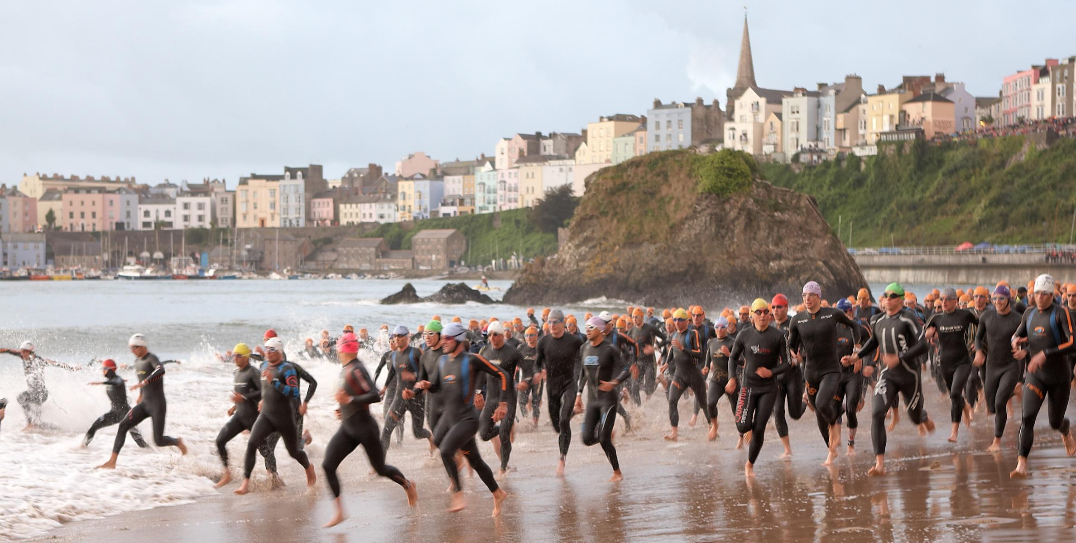
Sustainable Event Management
Ironman Wales
Obaidah Sbeitan
Caitlin James-Deane
Samantha Winkley

Slide 2
Sports Events
‘ sports and physical recreation have a vital role to play in today’s society by giving a sense of pride, by helping to alleviate the consequences of social and economic disadvantages and by having a positive effect on the mental and physical well-being of individuals and the nation. Sports also enables people to participate in activities which can bring together those of different races, gender, social class, age, ability or religious’ (sports council, 1995/ Cited by Torkildsen, 2005)
Importance of sports:
Sports entertains us; gives us the opportunity for self-expression; it provides us with a sense of camaraderie and friendship; it enables us to stretch ourselves mentally and physically; it teaches us how to win and how to lose; it enables us to appreciate and value our natural environment.

Slide 3
Sustainability
Sustainable event management (SEM) is about applying sustainable development principles to the management of a particular event. Specifically, it looks at minimising an event’s ecological footprint and ensuring that it does not impact negatively on the communities and stakeholders involved. (Greensense.com)
IRONMAN believes that the full scope of the event, from setup to breakdown, requires comprehensive planning to successfully manage the race’s diverse environmental, social and economic impacts. By assessing the entire event execution, IRONMAN is working to demonstrate its organizational commitment to sustainable operations and support for the growing number of sustainable sporting events. (Ironman.Report 2017)

Slide 4

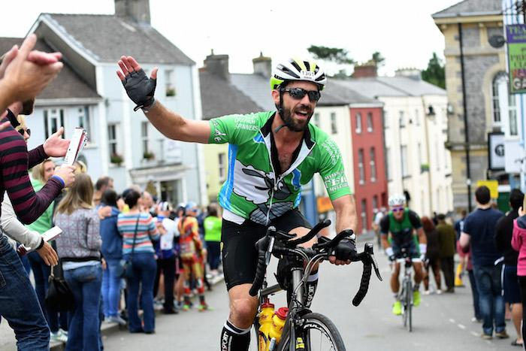
Ironman Wales as a Sustainable event
Globally renowned triathlon
One of the World's Toughest Endurance Races
Hardest Ironman bike course in the UK
Started in 2011, now has just agreed on new 5 year contract with contributions from Pembrokeshire County Council, Pembrokeshire Coast National Park and Tenby Town Council
Benefits felt over the country
Attracts tourist from all over the world
(Ironman, 2018), (Hayward, 2017), (Cooper, 2017)

Slide 5

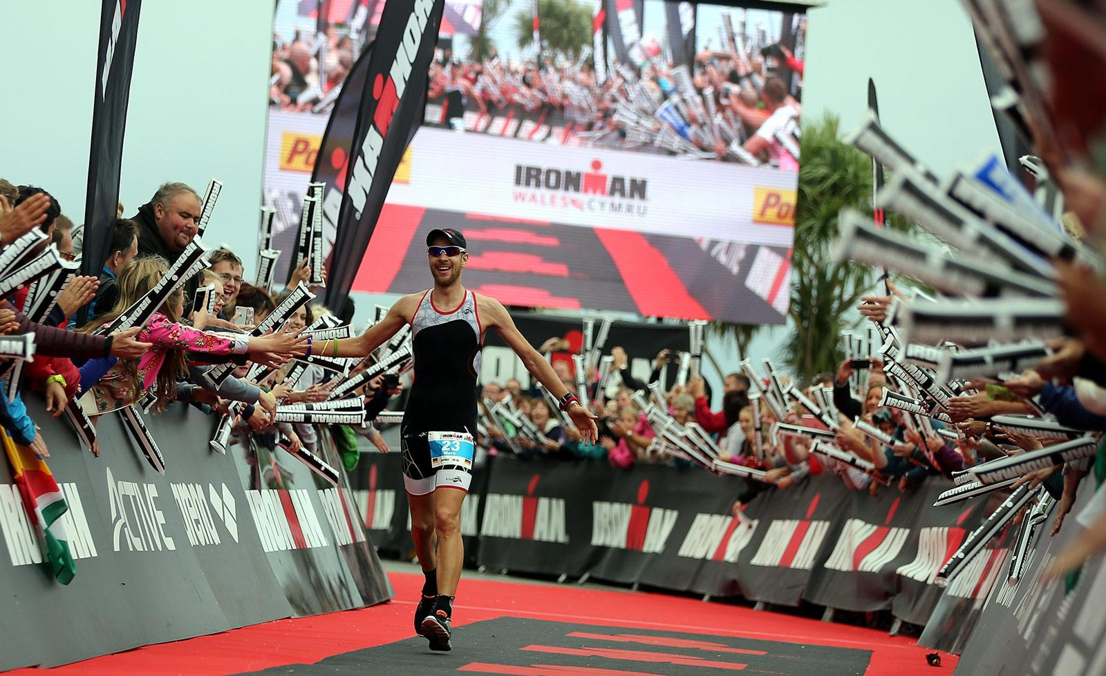
“Swim 2.4 miles, bike 112 miles, run 26.2 miles- BRAG FOR THE REST OF YOUR LIFE. "
- John Collins, IRONMAN co-founder.
The key stakeholders for Ironman Wales
Athletes
The participants, want to experience something new,
personal achievements
Volunteers
Critical for the event. In return receive experience,
groups awarded cash
Local Community
Welcoming supporters make it a great experience
for athletes and their guests
Ironman Wales In the Athlete Choice Awards-
1st in ‘Will recommend to a friend’
2nd in ‘Overall bike’
2nd in ‘Overall swim’
3rd in ‘Best host city experience’
5h in ‘Best race Venue’
(Triradar, 2013)

Slide 6
Impacts and implications
WHAT WERE THE POSITIVE IMPACTS?
Ø Generated 3.5 million for local economy
Ø Large surge in customer’s for local businesses
Ø Changed how Tenby is perceived
Ø Exposure & increased tourism
Ø Community spirit and togetherness
Ø Encouragement of sports
Ø Large media coverage
“I have built a business off the back of Ironman Tenby. The negatives are outweighed by the money, opportunities and healthy lifestyle it's created in Pembrokeshire”.

Slide 7
Impacts and implications
WHAT WERE THE NEGATIVE IMPACTS?
Planned protest = ‘Operation Lightning’.
200 people from the area prepared to take part.
Feeling ignored, mistreated and abused.
“We have contacted the people who arrange Ironman to advise them of our intention to completely halt Ironman”.
Ø Traffic
Ø Road closures
Ø Disruption
Ø Negative resident’s
Ø Rubbish/litter
Ø Economic cost to prepare for event

Slide 8
Recommendations
Greater awareness
Focus on recycling and introduction of wardens
IS IRONMAN A SUSTAINABLE EVENT?
Economically = YES
Return on investment
Increased business performance
Increased shareholder value

Slide 9
Conclusion
“Events have a range of impacts- both positive and negative- on their host communities and stakeholders. It is the task of the event manager to identify and predict these impacts and then to manage them to achieve the best balance for all parties, so that in the balance the overall impact of the event is positive. To achieve this, all foreseeable positive impacts must be developed and maximized, and negative impacts countered. Often negative impacts can be addressed through awareness and intervention- good planning is always critical. Ultimately, the success of the event depends on the event manager achieving this positive balance sheet and communicating it to a range of stakeholders ”. (Bowdin. 1999, p.26)

Slide 10
Reference List
Bowdin, G… et all, (1999). Events Management,Oxford: Butterworth-Heinemann.
Cooper, J. (2017) Ironman Funding Agreed. http://pembrokeshire-herald.com/35541/ironman-funding-agreed/ (Accessed: 10/01/2018)
Greensense.(2018), Sustainability event management.[online].Available http://greensense.com.au/2009/06/13/sustainable-event-management/ ( Accessed, 2017,Dec, 17)
Hayward, W. (2017) Tenby, the town transformed by Ironman. http://www.walesonline.co.uk/news/wales-news/tenby-town-transformed-ironman-13584815 (Accessed: 10:01:2018)
Ironman (2018) FAQS. http://eu.ironman.com/triathlon/events/emea/ironman/wales/athletes/faqs.aspx#axzz53mlDGsuR (Accessed: 10/01/2018)
Ironman.(2018), ‘Reports’,[online]. Available http://www.ironman.com/~/media/4beb11d1f4d64e068b83a07f009e6109/imboulder%20sustainabilityreport.pdf, [Accessed ,2017, Dec,15]
“Protest threatens to disrupt popular Ironman Wales event” = Wales Online, by Rachael Misstear on 12 Sep 2014. Accessed on 02/12/2017. URL: http://www.walesonline.co.uk/news/wales-news/protest-threatens-disrupt-popular-ironman-7762690
Triradar (2013) Ironman UK Needs Volunteers. http://www.triradar.com/news/ironman-uk-needs-volunteers/ (Accessed: 11/01/2018)
Torkildsen, G. (2005), Leisure and Recreation Management, (5th ED),Oxon: Routledge.

