Slide 1
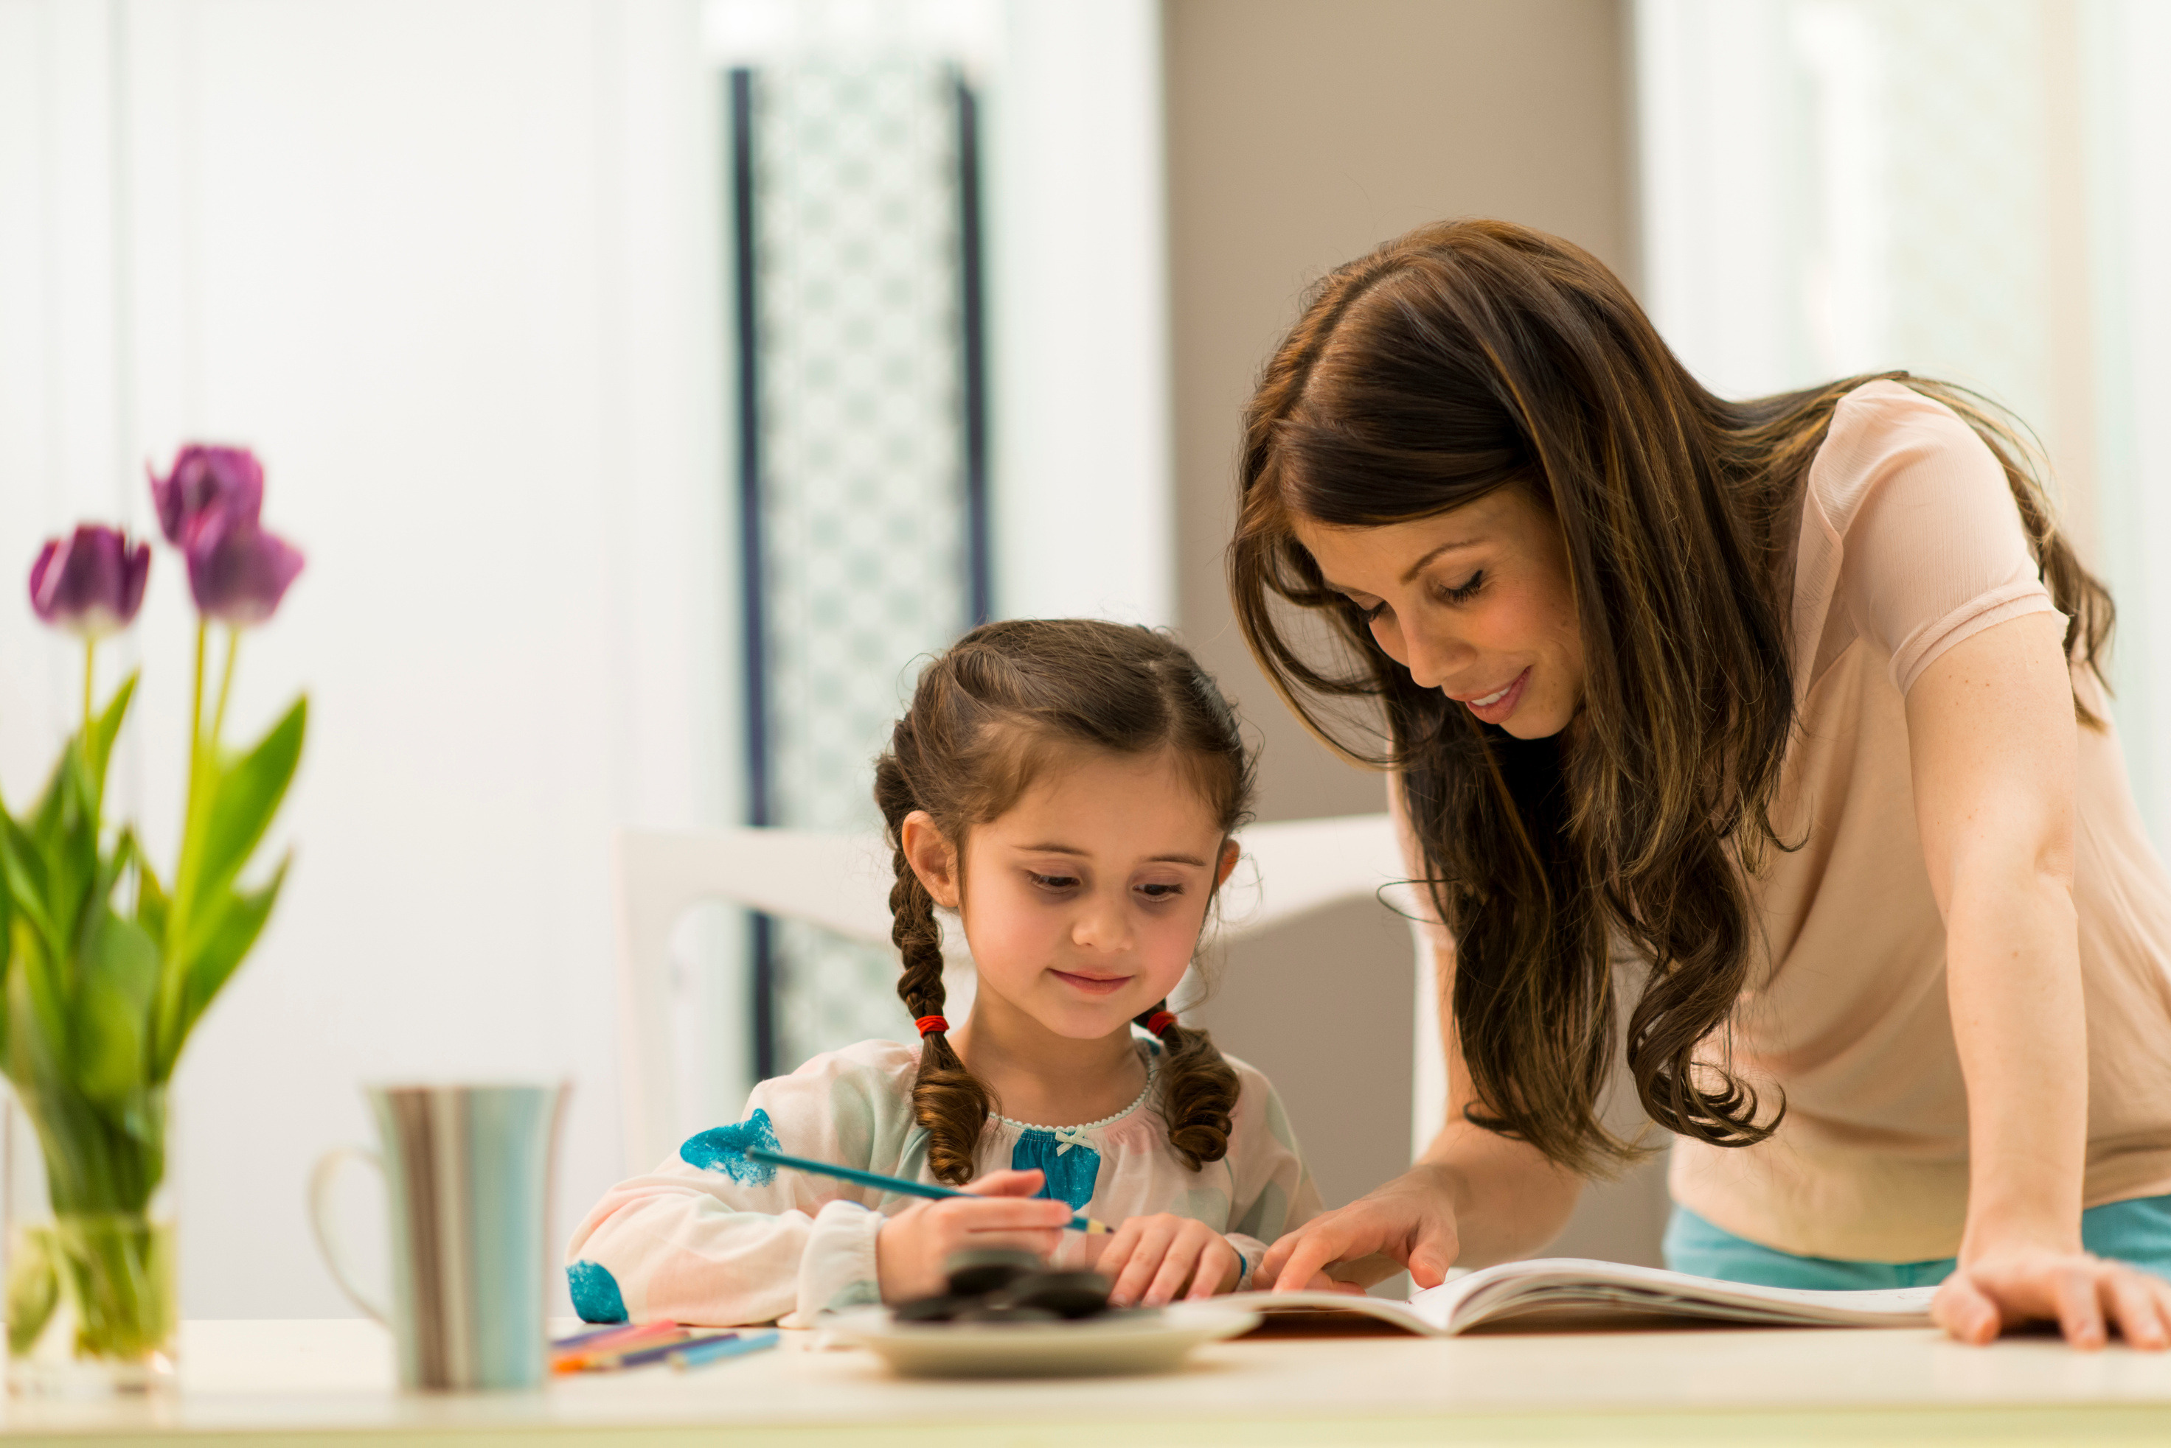
Sesiwn 2
ECES5020C
Addysg ysgolyn y cartref
Home-school education
Radical neu Chwyldroadol?
Radical or Revolutionary?

Slide 2
Datganiad Cyffredinol o Hawliau Dynol
Universal Declaration of Human Rights
Erthygl/Article 26
  Everyone has the right to education. Education shall be free, at least in the elementary and fundamental stages. Elementary (Primary) education shall be compulsory. Technical and professional education shall be made generally available and higher education shall be equally accessible to all on the basis of merit.
  Education shall be directed to the full development of the human personality and to the strengthening of respect for human rights and fundamental freedoms. It shall promote understanding, tolerance and friendship among all nations, racial or religious groups, and shall further the activities of the United Nations for the maintenance of peace.
  Parents have a prior right to choose the kind of education that shall be given to their children.
https://www.unicef.org.uk/what-we-do/un-convention-child-rights/

Slide 3
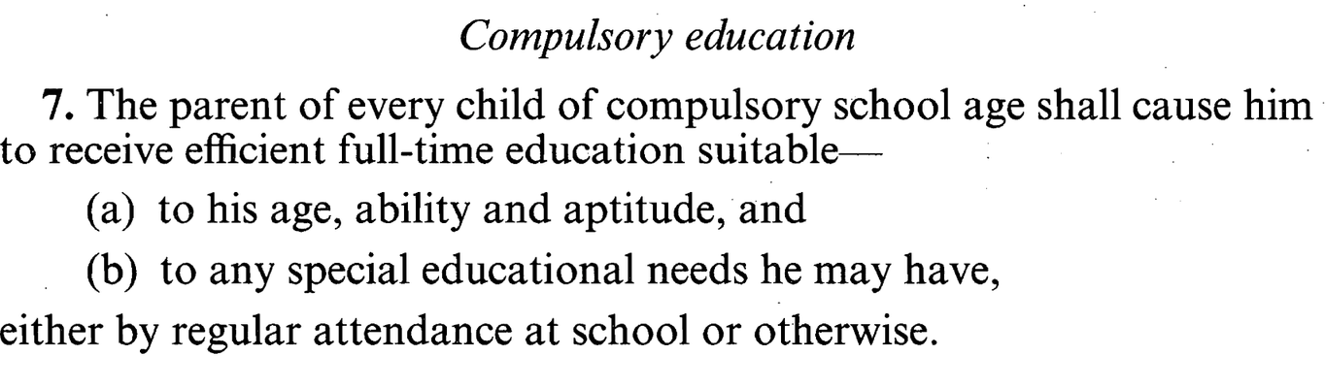
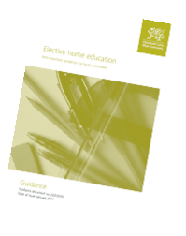

Nid yw ysgol yn statudol…/
Hawliau & Chyfrifoldebau
Mae erthygl 2 o Protocol 1 o’r Confensiwn Ewropeaidd ar Hawliau Dynol yn nodi:
O Adran 7 o Ddeddf Addysg
1996
…..ond mae addysg yn.

Slide 4

Diben Addysg / Purpose of Education
  I baratoi myfyrwyr i gyd-fynd â'r safbwynt neo-liberal presennol o gymdeithas
  I gyfreithloni'r farn ddominyddol hon ar gymdeithas a'i strwythurau
  Addysg yn cael ei yrru gan berfformiad ac yn dangos ei effeithiolrwydd yn ôl canlyniadau
  To prepare students to fit into the existing neoliberal view of society
  To legitimate this dominant view of society and its structures
  Education is performance driven and demonstrates its effectiveness by results

Slide 5
Sut mae plant a phobl ifanc yn dysgu?
  Mae tystiolaeth o niwrowyddoniaeth bod rhan ymlusgiadol ein hymennydd, sy'n eistedd yng nghanol ein hymennydd, pan fydd dan fygythiad, yn cau popeth arall i lawr, mae'n cau'r cortecs rhagarweiniol, y rhannau sy'n dysgu.
  Mae cosb ac arholiadau yn cael eu hystyried yn fygythiadau.
  Rydyn ni'n cymryd ein plant, rydyn ni'n gwneud iddyn nhw gau eu hymennydd i lawr, ac yna rydyn ni'n dweud, "Perfformiwch."
  Beth sy'n digwydd i greadigrwydd yn ein hoes ni?
  Mae angen inni symud y cydbwysedd hwnnw yn ôl o fygythiad i bleser.
Mitra (2013)

Slide 6
Sut mae plant a phobl ifanc yn dysgu?
How do children and young people learn?
“Children are biologically designed to educate themselves”
“If you can light the spark they will learn without the need for assistance, as children are natural learners”
Gray (2013)
Robinson (2013)

Slide 7
Bowles and Gintis (1976) argued school processes tend to induce passivity and the acceptance of authority.
“The truth is that schools don't really teach anything except how to obey orders”.
Gatto (1990)
“Education systems within capitalist societies are a form of ‘ideological state apparatus’
designed as a means of social control”
(Althusser, 1971 cited in Pollard et al, 2008).
Hegemony
Defines the meaning of common sense by making particular ideas seem normal for example:-
“That all children should go to school” Hicks
Schools are state mechanisms for control.
•Emphasis in schools on ‘classroom management’ is more about discipline and less about learning. It’s a way of getting students to conform to society’s expectations.
•Curriculum – prescribed knowledge which is the accepted ‘truth’ of a subject
•Who decides what should be included?
•The ‘hidden curriculum’ – reproducing social conformity?
•There is more of a concern about the quantity and quality of work irrespective of purpose.
Pollard et al, 2008

Slide 8
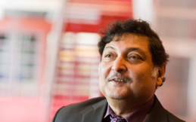
Sugata Mitra & The Hole In the Wall
‘Schools are meant to produce happy, healthy, productive people. Are they actually doing that?’
Sugata Mitra & The School in the Cloud

Slide 9
“The aim of education should be the promotion of happiness”
  William Godwin (1756 - 1836) oedd yr ysgrifennwr cyntaf ‘i roi datganiad clir o egwyddorion anarchaidd’.
  Roedd yn un o'r ysgrifenwyr Saesneg cyntaf i gydnabod bygythiad addysg a reolir gan y wladwriaeth ac i nodi rhinweddau addysg amgen, rydd.
  Yn briod â Mary Wollstonecraft, a ysgrifennodd y clasur ffeministaidd: A Vindication of the Rights of Woman -1792
  Tad Mary Shelley (awdur Frankenstein - 1818) a thad-yng-nghyfraith y bardd Shelley.
  William Godwin (1756 – 1836) was the first writer ‘to give a clear statement of anarchist principles’
  He was one of the first English-language writers to recognize the threat of state-controlled education and to set out the qualities of an alternative, free, education.
  Married to Mary Wollstonecraft, who wrote the feminist classic: A Vindication of the Rights of Woman -1792
  Father of Mary Shelley (the author of Frankenstein – 1818) and the father-in-law of the poet Shelley

Slide 10
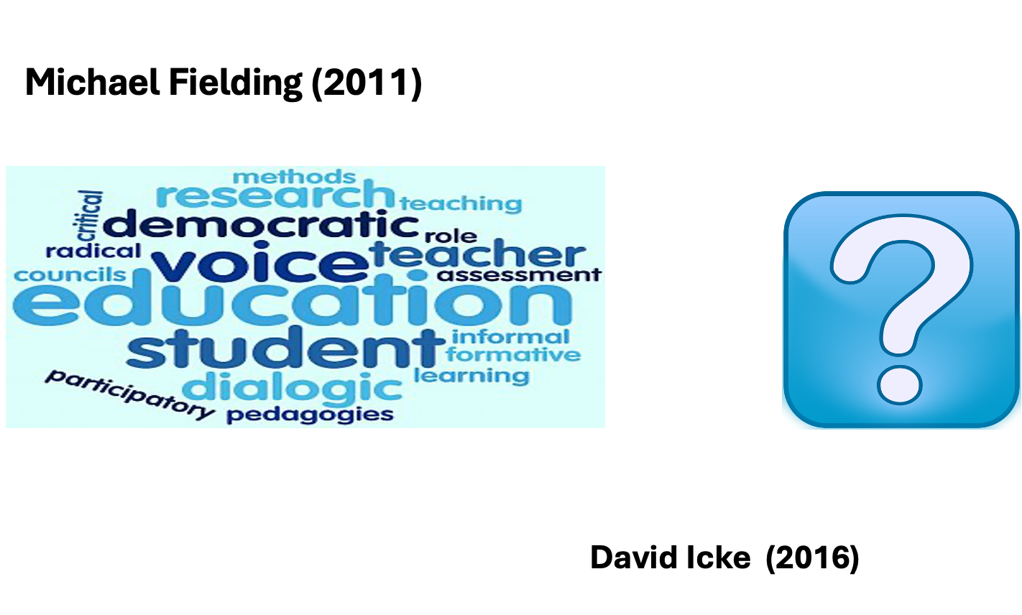

Slide 11
Satish Kumar on Alternative Education
(Addysg Amgen)
  Education: derived from educatum or educare means to bring out what is already there
  Education: should not encourage the individual to conform to society or to be negatively harmonious with it, but help him (her) to discover the true values, which come with unbiased investigation and self-awareness. When there is no self-knowledge, self expression becomes self-assertion, with all its aggressive and ambitious conflicts.
  Education: in the true sense, is the understanding of oneself, for it is within each one of us that the whole of existence is gathered.
  Education: is part of the problem and not part of the solution
  Education: is brain washing CYP to become part of the industrial system

Slide 12
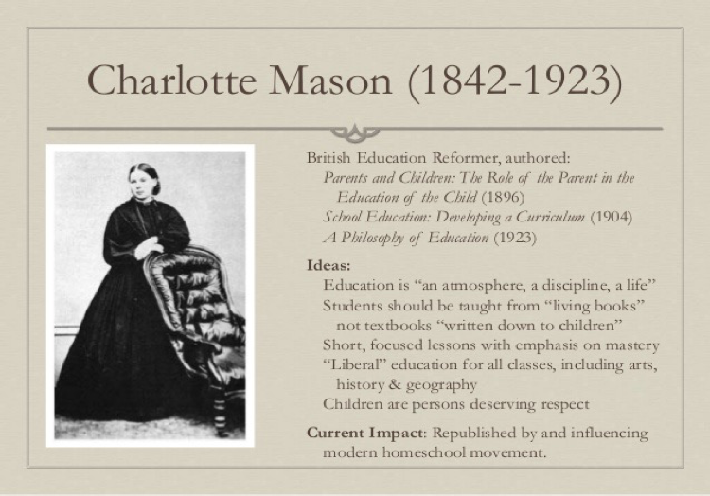

Slide 13
Addysg ddewisol yn y cartref
Elective home education
Credai Hicks y dylai addysg ganiatau:
  Gweithlu ~ greu gweithlu cystadleuol byd-eang
  Unigolyn ~ i ddod a’r gorau allan o bob un person
  Byd-eang ~ i ddeall cyd-ddibyniaeth lleol – byd-eang
  Byd gwell ~ cynorthwyo i newid cymdeithas am y gorau
Hicks believes that education should allow:-
  Workforce ~ to create a globally competitive workforce
  Individual ~ to bring out the best in every person
  Global ~ to understand local-global interdependence
  Better world ~ to help change society for the better
“We should be helping young people think more critically and creatively about probable and preferable futures”
Hicks, 2018

Slide 14
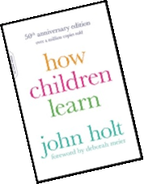
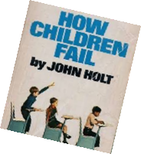
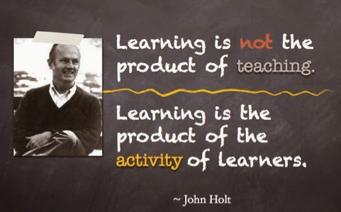
John Holt – tad ‘addysgu adref’ / the ‘father of homeschooling’

Slide 15
‘The War on Kids……’

Slide 16
Ym mha ffyrdd eraill y gall plant a phobl ifanc dderbyn addysg ar wahân i fynychu ysgol prif-ffrwd? Gelwir hefyd yn EOTAS.
In what other ways can children and young people receive an education other than attending a mainstream school? Sometimes known as EOTAS.
  Siarter (UDA) / Charter (USA)
  Hojskøle: Addysg Amgen/Alternative Ed
  Dysgu yn y cartref (Elective Home Education)
  SOLE (Self-Organising Learning Environments, Mitra)
  Ysgol Ddemocrataidd / Democratic School
  Addysg ‘Flexi’ Schooling
  Steiner (Waldorf)
  Montessori
  Small Schools
  Ysgolion Stiwdio / Studio Schools
  Summerhill
  Coedwig/Glan Môr/Mwdlyd
  Forest/Beach/Muddy

Slide 17
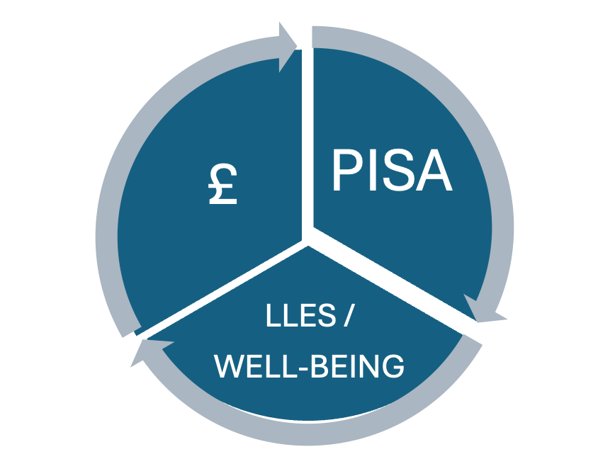
Beth sy’n digwydd yng Nghymru?
What's happening in Wales?
Notes:
PISA -Scores of Welsh students in science, reading and maths were below the average of 72 countries and economies taking part in a major study of educational performance.
Welsh students also did worse than their counterparts in England, Scotland and Northern Ireland.
The Pisa tests are taken by 15-year-olds every three years.
This is the fourth time Wales has done worse than the other UK nations.
Well-being
Time to Change Wales – an alliance of leading Welsh mental health charities – reports that one in ten young people will experience a mental health problem, and
WG What we know about children's well-being (2017-18). During secondary school there are dramatic changes in children’s well-being, self-reported health and lifestyles. Whilst at age 11 girls and boys report similar well-being and self-reported health, by aged 16 a gap is evident, with girls reporting lower well-being and worse health.
£ Investment in terms of money 7 Million investment into CAMHS!
But like Kumar said education is part of the problem…..

Slide 18
EHE
Elective Home Education
also known as:-
•Home schooling
•Home education
•Home educating
•De-schooling
•Unschooled
•Home based education
•Home based learning
•Dysgu Adref
•Addysg yn y cartref
•And many more…….

Slide 19
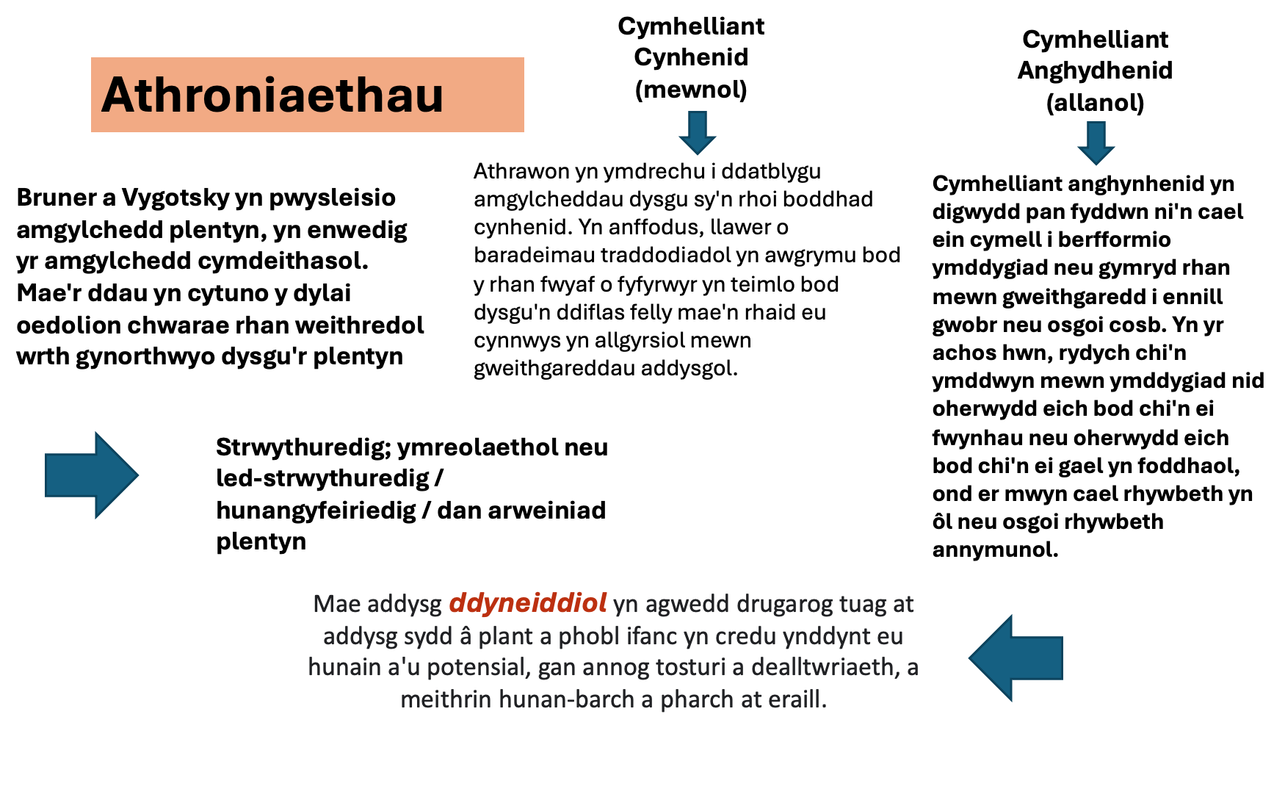

Slide 20
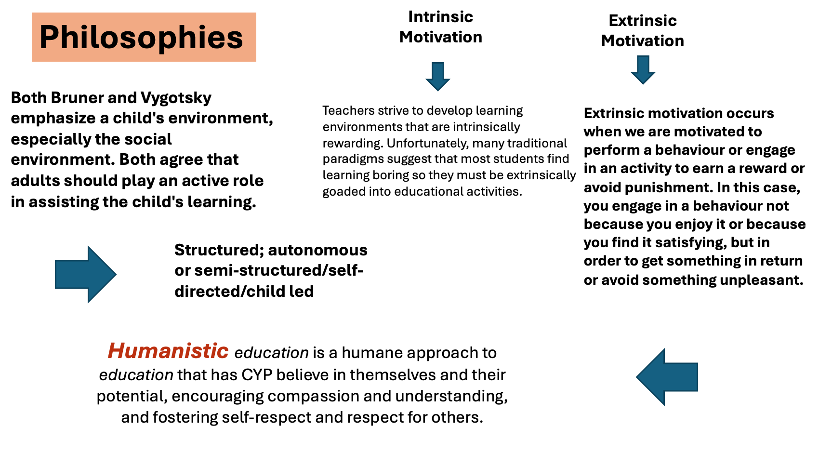

Slide 21

One of the most impressive things about home education is that in most cases learning is based on the child’s intrinsic motivation to learn.
Riley (2016)
Cymhwysedd / Competence
Hunan-reolaeth / Autonomy
Perthnasedd / Relatedness

Slide 22
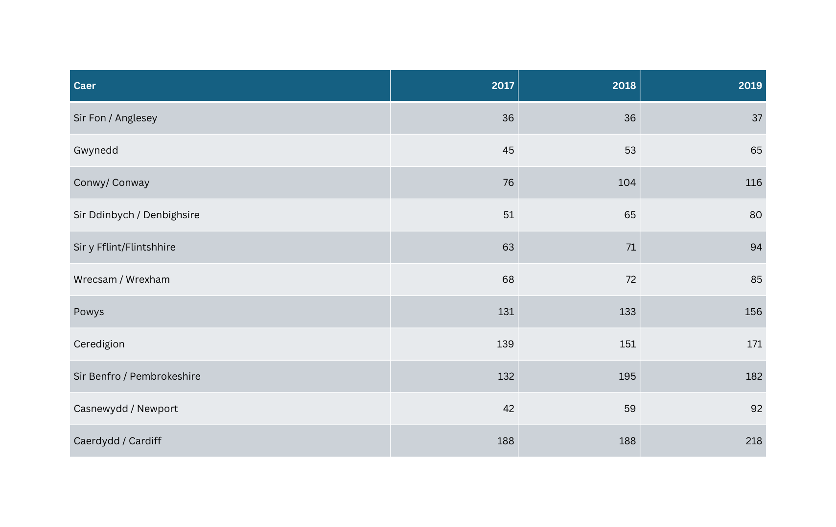
Data Addysgu yn y Cartref / EHE Data

Slide 23
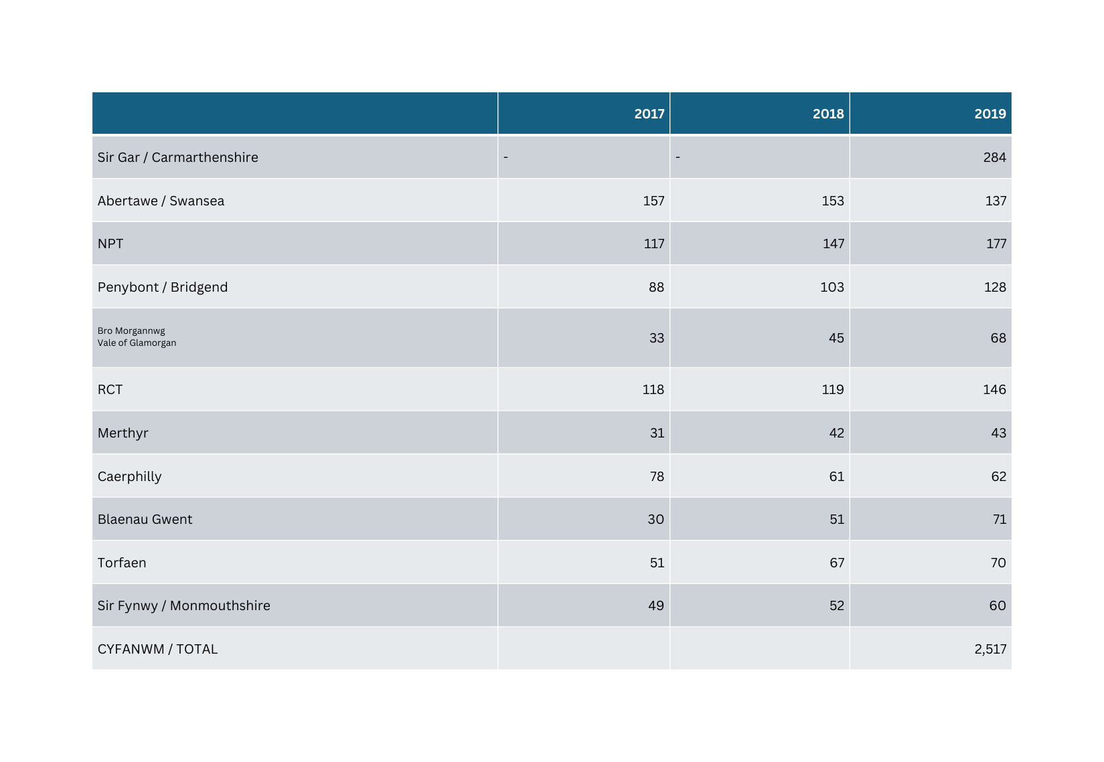
Data Addysgu yn y Cartref / EHE Data

Slide 24
Beth yw’r data diweddaraf ar gyfer Cymru?
What’s the latest data for Wales?
https://explore-education-statistics.service.gov.uk/find-statistics/elective-home-education/2025-26-autumn-term
What’s the latest data for England?

Slide 25
Ym mlwyddyn academaidd 2022/23 roedd yn hysbys bod 5,330 o blant yn derbyn addysg ddewisol yn y cartref yng Nghymru.
Cyfradd y disgyblion sy'n cael eu haddysgu fel cartref dewisol ar 2022/23 yw 11.1 o bob 1,000 o ddisgyblion, cynnydd o 1.6 o bob 1,000 o ddisgyblion yn 2009/10, ac mae'r gyfradd wedi cynyddu bob blwyddyn ers hynny. Cynyddodd y gyfradd ym mhob awdurdod lleol.
Sir Gaerfyrddin oedd â'r gyfradd uchaf, sef 26.1 o bob 1,000 o ddisgyblion. Ceredigion oedd a’r gyfradd uchaf o blant sy'n cael eu haddysgu gartref ers 2009/10 ar gyfer merched a bechgyn.
Yn 2022/23 mae'r gyfradd yn Sir Gaerfyrddin wedi cyrraedd:
•27.8 o bob 1,000 o fenywod
•24.4 o bob 1,000 o wrywod
Disgyblion sy'n derbyn addysg heblaw yn yr ysgol: Medi 2022 i Awst 2023 [HTML] | LLYW.CYMRU

Slide 26
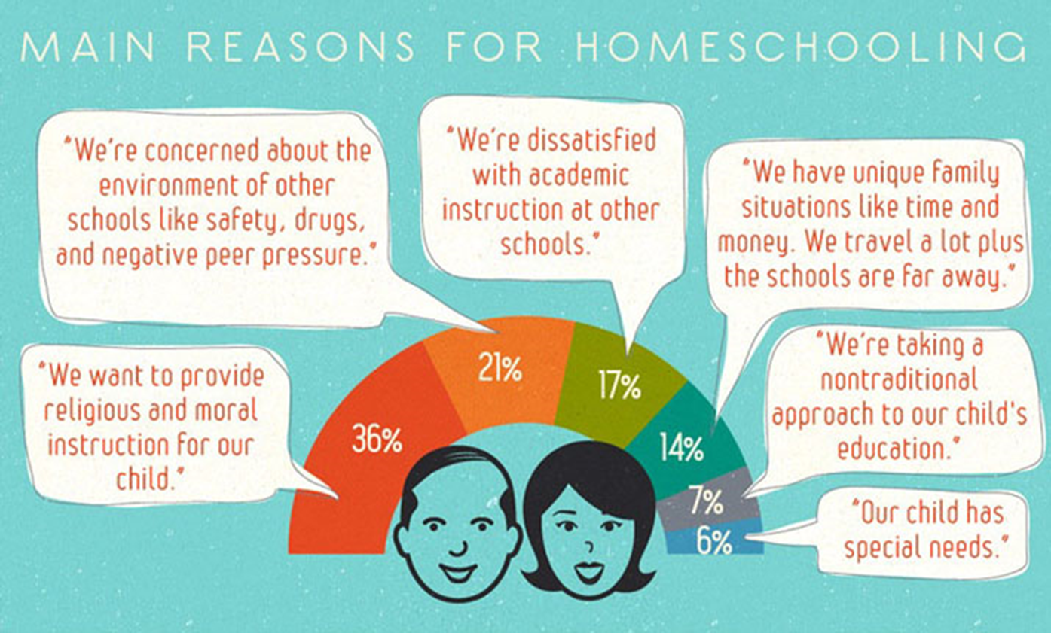

Slide 27
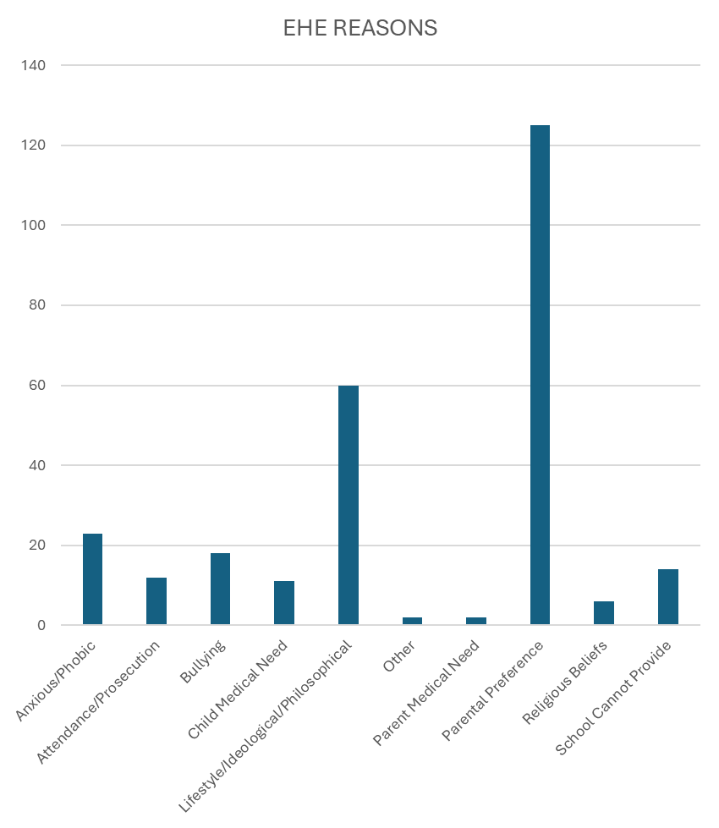
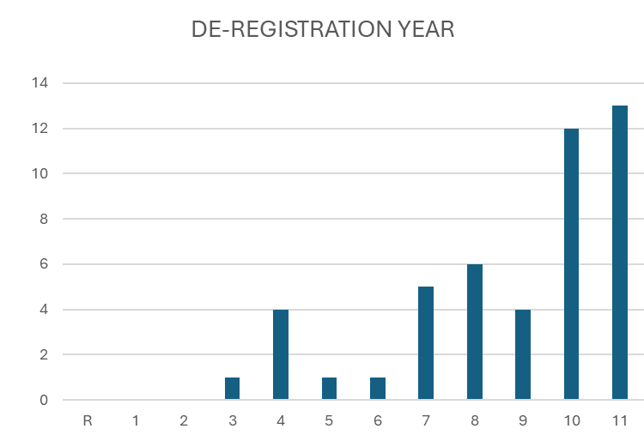
DATA-Beth mae’n dweud wrthym?
DATA-What is this telling us?

Slide 28
Darllen Pellach / Further reading…..
•Hern (1996) Deschooling Our Lives
•Gribble (1998) Real Education: Varieties of Freedom
•Carnie (2003) Alternative Approaches to Education
•Education Otherwise
What is education worth if it does not include discussion of moral and ethical dilemmas as one of its central concerns? Hicks (2004)
Disgyblion sy'n derbyn addysg heblaw yn yr ysgol: Medi 2022 i Awst 2023 [HTML] | LLYW.CYMRU
Elective Home Education Guidance

Slide 29
Watson, D. (ed.) (2012) Children’s Social and Emotional Wellbeing in Schools, Bristol: Policy Press.
Negroponte, N (2014) A 30 year history of the future [video]. Available at: https://www.ted.com (Accessed: 9 March 2019).
Mitra, S (2013) Build a school in the cloud. [video] Available at: https://www.ted.com/talks (Accessed: 9 March 2019).
Negroponte, N (2006) One laptop per child [video]. Available at: https://www.ted.com (Accessed: 9 March 2019).
Mulgan, G (2011) A short intro to the Studio School [video]. Available at: https://www.ted.com (Accessed: 10 March 2019).
Montessori Society AMI (UK) - Montessori Education Available st: https://www.montessorisociety.org.uk (Accessed: 11 March 2019).
Steiner Waldorf School Fellowship (2018) What is Steiner Education? Available at: https://www.steinerwaldorf.org (Accessed: 11 March 2019).
Hume, C (2016) PISA: Wales still worst in UK world education tests. Available at: https://www.bbc.co.uk/news/uk-wales-38208738 (Accessed: 12 March 2019).
Time to Change Wales, Myths and Facts, Available at: https://www.timetochangewales.org.uk (Accessed: 12 March 2019).
WG (2018) Well-being of Wales 2017-18: What do we know about children’s well-being? Available at: https://gov.wales/ (Accessed: 12 March 2019).
Smith, M. K. (1998) ‘William Goodwin and informal education’, the encyclopaedia of informal education. Available at: www.infed.org/thinkers/et-good.htm. (Accessed: 12 March 2019).
UNICEF (n.d.) What is the UNCRC? Available at: https://www.unicef.org.uk (Accessed: 16 March 2019).
WG (2017) Home education Non-statutory Guidance for local authority. Available at: https://beta.gov.wales/elective-home-education (Accessed: 16 March 2019).
Education Act 1996 Chapter 1. Available at: https://www.legislation.gov.uk (Accessed: 16 March 2019).
War on Kids (2009) Cevin Soling [documentary] https://www.youtube.com (Accessed: 16 March 2019).
Robinson, K (2013) How to escape education death valley. [video] TED.com. April 2013. Available at: https://www.ted.com (Accessed: 16 March 2019).
Fielding, M (2008) Personalisation, Education, Democracy and the market. Soundings Issue 38 spring pp 56-69.
Fielding, M., & Moss, P. (2011) Radical education and the common school: A democratic alternative. London, UK: Routledge.
Freire, P (1992). Pedagogy of hope: Reliving pedagogy of the oppressed. London: Continuum.
Riley, G (2016) The role of self-determination theory and cognitive evaluation theory in home education. Cogent Education, 3 (1), 1163651
Hicks, D (2012) The future only arrives when things look dangerous: Reflections on futures education in the UK Available at: www.teaching4abetterworld.co.uk (Accessed: 16 March 2019).
Askew, S. & Carnell, E. (1998) Transforming Learning: Individual and global change. London: Cassell.

