Slide 1

Child Protection

Slide 2
Objectives of the session
By the end of this session, you should be able to:
Give a definition of child abuse
Name and describe different types of abuse
Identify common signs of abuse
Understand what to do in case of suspected abuse
Identify situations when you might be vulnerable.

Slide 3


Legislation and Child Protection
The Children's Act 1989:
“All children, regardless of gender, racial origin, religious belief and sexual identity have a right to be protected from abuse.”
Article 6 UNCRC state that All children
have a right to life

Slide 4
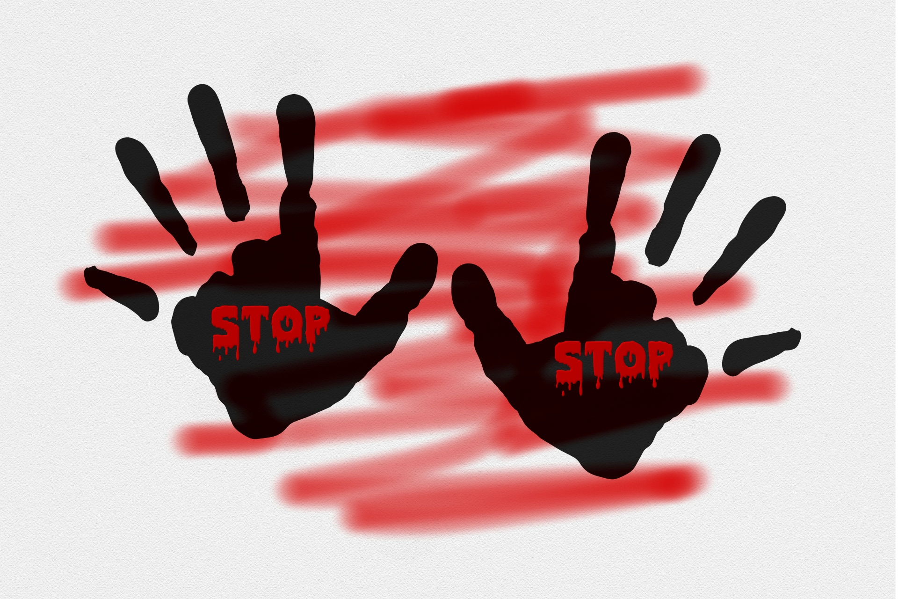

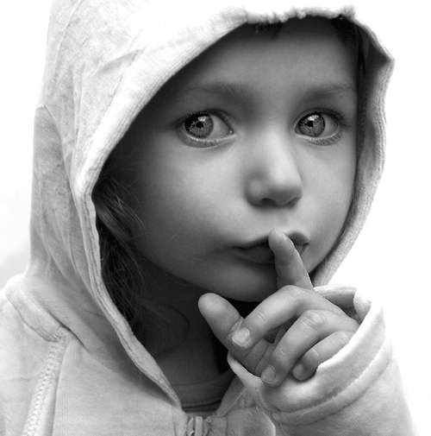
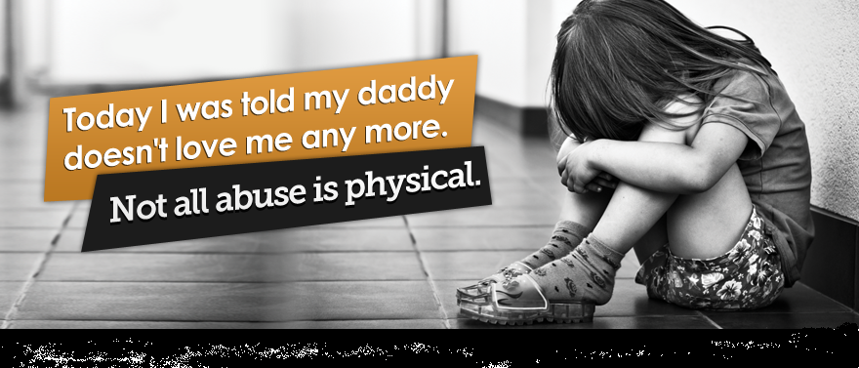
There are 4 different types of abuse:
Physical abuse
Emotional abuse
Sexual abuse
Neglect
This Photo by Unknown Author is licensed under CC BY-SA

Slide 5

PHYSICAL ABUSE
Hitting
Shaking
Throwing
Poisoning
Burning & scalding
Drowning
Suffocating
Fabricated & Induced Illness

Slide 6
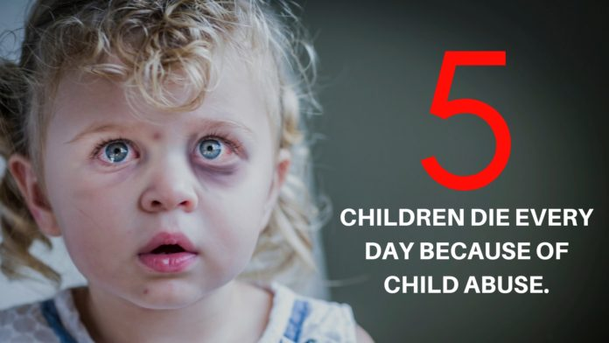

Signs of Physical Abuse
Social Isolation or Withdrawal
Bruising

Slide 7
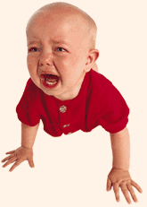
EMOTIONAL ABUSE
Persistent emotional ill-treatment
of a child, which causes severe and
persistent damage to his/her emotional development.
It may involve:
conveying to children they are worthless, unloved or inadequate
conveying to children that they are valued only so far as they meet the needs of another person
inappropriate expectations for their age or development
causing children to feel frightened or in danger
the exploitation or corruption of children

Slide 8
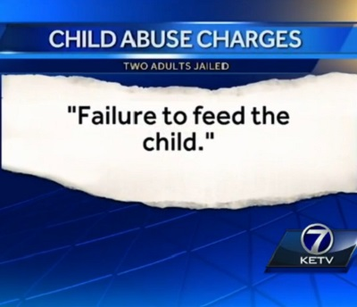
NEGLECT
Persistent failure to meet a child’s
basic and/or psychological needs,
likely to result in the serious
impairment of a child’s health
or development.
This may involve
a parent or carer failing to provide adequate food, shelter and clothing
failing to protect a child from physical harm or danger
failure to ensure access to appropriate medical care or treatment
unresponsiveness to a child’s basic emotional needs

Slide 9
SEXUAL ABUSE
Forcing or enticing a child or
young person to take part in
sexual activities, whether or
not the child is aware of what
is happening.
Activities include:-
physical contact, including penetrative and non-penetrative acts
involving children looking at or in the production of pornographic material
watching sexual activities
encouraging children to behave in sexually inappropriate ways

Slide 10

Child Protection
Child Protection Policies
Anti Bullying Policies
Attendance
Health & Safety
Whistle Blowing
Staff Training
Curriculum
Safe Recruitment & Selection
Managing Allegations Against Staff

Slide 11

What can be done by a setting to protect children?
Discuss with a person sitting next to you and suggest one example

Slide 12

WHY DO THINGS GO WRONG?
Understanding our personal values and beliefs about child abuse

Slide 13
Why do things go wrong?
The biggest barrier to diagnosis is the existence of emotional blocks in the minds of professionals.
These can be so powerful that they prevent diagnosis even being considered in quite obvious cases.
All those working with children should be warned that their overwhelming impulse on confronting their first case is to cover it up.’ (????!!!!!!!!)
British Medical Journal (1999)

Slide 14
Identify situations when you might be vulnerable within your workplace setting
when you are likely to be alone with a child
administering first aid
restraining a child
when a child wants affection
when providing intimate care or a service that involves touching children, such as dealing with incontinence

Slide 15
Serious Case Reviews - Statistics
From to 2018 to 2019 the NSPCC (2019) have reported 136 serious case reviews within the UK.
Discuss:
In what areas are the government and agencies failing?
Why are serious case reviews highlighting the same failings time and time again?
What needs to be done?
Are the recommendations achievable within our current economic climate?

Slide 16
Activity
Discuss in your groups
Do we need to look at how society regards a child?
Introduce more policy and legislation?
Tighten security measures?
Punishments for the perpetrators needs to be harsher.
Educate?

Slide 17
References
GOV.UK, (2019) Child Protection. Available at: www.teachernet.gov.uk/childprotection. (Accessed 14th October 2019)
GOV.UK, (2019) All DfE Services and Information. Available at:https://www.gov.uk/government/organisations/departmentfor-education (Accessed 14th October 2019).
NSPCC, (2019) Safeguarding Children. Available at: https://learning.nspcc.org.uk/safeguarding-child-protection/ (Accessed 14th October 2019).
NSPCC, (2019) National case review repository. Available at: https://learning.nspcc.org.uk/case-reviews/national-case-review-repository/ (Accessed 14th October 2019)

Slide 18


Quote

