Slide 1
Apple’s culture and ethics
People management
26/11/2022
Vasilica Toma

Slide 2
Apple’s culture
Apple is one of the most well-known firms that have revolutionised the consumer electronics sector. After the death of its famous leader, Steve Jobs, Apple faced truly difficult days, and many did not trust that Tim Cook, with his quiet and unassuming personality, could secure the organization's continued growth. (Lashinsky 2015). Nonetheless, the company has strong dynamics and revenue growth. Apple has a robust organisational culture and a relatively tight hierarchical structure (Schermerhorn et al., 2019).
A company's organisational structure is one of the variables that might secure its market share and competitiveness. It is "the system of tasks, workflows, reporting linkages, and communication channels that connects the work of various individuals and groups."(Schermerhorn et al. 2019, p. 237).
Apple's structure has evolved into a highly hierarchical organisation with aspects of simple structure, strong divisional form, and a certain amount of adhocracy. Steve Jobs, who communicated his vision and pushed on the implementation of his projects, ideas, and plans, initially made all significant strategic choices. (Schermerhorn et al., 2019). This form of leadership is typical of simple systems in which a single individual is in charge of all decisions and operations. Typically, this form of organisation characterises tiny businesses and corporations with a small number of employees. Apple's organisational structure has been subject to a few rounds of revisions as a direct result of Tim Cook's leadership. For instance, compared to the early years of Apple's existence, the company's executives now enjoy a greater degree of independence when it comes to making decisions. During the time of Steve Jobs, all procedures and decisions required his approval. This rigorous control no longer exists as strategic goals and decisions are formulated through dialogue, but Tim Cook has the last word. (Schermerhorn et al., 2019).

Slide 3
Charles Handy was one of the most notable academics who studied organisational culture. Handy felt that organisational culture and organisational structure were intimately intertwined, which is now one of the field's basic theories (Hughes 2018). Power, role, task, and person cultures comprise the researcher's typology of culture. According to this paradigm, Apple's culture might be regarded as a combination of power culture and task culture. The former style of organisational culture is characterised by centralised decision-making, in which a single individual or a small group of individuals make key choices (Hughes 2018). The latter is connected with a substantial amount of collaboration across several networks. It is possible for a person's authority to be based on their position within the organisation, but it can also be based on their competence and charm.
Apple's workplace environment is one that many other companies have looked to for inspiration. This prestigious corporation owes a significant portion of its success to the management team's ability to provide for its workers' basic needs while also ensuring their happiness. So, what is it about the company culture at Apple that is so admirable?
Culture in the workplace refers to the guiding principles by which daily operations are guided. Employee retention and turnover can both benefit from a well-maintained business culture.
Apple serves as an example of effective team and staff management for the tech sector. Apple's employees have their own distinct corporate culture and set of values, which fosters a productive partnership between human resources and innovation.

Slide 4
The iconic iPhone, iPad, Macbook, Apple Watch, and other products have helped make Apple Inc. the most valuable and largest technological business in the world. They face off against other industry heavyweights including Google, Amazon, PayPal, Intel, Samsung, and many more.
Apple, a technology firm, is focused on forward-thinking strategies in the face of intense competition. They are perfectly comfortable flouting established norms.
Apple employees are encouraged to not just think creatively but also to ignore conventional wisdom. They do not base their decisions or priorities on those of rival businesses. Instead of coming up with tried-and-true methods, this group of experts is challenged to find novel approaches.
The organization also promotes healthy rivalries amongst departments in order to spur expansion and enhanced productivity. Apple's internal competitiveness was higher while Steve Jobs was CEO, but Tim Cook has lowered it in favour of greater teamwork and collaboration. Employees can push themselves to their limits without creating a hostile working atmosphere thanks to this moderate degree of competitiveness.

Slide 5
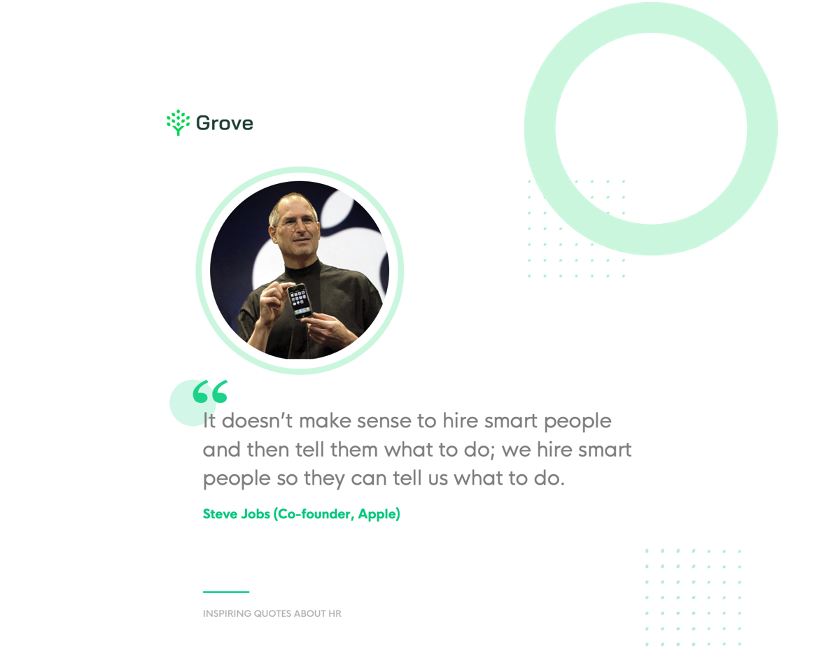
According to Steve Jobs, quality work is expected of all Apple employees. They exclusively hire the most qualified candidates available in the job market to ensure that this standard is upheld. When reviewing applicants, they are only interested in people who can actually make a change. Invest in establishing and overhauling your recruitment process from screening to interviewing to ensure only the best and most cultural-fit individuals are qualified.

Slide 6
Apple’s ethics
Because of problems with worker rights at its supplier factories, Apple has been the target of many campaigns for a long time.
According to a December 2019 Guardian report, Apple was listed as a defendant in a lawsuit brought in Washington, DC, on behalf of 14 parents and children from the Democratic Republic of the Congo by the human rights organisation International Rights Advocates (DRC). In this action, Google, Dell, Microsoft, and Tesla were all named as defendants. A number of families were suing Apple for damages and compensation after their children allegedly died or suffered major injuries while working in cobalt mines within Apple's supply chain. (Kelly, 2019)
Also, over the years Apple managed to show significant issues in the environment sector as well. For example, PVC, brominated flame retardants (BFR), and phthalates were a few examples of the potentially dangerous compounds that were covered in Apple's 2019 Environmental Responsibility Report. (Apple, 2019)
Apple received the lowest reviews in 2019 from Ethical Consumer's rating for its environmental reporting. Despite considerable environmental implications, Apple's 2019 Environmental Responsibility report featured only one measurable and dated future environmental goal, which was to generate or procure at least 4 gigawatts of clean energy in its supply chain by 2020 (Ethical Consumer, 2018).
Ethical dilemmas can have a substantial influence on the brand image of a firm, as well as on its customers and workers. The numerous ethical concerns that have been raised about Apple Inc. have shed light on the degree to which the company adheres to the ethical principles it has outlined for its business practises and maintains the social responsibility standards it has established. Apple admits that it does not always live up to its commitments, despite the fact that it values things like honesty, respect, confidentiality, compliance, and dedication to society.

Slide 7
Despite this, it would appear that the corporation will not be affected by the consequences. Its powerful name is synonymous with expensive prices and fashionable technical equipment. The most recent information available (as of the 27th of October, 2022) indicated that Apple was among the top 10 consumer electronics firms and finest brands in the entire world. In addition to this, the company's revenue has been consistently expanding over the past few years. It began at 108.2 billion dollars in 2011 and increased to 394.3 billion dollars in 2022 from that point on. (Rosenstock and Gala, 2022)
Therefore, it is possible to draw the conclusion that the ethical difficulties did not cause any harm to the brand image of Apple and did not discourage any of its customers.
There are also some positive aspects of this growth. Apple has revealed that it intends to accelerate its investments in the United States, with plans to make new contributions of more than $430 billion and add 20,000 new jobs across the country over the next five years. This news was revealed in conjunction with the company's announcement that it will accelerate its US investments. Apple's donations in the United States have greatly surpassed the company's original five-year goal of $350 billion established in 2018. This has been the case over the course of the past three years. Apple has announced that it will increase the degree of commitment it has made to the United States by twenty percent over the next five years. This move will boost American innovation and drive economic benefits across the country. This comprises tens of billions of dollars for the development of silicon for the next generation and innovation related to 5G across nine states in the United States. (Apple, 2021)
Through direct employment, spending with US suppliers and manufacturers, and developer jobs in the burgeoning iOS app economy, Apple currently supports more than 2.7 million jobs in the United States. Apple is the greatest taxpayer in the United States, having paid about $45 billion in domestic corporate income taxes in only the past five years. (Apple, 2021)

Slide 8
References
Schermerhorn, JR, Davidson, P, Woods, P, Factor, A, Junaid, F & McBarron, E 2019, Management, John Wiley & Sons, Milton.
Lashinsky, A. (2015). Apple’s Tim Cook leads different. [online] Fortune. Available at: https://fortune.com/2015/03/26/tim-cook/.
Hughes, M. (2019). Managing and leading organizational change. London ; New York, N.Y.: Routledge.
Rossman, L. (10AD). Apple’s Independent Repair Program is a useless PR stunt. [online] www.youtube.com. Available at: https://www.youtube.com/watch?v=0rCUF-V1esM [Accessed 27 Nov. 2022].
Ethical Consumer (2018). Apple Inc | Ethical Consumer. [online] Ethical Consumer. Available at: https://www.ethicalconsumer.org/company-profile/apple-inc.
Apple (2019). Ethics and Compliance - Policies - Apple. [online] Apple Compliance. Available at: https://www.apple.com/compliance/policies/.
Kelly, A. (2019). Apple And Google Named in US Lawsuit Over Congolese Child Cobalt Mining Deaths. [online] The Guardian. Available at: https://www.theguardian.com/global-development/2019/dec/16/apple-and-google-named-in-us-lawsuit-over-congolese-child-cobalt-mining-deaths.
Apple (2019). Environmental Responsibility Report. [online] Available at: https://www.apple.com/environment/pdf/Apple_Environmental_Responsibility_Report_2019.pdf.
Rosenstock, J. and Gala, T. (2022). Apple Reports Fourth Quarter Results. [online] Apple Newsroom. Available at: https://www.apple.com/newsroom/2022/10/apple-reports-fourth-quarter-results/#:~:text=Cupertino%2C%20California%20October%2027%2C%202022.
Apple (2021). Apple Commits $430 Billion in US Investments over Five Years. [online] Apple Newsroom. Available at: https://www.apple.com/newsroom/2021/04/apple-commits-430-billion-in-us-investments-over-five-years/.

