Slide 2
ECEY4001/C
Human Development
Lecture 8 – Play

Slide 3
Task
Research the term ‘Play’
10 minutes

Slide 4
Play
Google the definition of ‘play’ and the first thing that pops up is this:
“to engage in activity for enjoyment and recreation rather than a serious or practical purpose”

Slide 5
Play
Different to each one of us
‘Play is whatever the individual wants it to be, either to meet a need, solve a problem or express a feeling’
(Smidt, 2011)

Slide 6
Task
What does play look like for 3 – 4 –year olds
How do settings ensure they provide appropriate opportunities to play
What are some of the barriers to providing good play opportunities
What skills can be developed through play?

Slide 7
What about you?
Think back to your own childhood

Slide 8
Why?
Rights
Read Article 31 of UNCRC

Slide 9
Play
It is paradoxical that many educators and parents still differentiate between a time for learning and a time for play without seeing the vital connection between them

Slide 10
Play Policy Wales
Play is the elemental learning process by which humankind has developed. Children exhibit a behavioural imperative and instinctive desire to play. It has contributed significantly to the evolutionary and developmental survival of our species. Children use play in the natural environment to learn of the world they inhabit with others. It is the very process of learning and growth, and as such all that is learnt through it is of benefit to the child
(Welsh Assembly Government, 2002)
(Welsh Government, 2008)

Slide 11
Foundation Phase
‘Through their play, children practice and consolidate their learning, play with ideas, experiment, take risks, solve problems, and make decisions individually, in small and in large groups’
(Welsh Government, 2015)

Slide 12
A Curriculum for Funded Non-Maintained Nursery Settings
Play is a fundamental right for all children. They have a strong intrinsic need to play. Through play and playful experiences, children find ways to explore a range of emotions and learn about the world they inhabit with others
(Welsh Government, 2022)

Slide 13
Effects of Play
As children play, their brain develops, their muscles grow strong, and they develop good social and life skills such as learning to share, take turns, make choices and understand the feelings of others

Slide 14
Discuss
Play is the lens through which children experience their world, and the world of others
(Sutton Smith, 1997)

Slide 15
Task
Use the resources to play, create and explore

Slide 16
Emotional-behavioural benefits
Play reduces fear, anxiety, stress, irritability
Creates joy, intimacy, self-esteem and mastery not based on other’s loss of esteem
Improves emotional flexibility and openness
Increases calmness, resilience and adaptability and ability to deal with surprise and change
Play can heal emotional pain

Slide 17
Social benefits of play
Increases empathy, compassion, and sharing
Creates options and choices
Models relationships based on inclusion rather than exclusion
Improves nonverbal skills
Increases attention and attachment

Slide 18
Physical benefits
Positive emotions increase the efficiency of immune, endocrine, and cardiovascular systems
Decreases stress, fatigue, injury, and depression
Increases range of motion, agility, coordination, balance, flexibility, and fine and gross motor exploration

Slide 19
Froebel
Froebel's Gifts
Songs and games
Caring for living thing, plants and animals
Prior to Froebel, very young children were not educated
Recognizes that at our essence we are creative beings

Slide 20
Piaget
Accommodation
Assimilation
Schema
Equilibration

Slide 21
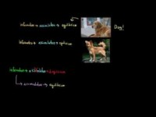
Piaget –
Schema, Accomodation, Assimiliation
What is the relation between assimilation and accommodation?
How do these concepts tell us how children learn?

Slide 22
Play
Play is an essential element of a child's development
It creates opportunities to learn about the world in which the child inhabits
It appears innate in children

Slide 23
Transitions
New Situations
Emotions
Who
Think about what you have learnt so far, how could you support transition in early childhood education.

Slide 24
Curricula
Foundation Phase
Scotland
Te Whariki

Slide 25

The 5 ‘C’s

Slide 26
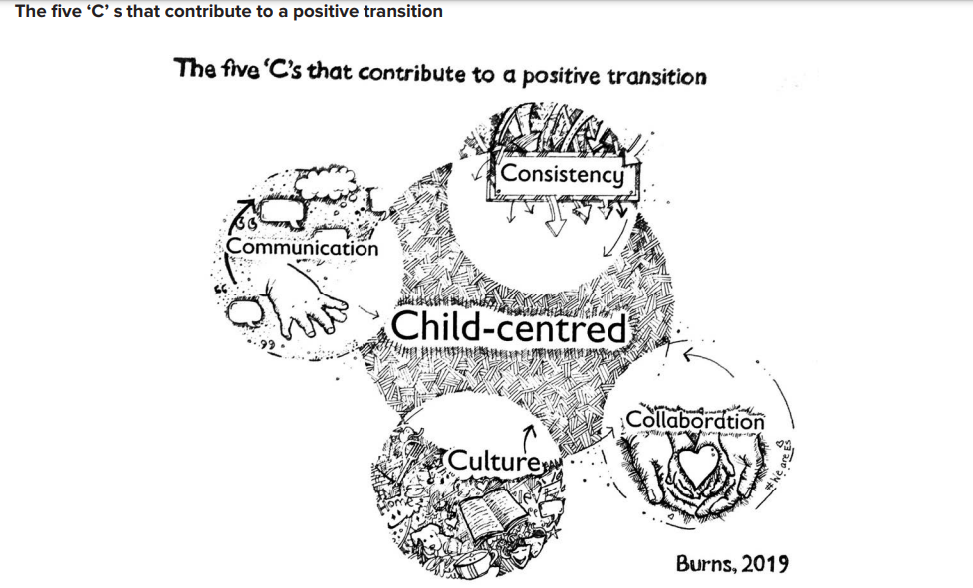
Transition

Slide 27
References
Gray, C and Macblain, S. (2012) Learning Theories in Childhood. London: Sage Publishing.
Smidt, S. (2011) Playing to Learn; The role of play in the early years. Abingdon: Routledge.
Sutton-Smith, Brian. (1997). The Ambiguity of Play. Cambridge: Harvard University Press.
Welsh Assembly Government (2002) Welsh Assembly Government Play Policy. Wales: Welsh Assemble Government.
Welsh Government (2015) Curriculum for Wales; Foundation Phase Framework. Wales: Welsh Government.
Welsh Government (2022)

