Slide 1

Employee Engagement
Student name: Antonela Costiuc
Student number: 2117337
Module name: Operating Hotel Facilities ( BMIH4006)
Lecturer name: Ffion Cumberpatch

Slide 2
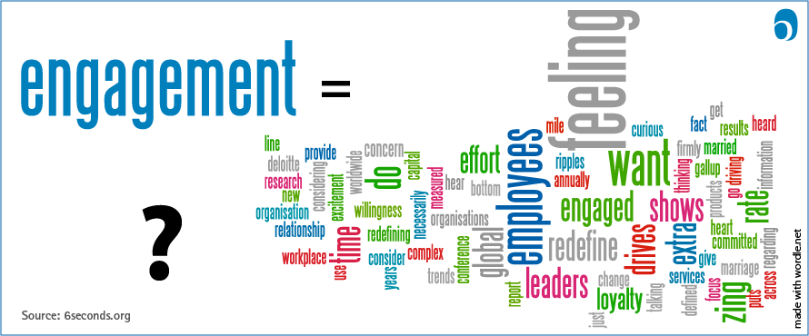
Definition
In 1993, Schmidt et al. suggested a connection between the established perception of `job satisfaction` and employee engagement with the definition: “ an employee's involvement with, commitment to, and satisfaction with work. Employee engagement is a part of employee retention.” This description fit in the characteristic concepts of employment happiness (Smith et al.,1969), and structural commitment (Meyer and Allen,1991).
Meanings of employee engagement differ in the heaviness they provide to the individual versus the organization in making engagement.

Slide 3
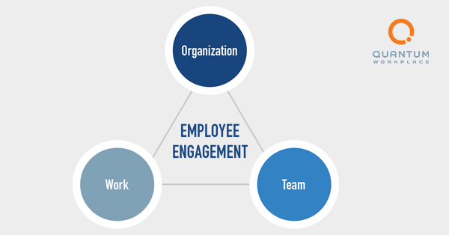
Employee engagement is the strong point of the psychological and responsive assembly workers feel in the direction of the work they do, their teams, and their organization.

Slide 4

In latest years here has been a heaviness of confirmation advising that engagement has a meaningfully progressive effect on production, performance and structural support, as well as discrete comfort, and a meaningfully bad effect on intending to quit and non-attendance from the work place.

Slide 5

Employee engagement within the Hospitality Industry
Employee engagement is significant in all businesses, but the hospitality industry in particular. The hospitality industry is customer service focussed, what is mean the employees are exclusive type representatives. One mistake up can be the difference among a pleased customer and an mad one. Experienced, competent employees are more skilled in simply given that customers the greatest experience possible, and the method to keep these employees nearby and happy with their place of work is to keep them engaged.

Slide 6

To keep the employees engaged, need to be followed a few steps:
Rewards and Recognition
Therefore, hospitality organizations need think through making a well-proportioned however flexible reward-recognition background. It would encourage employees to reach organizational objectives while get-together their individual requirements.
Freebies
In the hospitality industry, it is important to think of labours at all work stages. Start from housekeeping to the front desk, making them feel extraordinary is vital. It is a good clue to offer them freebees similar to fresh fruits, coffee, or soft drinks all through the day.

Slide 7
Compensatory Time
The hospitality industry can be influenced by customers disposable income and holiday period. Then, there is continuous work, which can have emotional impact for these workers lives. So, a small break is often the best thing you can deal a hospitality employee.
Friendly Competitions
Responsive race between employees can advantage organizational sales and employee engagement. Encourage your employees for reaching their objectives and occasionally, for giving their best.

Slide 8
Development Opportunities
The hospitality industry can offer a wide-ranging chances. A lot of people who work in the hospitality industry begin at the bottommost and work their way up. In consequence, in the hospitality industry, employee training and progress are important. It benefits to have a stability about how they performance and how they do things.
Communication Opportunities
A effective employee development instrument as well offer a team communication purpose well. It permits employees to connect and organize with their co-worker's from their smartphones.

Slide 9

A good employee engagement database supports team in doing their greatest work and liking it. Bring into line employees objectives with your Engaged Purpose is the first phase to giving your team what they need to provide memorable experiences. Employees who feel linked to their organization work harder, stay longer, and encourage others to do the similar.

Slide 10
Reference list
https://www.quantumworkplace.com/future-of-work/what-is-employee-engagement-definition
https://blog.vantagecircle.com/employee-engagement-hospitality-industry/
https://blog.vantagecircle.com/employee-engagement-hospitality-industry/
https://www.engagementmultiplier.com/resources/engaged-employees-happy-guests-how-employee-engagement-works-in-the-hospitality-industry/
https://blog.rewardian.com/why-is-employee-engagement-in-the-hospitality-industry-important
Routledge (2013), Edition1
Schmidt et al. (1993)
Smith et al. (1969)
Meyer and Allen (1991)
Catherine Truss, Kerstin Alfes, Rick Delbridge, Amanda Shantz, Emma Soane, Employee Engagement in Theory and Practice

