Slide 1
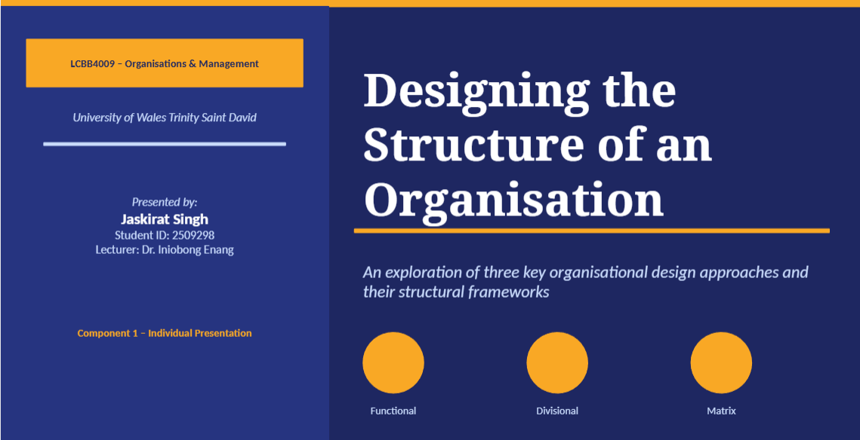

Slide 2
Outline
01
Introduction
04
Matrix Structure
Outlining organisational structure and the function of organisational charts
Design, its characteristics, its advantages and limitations
02
Functional Structure
05
Comparative Analysis
Design, its characteristics, limitations and advantages
Evaluation of the three structures aligned with key criteria
03
Divisional Structure
06
Conclusion
Design, its characteristics, limitations and advantages
Summarization of key insights and their practical implications

Slide 3
Introduction: Organisational-Structure
"Organisational structure outlines how tasks, supervision, and coordination are aimed at accomplishing organisational objectives."
(Robbins & Judge, 2023)
Key Elements of Structure
What is an Organisation Chart?
Work specialisation is the separation of duties into specialized occupations.
Putting jobs into departments is known as departmentalisation.
From the top to the bottom, the chain of command is the authority structure.
The number of workers under each manager's supervision is known as their span of control.
Where decisions are made: centralisation versus decentralisation
An illustration of the internal organization of a company (Mintzberg, 2019).
Displays departmental relationships, roles, and reporting lines.
Facilitates role accountability and clear communication.
Crucial for strategic planning, governance, and onboarding (Hill et al., 2022).
Robbins & Judge (2023); Mintzberg (2019); Hill et al. (2022)

Slide 4
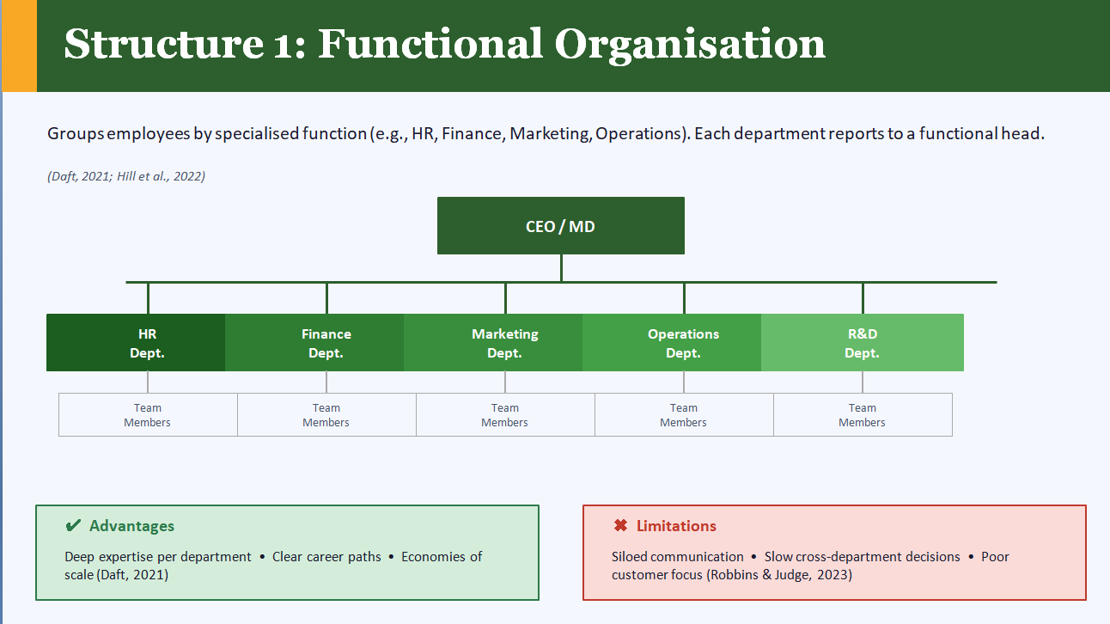

Slide 5
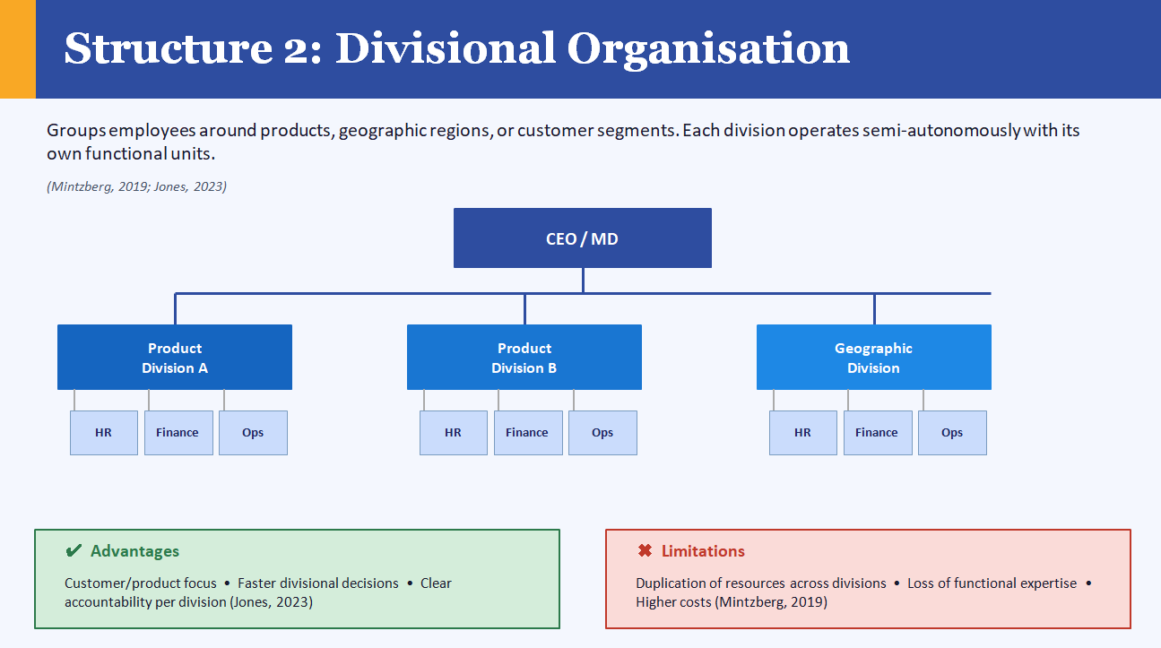

Slide 6
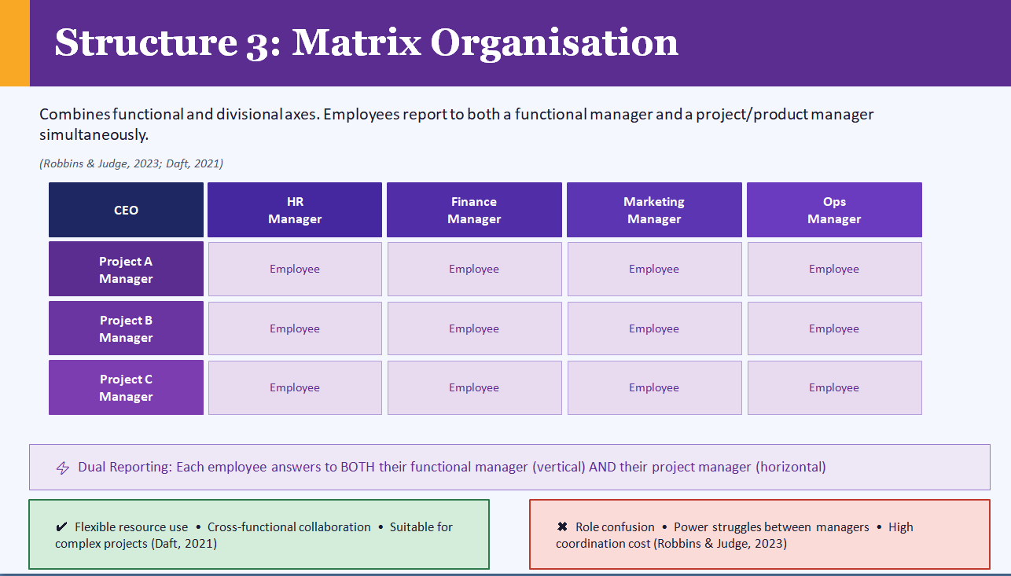

Slide 7
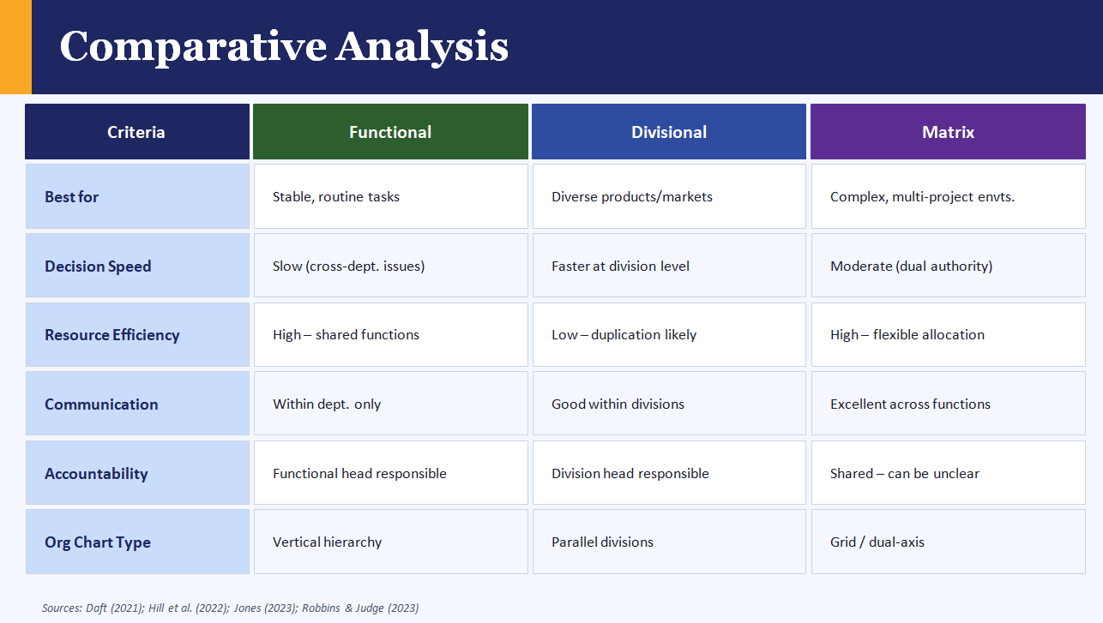

Slide 8
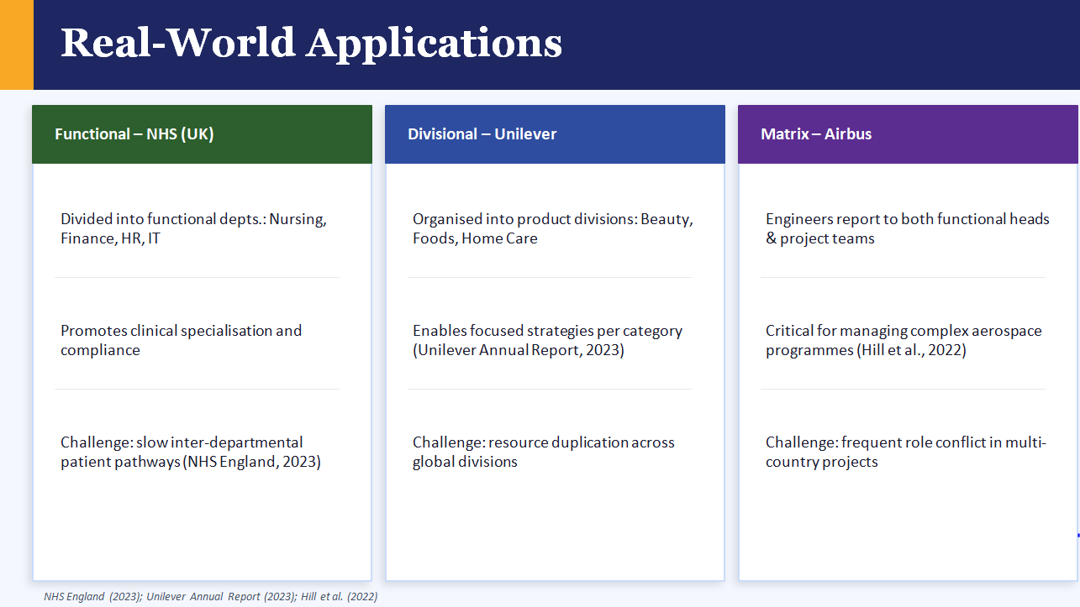

Slide 9
Conclusion
1
The foundation of any business is its organizational structure, which determines how authority, tasks, and communication are handled (Robbins & Judge, 2023).
2
For stable, single-industry businesses, a functional structure maximizes efficiency and specialization (Daft, 2021).
3
Semi-autonomous units are empowered by divisional structure, making them ideal for large companies with a variety of product lines or geographical areas (Mintzberg, 2019).
4
Although it sacrifices clear authority, matrix structures provide the most flexibility for intricate, project-based environments (Hill et al., 2022).
5
No one structure is always better than another; the best design relies on the environment, size, and strategy of the company (Jones, 2023).
Thank you | Questions? | LCBB4009 – University of Wales Trinity Saint David

Slide 10
List of References
Daft, R.L. (2021) Organization Theory & Design. 13th ed. Mason: South-Western Cengage Learning.
Hill, C.W.L., Jones, G.R. and Schilling, M.A. (2022) Strategic Management: Theory and Cases. 13th ed. Boston: Cengage Learning.
Jones, G.R. (2023) Organizational Theory, Design and Change. 9th ed. Harlow: Pearson Education.
Mintzberg, H. (2019) Mintzberg on Management: Inside Our Strange World of Organizations. New York: Free Press.
NHS England (2023) NHS Organisational Structure and Governance. Available at: https://www.england.nhs.uk [Accessed: 10 January 2026].
Robbins, S.P. and Judge, T.A. (2023) Organizational Behavior. 19th ed. Harlow: Pearson Education.
Unilever (2023) Annual Report and Accounts 2023. Available at: https://www.unilever.com/investors/annual-report [Accessed: 10 January 2026].
.

