Slide 1





Human Capital Management
LCMB7023
Assessment Component 2: Group presentation
Organisation: NHS England
Focus areas: Job Design & Job satisfaction
Student IDs:
Galla Prasith - 2543438(Team Leader)
Ahmed Rain - 2535781
Rajveer Singh - 2536659
Divya Adduru -2537627
Lecturer: Sharukh irfan

Slide 2
CONTENTS
Topic | Slide Number | Presented by
Introduction | 1 | Galla Prasith
Organisation Overview | 2 | Galla Prasith
Concept of Job Design and Job Satisfaction | 3 | Galla Prasith
Current Policies and Practices: Job Design | 4 | Galla Prasith
Current Policies and Practices: Job Satisfaction | 5 | Ahmed Rain
Current Opportunities in Job Design | 6 | Ahmed Rain
Current Opportunities in Job Satisfaction | 7 | Ahmed Rain
Current Challenges in Job Design | 8 | Ahmed Rain
Current Challenges in Job Satisfaction | 9 | Rajveer Singh
Impact of Challenges on Employees and Organisational Performance | 10 | Rajveer Singh
Critical Analysis of Opportunities and Challenges | 11 | Rajveer Singh
Root-Cause Analysis | 12 -13 | Rajveer Singh
Evidence-Based Recommendation 1: Implement AI-Enabled Job Redesign and Workforce Development | 14 | Divya Adduru
Evidence-Based Recommendation 2: Enhance Job Satisfaction through Strategic Human Capital Management | 15 | Divya Adduru
Future of Work Implications | 16 | Divya Adduru
Conclusion & Overall HRM Strategy | 17 | Divya Adduru
Summary | 18 | Galla Prasith
Synthesis of Key Findings | 19 | Galla Prasith
Recommendations | 20 | Galla Prasith

Slide 3

Student Name: Galla Prasith
ID: 2543438
INTRODUCTION
NHS England provides health care services with a workforce that is extensive and varied (NHS, 2026a).
Human Capital Management empowers workforce skills, employees' job satisfaction and organisational effectiveness.
Good job design leads to increased satisfaction, motivation, wellbeing, productivity and retention.
This presentation focuses on practices, challenges, opportunities, recommendations, and implications for the future workforce.
Figure 1: NHS England
(Source: NHS, 2026a)
Notes:
An effective workforce is essential for the delivery of high-quality health care services, which NHS England relies on. Human Capital Management fosters the capacity, engagement, wellbeing, and performance of organisations. Job design is a key factor in motivating, satisfying, enhancing productivity and retaining employees. This presentation reviews current practices, addresses challenges and opportunities, provides recommendations based on evidence, and takes into account the implications for the future workforce.

Slide 4
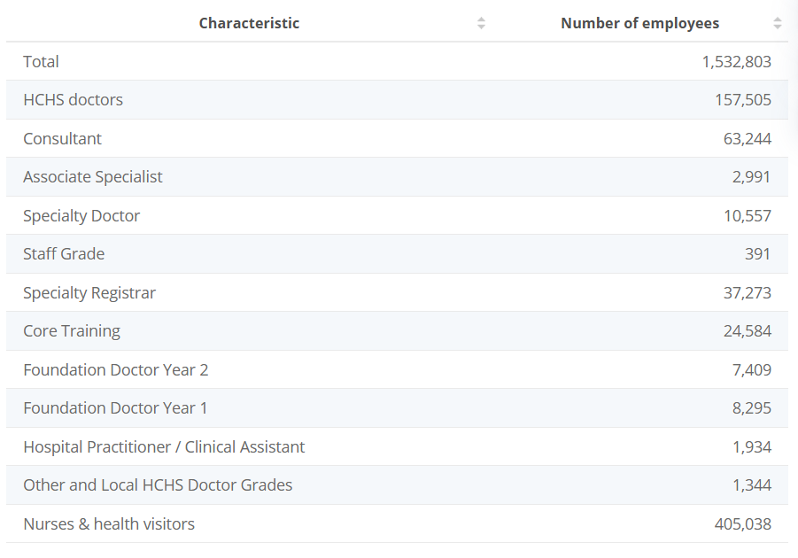

Student Name: Galla Prasith
ID: 2543438
ORGANISATION OVERVIEW
NHS England is responsible for the direction of the NHS in England, and aims to ensure all people receive high-quality health care (NHS, 2026a).
As of December 2024, there were 1.5 million staff members, comprising 157,000 doctors working in the NHS (Yang, 20225).
It includes a complex organisational structure that involves national, regional and local healthcare organisations (NHS, 2024).
Safe care, innovation, workforce development and digital transformation are emphasised as strategic priorities.
NHS England is responsible for the direction of the NHS in England, and aims to ensure all people receive high-quality health care (NHS, 2026a).
As of December 2024, there were 1.5 million staff members, comprising 157,000 doctors working in the NHS (Yang, 20225).
It includes a complex organisational structure that involves national, regional and local healthcare organisations (NHS, 2024).
Safe care, innovation, workforce development and digital transformation are emphasised as strategic priorities.
Figure 2: Total Workforce at NHS England
(Source: Yang, 2025)
Notes:
NHS England is responsible for running a complicated healthcare system, with an emphasis on providing facilities for patients of a high quality, in a safe and accessible environment. It has a very large workforce of 1.5 million staff, which is a crucial human capital resource to be planned, developed, and engaged effectively. Organisational structures are decentralised to be more responsive in the region, and strategic issues increasingly focus on innovation, technology implementation, employee wellness, and sustainable provision of care.

Slide 5
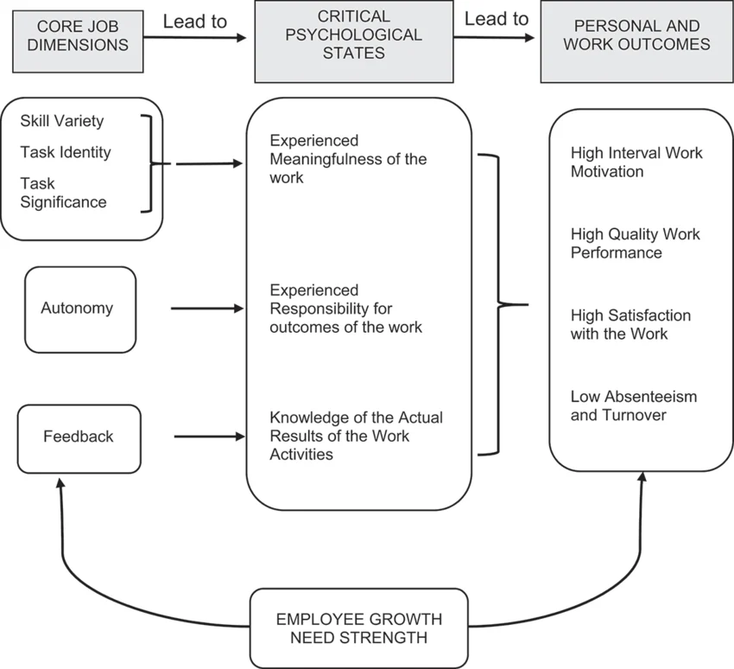
CONCEPT OF JOB DESIGN AND JOB SATISFACTION
Student Name: Galla Prasith
ID: 2543438
Job design organises tasks, responsibilities, roles, and working conditions in order to enhance employee performance (Stone, Cox, and Gavin, 2020).
According to the Job Characteristics Model, dimensions of interest are skill variety, task identity, significance, autonomy, and feedback (Tcharmtchi et al. 2023).
Job satisfaction is a key factor in employees' attitudes towards their job, which helps with the motivation and retention process (Armstrong, 2021).
In this context, the knowledge, skills and experience of satisfied employees are regarded by Human Capital Theory as paying organisational investments (Yakusheva, Lee, and Weiss, 2024).
Figure 3: Job Characteristics Model
(Source: Tcharmtchi et al. 2023)
Notes:
Job design is a key factor to balance work responsibilities, autonomy, and meaningfulness as experienced by employees. According to the Job Characteristics Model, enriched jobs can improve employee motivation and engagement. Job satisfaction is not just about positive feelings, but also about what employees feel over time. According to the Human Capital Theory, the knowledge and competencies that satisfied employees acquire over time augment their organisation's capacities, productivity and retention.

Slide 6
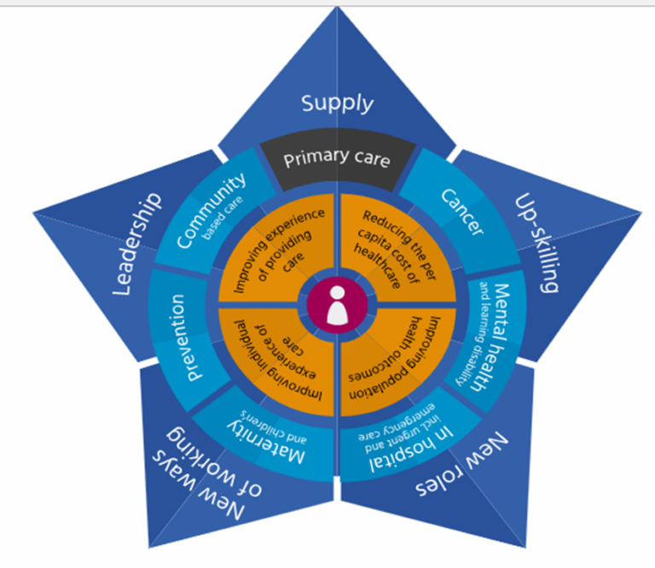
CURRENT POLICIES AND PRACTICES: JOB DESIGN
Student Name: Galla Prasith
ID: 2543438
NHS England advocates the redesign of the workforce to increase skill and enhance staff resilience.
HEE Star is for supply, upskilling, new roles, working and leadership (NHS, 2026b).
Calderdale Framework is a seven-stage structured pathway to workforce development for role redesign (NHS Employers, 2026).
Digital staff passports facilitate seamless mobility in interoperable workforce systems and data (NHS, 2026c).
Figure 4: HEE Star Framework Policy by NHS England
(Source: NHS, 2026b)
Notes:
NHS England is using flexible roles, skills development and workforce mobility as an indicator of workforce redesign. But their success relies on significant staff involvement, positive management and regular feedback. Structures like HEE Star and Calderdale create a framework, and digital passports remove barriers and assist in job design that is more efficient and flexible.

Slide 7
Student Name: Ahmed Rain
ID: 2535781
CURRENT POLICIES AND PRACTICES: JOB SATISFACTION
NHS People Plan supports flexible working and diversity of working opportunities.
Flexible Working Policy Framework is consistent with employee wellbeing, employee engagement and employee retention (NHS, 2026d).
Flexible working guides can help individuals and managers to implement supportive practices.
According to The NHS Alliance (2026), an all-time high of 57.66% are satisfied with the opportunities available for flexible working.
NHS People Plan supports flexible working and diversity of working opportunities.
Flexible Working Policy Framework is consistent with employee wellbeing, employee engagement and employee retention (NHS, 2026d).
Flexible working guides can help individuals and managers to implement supportive practices.
According to The NHS Alliance (2026), an all-time high of 57.66% are satisfied with the opportunities available for flexible working.
Notes:
The flexible working programs NHS England has in place reflect a strategy of caring for wellbeing, engagement and retention, which has the potential to improve job satisfaction and patient outcomes. However, although 57.66% feel positive about flexible working, the other proportion of the workforce suggests that there are inequalities in flexible working access, implementation and managerial support that need to be addressed.

Slide 8
Student Name: Ahmed Rain
ID: 2535781
CURRENT OPPORTUNITIES IN JOB DESIGN
AI multidisciplinary teams enhance job specifications in the healthcare sector, collaboration, and innovation within organisations.
The digital transformation drives clinical informatics positions in the NHS that support technology-based job redesign projects.
AI Training & Workforce upskilling improves Digital capability, agility, and resilience of the future workforce (NHS, 2026e).
Almost 60% of NHS workers feel that AI helps in making health care better by creating new opportunities for innovation (Stewart, 2026).
AI multidisciplinary teams enhance job specifications in the healthcare sector, collaboration, and innovation within organisations.
The digital transformation drives clinical informatics positions in the NHS that support technology-based job redesign projects.
AI Training & Workforce upskilling improves Digital capability, agility, and resilience of the future workforce (NHS, 2026e).
Almost 60% of NHS workers feel that AI helps in making health care better by creating new opportunities for innovation (Stewart, 2026).
Notes:
AI can present opportunities for NHS England to reimagine work, particularly addressing workforce shortcomings and enhancing resilience, through multidisciplinary teams and digital jobs. But implementation also needs to be backed by ongoing training, specialist recruitment, effective leadership and employee engagement to guarantee the technology supports and improves the quality of care and working lives.

Slide 9

Student Name: Ahmed Rain
ID: 2535781
CURRENT OPPORTUNITIES IN JOB SATISFACTION
AI capabilities have the potential to free up 2 administrative days per month for employees, enhancing satisfaction (NHS, 2025).
505,000 employees can benefit from significant administrative workflow reductions with Microsoft 365 Copilot (NHS, 2026f).
Clinicians can focus more on the patient with AI-assisted documentation and data analysis.
Using AI for digital collaboration can help alleviate workload issues and enhance employee wellbeing.
Figure 5: Microsoft 365 by NHS England
(Source: WindowsForum, 2026)
Notes:
The use of AI and digital tools presents potential for NHS professionals to streamline administrative tasks and shift their focus towards patient care. But correct use of the technology means better workflow integration, employee training, and assurance of security will result in higher levels of job satisfaction; otherwise, technology can add more stressors and potentially harm employee wellbeing.

Slide 10
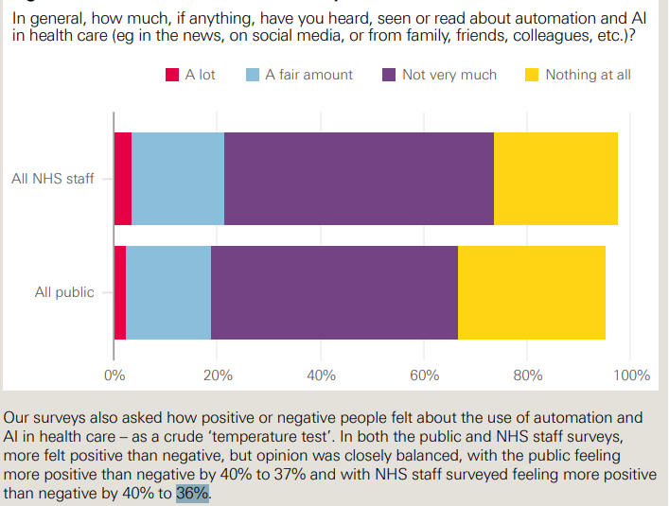
Student Name: Ahmed Rain
ID: 2535781
CURRENT CHALLENGES IN JOB DESIGN
AI is being adopted faster than employees are ready, and new roles, governance, training, and accountability structures need to be established (McKelvie, 2026).
AI replaces jobs and complicates supervising roles, increasing the risk of burnout (Pinner, 2026).
Only 45% of staff expressed a positive attitude towards AI, while 36% reported fear of threat to their roles and status (Hardie et al. 2021).
Digital exclusion and privacy concerns are challenges for job design.
Figure 6: Public and NHS staff familiarity with automation and AI
(Source: Hardie et al. 2021)
Notes:
AI adoption in NHS England is advancing faster than workforce readiness, suggesting job design, governance, training and accountability are required for AI uptake across NHS England. AI also has a redistributing effect which escalates workloads and risks burnout. In addition, staff perceptions are varied, where 45% are positive, and 36% are worried about the consequences of AI adoption on their professional duties. Digital exclusion and privacy concerns are challenges for job design with technology, resulting in lower equitable effectiveness of the workforce.

Slide 11
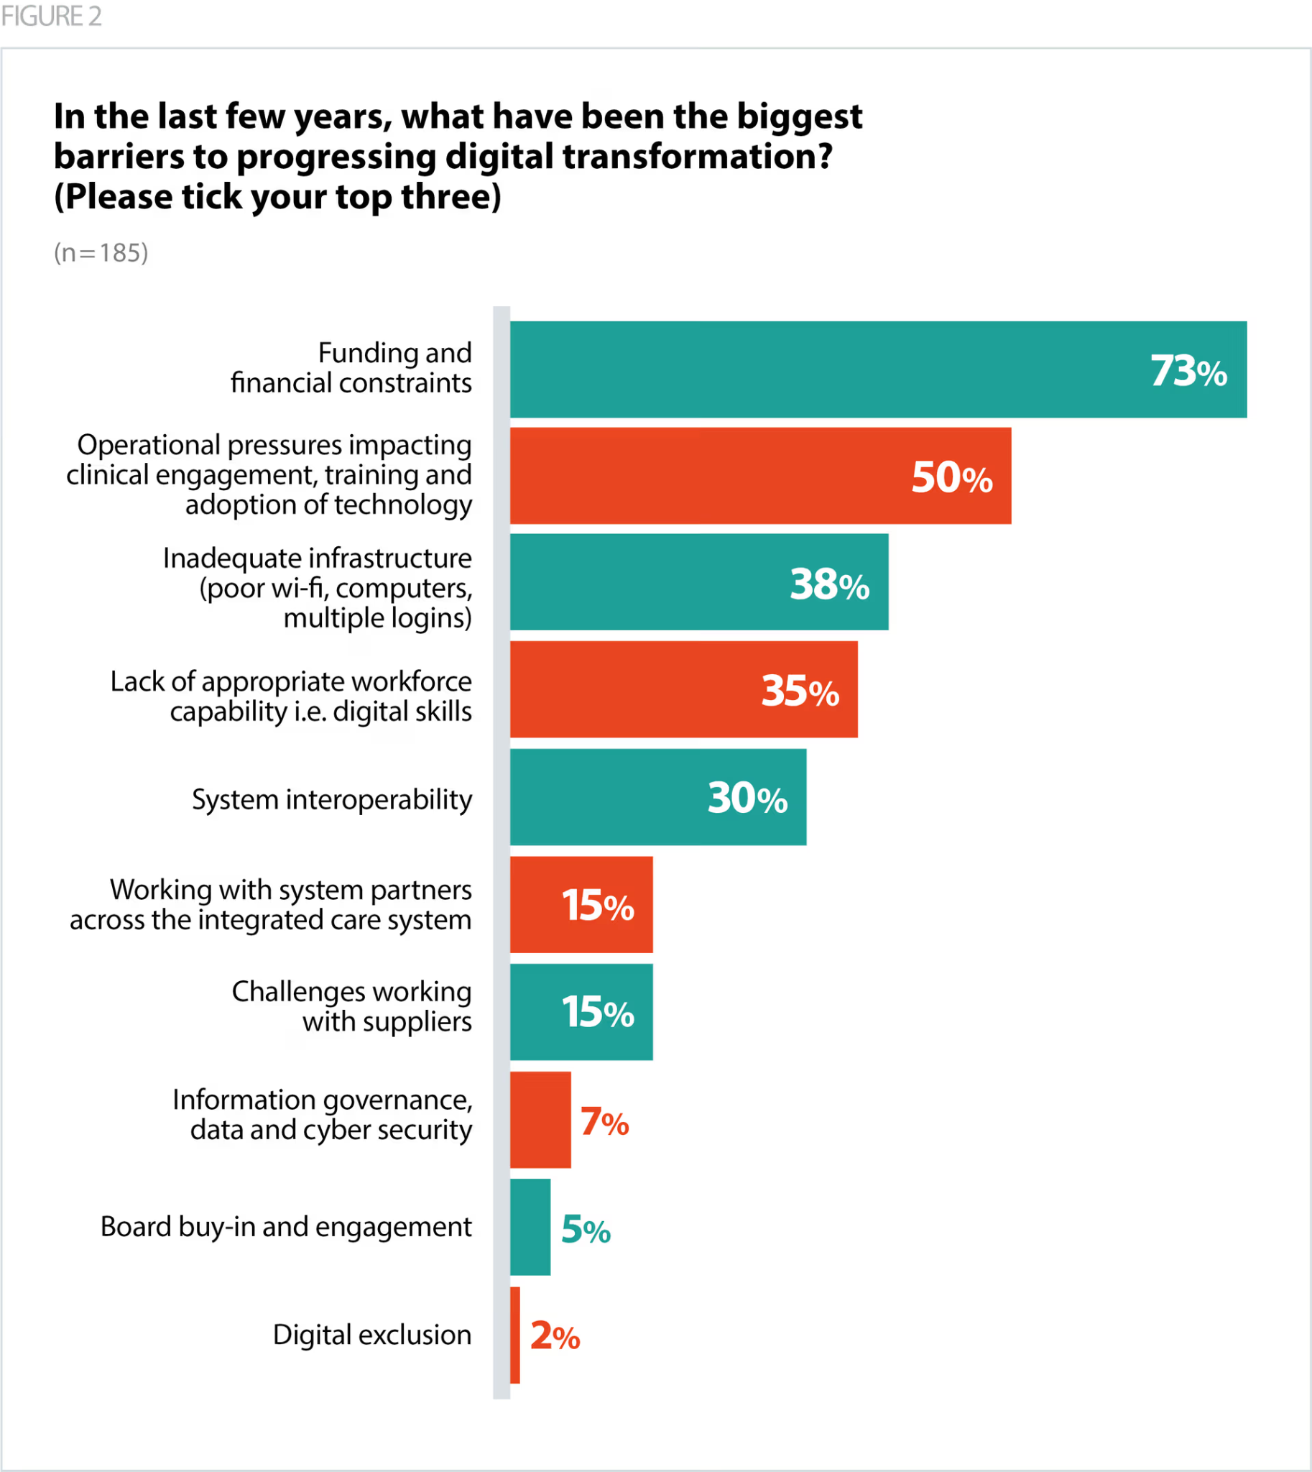
Student Name: Rajveer Singh
ID: 2536659
CURRENT CHALLENGES IN JOB SATISFACTION
Training of NHS staff is inadequate, leading to doubt and reduced satisfaction regarding the application of AI in healthcare practices (NewsMedical, 2025).
The aging systems in the NHS make the integration of AI challenging, leading to frustration and employee satisfaction issues in organisations (NHS, 2024).
High workloads inhibit engagement with clinicians' participation and thus decrease clinician engagement and job satisfaction with AI participation (Shanks et al. 2024).
73% identified funding constraints and 38% of trust leaders identified poor wi-fi, computers and other infrastructure problems as a barrier to progress (TheNHSAlliance, 2024).
Figure 7: Barriers to progressing digital transformation
(Source: TheNHSAlliance, 2024)
Notes:
Healthcare staff in the NHS have expressed concerns about potential job satisfaction issues as a result of AI implementation, citing greater workload, friction and doubt among staff. Employees lack confidence and engagement due to poor training preparation, outdated IT resources, and the non-uniform application of AI. Additionally, 73% identified funding constraints and 38% of trust leaders identified poor wi-fi, computers and other infrastructure problems as a barrier to progress, reducing job satisfaction.

Slide 12
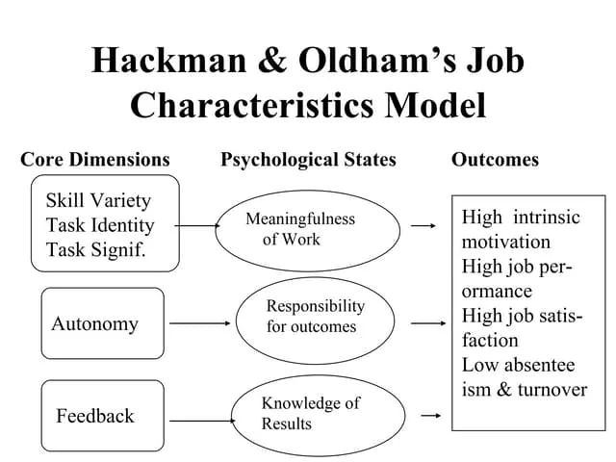
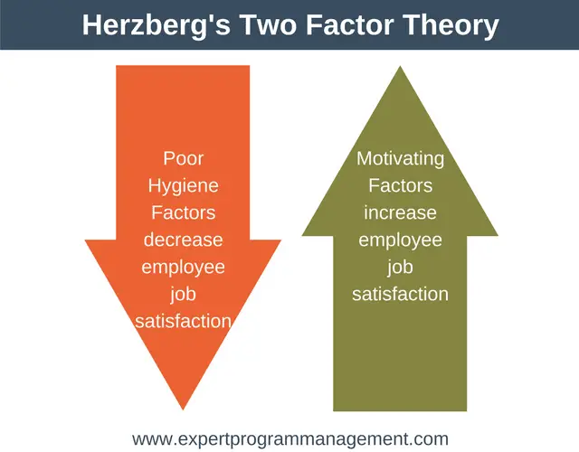
Student Name: Rajveer Singh
ID: 2536659
IMPACT OF CHALLENGES ON EMPLOYEES AND ORGANISATIONAL PERFORMANCE
Job Characteristics Model
When job redesign is poor, there is a significant reduction in autonomy, motivation, employee satisfaction and a significant drop in employee performance.
Burnout level is greater as the complexity of the job increases, thereby decreasing overall service quality and organisational effectiveness (Demerouti, 2024).
Figure 8: Job Characteristics Model
(Source: Hackman and Oldham, 1976)
Herzberg's Two-Factor Theory
Lack of training and technology would lead to low employee morale, creating dissatisfaction and lowering employee morale (Duba and Marwa, 2024).
Turnover risk increases due to reduced motivation and satisfaction, undermining NHS organisational performance.
Figure 9: Herzberg's Two-Factor theory
(Source: Armstrong, 2021)
Notes:
According to the Job Characteristics Model (Hackman & Oldham), when job redesign is not effective with the use of AI, autonomy is negatively affected and contributes to reduced motivation, poor job performance and burnout. Additionally, Herzberg's Two-Factor theory suggests that a lack of training, obsolete technologies and high workloads constitute a hygiene factor problem that can cause employee dissatisfaction, lack of engagement, lack of service quality, low productivity and increased employee turnover.

Slide 13
Student Name: Rajveer Singh
ID: 2536659
CRITICAL ANALYSIS OF OPPORTUNITIES AND CHALLENGES
AI can greatly enhance the potential for job design, but insufficiently prepared people can be a huge constraint in the sustainable evolution of job design and organisational capacity (Yang and Jiang, 2025).
Digital technologies add to satisfaction but create uncertainty and disengagement when there is not the right infrastructure.
Governance, training, funds, and implementation capacity are some other areas of need at the country and regional level across the country that reduce the potential of efficiency through AI (Stewart and Brown, 2019).
The balance of innovation and wellbeing of the workforce shapes longer-term productivity and resilience in the NHS and its service quality outcomes.
AI can greatly enhance the potential for job design, but insufficiently prepared people can be a huge constraint in the sustainable evolution of job design and organisational capacity (Yang and Jiang, 2025).
Digital technologies add to satisfaction but create uncertainty and disengagement when there is not the right infrastructure.
Governance, training, funds, and implementation capacity are some other areas of need at the country and regional level across the country that reduce the potential of efficiency through AI (Stewart and Brown, 2019).
The balance of innovation and wellbeing of the workforce shapes longer-term productivity and resilience in the NHS and its service quality outcomes.
Notes:
It is clear that AI and digital technologies can offer the NHS England fantastic opportunities in improving job design, satisfaction and improving service efficiencies. However, the advantages of this are limited due to limited training, governance problems, ageing infrastructure and financial constraints. Therefore, it is important to consider technological innovation, employee wellbeing, readiness of the organisation and effective leadership to achieve sustainable workforce transformation for maximum work performance.

Slide 14
Student Name: Rajveer Singh
ID: 2536659
ROOT-CAUSE ANALYSIS
Organisational culture: The resistance of the employees has an impact on the involvement, cooperation, and successful implementation of AI-based initiatives.
External pressures: Demand for AI is increasing, and the adoption rate is outpacing the capacity of the workforce and the organisation (Appiah, 2025).
Technology: Employees' competency, confidence in adopting technology and competence in AI training and education are organisation-wise limited.
Policy implementation: Slow procurement and governance approval processes slowed AI implementation in 23 NHS trusts (Advisors, 2025).
Organisational culture: The resistance of the employees has an impact on the involvement, cooperation, and successful implementation of AI-based initiatives.
External pressures: Demand for AI is increasing, and the adoption rate is outpacing the capacity of the workforce and the organisation (Appiah, 2025).
Technology: Employees' competency, confidence in adopting technology and competence in AI training and education are organisation-wise limited.
Policy implementation: Slow procurement and governance approval processes slowed AI implementation in 23 NHS trusts (Advisors, 2025).
Notes:
Successful implementation of AI is hindered by cultural resistance, the increasing demands for healthcare and a lack of adequate training of the workforce. Geographical differences and complex procurement and governance approvals meant that only 23 out of 66 NHS trusts had deployed the AI at a clinical level. These root causes, in turn, led to employee dissatisfaction, inconsistent DT and reduced organisational effectiveness.

Slide 15
Student Name: Rajveer Singh
ID: 2536659
ROOT-CAUSE ANALYSIS
Policy design: AI governance frameworks and structures are still underdeveloped and inconsistent between staff of NHS organisations (Sides et al. 2025).
Leadership behaviour: Lack of strategic leadership has a significant impact on staff confidence, trust, and readiness to adopt AI.
Governance: Fragmented NHS systems are barriers to national-level coordination of AI implementation and consistency in workforce policy.
Technology: Outdated IT systems prevent the easy adoption of AI, creating operational challenges and frustration for staff (Kar and Kushwaha, 2023).
Policy design: AI governance frameworks and structures are still underdeveloped and inconsistent between staff of NHS organisations (Sides et al. 2025).
Leadership behaviour: Lack of strategic leadership has a significant impact on staff confidence, trust, and readiness to adopt AI.
Governance: Fragmented NHS systems are barriers to national-level coordination of AI implementation and consistency in workforce policy.
Technology: Outdated IT systems prevent the easy adoption of AI, creating operational challenges and frustration for staff (Kar and Kushwaha, 2023).
Notes:
Policy frameworks and leadership have been inconsistent, with overall uptake of AI being hampered within NHS England. Reducing organisational structures and legacy digital systems causes delays and inconsistencies in implementation, inefficient operations and governance. These factors undermining employee confidence heighten levels of frustration and a lack of expected benefits to job design, job satisfaction and organisational performance from AI.

Slide 16
EVIDENCE-BASED RECOMMENDATION 1: IMPLEMENT AI-ENABLED JOB REDESIGN AND WORKFORCE DEVELOPMENT
Student Name: Divya Adduru
ID: 2537627
Increase AI training across the NHS by leveraging the HEE Star workforce transformation framework (NHS, 2026b).
Redesign jobs within the Job Characteristics Model to have greater autonomy, meaningfulness and collaborative responsibility (Ulrich, 2017).
Build multidisciplinary AI teams comprising clinicians, data scientists and digital specialists effectively.
Improve leadership skills to foster the workforce, lifelong learning, innovation and organisational resilience.
Increase AI training across the NHS by leveraging the HEE Star workforce transformation framework (NHS, 2026b).
Redesign jobs within the Job Characteristics Model to have greater autonomy, meaningfulness and collaborative responsibility (Ulrich, 2017).
Build multidisciplinary AI teams comprising clinicians, data scientists and digital specialists effectively.
Improve leadership skills to foster the workforce, lifelong learning, innovation and organisational resilience.
Notes:
The strategic implementation of AI in the redesign of job roles needs to address HEE's workforce framework with enhanced roles and multidisciplinary collaboration and leadership development. But it requires ongoing investment, good change management and equal access to training; technological change, otherwise, can lead to exacerbated skills gaps and employee resistance.

Slide 17
EVIDENCE-BASED RECOMMENDATION 2: ENHANCE JOB SATISFACTION THROUGH STRATEGIC HUMAN CAPITAL MANAGEMENT
Student Name: Divya Adduru
ID: 2537627
Leverage extended flexible working arrangements that enhance wellbeing, engagement, retention and sustainable organisational performance outcomes.
Implementing Herzberg's Motivation Theory consistently, with recognition, development, supportive supervision and meaningful responsibilities (Cappelli and Keller, 2020).
Modern digital infrastructure that eradicates work frustrations, builds confidence, improves productivity and increases employee satisfaction.
Encourage regular feedback processes that foster inclusive decision-making, participation in trust, and organisational development processes (Ahmad and Islam, 2024).
Leverage extended flexible working arrangements that enhance wellbeing, engagement, retention and sustainable organisational performance outcomes.
Implementing Herzberg's Motivation Theory consistently, with recognition, development, supportive supervision and meaningful responsibilities (Cappelli and Keller, 2020).
Modern digital infrastructure that eradicates work frustrations, builds confidence, improves productivity and increases employee satisfaction.
Encourage regular feedback processes that foster inclusive decision-making, participation in trust, and organisational development processes (Ahmad and Islam, 2024).
Notes:
Flexible work practices, motivational strategies, investment in digital infrastructure, and a focus on employee voice and engagement are all ways that a company's human capital management strategy can enhance satisfaction. But effectiveness is dependent on consistent implementation in NHS settings with gaps in managerial support and technicalities as well as feedback mechanisms impacting wellbeing, engagement and retention.

Slide 18
Student Name: Divya Adduru
ID: 2537627
FUTURE OF WORK IMPLICATIONS
The role redesign would involve using AI to enable digital dexterity, flexibility and interprofessional working in the NHS workforce.
Reducing administrative workloads would allow clinicians to provide more patient-centred care in a consistent manner through automation (Cappelli and Keller, 2020).
However, there is a need for continuous retraining of the workforce, an ethical governance process and lifelong learning programmes in digital skills (Ossiannilsson, 2025).
NHS could invest in infrastructure, improve its AI leadership, develop workforce resilience and capacity, as well as prepare for the future.
The role redesign would involve using AI to enable digital dexterity, flexibility and interprofessional working in the NHS workforce.
Reducing administrative workloads would allow clinicians to provide more patient-centred care in a consistent manner through automation (Cappelli and Keller, 2020).
However, there is a need for continuous retraining of the workforce, an ethical governance process and lifelong learning programmes in digital skills (Ossiannilsson, 2025).
NHS could invest in infrastructure, improve its AI leadership, develop workforce resilience and capacity, as well as prepare for the future.
Notes:
In the next 5–10 years, AI and automation will transform the concept of job design and job satisfaction, NHS England. Standard, repetitive tasks would be automated, and workers would have to develop advanced information literacy. Investment in workforce upskilling, modern digital systems, ethical governance of AI and adaptive leadership practice would be essential for NHS England to be sustainably performing and providing high-quality care for patients.

Slide 19
Student Name: Divya Adduru
ID: 2537627
CONCLUSION & OVERALL HRM STRATEGY
Integrated job design, workforce development and employee wellbeing for the NHS is required in the strategic context of adoption of AI.
Human Capital Management, employee engagement, resilience and organisational performance must play a role alongside technology-innovative solutions.
Continuous learning, ethical governance of AI and digital leadership support sustainable workforce transformation and adaptability.
Evidence-based HRM strategies play a role in improved levels of job satisfaction, productivity, retention, and high-quality patient care outcomes.
Integrated job design, workforce development and employee wellbeing for the NHS is required in the strategic context of adoption of AI.
Human Capital Management, employee engagement, resilience and organisational performance must play a role alongside technology-innovative solutions.
Continuous learning, ethical governance of AI and digital leadership support sustainable workforce transformation and adaptability.
Evidence-based HRM strategies play a role in improved levels of job satisfaction, productivity, retention, and high-quality patient care outcomes.
Notes:
NHS England should work towards an integrated HCM undergoing AI-driven Job Design, Continuous Workforce Development, Ethical Governance and Employee Wellbeing. But digital capability and employee engagement would result in greater job satisfaction, resilient organisations, improved retention of staff and improved quality and sustainability of patient care with the appropriate leadership and technology.

Slide 20

GROUP LEADER
Student Name: Galla Prasith
ID: 2543438
SUMMARY
NHS England takes strategic decisions around job design with a view to making employment feel more flexible, facilitating skill development and digitalisation.
AI has the potential to improve efficiency, enhance innovation, train medical professionals, and drive high patient-centric health care delivery outcomes.
Implementation barriers include outdated infrastructure, employee resistance to AI, governance issues, and lack of training.
AI adoption in HRM through strategic recommendations enhances resilience, satisfaction, productivity, and sustainable organisational performance.
Notes:
The presentation covered the influence of AI and digital technologies on job design and job satisfaction within NHS England. AI presents opportunities for innovation, efficiency, and workforce development, but the challenges of implementation need to be resolved. Leadership, training, governance, and evidence are at the core of workforce transformation, and workforce transformation in itself is vital and central for Human Capital Management moving toward sustainable workforce transformation and enhanced organisational performance.

Slide 21
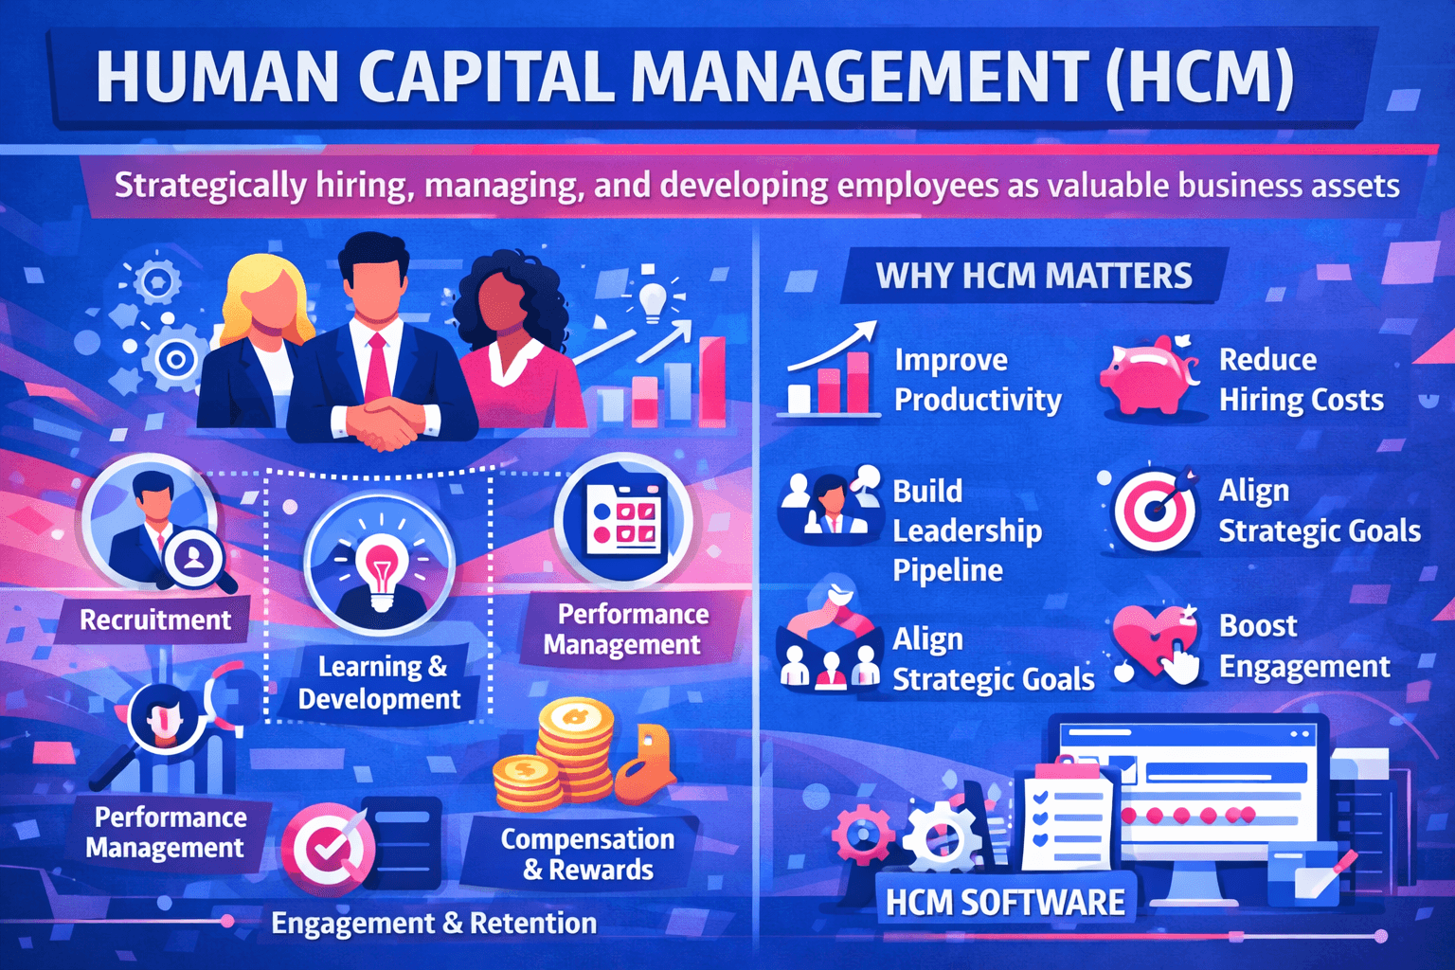
Student Name: Galla Prasith
ID: 2543438
SYNTHESIS OF KEY FINDINGS
Aligning job design, job satisfaction, leadership roles, and organisational readiness are crucial for the proper implementation of AI.
Successful workforce transformation and resilience outcomes are defined by employee wellbeing, digital skills, and governance.
Developing technologies is only beneficial with training and organisational culture (Bozkus, 2023).
Integrated Human Capital Management supports the NHS with Greater productivity, retention, innovation, and high-quality patient care.
Notes:
The findings show that AI cannot solve all the issues for NHS England when it comes to staffing. Sustainable improvements in job design and job satisfaction require aligned leadership, employee wellbeing, use of digital tools, good governance and organisational culture. By integrating all these Human Capital Management components, you can ensure that digital transformation is successful, force the workforce to be resilient, and have a positive impact on long-term organisational performance and patient outcomes.

Slide 22
Student Name: Galla Prasith
ID: 2543438
RECOMMENDATIONS
Expand AI workforce developments in the country and enhance digital skills and readiness via HEE Star.
Improve NHS digital systems to enable the seamless and effective integration of AI across all areas, including governance and staff buy-in.
Adapt work by implementing the Job Characteristics Model to boost autonomy, wellbeing, teamwork, and strength of workforce.
Expand AI workforce developments in the country and enhance digital skills and readiness via HEE Star.
Improve NHS digital systems to enable the seamless and effective integration of AI across all areas, including governance and staff buy-in.
Adapt work by implementing the Job Characteristics Model to boost autonomy, wellbeing, teamwork, and strength of workforce.
Notes:
AI Training, modern Digital Infrastructure and Evidence-Based Job Redesign should be priorities for NHS England. These recommendations would help build employee skills, confidence and wellbeing, increase the uptake of AI, boost workforce resilience, enhance organisational performance and create high-quality, patient-centric health care in the future.

Slide 23
REFERENCE LIST
Advisors, N. (2025) AI in the NHS: Transformative Promise v's Operational Reality. [Online] Available at: https://www.healthcare.digital/single-post/ai-in-the-nhs-transformative-promise-v-s-operational-reality [Accessed on: 29 July 2026].
Ahmad, I., and Islam, M. R. (2024). Empowerment and participation: Key strategies for inclusive development. In Building strong communities: Ethical approaches to inclusive development (pp. 47-68). Emerald Publishing Limited. https://doi.org/10.1108/978-1-83549-174-420241003
Appiah, R. I. (2025). Corporate Strategies for Successful Workforce Upskilling and Reskilling in Response to AI Adoption-What Works, What Does not, and Why. International Journal of Emerging Research in Engineering and Technology, 6(1), 91-99. https://doi.org/10.63282/3050-922X.IJERET-V6I1P112
Armstrong, M. (2021). Armstrong’s Handbook of Human Resource Management Practice (15th Ed.). Kogan Page.
Armstrong, M. (2021). Armstrong's Handbook of Human Resource Management Practice. 15th ed. London: Kogan Page.
Bozkus, K. (2023). Organizational culture change and technology: Navigating the digital transformation. In Organizational culture-Cultural change and technology. IntechOpen.
Cappelli, P. and Keller, J. (2020). Managing the Future of Work: The New HR Imperative. Harvard Business Review Press.
Cappelli, P. and Keller, J. (2020). Managing the Future of Work: The New HR Imperative. Harvard Business Review Press.
Demerouti, E. (2024). Burnout: a comprehensive review. Zeitschrift für Arbeitswissenschaft, 78(4), 492-504.
Duba, B., and Marwa, N. (2024, June). Revitalizing retail: Innovative strategies for boosting employee morale in the age of digital technology. In International conference of accounting & business (pp. 107-128). Cham: Springer Nature Switzerland.
Hackman, J.R. and Oldham, G.R. (1976) Motivation through the Design of Work.
Hardie T, Horton T, Willis M, Warburton W. (2021) Switched on: How do we get the best out of automation and AI in health care? The Health Foundation. [Online] Available at: https://www.health.org.uk/sites/default/files/upload/publications/2021/SwitchedOn_WEB.pdf [Accessed on: 29 July 2026].
Kar, A. K., and Kushwaha, A. K. (2023). Facilitators and barriers of artificial intelligence adoption in business–insights from opinions using big data analytics. Information Systems Frontiers, 25(4), 1351-1374. https://doi.org/10.1007/s10796-021-10219-4
McKelvie, G. (2026) NHS to use AI on its app to direct patients to appropriate services. [Online] Available at: https://www.theguardian.com/society/2026/jul/04/nhs-ai-app-patients-appropriate-services-health [Accessed on: 29 July 2026].
NHS (2024). Structure of the NHS. [Online] Available at: https://www.england.nhs.uk/long-read/structure-of-the-nhs/
NHS (2026d). We work flexibly. [Online] Available at: https://www.england.nhs.uk/looking-after-our-people/the-programme-and-resources/we-work-flexibly/
NHS (2026e). Workforce, Training, Education. [Online] Available at: https://digital-transformation.hee.nhs.uk/support-for-organisations/research-and-publications/dart-ed/horizon-scanning/developing-healthcare-workers-confidence-in-ai/chapter-4-workforce-transformation/in-this-chapter
NHS Employers (2026). Workforce redesign. [Online] Available at: https://www.nhsemployers.org/articles/workforce-redesign
NHS. (2024b) The impact of Artificial Intelligence (AI). [Online] Available at: https://digital-transformation.hee.nhs.uk/support-for-organisations/research-and-publications/dart-ed/horizon-scanning/ai-and-digital-healthcare-technologies/introduction/the-impact-of-ai

Slide 24
REFERENCE LIST
Ossiannilsson, E. (2025). The role of ethical leadership in improving education through open education, digital inclusion and seamless learning. AI for Seamless Education. https://pressbooks.pub/aiforseamlesseducation/chapter/the-role-of-ethical-leadership-in-improving-education-through-open-education-digital-inclusion-and-seamless-learning/
Pinner, J. (2026) Misleading AI-generated doctors pose ‘huge danger to public safety’. [Online] Available at: https://www.theguardian.com/technology/2026/jul/27/misleading-ai-generated-doctors-public-safety-danger-tiktok
Shanks, D., Shah, T., Hudson, T., Thompson, J., Filardi, T., Wright, K., ... and Albrecht, M. (2024). Enhancing clinical documentation workflow with ambient artificial intelligence: Clinician perspectives on work burden, burnout, and job satisfaction. medRxiv, 2024-08. https://doi.org/10.1101/2024.08.12.24311883
Sides, T., Kbaier, D., Farrell, T., and Third, A. (2025). Bridging trust gaps: Stakeholder perspectives on AI adoption in the United Kingdom NHS primary care. Digital Health, 11, 20552076251386706. https://doi.org/10.1177/20552076251386706
Stewart, C. (2026). Attitudes of the public and NHS staff towards the impact of AI on the quality of care in the United Kingdom as of 2025. [Online] Available at: https://www.statista.com/statistics/1660374/attitudes-towards-ai-impact-on-healthcare-uk/?srsltid=AfmBOopjSz09igPrFXyuswUgkONvxONhos3WercEQZF1Y7wiK4_nQV6k
Stewart, G.L. and Brown, K.G. (2019). Human Resource Management. John Wiley & Sons.
Stone, R.J., Cox, A. and Gavin, M. (2020). Human Resource Management. John Wiley & Sons.
Tcharmtchi, M.H., Kumar, S., Rama, J., Rissmiller, B., Castro, D. and Thammasitboon, S., 2023. Job characteristics that enrich clinician-educators’ career: A theory-informed exploratory survey. Medical Education Online, 28(1), p.2158528. https://doi.org/10.1080/10872981.2022.2158528
The NHS Alliance (2026). NHS Staff Survey results 2025: what you need to know. [Online] Available at: https://thenhsalliance.org/resources/nhs-staff-survey-results-2025-what-you-need-to-know
TheNHSAlliance. (2024) Digital transformation hampered by budgets, NHS pressures and poor IT infrastructure. [Online] Available at: https://thenhsalliance.org/news/digital-transformation-hampered-by-budgets-nhs-pressures-and-poor-it-infrastructure
Ulrich, D. (2017). Victory Through Organization: Why the War for Talent is Failing Your Company and What You Can Do About It. McGraw-Hill Education.
Yakusheva, O., Lee, K.A. and Weiss, M., 2024. The nursing human capital value model. International journal of nursing studies, 160, p.104890. https://doi.org/10.1016/j.ijnurstu.2024.104890
Yang, J. (2025). Total headcount of the NHS Hospitals and Community Health Service (HCHS) workforce in England as of December 2024, by staff group. [Online] Available at: https://www.statista.com/statistics/679898/number-of-nhs-hchs-workforce-by-staff-group-england/?srsltid=AfmBOoqbFENvkyGUcOLlaouIMAOZvmcqaCHH6YA-eqaOGUmDNob4BSPC
Yang, T., and Jiang, J. (2025). Designing job characteristics for effective hybrid intelligence: insights from job design and human–AI collaboration. Personnel Review, 54(6), 1441-1456. https://doi.org/10.1108/PR-03-2024-0229

Slide 25
Thank
You

