Slide 1

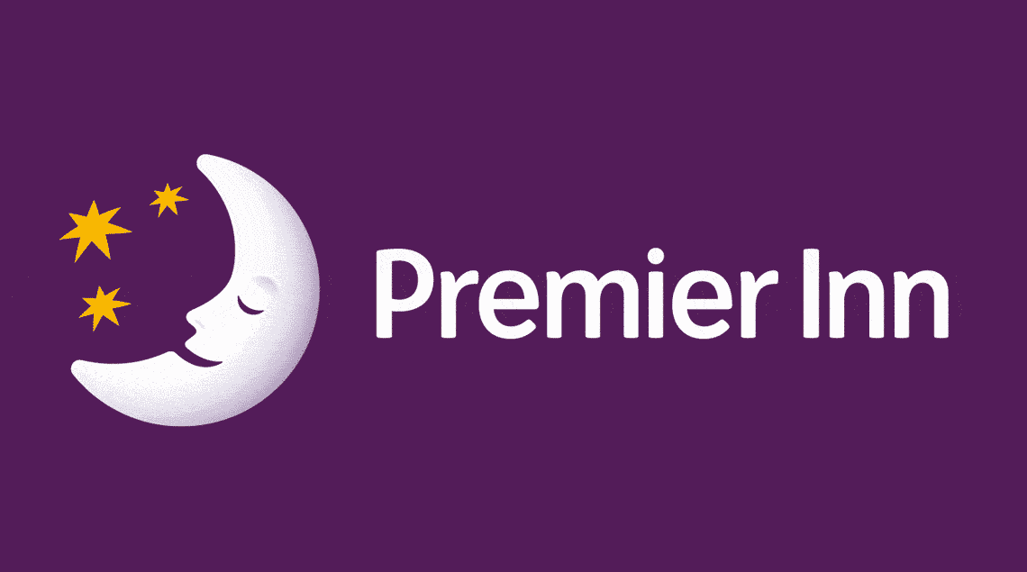
Module Name: Foreign Languages & Cultural Awareness
Module Code: BMIH5003
Presentation

Slide 2
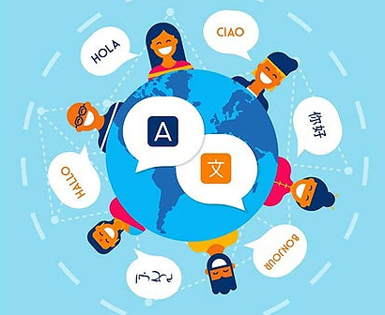
Introduction
The construction of the presentation is to present the importance of Multilingualism and Language Awareness for Hotel Staff
It provides examples of modern European languages and their usage.
The presentation also discusses learning difficulties and politeness in business contexts.
The chosen language is European language which is Italian and the Hotel is Premier Inn.

Slide 3
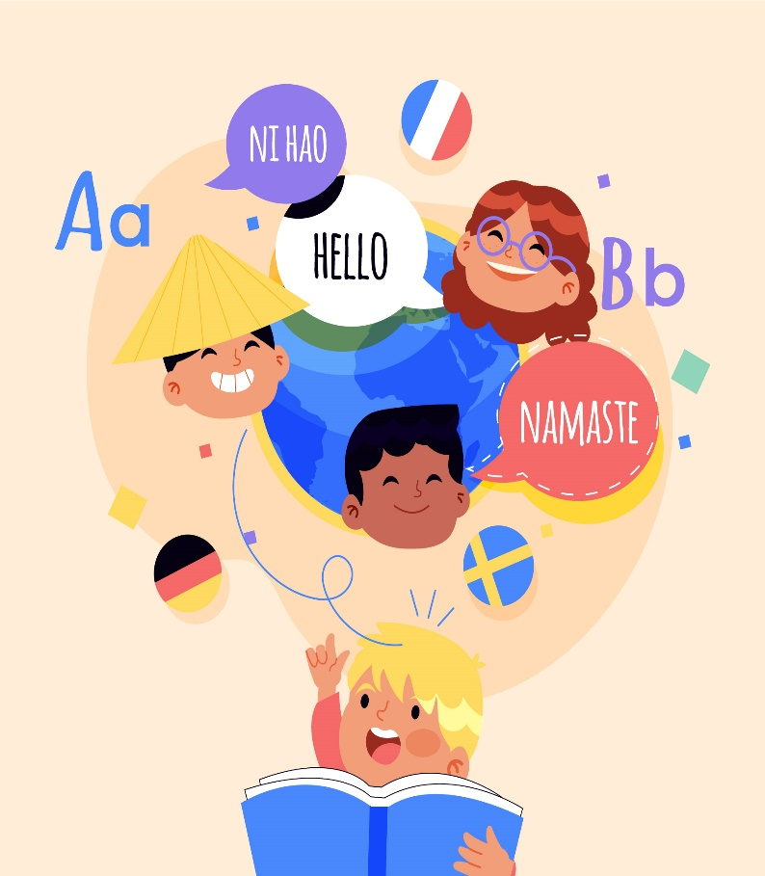
Importance of Multilingualism Language
Learning a new language helps an individual see things in a new way and think of new ideas (Grutman, 2019).
Multilingualism is people who use and speak more than one language in their daily lives.
It opens people up to other countries and shows them the benefits of variety
In today's globalised world, it's good for an individual’s career to know two or three languages.
It takes years to get good at even one language.
Being multilingual is necessary to promote variety, understanding, and acceptance (Schroedler, 2021).
People who speak more than one language can communicate with people from different backgrounds.
Notes:
However, learning a language can be hard to learn a lot of languages. Polyglots are people who can speak five or more languages very well. It also goes beyond differences in culture, breaking down barriers and promoting tolerance and understanding. Likewise, learning a second or third language can help them feel better about self-worth and boost one’s confidence.

Slide 4
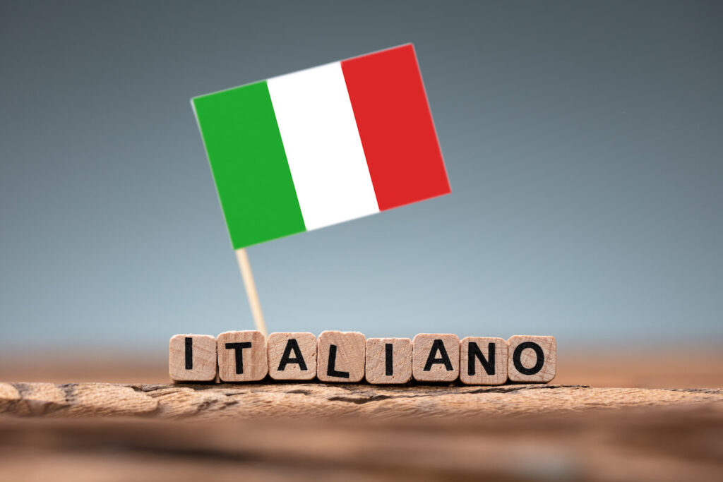
About the Italian Language
It is the national language of Italy, Vatican City, and San Marino, along with Latin.
Italy is an official language in Switzerland, just like French, German, and Romansch.
It is spoken by about 666,000 people in the cantons of Ticino and Graubünden (Monacis et al., 2017).
About 67 million people speak Italian as their first language, plus 18 million who speak it as a learned language.
It's possible that learning Italian will not only open up a lot of new markets but also lead to new finds.
Doing business in Italian is becoming more and more possible as the internet gets better.
Notes:
Italian is closely related to other important business languages like Spanish, Portuguese, and French because it comes from Latin. (MacIntyre and Vincze, 2017) It is the main language of about 64 million people in Switzerland, Croatia, Slovenia, and Malta, as well as a lot of people in Italy. When it comes to shopping online, Italians seem to be ahead of people from other countries. Italy is one of the Western European countries with the lowest rates of people using the internet to buy things.

Slide 5
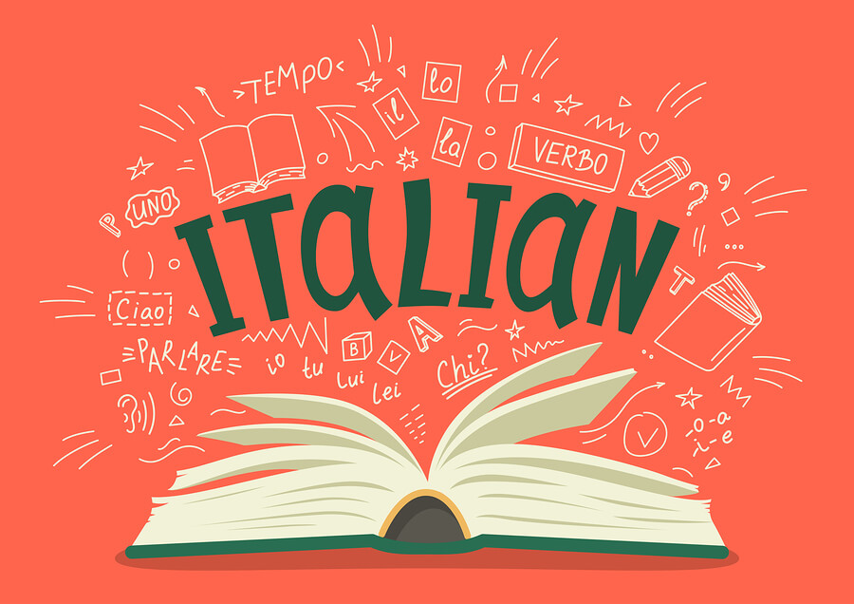
Is Italian hard to Learn?
The Foreign Service Institute asserts that people who possess English will find Italian one of the easier languages to learn (Mariani et al., 2019).
They believe that it could take as little as 600 hours, or 24 weeks, to learn the basics of competence.
For professionals who want to learn Italian to start a job in travel, tourism, or hospitality, these classes are a good choice.
Notes:
Italian, French, Russian, Arabic, Mandarin, and Spanish are the next best languages to learn for business and leisure after English (Francesco and Roberta, 2019). People who work in foreign catering, on the other hand, interact with people from all over the world. Language and culture barriers can be overcome with good communication, which ensures polite and thorough talks.

Slide 6
Politeness in Business Context
When dealing with Italian-speaking guests, it's important to use the right names and manners.
Politeness is very important in Italy, especially in business settings.
"Buongiorno" (good morning), "Buonasera" (good evening), and "Buona giornata" means "have a wonderful day."
When an individual is in a professional setting, they should avoid using motions and personal space.
When an individual speaks Italian, they need to use the right words and tone.
In the hotel industry, "Prego" and "Grazie" are important words for thanking someone and being polite.
A dress code is also very important, especially in business settings where humility and efficiency are expected.
Italian culture values hierarchy and respects authority in business.
Notes:
Moreover, hotel staff should treat guests with care and compassion if they want to make a good impression and make sure guests are happy overall. When doing business with Italians, they need to be very polite. People in better roles or with more status must be treated with the respect they deserve.

Slide 7
Application in Hotel Industry
There are many parts of running a Premier hotel where being able to speak Italian is useful.
Italian guests come up to the front desk during a practice check-in at the Premier INN Hotel (Liu et al., 2019).
"Buongiorno" is what employees say to guests and use Italian to help them.
In terms of check-in processes, they might ask for ID or check reservation details in Italian.
The people who work in room service and the restaurant should use simple words to talk about the food and the Italian offerings.
Menus are translated with the help of language tools, and staff members learn the basics of Italian before they serve food.
However, staff who work there should take language classes and use tools for learning languages.
Moreover, the staff should say goodbye to the guests in Italian and thank them for coming (Hassanien and Dale, 2019).
Concierge services can help find ways and suggest interesting places to visit in Italian.
Likewise, the cleaning crew needs to speak Italian to do their job well.
Notes:
The hotel industry articulates that accepting people of different languages is important for making guests happy and giving them unique experiences (Bharwani and Mathews, 2021). At the Premier Inn hotel, to answer questions from guests, the staff can use Frequently Asked Questions (FAQs) or tools for language-specific translation.

Slide 8
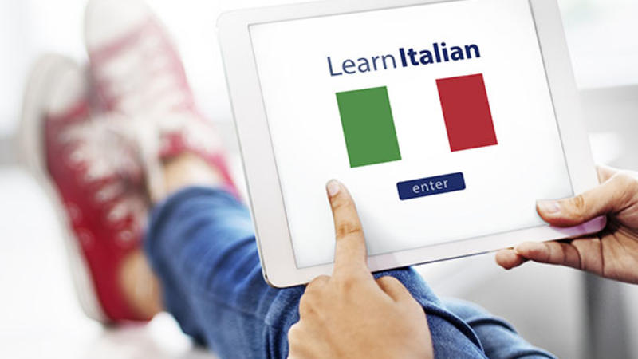
Conclusion
Employees who work in the global hotel business have to deal with guests from a wide range of cultures.
For particular individuals, being able to talk in their language could make them very happy and loyal.
Italian is the language of not only Italy but also the whole world.
People in Vatican City, which is home to the Catholic Church, speak it as their main language.
Many Italian refugee groups around the world still speak it as well.
For check-in, meals, cleaning, and concierge services at the Premier INN Hotel, staff need to be able to speak Italian.
People who work there say "Buongiorno" to customers and use words to help them.

Slide 9


Slide 10
References
Bharwani, S. and Mathews, D., 2021. Techno-business strategies for enhancing guest experience in luxury hotels: a managerial perspective. Worldwide Hospitality and Tourism Themes, 13(2), pp.168-185.
Francesco, G. and Roberta, G., 2019. Cross-country analysis of perception and emphasis of hotel attributes. Tourism Management, 74, pp.24-42.
Grutman, R., 2019. Multilingualism. In Routledge encyclopedia of translation studies (pp. 341-346). Routledge.
Hassanien, A. and Dale, C., 2019. Hospitality business development. Routledge.
Liu, H., Li, H., DiPietro, R.B. and Levitt, J.A., 2018. The role of authenticity in mainstream ethnic restaurants: evidence from an independent full-service Italian restaurant. International Journal of Contemporary Hospitality Management, 30(2), pp.1035-1053.
MacIntyre, P.D. and Vincze, L., 2017. Positive and negative emotions underlie motivation for L2 learning. Studies in Second Language Learning and Teaching, 7(1), pp.61-88.
Mariani, M.M., Borghi, M. and Kazakov, S., 2019. The role of language in the online evaluation of hospitality service encounters: An empirical study. International Journal of Hospitality Management, 78, pp.50-58.
Monacis, L., De Palo, V., Griffiths, M.D. and Sinatra, M., 2017. Social networking addiction, attachment style, and validation of the Italian version of the Bergen Social Media Addiction Scale. Journal of behavioral addictions, 6(2), pp.178-186.
Schroedler, T., 2021. What is multilingualism? Towards an inclusive understanding. Preparing teachers to work with multilingual learners, pp.17-37.

