Slide 1
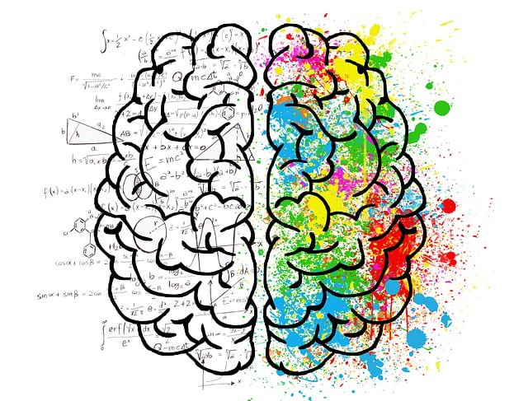
BMHP6029
Psychopathological Classifications and Provisions
Week 6
Autism spectrum Disorder
October 2024

Slide 2
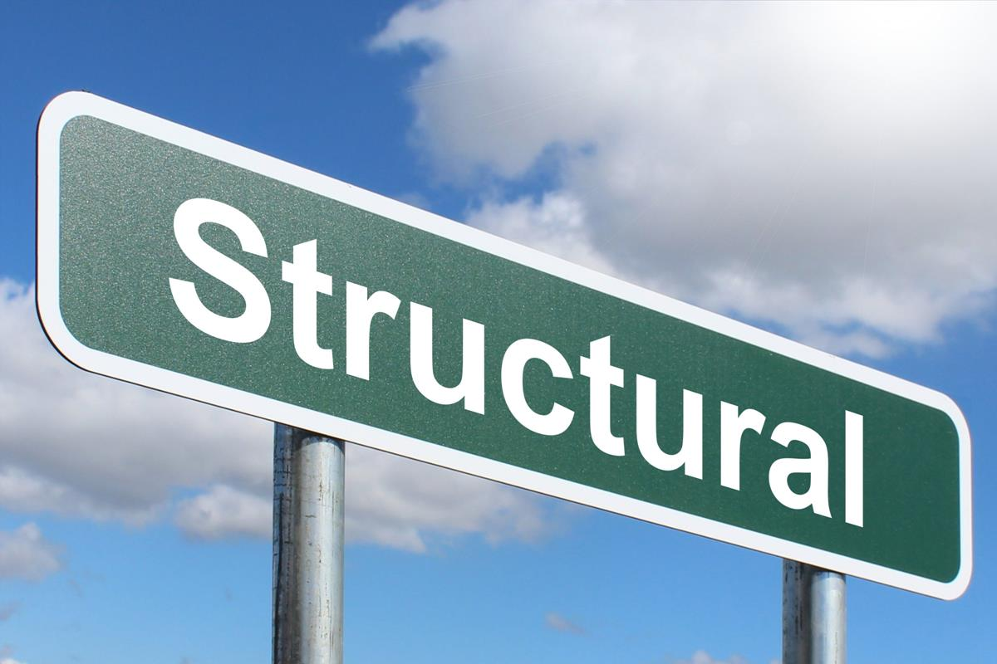
Autism
Neurodiversity movement
This Photo by Unknown Author is licensed under CC BY-SA

Slide 3
Autism Spectrum Disorder

Slide 4
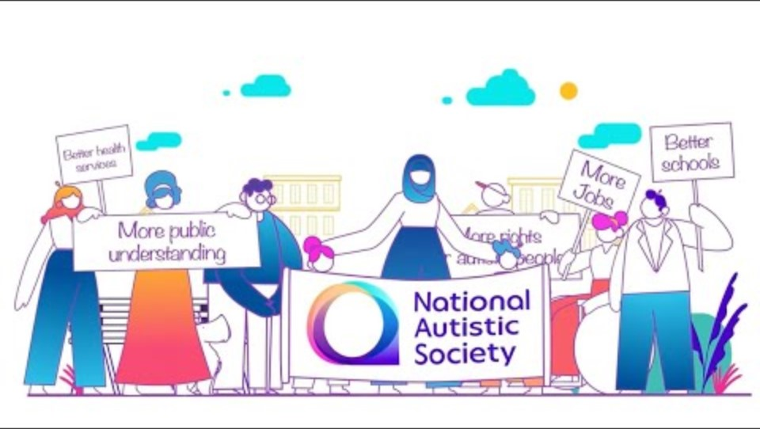

Slide 5
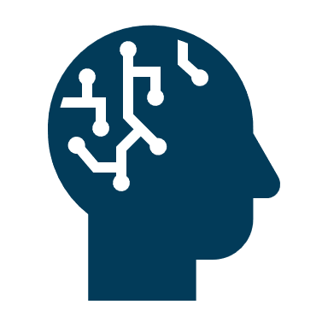
What is autism
According to the National Institute of Mental Health (2022), autism spectrum disorder (ASD) is a developmental disorder that affects communication and behaviour.
Although autism can be diagnosed at any age, it is said to be a “developmental disorder” because symptoms generally appear in the first two years of life.
Autism is known as a “spectrum” disorder because there is wide variation in the type and severity of symptoms people experience.
Notes:
ASD occurs in all ethnic, racial, and economic groups.

Slide 6

Neurodevelopmental Disorders in ICD-11
(1) disorders of intellectual development
(2) developmental speech or language disorders
(3) autism spectrum disorders (ASD)
(4) developmental learning disorders
(5) developmental motor coordination disorder
(6) attention deficit hyperactivity disorder (ADHD)
(7) stereotyped movement disorder
(8) other neurodevelopmental disorders
New category in ICD-11
Disorders with early onset affecting cognitive and social communicative development
Multifactorial in origin
Complex sex differences and long lasting impairments into adulthood (Stein et al., 2020)

Slide 7

Common Features
an onset that is invariably during infancy or childhood;
an impairment or delay in the development of functions that are strongly related to biological maturation of the central nervous system; and
a steady course that does not involve the remissions and relapses that tend to be characteristic of many mental disorders.

Slide 8
A broad spectrum in presentation and outcome
Some argue that ASD should not be included in the ICD-11 chapter about mental health disorders as a neural developmental disorder (tonyattwoodcom.au)
  Especially some are high functioning
Frequently combined with intellectual disability
  Overlap with traits of OCD, psychosis and higher anxiety and depression in some
Lower employment rate (Autism Speak, n.d.)
Increasing diagnosis and largest number on assessment for ECHP (2024)
Higher rate and longer stay in inpatient facilities (National Autistic Society, n.d. ;NHS, 2024)
Higher prevalence in GEM in the US (Autism Speak, n.d.)
Higher prevalence in black and Chinese boys show intersection with socioeconomical status and home language in the UK (Roman-Urrestarazu et al., 2021)
Notes:
Autism statistics and facts | Autism Speaks

Slide 9
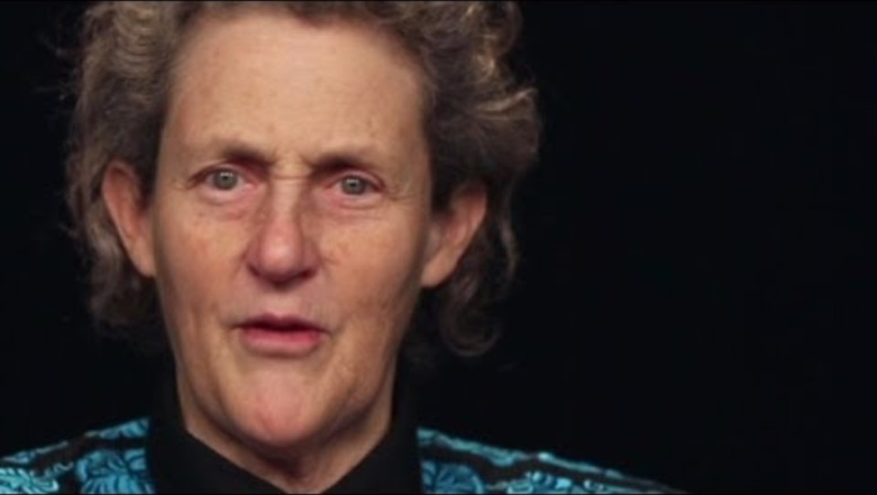
Dr Temple talks about autism. Are there changes in her communication between her younger self and now?
Notes:
Dr Temple is a good example of a high functioning ASD.

Slide 10
Comparing classification systems (adapted from Open University, n.d. )
System
Main types of symptoms
Subtypes
ICD-10
1) communication
2) social interaction
3) restrictive, repetitive activities and interests (RRBIs).
DSM 5
1) social communication
2) restrictive, repetitive activities and interests; sensory difficulties.
early development period
ICD-11
No subtype, a spectrum
No subtype, a spectrum
Onset
1) social communication
2) restrictive, repetitive activities and interests; sensory difficulties.
Functional impairment in either communication or social by age 3
Difficulties in 1 or 2 appear in early childhood ; functional impairment maybe later
1) Subtypes such as Childhood autism atypical autism, Asperger syndrome;
2) Pervasive developmental disorder
Understanding autism: Week 3: 2.2 | OpenLearn - Open University

Slide 11
Closer look at ICD-11
No fixed age for onset
Presentation throughout lifespan (Reeds et al., 2019)
Better synchronised with DSM 5: No subtype but a spectrum
Quantifiers to indicate the extent of impairment used instead (Reeds et al., 2019; Stein et al., 2020)→ better able to capture changes with age in functioning
Intellectual functioning
Functioning in language and communicative
Mental health as well as medical and genetic comorbidity (Stein et al, 2020)
No longer exclusive from ADHD, with strong implications on the use of medication
System
Main types of symptoms
Subtypes
early development period
ICD-11
No subtype, a spectrum
Onset
1) social communication
2) restrictive, repetitive activities and interests; sensory difficulties.
Notes:
The slide is a summary of comparison to ICD-10 for autism
Wider age for the onset unlike the strick age 3
Presentation is now regarded to last the lifespan and no longer limited to childhood and adolescence
A truly more spectrum approach in that subtypes are not differentiated, which historically short on validity anyway. In their place, more on a spectrum with qualitative differences rather than quantitative differences.
Quantifiers are used to classify the level of impairment/severity
Intellectual, language & communication functioning , mental health, medical and genetic comorbidity are the quantifiers in ICD-11
ASD and ADHD can now co-exist in ICD-11, they used to be in different categories

Slide 12

Challenges experienced - Autism
Communication impairment/limitation
Limited theory of mind
Hypersensitivity/hyposensitivity – sensory stimulus (sounds, touch, taste)
Changes in terms of social interaction
Limited eye contact
Routine and rigidity in daily functioning

Slide 13

Signs of Autism - Children
Lack of eye contact
Limited response to sensory cues
May not respond to name
Repetitive behaviors or actions: Flapping, repeating same terms
Limited interactions with other children
Limited emotional responses such as smiling
Notes:
These are more frequently observed in children also with intellectual disability

Slide 14
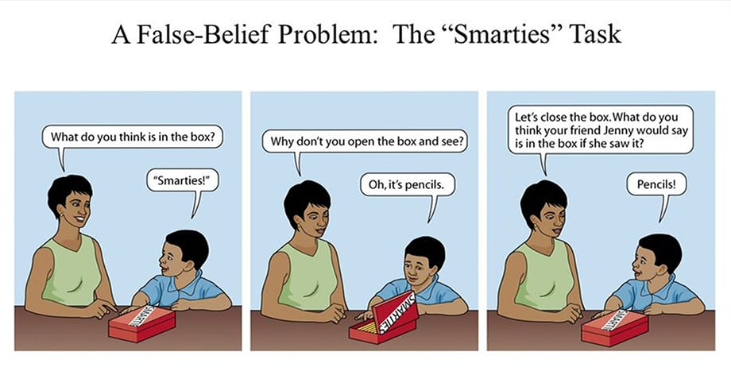
Psychological explanation of autism: Theory of mind deficit
To pass this task, you need to be able to hold multiple representations: your earlier false belief about the chocolate, what you now know about the pencils and that your friend does not know about the pencils. A four year old can pass the task of reality (pencils) and appearance (smarties) when a much older autistic child cannot pass

Slide 15
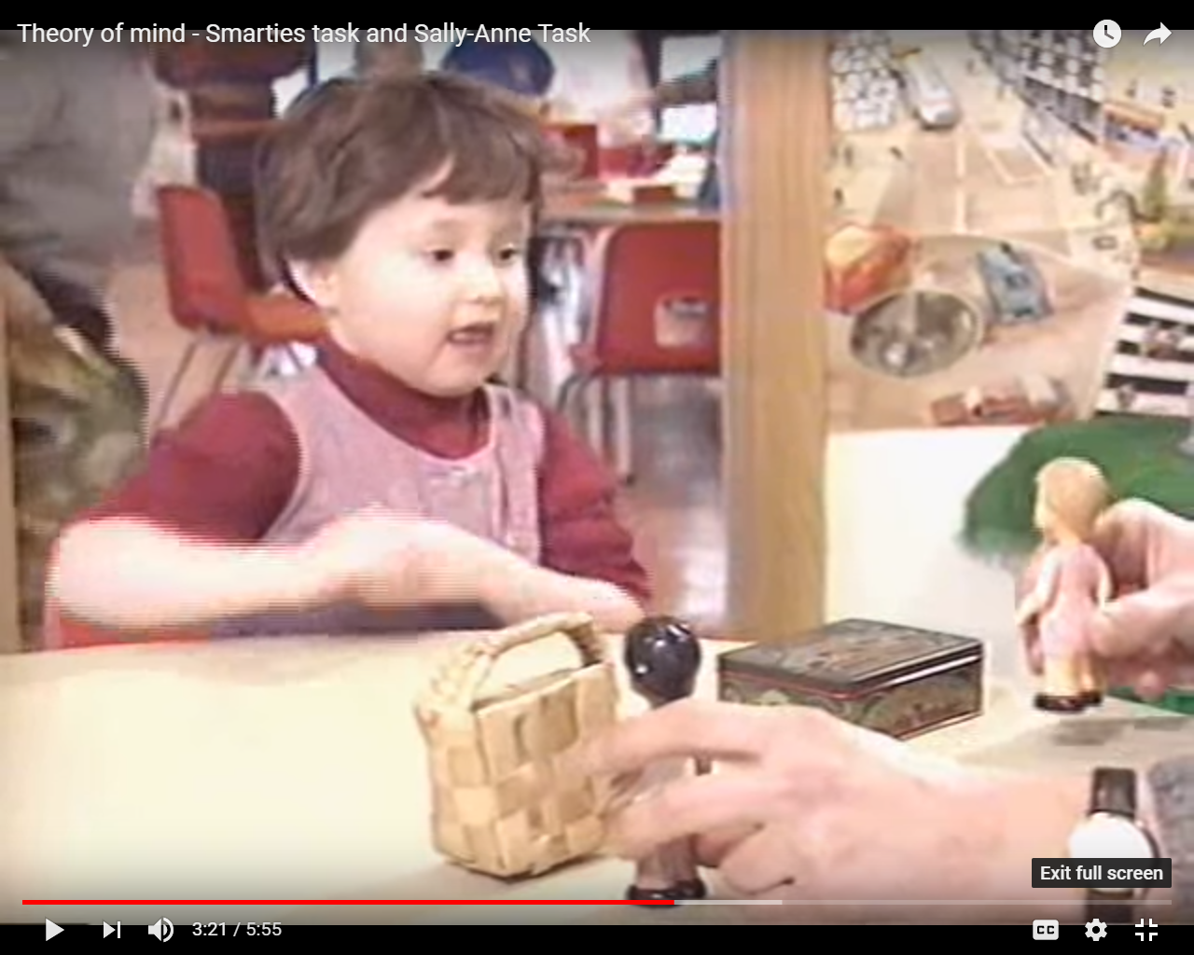
Theory of mind measured by the Sally –Anne task (Baron-Cohen et al., 1985)
https://www.youtube.com/watch?v=41jSdOQQpv0

Slide 16
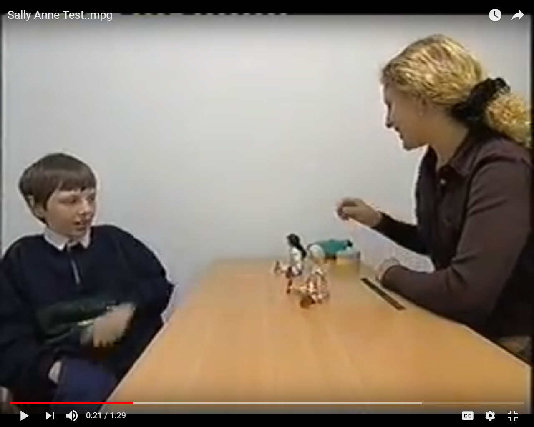
A much older child doing the Sally-Ann task. How does his behaviour compare to the little girl?
It is a useful concept to explain the difficulty in understanding other’s and social interaction. But it does not explain the restricted and repetitive behaviour
https://www.youtube.com/watch?v=QjkTQtggLH4

Slide 17
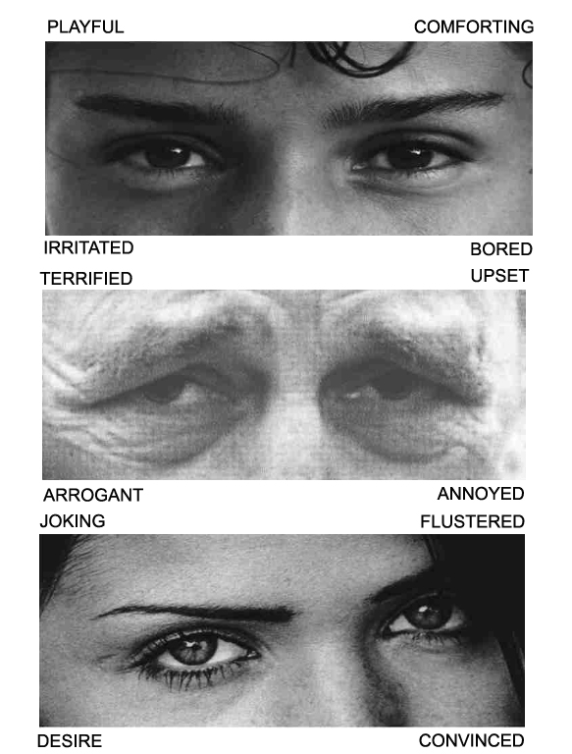
RTMIE task (Baron-Cohen et al, 2015)
High functioning autistic individuals can pass the Theory of Mind task without understanding other’s mind.
The Reading the mind in the eyes task measures the affective Theory of Mind: both verbal and non-verbal understanding (Baron-Cohen et al., 2015 )
Some studies also measured the participant’s brainwaves when they are completing the task
Age effect in some adults as processing in emotion display is affected
This Photo by Unknown Author is licensed under CC BY-SA

Slide 18
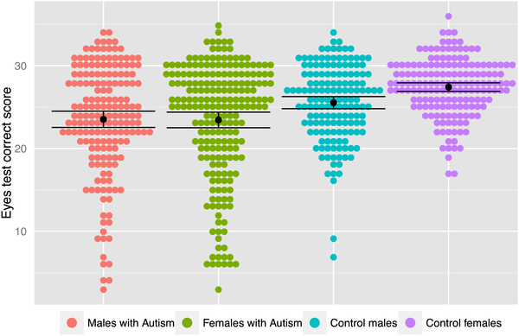

Reading the Mind in the eyes task
Fig 1. Performance accuracy on the Eyes test by group.
In general, female better at this task than male (see higher mean in purple data compared to blue data)
On the other hand, individuals with ASD performed poorer in this task.
No gender differences and some very low scores in these two groups.
Again it does not explain the repetitive and restricted interest.
Baron-Cohen S, Bowen DC, Holt RJ, Allison C, Auyeung B, et al. (2015) The “Reading the Mind in the Eyes” Test: Complete Absence of Typical Sex Difference in ~400 Men and Women with Autism. PLOS ONE 10(8): e0136521. https://doi.org/10.1371/journal.pone.0136521
Notes:
htps://journals.plos.org/plosone/article?id=10.1371/journal.pone.0136521
Baron-Cohen et al., (2017)

Slide 19
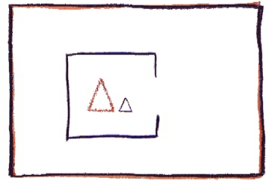
Theory of mind task without words
What can you see?
What are the two triangles doing?
To most autistic individuals there is no social meaning behind the movement of the two triangles regardless of their level of intelligence
Abell et al (2000), White et al (2011), Frith & Happé

Slide 20

Mental State Stories
Simon is a big liar. Simon’s brother Jim knows this, he knows that Simon never tells the truth! Now yesterday Simon stole Jim’s ping‐pong paddle, and Jim knows Simon has hidden it somewhere, though he can’t find it. He’s very cross. So he finds Simon and he says, “Where is my ping‐pong paddle? You must have hidden it either in the cupboard or under your bed, because I’ve looked everywhere else. Where is it, in the cupboard or under your bed”? Simon tells him the paddle is under his bed.
Q: Why will Jim look in the cupboard for the paddle?

Slide 21
Strange Stories (Murray et al., 2017; White et al., 2009)
Strange stories (White et al., 2009): traditionally presented to the person verbally to examine their cognitive ToM. Autistic individuals had no problems passing the question about physical and mental state in the stories. However, they performed poorly when the story is about a person’s mental state.
Now presented in video/short films (Murrary et al., 2017)
Scoring:
Q: Why will Jim look in the cupboard for the paddle?
  2 points—reference to Jim knowing Simon lies
  1 point—reference to facts (that’s where it really is, Simon’s a big liar) or Simon hiding it without reference to implications of lying
  0 points—reference to general nonspecific information (because he looked everywhere else)
Notes:
White, S., Hill, E., Happé, F. and Frith, U. (2009), Revisiting the Strange Stories: Revealing Mentalizing Impairments in Autism. Child Development, 80: 1097-1117. doi:10.1111/j.1467-8624.2009.01319.x
Murray, K., Johnston, K., Cunnane, H., Kerr, C., Spain, D., Gillan, N., ... & Happé, F. (2017). A new test of advanced theory of mind: The “Strange Stories Film Task” captures social processing differences in adults with autism spectrum disorders. Autism Research, 10(6), 1120-1132.
The complete sets of stories are included as follows. The mental state stories and the unlinked sentences are suitable for use with both adults and children; the new questions for the unlinked sentences are a more suitable control task. The original physical state stories are most suitable for high‐functioning adults, whereas the four new physical stories in addition to the first four (as listed) original physical stories are more suitable for children. The animal and nature sets are matched for difficulty to the other sets in children.
https://srcd.onlinelibrary.wiley.com/doi/full/10.1111/j.1467-8624.2009.01319.x in Appendix

Slide 22
Making diagnosis: Autism Team
Pediatrician
Psychologist (appropriate based on age)
Educational Psychologist
Clinical Psychologist
Occupational Therapist

Slide 23
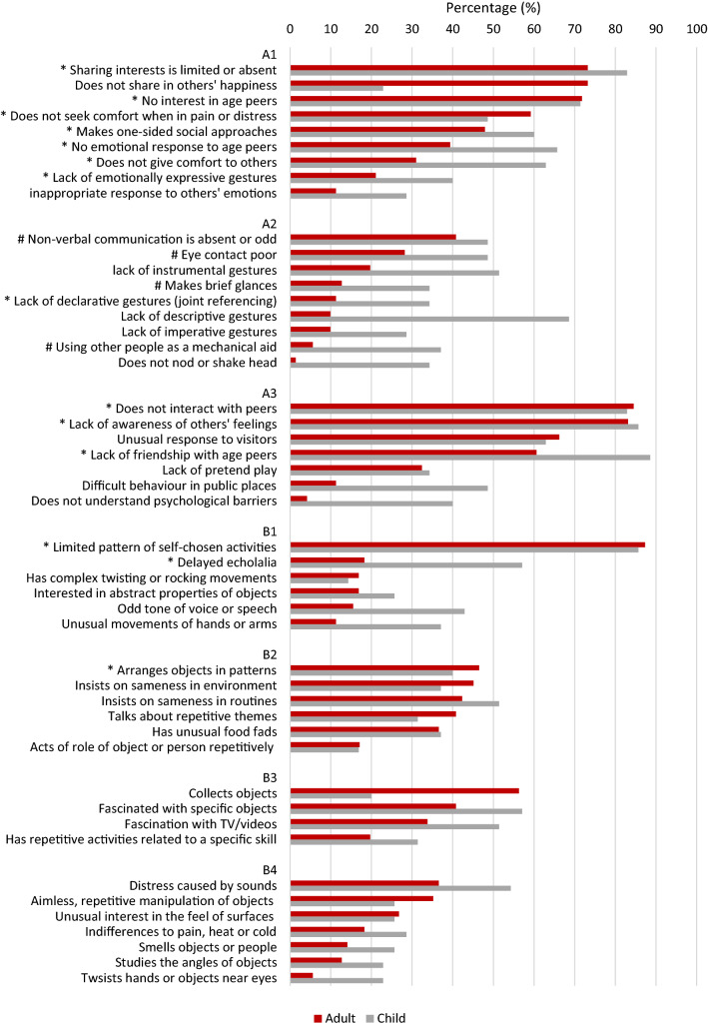
The Diagnostic Interview for Social and Communication Disorders:
DISCO (Leekam et al., 2002)
Graph from (Carrington et al., 2020)
https://www.ncbi.nlm.nih.gov/pmc/articles/PMC6841916/bin/10803_2019_4214_Fig3_HTML.jpg
Notes:
Carrington, S. J., Barrett, S. L., Sivagamasundari, U., Fretwell, C., Noens, I., Maljaars, J., & Leekam, S. R. (2019). Describing the Profile of Diagnostic Features in Autistic Adults Using an Abbreviated Version of the Diagnostic Interview for Social and Communication Disorders (DISCO-Abbreviated). Journal of autism and developmental disorders, 49(12), 5036–5046. https://doi.org/10.1007/s10803-019-04214-7

Slide 24
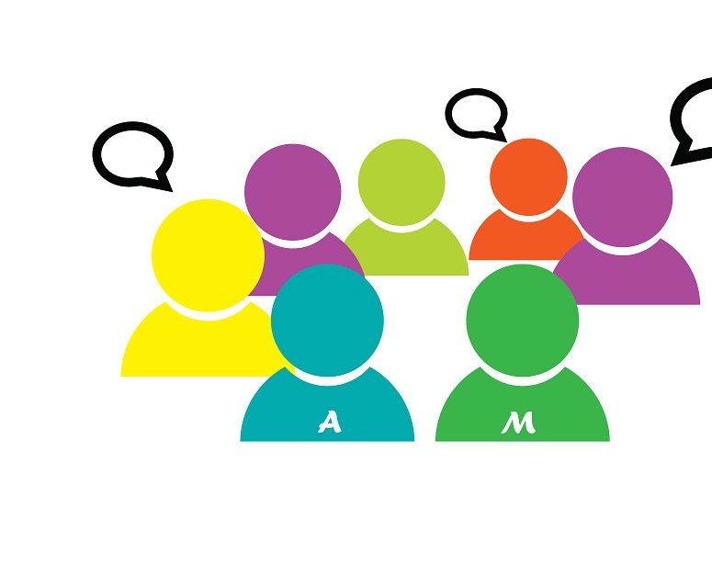
Diagnosis Tools of ASD
See Moodle for how to complete this week’s forum activity
  ADOS
  ARI
  DISCO
This Photo by Unknown Author is licensed under CC BY
Notes:
We can do this activity if there is time at the end

Slide 25
Treatment and Intervention (US Centre for Disease and Control, n.d.)
Behavioural
ABA: applied behaviour analysis
Developmental
Speech and language therapy
Educational
Social-relational
Pharmacological
Psychological
Complementary and alternative
Occupational therapy
Treatment and Education of Autistic and Related Communication-Handicapped Children (TEACCH)
CBT
Not address the core symptoms
Mindfulness
Pre-school autism communication therapy (PACT)
Assistive technologies
EIBI
Social stories
Social skills group
Family therapies – Parents and other family members can learn how to play and interact with their children in a way that promotes social interaction skills and manages problem behaviours.
Notes:
Treatment and Intervention for Autism Spectrum Disorder | Autism Spectrum Disorder (ASD) | CDC

Slide 26
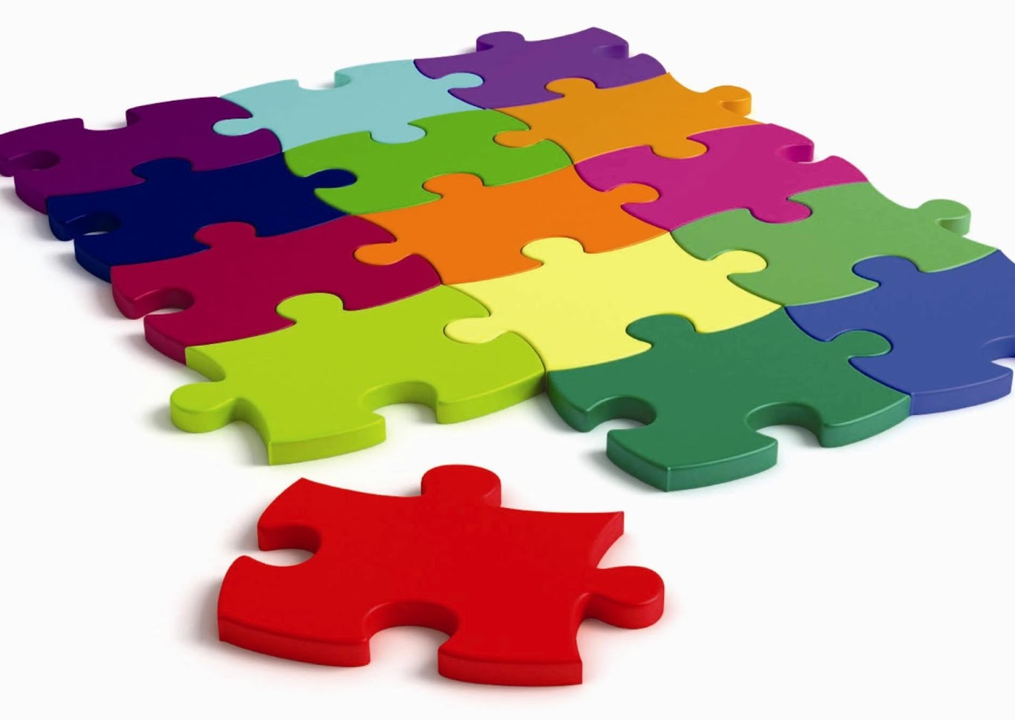
Mosaic activity: Which treatment for ASD?
Applied behaviour Analysis (OpenLearn)
Medication Treatment for Autism | NICHD - Eunice Kennedy Shriver National Institute of Child Health and Human Development (nih.gov)
What is AAC? - AssistiveWare
Picture Exchange Communication System (PECS) (pecs-unitedkingdom.com)
Treatments that are not recommended for autism - NHS (www.nhs.uk)
This Photo by Unknown Author is licensed under CC BY-NC-ND
Notes:
Students to work in pairs and choose one of the types each. Give them about 15-20 minutes to do the reading. They will report back to the group the type of treatment they read about.
Applied Behavior Analysis (ABA) | Autism Speaks
What is Augmentative and Alternative Communication and how can it benefit autistic people? (autism.org.uk)
Applied Behavior Analysis (ABA) | Autism Speaks
Fake treatments for autism
Special Diets Eg: Keto
Vitamins or other supplements
GcMAF – an injection made from blood cells
Specific medications (targeted towards memory and/hormones
Neurofeedback

Slide 27

Children and young people with Autism in schools
More likely to be placed in mainstream schools
Provisions within mainstream schools inconsistent (Watkins, 2019): interviews with autistic adolescents, parent of autistic child and teachers who supported autistic children transitioned from primary to secondary schools
  Bullying, anxiety and sense of isolation were frequently reported
  Children with more severe ASD were more likely to be placed in mainstream secondary schools with special units whereas those with milder conditions were less likely to have the support and special provisions put in place for them
This Photo by Unknown Author is licensed under CC BY-SA

Slide 28
“And then eventually I started getting really distressed, and erm, XXXX went up to the teacher again and offered to take me outside of the classroom and the teacher just said “She's fine.” XXXX replied with “She's banging her head against the table, she's not fine.” And erm, then the teacher didn’t, erm, like try to actually address the situation herself, she didn’t ask me why I was upset, she didn’t ask me if I wanted to go to, if I, wanted to go outside of the classroom, she just completely ignored what was going on and that’s why I think she should at least go through a training course that will inform her about special needs, like erm, like autism, and all that, because obviously she doesn’t know.” (lines 707-725) (Watkins, 2019. pp. 138-139)
Notes:
Hope’s recollection of her secondary school experience.
She was deemed as having mild symptoms and capable. Therefore seen by teachers as not needing much additional help.
Hope eventually refused to return to school. Watkins’ grounded theory research

Slide 29
Did Hope feel she was listened to in school on the last slide?
What would you feel if you were in Hope’s shoe?
This Photo by Unknown Author is licensed under CC BY
Notes:
We will cover some of the masking that Hope showed in a bit

Slide 30

Autism and health
Shorter life expectancy and premature mortality
  3 times more likely to die between 2010-2016 in Canada compared to people without autism (Lunsky et al, 2022)
  2.06 times higher mortality than non-autistic Australian between 2001 and 2015 due to nervous and sense disorders (Hwang et al., 2019)
  According to Hirvikoski et al (2016) a multitudes of medical conditions lead to higher pre-mature mortality in ASD
    Especially for female with low functioning
    Individuals with higher functioning higher risk for suicide
Greater risks of physical health conditions and complex health needs across lifespan of autistic individuals in the UK (Ward et al, 2023)
  No single cause of poor physical health
  Biological contributions
  Socioeconomic issues related to negative life experiences and stigma
  Poorer self-reported healthcare quality
Health and social care provisions need to be individually designed and taking into account the vulnerability of ASD individuals
Notes:
Take home message in the purple
Lunsky et al is a population based study for people with autism aged between 19-65 within 6 years Premature mortality in a population‐based cohort of autistic adults in Canada - Lunsky - 2022 - Autism Research - Wiley Online Library
Mortality and cause of death of Australians on the autism spectrum (researchgate.net) large Oz population study with nearly 36k. There were cases caused by epilepsy and “injury and poisoning”, respectively
232 232..238 (uwtsd.ac.uk) large population study
In summary, we observed markedly increased premature mortality in ASD owing to a multitude of medical conditions. The risk was particularly high for females with low-functioning ASD. However, individuals with high-functioning ASD had a high risk for suicide. Adequate and coordinated medical care for individuals with ASD and research into the phenomenon should be a target for a considerably broader audience of medical specialties than psychiatry and neurology.
Ward et al (2023) )Increased rates of chronic physical health conditions across all organ systems in autistic adolescents and adults | Molecular Autism | Full Text (biomedcentral.com) large UK study
Our results suggest that there are greater risks of co-occurring physical health conditions and complex health needs across the lifespan among autistic people compared to non-autistic people. This is supported by several previous papers using a wide range of methodologies and samples [11, 12, 15, 20]. This may be due to biological contributors (e.g., genetic or hormonal) to risk of these physical health conditions and/or due to social/economic issues related to negative life experiences, stigma, as well as poorer self-reported healthcare quality [23, 24, 37, 68,69,70,71,72]. Importantly, no singular cause of the poorer physical health of autistic emerges from the existing literature or the present study. [24, 37].
The only cross-sectional study with an online survey design
N= 3657 responses to the survey

Slide 31

Gender differences in ASD
Most stereotyped autistic behaviours are biased towards male in the literature
Harder to detect autism in females
Masking is common in females: some show eye contact and animated facial expressions
  To avoid stigma or prejudice (Perry et al., 2021)
  “to blend in or ‘pass’ in a neurotypical world” (National Autistic Society, n.d.)
  To avoid social rejection

Slide 32
“Masking happens in the context of being given the message at quite a young age that who you are and your natural, instinctive way of being is not okay, and that you will only be accepted if you shape yourself into something else. … I think as an autistic child, I was given the message that my entire job in life was to make other people feel comfortable. And I never thought about making myself feel comfortable.”
– Purple Ella (National Autistic Society, n.d.)
Research has found its negative impacts on people’s self-esteem, identity
Leading to burnout, distress, autistic meltdowns and internalised problems and mental health issues
Notes:
Suicide rate is a concern
Masking (autism.org.uk)

Slide 33
Mosaic activity: learn more about ASD
Each group focuses on one of the below
Number of autistic people in mental health hospitals (autism.org.uk)
Read the what we are calling for section in Thousands sign our open letter to the Prime Minister (autism.org.uk)
What is STOMP Everyone working together to stop the over use of psychotropic medicines and to improve people's quality of life (england.nhs.uk)
This Photo by Unknown Author is licensed under CC BY-NC-ND

Slide 34
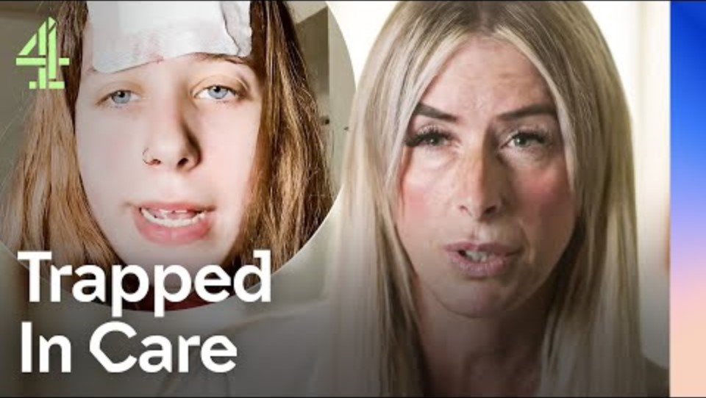
Individuals with Autism in mental hospital
Notes:
This is a difficult watch. Might be better to keep it shorter. It is for awareness raising but with sensitivity
https://youtu.be/mSFkRa0yyuY?feature=sharedWatch Locked Away: Our Autism Scandal - Dispatches | Stream free on Channel 4
https://youtu.be/mSFkRa0yyuY?feature=shared

Slide 35
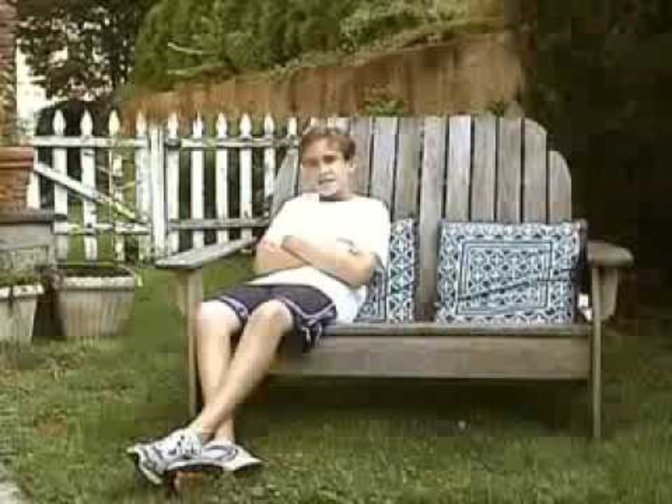
ASD not understood or being misunderstood
Notes:
Not helpful at all. But shows popular misunderstanding

Slide 36
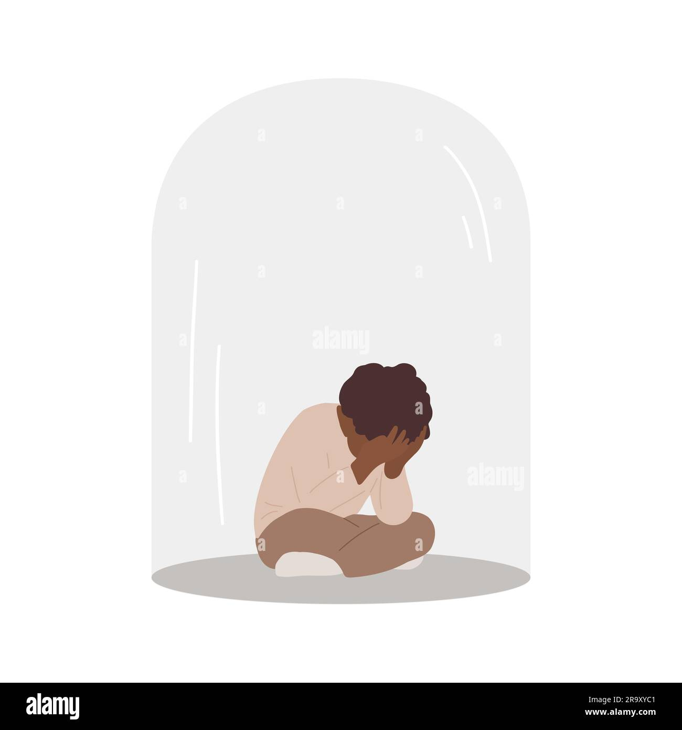
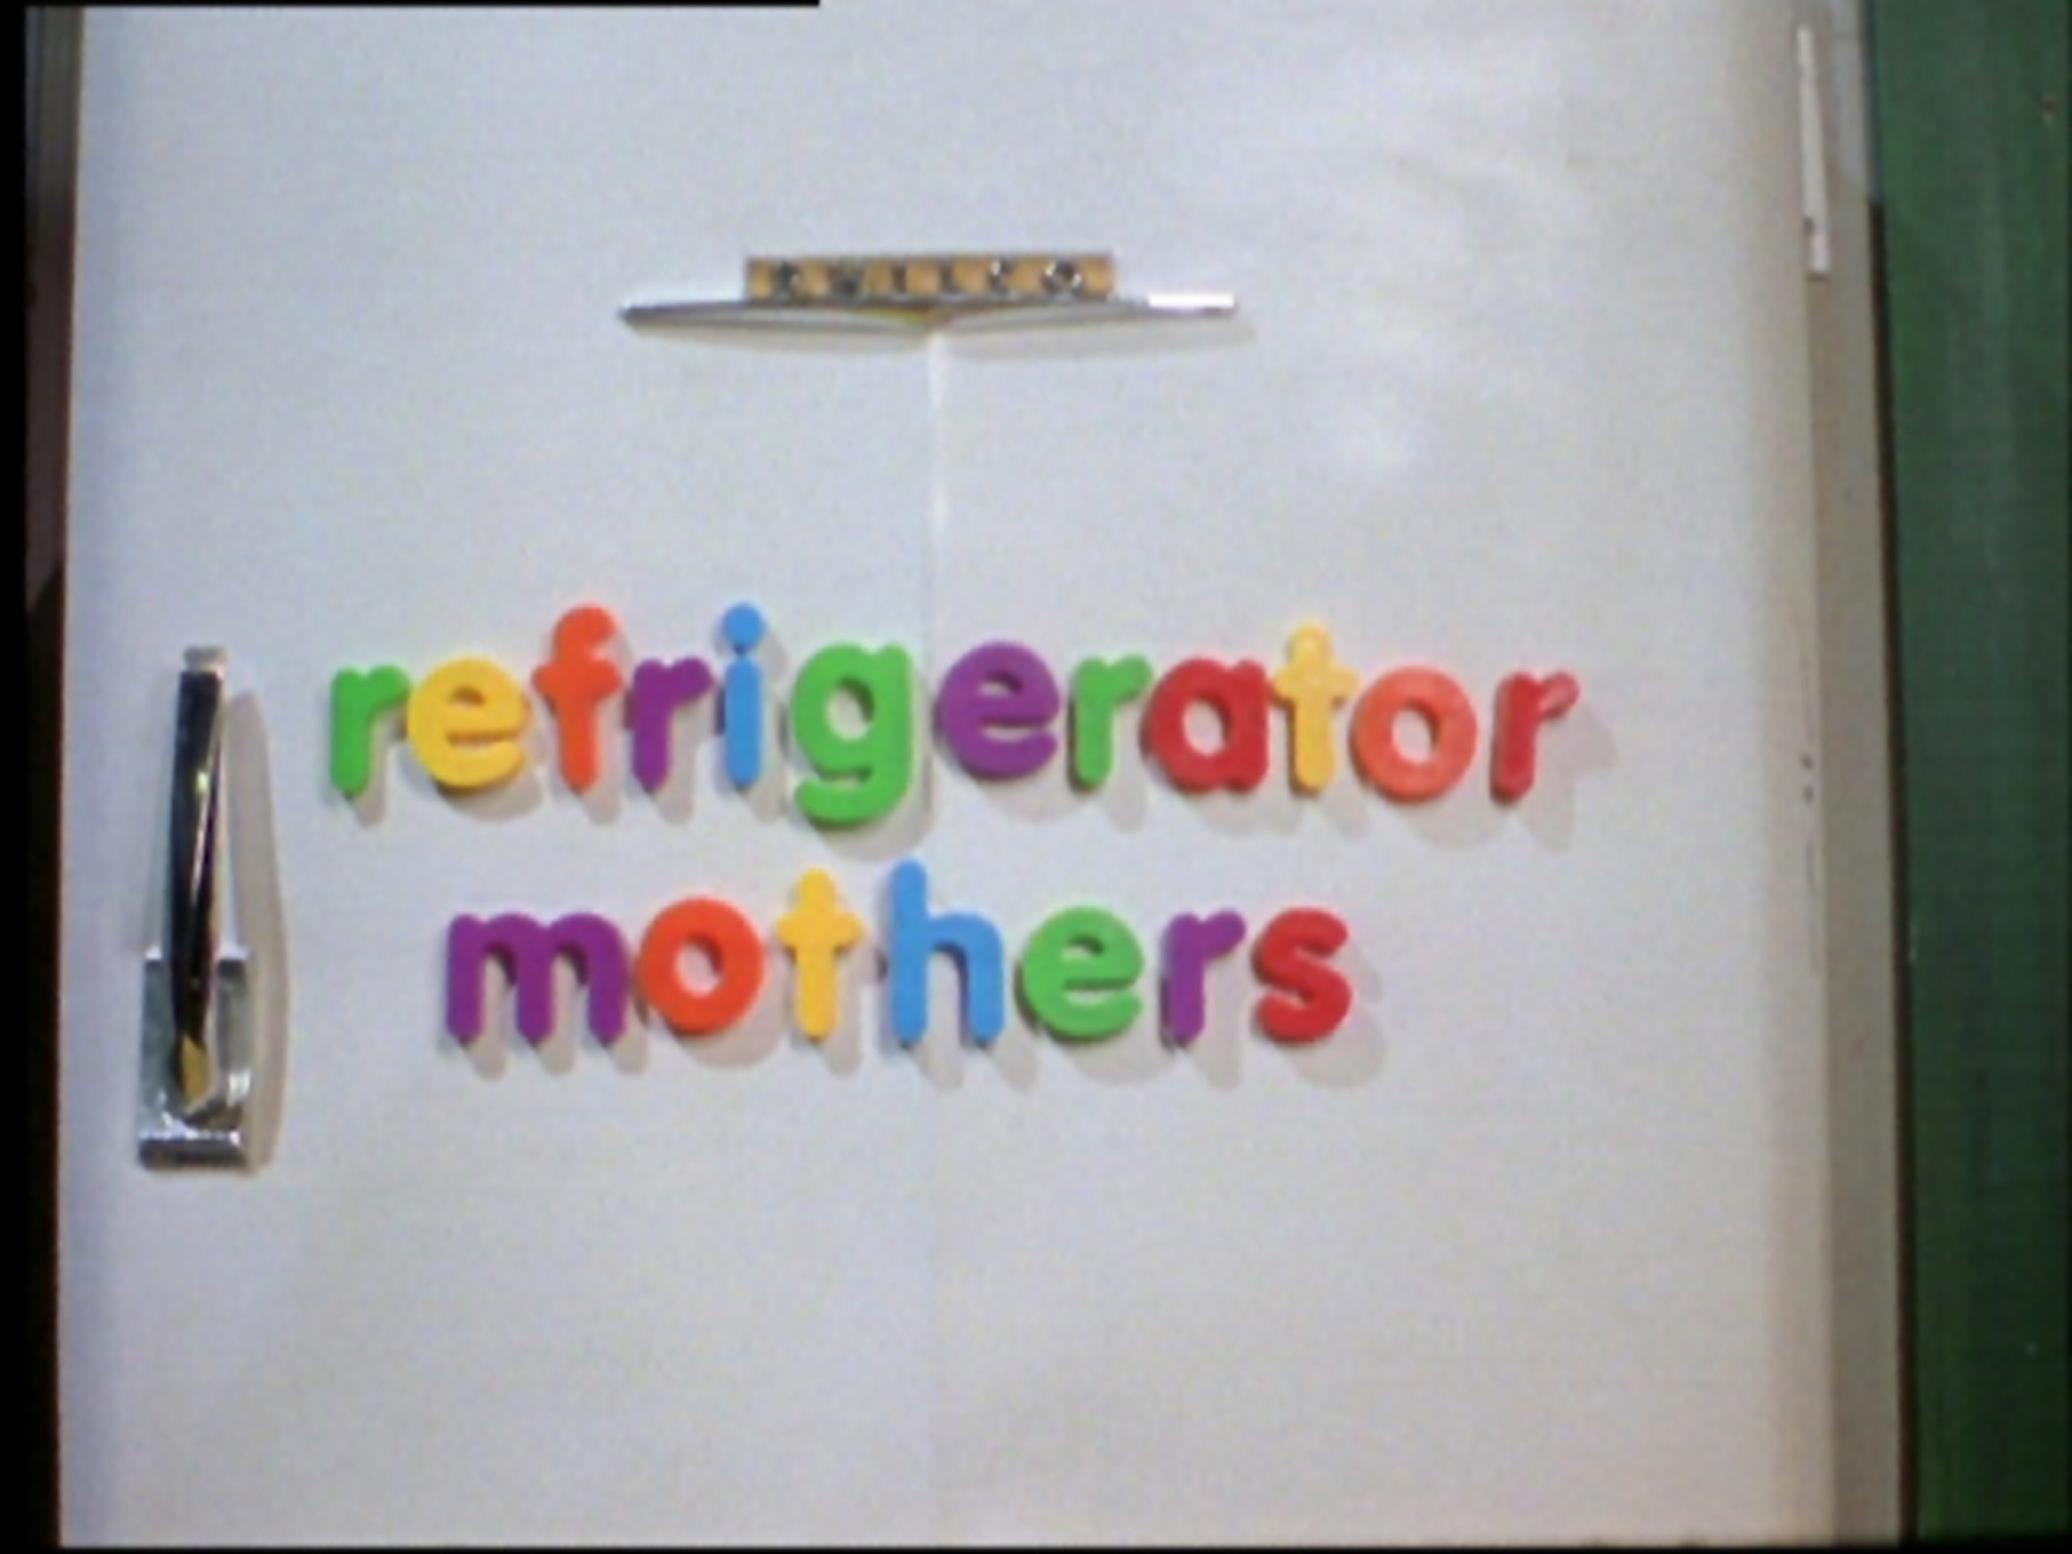

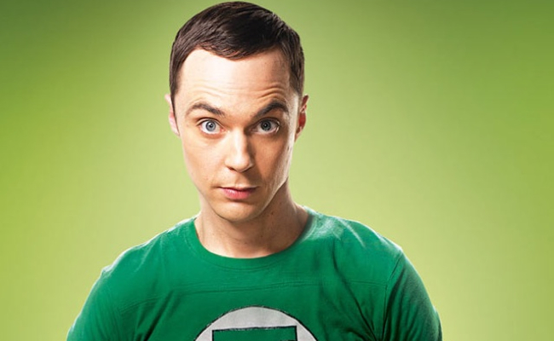
Changing imagines of ASD in popular culture
Card counting savant with super memory
Socially awkward but highly intelligent
A child isolated from the world
ASD caused by poor parenting
This Photo by Unknown Author is licensed under CC BY-NC
This Photo by Unknown Author is licensed under CC BY-NC-ND
Notes:
Childhood traumas not the leading cause of ASD (most can be diagnosed at 18 months), nor is poor parenting. The premises is that there should not be a known cause to the child’s autism according to the ICD-11.
ASD is a very broad spectrum. However, the stereotyped media portrayals such as Sheldon Cooper tend to be more related to high functioning individuals

Slide 37
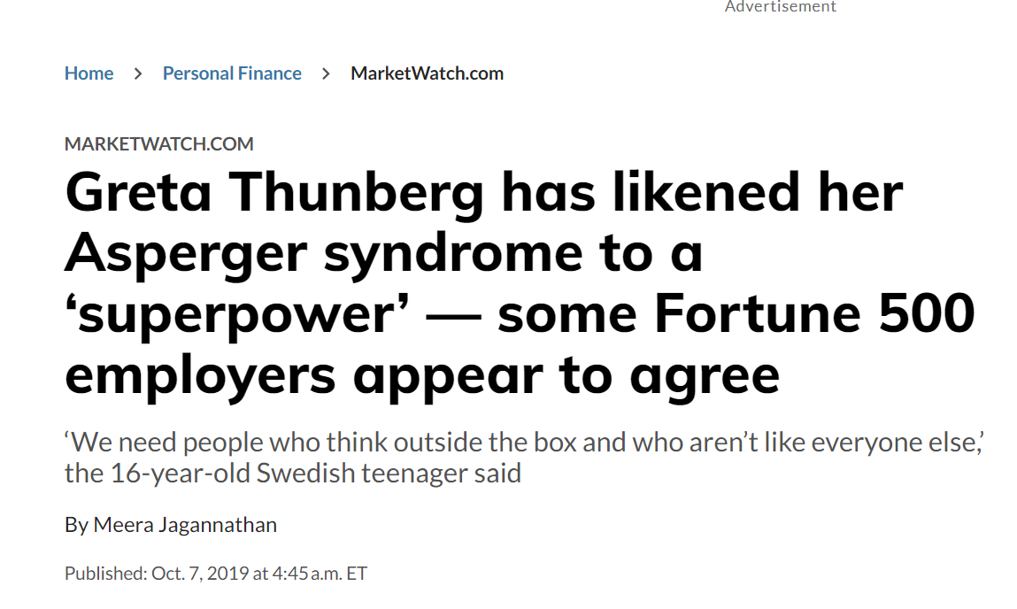
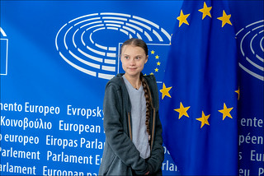
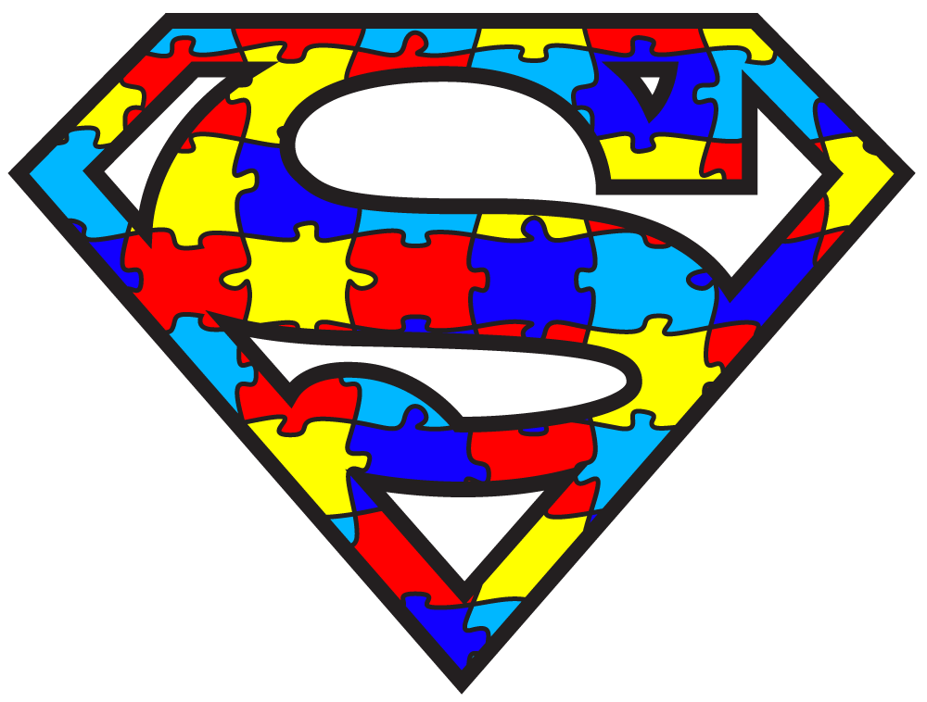
Change in discourse about ASD: focused, persistent etc
This Photo by Unknown Author is licensed under CC BY
This Photo by Unknown Author is licensed under CC BY-NC-ND
Notes:
Greta Thunberg Likens Autism to Superpower | Organization for Autism Research (researchautism.org)

Slide 38
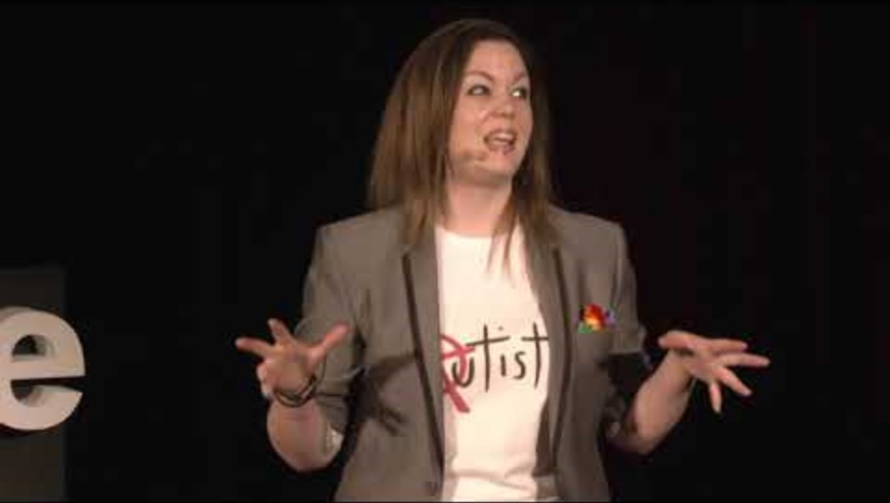
Notes:
Please play the whole talk. Invite students to discuss

Slide 39
Neurodiversity movement
Many of the points were discussed in the TedEx talk
Like biodiversity, neurodivergent people should not be ‘treated’ as if they are ‘less’ than neurotypical individuals. Instead, their differences should be respected and valued
  Use the superpower
  Treatments should not be necessary to correct their characteristics
  Some of the treatments such as Lova’s are seen as unethical
Notes:
Also to include ADHD, dyslexia and other neurodevelopmental disorder
We will follow this up with antipsychiatry movement later

Slide 40
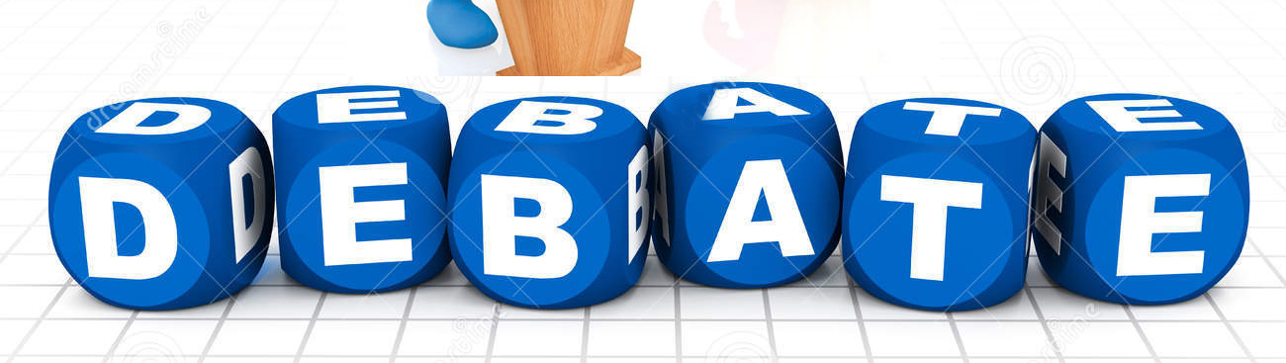
How helpful is it to tell young neurodivergent children with ASD that they have superpower?
This Photo by Unknown Author is licensed under CC BY-NC-ND

Slide 41

Practise your Poster presentation
This Photo by Unknown Author is licensed under CC BY-NC
Notes:
Invite the students to put their draft poster on draft Turnitin and display it on widescreen to check on the effect

