Slide 1

Improve efficiency and communication by using Microsoft teams
Anysah Maria Saleem
Student ID 2614223
Teacher : Masud Siddiqui

Slide 2
Microsoft teams
Microsoft teams is digital platform that helps social worker communication better and work faster. It brings chat meeting files and calendars together in one easy to use place.
Better communication
Instant messaging for quick updates instead of waiting for emails.
Video call or voice call to connect with colleagues , care teams and other organization without traveling.
Everyone gets the same important information at the same time.
All document is one place easy to find and share and save time_ chasing people for information.
Working Together
Helping social worker doctor Nurses and support staff stay on the same pages.
Decision happen faster because communication is instant.
Less confusion safer better care for people families.

Slide 3
Why it matter for social work
Clear communication
Social worker need to talk to many different people families doctor school polices and care teams.
Teams keep conversation organized instead of messages getting lost in email on phones.
Information is shared quickly so everyone understanding what is happening with the person being supported.
Less stress and more focus
Everything is in one app messages files and meeting and schedules.
Less time searching for notes or waiting for replies means more time helping people.
Social worker can update care plans or share important new instantly.

Slide 4
Safe & connected
keeps information safe
Client details and sensitive notes stay protected within the secure system.
Only the right people can access what they need.
No more worrying about loss paper or messages going to the wrong person
Bring teams together
Work well even when people are in different building or locations.
Care teams can have quick check ins without traveling.
Helps different organization trust and support each other better.

Slide 5
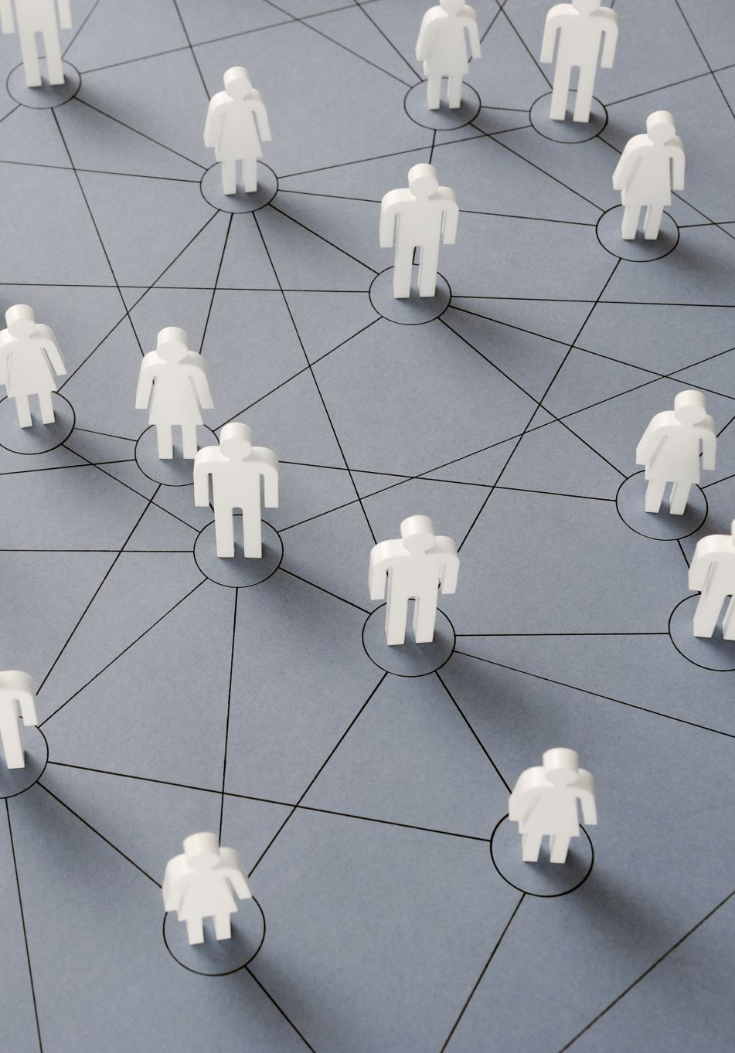
Microsoft Teams
Microsoft teams is fast and convenient for people in different jobs. Social worker use it every day, alongside Excel for draft and date handing.
It is widely used by care teams, allowing social worker to communication easily with other professional.
I also support video calls shared document and quicky update making teamwork smoother.
This help care teams stay organized and provide better support to people they work with.

Slide 6
Reference
I use the YouTube I was watching the name of the video was
Kevin Stratvert
https://youtu.be/VDDPoYOQYfM?si=kBuLhzfNItIcNZ6n
All content in this assignment is written in my own words.
I have done this myself and I use that video of the work.
Thank you for listen.

