Slide 1

Personal Aspects of Vulnerability and Trauma
Week 2
BMPL 5015

Slide 2
Recap
Last week
Assignment discussion/dates
Professional curiosity
Police approach to vulnerability
Factors to vulnerability - Health / equality / poverty / personal
Services definitions of vulnerability
The Social Services and Well-being (Wales) Act 2014
THRIVE

Slide 3
Why do people become victims - Personal aspects – Week 2
Impact of early life events
ACE’s
Trauma
Stockholm Syndrome
Circle of Abuse

Slide 4

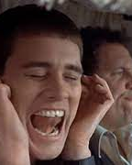
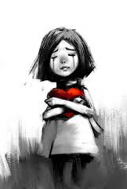
Warnings and Feelings

Slide 5

Police Definition
A person is vulnerable if, as a result of their situation or circumstances, they are unable to take care of or protect themselves or others from harm or exploitation.

Slide 6
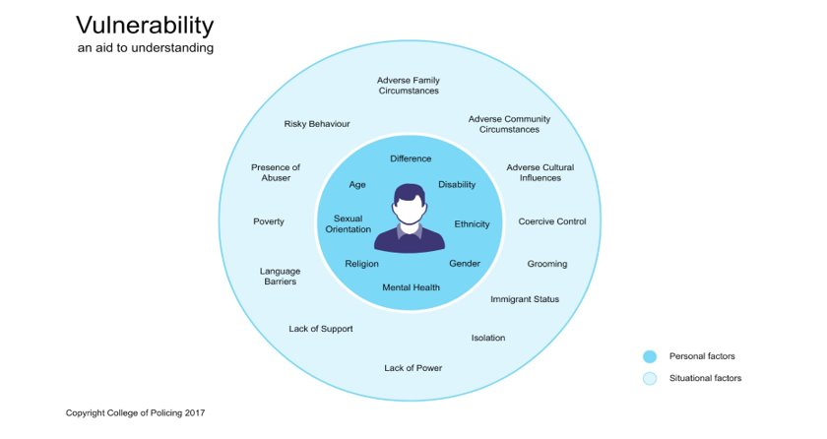
Notes:
https://www.npcc.police.uk/Crime%20Ops%20Committee/NVAP.pdf

Slide 7

National Vulnerability Action Plan (NVAP) Assignment option
Developed by National Police Chiefs’ Council, CoP, and support from His Majesty's Inspectorate of Constabulary and Fire & Rescue Services (HMICFRS)
Improve policing’s response to vulnerability, improve criminal justice outcomes, increase victim satisfaction
A framework that supports forces by identifying cross-cutting themes of vulnerability and gives clear plans for forces to use in shaping and delivering their approaches
Notes:
https://www.vkpp.org.uk/vkpp-work/national-vulnerability-action-plan-nvap/

Slide 8
National Vulnerability Action Plan (NVAP)
Overarching Principles:
Partners to work together and effectively
The concept of ‘vulnerability’ encompasses the person and their circumstances
Responding to vulnerability includes empowering people to seek their own support networks
Prioritising prevention reduces harm and demand
There needs to be a change in culture within and across service providers

Slide 9
key themes NVAP
1. Early Intervention and Prevention:
By adopting the principle of ‘professional curiosity’
Identifying vulnerability at an early stage gives an opportunity for partners so that risk of harm might be reduced
  This does not always mean referral to other statutory agencies but does mean taking a caring approach to reduce the risk of further harm. E.g. this could be as little as knowing what local and national support services are available and signposting accordingly.

Slide 10
NVAP
3. Information, Intelligence, Data Collection and Management Information:
Forces need an effective processes in place to gather information and intelligence. Officers and staff use the tools to effectively assess risk to consider an appropriate and proportionate response. Each force develops appropriate data and related evidence to ensure that its response to vulnerability is as effective as possible
2. Protecting, Supporting, Safeguarding and Managing Risk:
By investigating fully, officers and staff develop a comprehensive understanding of the causes of risk of harm and together with partners, take effective measures to manage them

Slide 11
NVAP Key Themes
4. Effective investigation and out comes:
All staff/officers must engage with vulnerable people in a supporting way. Be open minded, respond to the vulnerability rather than stereotype. Ensuring support/interventions leads to better outcomes. * ‘Need to reach’ people – YP involved in gangs, C/Lines & Victims of M/S
PROFESSIONAL CURIOSITY
5. Leadership:
Not rank specific! Exercise professional judgement in determining the most appropriate response and support to vulnerable people. Ensure that correct governance is in place to manage risk relating to vulnerability effectively.

Slide 12
NVAP Key Themes
6. Learning & Development: Officers & staff are supported to attain and maintain the skills and knowledge that they need to effectively recognise and respond to all forms of vulnerability. The outcome will be that staff will be able to work in partnership to take a problem solving approach in addressing vulnerability.
7. Communication:
Communication used is understood by all internal and external audiences. Utilise information to ensure that people understand how to reduce potential risks, and our officers and staff understand what is expected of them. Vulnerability should be recognised as relating to witnesses, victims, suspects

Slide 13


Task
Consider one of the most serious child exploitation cases within the UK and discuss
Oldham
Rotherham - Operation Clover
Operation Globe – Wales
Telford Child exploitation
Task of week 3 TBC

Slide 14

Impact of Early Life Events

Slide 15
Adverse Childhood Experience’s - ACE’s
Traumatic experiences that occur before the age of 18 and are remembered throughout adulthood.
Verbal, mental, sexual and physical abuse, to being raised in a household where domestic violence, alcohol abuse, parental separation or drug abuse is present.
Evidence shows children who experience ACE’s are more likely to develop problems as adults
Becoming less likely to be a productive member of society
Poor school attainment
Notes:
ACE’s = adults more likely to develop health-harming and anti-social behaviours, more likely to perform poorly in school, more likely to be involved in crime and ultimately less likely to be a productive member of society.

Slide 16

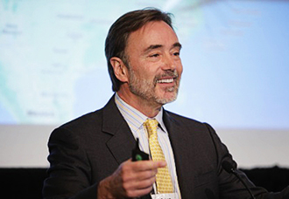

Adverse Childhood Experiences ACE’s
ACE’s adopted from USA
1995
traumatic experiences in children that are remembered throughout adulthood
Dr. Felitti Dr. Anda Dr. Harris
Notes:
Dr. Felitti dr. in an obese clinic who found that due to a high drop out they were dealing with stress PTSD etc due to things that happened in their childhood - San Diego discovered that a majority of 286 people he interviewed had been sexually abused.
Dr. Anda disease surveillance, behavioural health, mental health and disease, cardiovascular disease, psychosocial origins of health-risk behaviours, and childhood determinants of health.
Dr Harris Paediatrician USA

Slide 17
ACE’s
Dr. Felitti – had 50% drop-out of clinic.
Found that 286 people interviewed had experienced sexual assault.
ID – stress, PTSD = could not cope with other demands
Dr. Anda worked in mental health, behavioural health and cardiovascular disease.
ID – that childhood effects were linked to these disease’s

Slide 18
The Research
17,337 participants interviewed
50% female / 50% male;
The average age was 57 years;
75.2% had attended college;
All had jobs
Remember USA no NHS so individuals are paying for health care!
Notes:
74.8% were white;

Slide 19
The Research - USA
28% of study participants reported physical abuse (4,854)
21% reported sexual abuse (3,640)
High reports of divorce or parental separation, or having a parent with a mental and/or substance use.
Almost 40% of the original sample reported two or more ACE’s (6934)
12.5% experienced four or more ACE’s (2,167)
Notes:
4,854 people reported physical abuse
3640 reported sexual abuse
6934 2 or more ACES
2,167 experience 4 or more ACES

Slide 20
What are they?
Adverse Childhood Experiences ( ACEs) are stressful experiences occurring during childhood that directly harm a child (e.g. sexual or physical abuse) or affect the environment in which they live (e.g. growing up in a house with domestic violence)’
Bellis et al, 2016

Slide 21
Video – ACE’s
https://www.youtube.com/watch?v=0tyZnASq8aQ

Slide 22
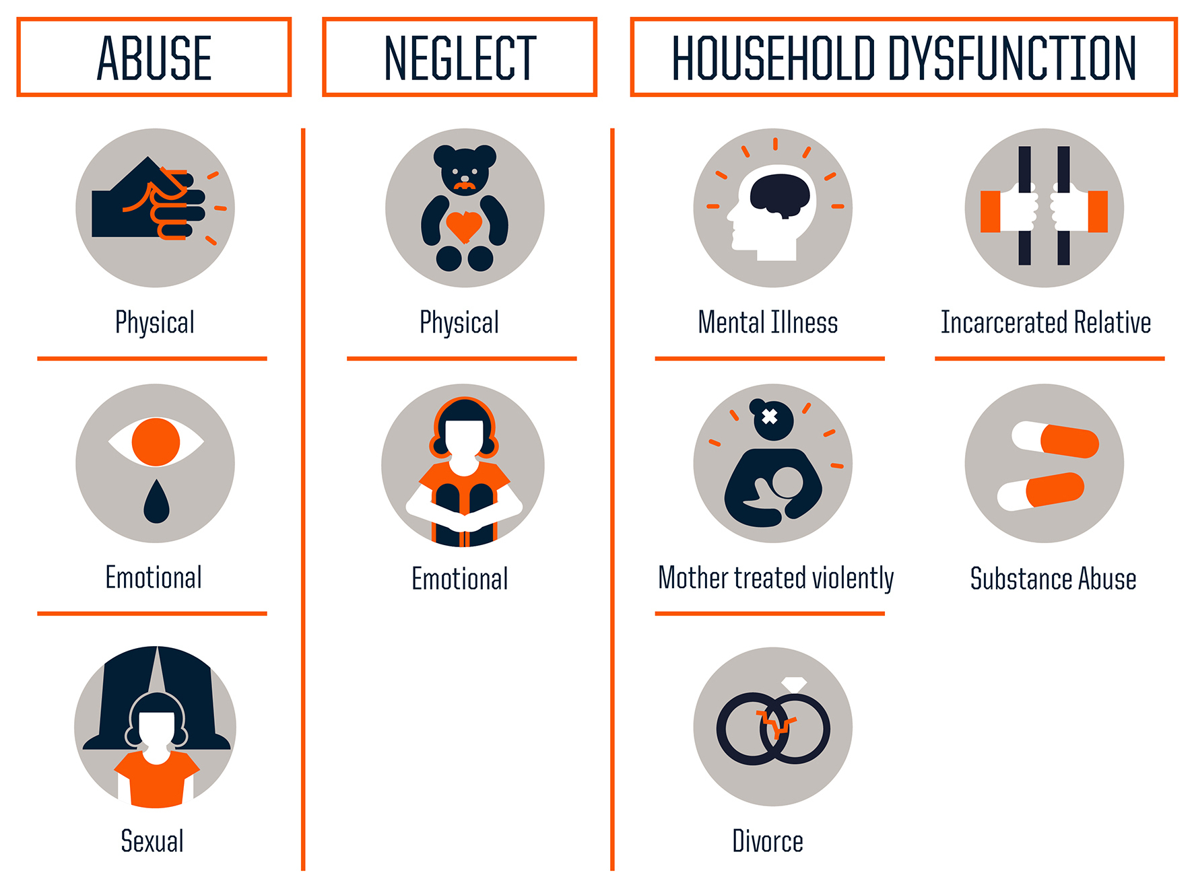
Considers

Slide 23
ACE Questions
Five are personal - have you been affected by verbal abuse?
Five are related to other family members - was your mother a victim of domestic violence?
Each type of trauma counts as one.
Therefore, a person who’s been verbally abused, with one alcoholic parent, and a mother who experienced domestic abuse = ACE score of three.
Notes:
physical abuse, verbal abuse, sexual abuse, physical neglect, and emotional neglect.
According to the research, the higher the score, the higher a person’s risk of adverse health outcomes, including substance use disorders and addiction. Remember this, too: ACE scores don’t tally the positive experiences in early life that can help build resilience and protect a child from the effects of trauma. Having a grandparent who loves you, a teacher who understands and believes in you, or a trusted friend you can confide in may mitigate the long-term effects of early trauma, psychologists say.

Slide 24
WALES – Results from first study:
suffering four or more harmful experiences in childhood increases the chances of:
high-risk drinking in adulthood by four times
being a smoker by six times
involved in violence in the last year by around 14 times.
The survey revealed around one in every seven adults aged 18-69 years in Wales had experienced four or more Adverse Childhood Experiences during their childhood and just under half had experienced at least one.
2000 adults in study

Slide 25
Chain of abuse

Slide 26
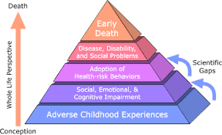
Notes:
Graph showing how adverse childhood experiences are related to risk factors for disease, health, and social well-being. The lifespan is represented as an arrow ascending past the layers of a pyramid, beginning at Adverse Childhood Experiences and moving through Social, Emotional, and Cognitive Impairment; Adoption of Health-risk Behaviours; Disease, Disability, and Social Problems; and finally Early Death. Smaller arrows depict gaps in scientific knowledge about the links between Adverse Childhood Experiences and later risk factors

Slide 27
ACE’s Increasing Harmful Behaviours
4 times more likely to be a high-risk drinker
6 times more likely to have or caused intended teenage pregnancy
6 times more likely to smoke
6 times more likely to have had sex under the age of 16
11 times more likely to have smoke cannabis
14 times more likely to have been a victim of violence
15 times more likely to have committed violence to another person
16 times more likely to have used crack cocaine or heroin
20 times more likely to have been incarcerated
Notes:
https://publications.parliament.uk/pa/cm201719/cmselect/cmsctech/506/50605.htm
https://www.ljmu.ac.uk/-/media/phi-reports/pdf/2023-01-state-of-the-art-report-eng.pdf

Slide 28
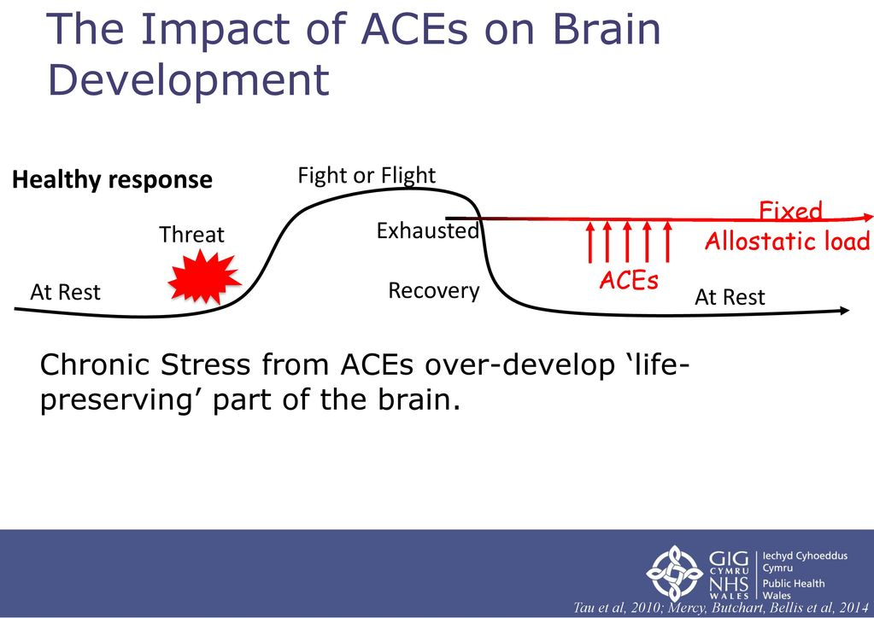
Notes:
Flight or fight = the instinctive physiological response to a threatening situation, which readies one either to resist forcibly or to run away.
Allostatic load refers to the long-term effects of continued exposure to chronic stress on the body. Colloquially, it is often referred to as 'wear and tear.' ... Long-term exposure to allostatic load can lead to disease and bodily breakdown.

Slide 29
Over all ACE’s can:
suicide increased suicide risk has been shown to be linked to the presence of childhood adversity by age seven
being a perpetrator of crime people who have experienced 4 or more ACEs were almost 9 x more likely to be incarcerated compared to people with no ACEs
being a victim of crime people with ACEs have been found to be at greater risk of intimate partner violence
education/employment those with higher ACEs have been found to be at greater risk of poorer educational and employment outcomes

Slide 30
Can ACE’s be Overturned?
A positive environment can reverse behavioural symptoms
Early intervention
Working with families and schools
Positive impact by parents and family members

Slide 31
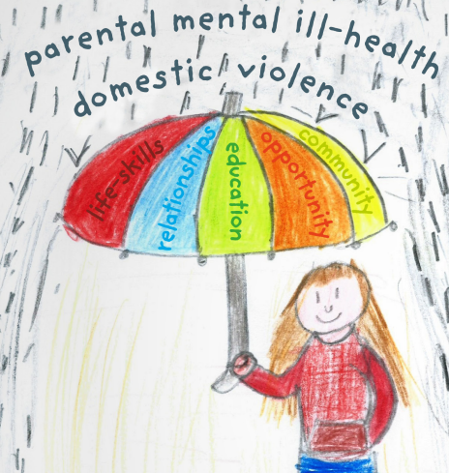

ACE scores don’t tally the positive experiences that can help.

Slide 32
How to Over Turn ACE’s
Developing resilience
access to a trusted adult in childhood
supportive friends
engaged in community activities, such as sports
Overall having opportunities in community / employment / education

Slide 33
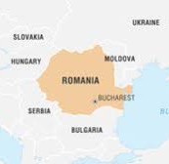
Children & Trauma
Romania's Communist leader overthrown in 1989
Opened up the country to the world
25-year regime of brutal repression, more than 100,000 children had been abandoned to squalid and overcrowded institutions.
The world watched in horror as footage emerged of naked children with shaved heads, chained to cribs, sitting on cold concrete floors, surrounded in body fluid. No crying, just rocking.

Slide 34
Why?
After the Second World War, the country's birth-rate had deteriorated.
Abortions were outlawed
Childless couples and women were taxed
Women and girls were checked for signs of pregnancy and miscarriage by the secret police.
Widespread poverty in country
= parents had more children than they could afford
= could not afford health treatment especially for disabled children
Tens of thousands of children were left in orphanages

Slide 35

https://www.youtube.com/watch?v=VCeWr8OFuEs

Slide 36

Research into the Children
Romanian orphans raised without nurturing or love had their brains were scanned.
Frontal-temporal areas of the brain (responsible for regulating emotions) were underdeveloped.
It showing little or no activity when a child was stimulated.
Found that neglected three-year-olds had smaller head circumferences than children raised in loving families.

Slide 37
https://www.youtube.com/watch?v=XHgLYI9KZ-A
  WG ACE’s launch
https://www.safelaunch.org/aces-quiz/
  Quiz with the ACE’s questions

Slide 38
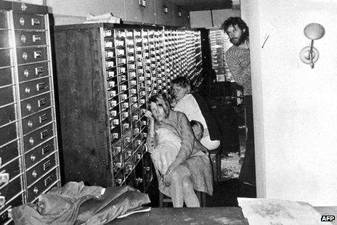
Stockholm Syndrome

Slide 39
Stockholm Syndrome
Derived from a 1973 bank robbery in Stockholm, Sweden
Four hostages were held for six days.
Defended the actions of the robbers.
Pled for the captors not to be harmed during the rescue.
Sympathetic and lacked hatred toward their captors.
Hostages continued to exhibit loyalty by -
Refused to testify against them.
Helped raise funds for legal representation.
Visited them in prison.
Notes:
The response of the hostages intrigued behaviourists and journalists, who, following the incident, conducted research to see if the Kreditbanken incident was unique or if other hostages in similar circumstances experienced the same sympathetic, supportive bonding with their captors.

Slide 40
What Causes Stockholm Syndrome?
Individuals can succumb to Stockholm syndrome under the following circumstances:
The belief that one's captor can and will kill them. The feelings of relief by the victim for not being killed then turn to gratitude.
Isolation from everyone but the captors
The belief that escape is impossible
The inflation of the captor's acts of kindness into genuine care for each other's welfare
The passage of at least a few days in captivity

Slide 41
Stockholm Syndrome / Traumatic Bonding
A positive feeling towards your captor is known as the Stockholm Effect
Psychological tendency of a hostage to bond with, or sympathize with their captor
Not limited to captors – any relationship where strong emotional ties develop between two persons where one person intermittently harasses, beats, threatens, abuses, or intimidates the other can also be called the Stockholm effect.

Slide 42
Situation -
You are kidnapped and told you going to die
You are terrified!
You have to ask to go to the toilet and you cannot eat or speak.
You are still alive! You are terrified!
You have food, you think this is an act of kindness you are thankful.
You are still alive! You are terrified!
You are thankful and think that the act of ‘kindness’ keeping me alive.
Small act of goodness = them being kind but you are not thinking about the abuse only that this person is keeping you alive.

Slide 43
Notes:
Flight or fight = the instinctive physiological response to a threatening situation, which readies one either to resist forcibly or to run away.
Allostatic load refers to the long-term effects of continued exposure to chronic stress on the body. Colloquially, it is often referred to as 'wear and tear.' ... Long-term exposure to allostatic load can lead to disease and bodily breakdown.

Slide 44
Victims of Stockholm Syndrome
Generally suffer from severe isolation and emotional and physical abuse
Kidnapping, hostage, prisoners of war, abused children, incest victims, domestic abuse cases
Each of these circumstances can result in the victims responding in a compliant and supportive way as a tactic for survival
It is similar to the reaction from brainwashing. Victims show some of the same symptoms as those who have post-traumatic stress syndrome PTSD

Slide 45
Natascha Kampusch
1998 at 10-year-old was grabbed by two men.
For the next eight years was held prisoner in a cellar beneath the garage of Wolfgang Přiklopil.
He beat and raped her and maintaining the doors/windows rigged with explosives.
Day of escape she was cleaning a car under supervision when the phone rang. Wolfgang left her to take the call.
Opportunity to run for help.
Wolfgang killed himself before being arrested.

Slide 46
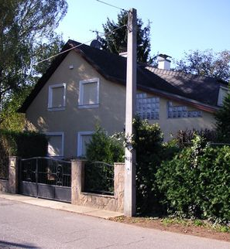
After the Dealth
Natascha was informed of the death, she wept for days;
Sat alone with his coffin for hours.
Years after the escape, she carried a photo of him in her wallet.
She even bought the house that she was held captive.
Made arrangements to move in.

Slide 47
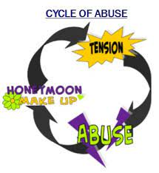
Cycle of Abuse

Slide 48
Cycle of Abuse
A social cycle theory
Lenore Walker 1979 – to explain behaviour patterns in abuse relationships
A set of conditions which maintain abusive and dysfunctional relationships
Usually passed down - remember chain of abuse image

Slide 49
Phase1
Tension building
Stress builds from the pressures of daily life (money, children, work, family conflicts, illness)
During this period, the abuser feels ignored, threatened, annoyed or wronged.
Feeling last for sometime
To prevent violence, the victim may try to reduce the tension by becoming compliant OR
the victim may provoke the abuser

Slide 50
Phase 2
Incident
During this stage the abuser attempts to dominate their victim.
  Outbursts may include Violence/ verbal abuse/ psychological abuse
Children are affected by having witnessed the violence
Partner's relationship is damaged
The release of energy reduces the tension, and the abuser may feel or express that the victim "had it coming" to them

Slide 51
Phase 3
Reconciliation
The perpetrator may feel guilty, or fear that their partner will leave or call the police.
The victim feels pain, fear, humiliation, disrespect, confusion, and may mistakenly feel responsible
“It will never happen again” / “I am sorry” / “I will change”
  Apologies happen or ignoring the incident or giving assurances that change will happen
This phase marks an apparent end of the incident or violence
Some perpetrators would use love and affection / self-harm / threats of suicide to gain sympathy to prevent the victim from leaving
Abusers are convincing, and survivors so eager for the relationship to improve, that survivors stay in the relationship

Slide 52
Phase 4
Calm
During this time the relationship is relatively calm and peaceful.
  May be a normal atmosphere / presents /
Over time - apologies and forgiveness become less open
The difficulties will inevitably arise = tension building
A continual cycle may include loss of love, contempt, distress
Partners may separate, divorce or, at the extreme, someone may be killed

Slide 53
Task last week
Consider one of the most serious child exploitation cases within the UK and discuss what happened, what went wrong
Oldham
Rotherham - Operation Clover
Operation Globe – Wales
Telford Child exploitation

Slide 54
Referencing / Links
https://orca.cardiff.ac.uk/id/eprint/52681/1/personal-situational-and-incidental-vulnerabilities-to-anti-social-behaviour-harm-a-follow-up-study.pdf
https://paas-s3-broker-prod-lon-6453d964-1d1a-432a-9260-5e0ba7d2fc51.s3.eu-west-2.amazonaws.com/s3fs-public/Recognising-responding-vulnerability-related-risks-guidelines.pdf
https://www.police-foundation.org.uk/2017/wp-content/uploads/2010/10/data_driven_policing_final.pdf
https://www.gov.uk/government/publications/vulnerabilities-applying-all-our-health/vulnerabilities-applying-all-our-health
https://gov.wales/review-adverse-childhood-experiences-ace-policy-report-html
https://www.cheshire.police.uk/SysSiteAssets/media/downloads/cheshire/about-us/strategies-and-action-plans/domestic-abuse-action-plan-2019-21.pdf
https://www.eif.org.uk/

