Slide 1
Reflective Practice

Slide 2
Todays Task
Recap of reflective practice
Identification of professional scenario
Peer review
Peer discussion
What have we learned ?

Slide 3
Recap of reflective practice
The outline of a particular task undertaken in the hope of identifying the possible flaws and improvements
There are several different ways of facilitating reflection
The more academic approaches to reflective practice involve the use of models

Slide 4
What models of reflection exist ?
Kolbs Cycle : - Mostly found within the education sector, used for experiential learning for teachers
Gibbs Cycle : - similar to kolbs cycle though used more generically
John’s Model: - A condensed form of Gibbs cycle mostly used within healthcare in particular for reflective practice for nurses.
Schon’s Model: - Similar approach to that of John’s Model

Slide 5
Gibbs Model

Slide 6
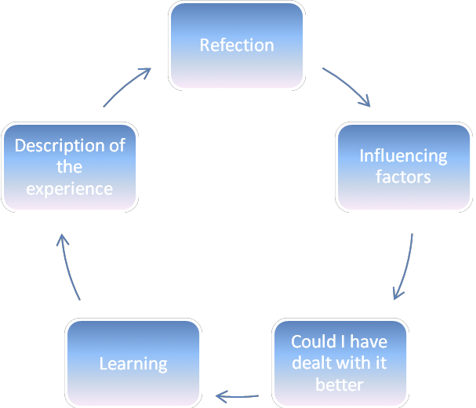
John’s Model

Slide 7
Task One
You have already written a reflective account about a piece of media, in addition you have written a reflection with respect to a non-professional experience.
You are to write a reflective account of an experience you have had whilst undertaking a professional task relating to your current role. You may use any of the reflective models you feel comfortable with and should ensure you include as much detail as possible in support of the lessons learned.

Slide 8
Task Two
Once you have completed your reflective element, you are now required to provide your document to another student within the class. Attempt to ensure that this is a student that did not share this same experience. It is the job of this peer to identify the following from your paper:
  The overall task being undertaken
  The important parameters of the task
  The beneficial and detrimental impacts
  What the overall outcome was
  What Should be changed

Slide 9
Task Three
From the recommendations provided in the document you have been given, you are to devise a method to test the impact these changes. In doing so, you should take in to consideration any limitations or constraints imposed in addition to any further measures required in their implementation. This should lead you to identify an appropriate means of measuring also.

