Slide 1

Empowering The Older Person
Name: Safina Bibi
Student Number: 2243482
Module Code: BMHP6027
Assignment Title: Component 1: Individual Presentation (PowerPoint with Voice-Over)
Lecturer: Kennedy Obohwemu

Slide 2

Introduction
This presentation critically examines how older people in the United Kingdom (UK) are supported to live independently in the community, within an ageing population.
Biological processes, including genetic and wear-and-tear theories, as well as social factors, impact ageing.
The presentation evaluates community care provision based on ageing theories, UK policies, and legislation.
Empowerment in practice is assessed through technological breakthroughs, case studies, and recommendations.
(Smith, 2024)

Slide 3
The Ageing Population: Setting the Scene
As life expectancy rises, the UK population is quickly ageing, with a growing number of persons aged 65 and above (Office for National Statistics, 2019).
Longer life frequently comes with chronic illnesses, weakness, and complex support needs (Jugran, 2025).
Important care needs include physical health, emotional well-being, social connection, and psychological assistance (Devkota et al., 2023).
Community-based services face increased pressure to promote independence and reduce institutionalisation (Ma and shen, 2023).
Meeting escalating demands requires innovation, empowerment-focused practices, and effective policies.

Slide 4
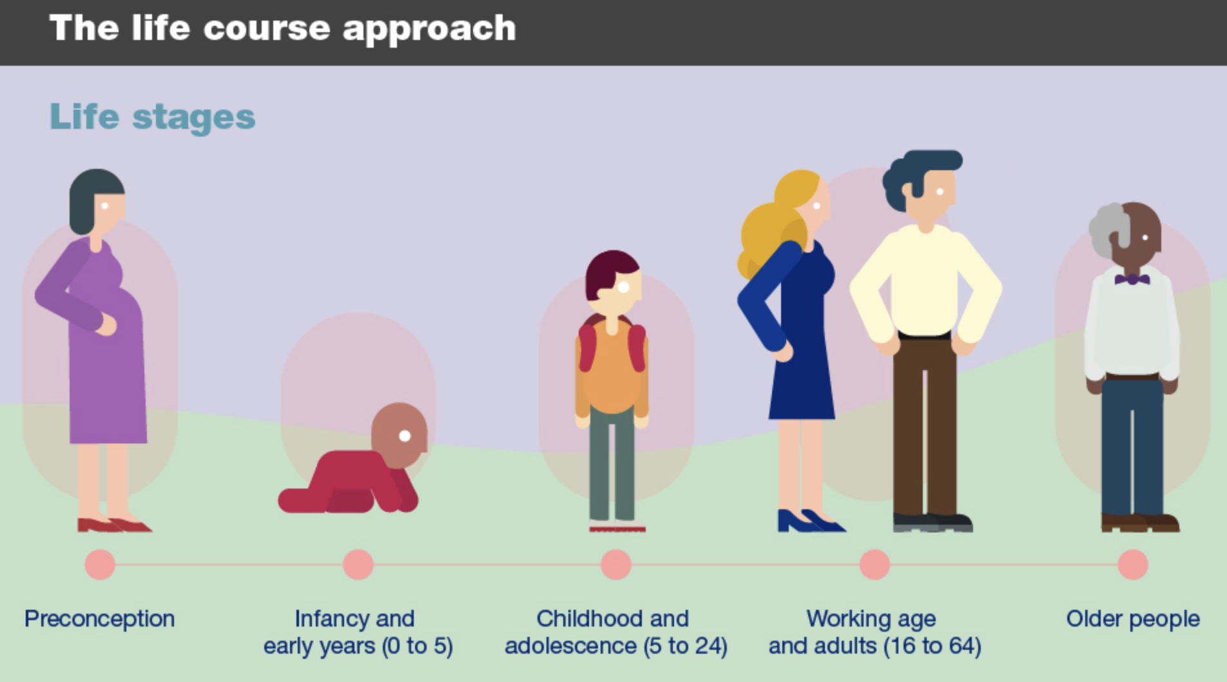
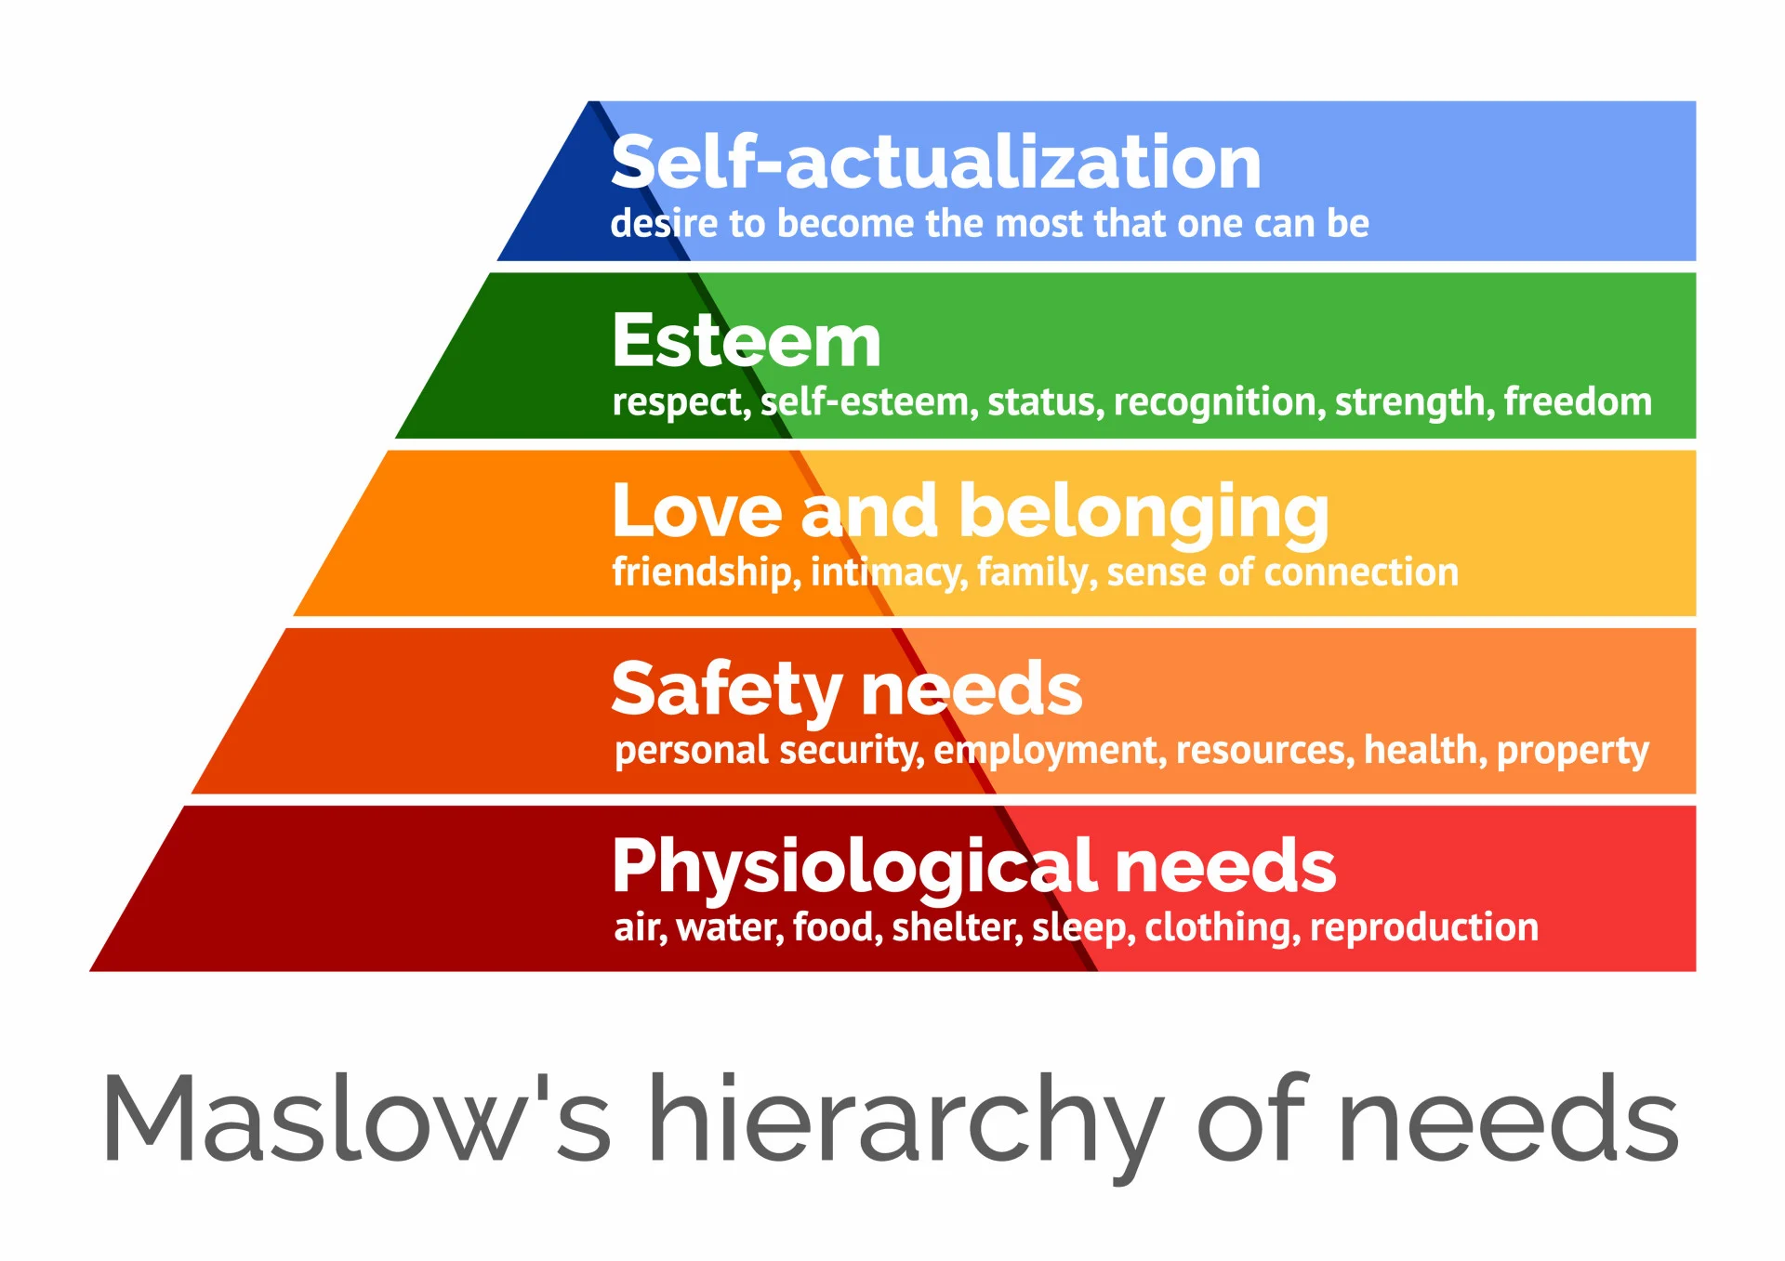
Theories of ageing help explain older people’s needs and guide community care practices
• According to the Life Course Theory, ageing is influenced by past experiences, social roles, and accumulated advantages or disadvantages (Kendig and Nazroo, 2016).
• This theory explains why older adults have specific needs, resilience levels, and support requirements.
• According to McLeod, (2026) Maslow's Hierarchy of needs, highlights the importance of meeting basic physical and safety needs before higher-level needs such as independence, dignity, and self-fulfillment.
• These theories evaluate whether community care priorities holistic well-being or just meets essential survival needs.
Theories challenge whether present care approaches truly empower elderly persons.
Theoretical Frameworks
(Public Health England, 2019)
(McLeod, 2026)

Slide 5

Policy and Legislation
The UK places a strong focus on older people’s independence, well-being, and protection (Age UK, 2026).
Age discrimination in employment and services is prohibited by the Equality Act of (2010).
Integrated, community-based care is supported by the NHS Long Term Plan (The King’s Fund, 2019).
Nonetheless, there are frequently still discrepancies between the goals of policies and actual practice.
The Care Act (2014) promotes wellbeing, personalisation, and prevention of escalating needs.

Slide 6

Evaluation of Current Care Provisions (Critical Analysis)
Many older adults remain at home with support from domiciliary care, district nursing, and voluntary sector organisations such as Age UK, which provides community companionship programmes, advice and community support (Age UK, 2026).
Following hospital release, reablement services seek to restore independence (NHS, 2022).
The King’s Fund (2022) suggests coordination between general practitioners, social workers, and community teams is encouraged by integrated care systems.
Demand is increasing due to longer life expectancy and multiple chronic conditions.
(Care Dynamics, no date)

Slide 7

Evaluation of Current Care Provisions (Critical Analysis)
Following being discharged from the hospital, reablement can increase confidence and mobility (Social Care Institute for Excellence, 2020).
By assisting with everyday living and personal care, domiciliary care can prevent residential admission (Social Care Institute for Excellence, 2020).
However, UNISON, (2016) suggests 15-minute domiciliary care visits often prioritise basic personal care tasks over meaningful interaction and relationship-building.
Relationship-building and continuity of care are impacted by a lack of workforce shortages (Care Quality Commission, 2023).
Policy encourages independence, but time and money constraints limit it.
(Qualis Home Care, 2026)

Slide 8
Safeguarding, Risk and Legal Tensions
• Under The Care Act (2014), local governments are required to protect adults who are at danger of abuse or neglect.
The Mental Capacity Act (2005) fosters decision-making while safeguarding those who are most in need.
• The Health and Safety at Work Act of (1974) guarantees secure working conditions for employees and clients.
• Promoting autonomy and avoiding harm are at odds (e.g., enabling risk-taking vs. protection).
• Increased demand places pressure on risk management and safeguarding systems.

Slide 9

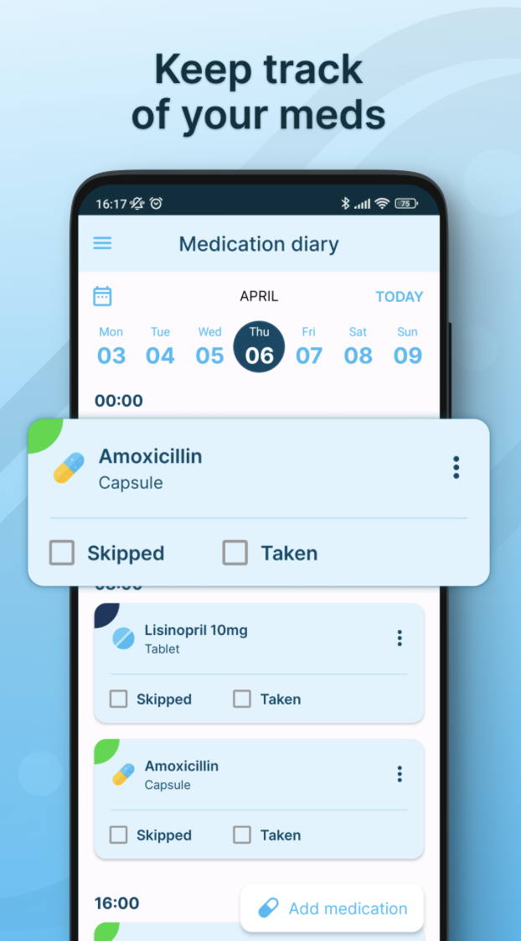
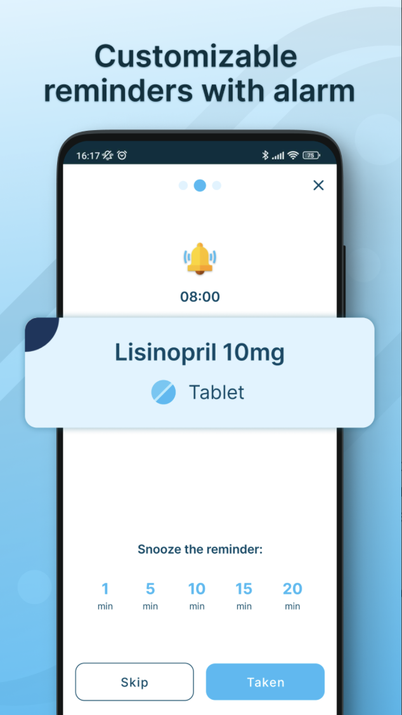
Technological Innovations in Elderly Care
Remote monitoring and telehealth allow elderly patients with chronic illnesses to live at home.
According to Schwedler et al., (2026) safety is improved by smart home appliances (such as medication reminders and fall detectors).
Digital care records provide better communication and coordination between social workers and health care providers (Schwedler et al., 2026).
Po et al., (2024) suggest technology can decrease hospital admissions and encourage self-management.
Increasingly positioned as a solution to workforce shortages and rising demand.
(CPR Guardian,2022)
(Medicine Reminder – Pill Alarm, no date)

Slide 10

Critical Evaluation of Technology
• According to Bertolazzi et al., (2024) while technology can increase independence, some older persons' access is restricted due to digital exclusion.
• Low digital literacy or cognitive impairment may limit efficacy (Bertolazzi et al., 2024).
• An over-reliance on technology could take the place of social engagement and human contact.
• Informed consent and data privacy are ethical issues (Grosman‑Rimon and Wegier, 2024)
• Innovation may reduce costs long-term, but initial investment and training remain barriers.
(Absolute Trust Counsel, 2026)

Slide 11
Case Study 1: Mrs Patel (Reablement & Independence)
Mrs Patel, 82, lives alone following a fall and short hospital admission.
She receives a 6-week reablement package to regain mobility and daily living skills.
Telecare (fall detector, medication reminder) supports safety at home (Fothergill et al., 2025).
Improvements in confidence reflect Maslow’s focus on safety and security as foundations for independence (Kenrick et al., 2010).
However, reduced support after six weeks raises concerns about long-term continuity of care.

Slide 12

Case Study 2: Mr Thompson (Technology & Autonomy)
Mr Thompson, 79, lives with heart failure and uses remote health monitoring.
Virtual GP consultations reduce hospital visits and support self-management (Campbell et al., 2023).
Technology supports higher-level independence, aligning with Maslow’s concept of autonomy cite
However, digital literacy challenges increase reliance on family support.
According by Mollborn et al., (2021) life Course Theory suggests earlier educational and social experiences shape his ability to engage with digital care.

Slide 13

Recommendations for Improvement
• Funding for domiciliary care should be increased to allow longer visits as opposed to 15-minute task-based care.
• In cases where continuous support is required, extend reablement beyond preset 6-week periods.
• Make investments in career advancement, training, and higher salaries to keep employees.
• Before implementing remote monitoring technologies, give senior citizens online training sessions.
• Improve communication between general practitioners, social workers, and charities.
• Recognise that financial constraints and staff shortages may limit implementation.

Slide 14
Conclusion
The ageing UK population presents increasing demand for community-based health and social care services.
Although policies encourage independence and ageing, their implementation is still uneven.
Innovation in technology and community care can improve wellbeing, safety, and autonomy.
However, equal access is restricted by funding constraints, a lack of workers, and digital exclusion.
To guarantee that independence is meaningful rather than aspirational, sustainable, person-centered approaches are important.

Slide 15
References
Age UK. (2026) Supporting older people’s health in 2026. Available at: https://www.ageuk.org.uk/discover/2026/january/supporting-older-peoples-health-in-2026 (Accessed: 11 February 2026).
Absolute Trust Counsel. (2026) How problems with using technology can lead to earlier dementia diagnosis. Available at: https://absolutetrustcounsel.com/how-problems-with-using-technology-can-lead-to-earlier-dementia-diagnosis/ (Accessed: 18 February 2026).
Bertolazzi, A., Quaglia, V. and Bongelli, R. (2024) ‘Barriers and facilitators to health technology adoption by older adults with chronic diseases: an integrative systematic review’, BMC Public Health, 24(1), p.506.
Care Quality Commission. (2023) The health and care workforce: State of Care 2022/23. Available at: https://www.cqc.org.uk/publications/major-report/state-care/2022-2023/workforce
(Accessed: 13 February 2026).
Care Dynamics. (no date) Domiciliary care provider. Available at: https://www.care-dynamics.com/domiciliary-care-provider/ (Accessed: 17 February 2026).
CPR Guardian. (no date) What is a personal alarm watch with fall detection?. Available at: https://www.cprguardian.com/blogs/latest-dementia-news-and-updates/what-is-a-personal-alarm-watch-with-fall-detection (Accessed: 18 February 2026).
Campbell, K., Greenfield, G., Li, E., O’Brien, N., Hayhoe, B., Beaney, T., Majeed, A. and Neves, A.L. (2023) ‘The impact of virtual consultations on the quality of primary care: Systematic review’, Journal of Medical Internet Research, 25, e48920.
Devkota, R., Cummings, G., Hunter, K.F., Maxwell, C., Shrestha, S., Dennett, L. and Hoben, M. (2023) ‘Factors influencing emotional support of older adults living in the community: a scoping review protocol’, Systematic Reviews, 12(1), p.186.
Fothergill, L., Hayes, N., Latham, Y., Hamilton, J., Ahmed, S. and Holland, C. (2025) ‘Understanding how, for whom and under what circumstances telecare can support independence in community‑dwelling older adults: a realist review’, BMC Geriatrics, 25, 59.

Slide 16
Grosman‑Rimon, L. and Wegier, P. (2024) ‘With advancement in health technology comes great responsibility – ethical and safety considerations for using digital health technology: a narrative review’, Medicine, 103(33), e39136.
Jugran, D. (2025) ‘Too well to die; too ill to live: an update on the lifespan versus health span debate’, Journal of Global Health, 15, 03022.
Kendig, H. and Nazroo, J. (2016) ‘Life course influences on inequalities in later life: comparative perspectives’, Population Ageing, 9, pp. 1–7.
Kenrick, D.T., Griskevicius, V., Neuberg, S.L. and Schaller, M. (2010) ‘Renovating the pyramid of needs: Contemporary extensions built upon ancient foundations’, Perspectives on Psychological Science, 5(3), pp. 292–314.
Legislation.gov.uk. (2014) Care Act 2014, Chapter 23. Available at: https://www.legislation.gov.uk/ukpga/2014/23/contents (Accessed: 10 February 2026).
Legislation.gov.uk. (2010) Equality Act 2010, Chapter 15. Available at: https://www.legislation.gov.uk/ukpga/2010/15/contents Accessed: 10 February 2026).
Legislation.gov.uk. (2005) Mental Capacity Act 2005, Chapter 9. Available at: https://www.legislation.gov.uk/ukpga/2005/9/contents (Accessed: 14 February 2026).
Legislation.gov.uk (1974) Health and Social Care Act 1974, Chapter 37. Available at: https://www.legislation.gov.uk/ukpga/1974/37/contents (Accessed: 14 February 2026).
Ma, W. and Shen, Z. (2023) ‘Impact of community care services on the health of older adults: evidence from China’, Frontiers in Public Health, 11, 1160151.
McLeod, S. (2026) Maslow’s hierarchy of needs. Simply Psychology. Available at: https://www.simplypsychology.org/maslow.html (Accessed: 17 February 2026).
Medicine Reminder – Pill Alarm. (no date) Android mobile app. Available at: https://play.google.com/store/apps/details?id=rs.podsetnik.lek&hl=en_GB (Accessed: 18 February 2026).
Mollborn, S., Fomby, P., Goode, J.A. and Modile, A. (2021) ‘A life course framework for understanding digital technology use in the transition to adulthood’, Advances in Life Course Research, 47, 100379.
NHS. (2022) Care after illness or hospital discharge: reablement. Available at: https://www.nhs.uk/social-care-and-support/care-after-a-hospital-stay/care-after-illness-or-hospital-discharge-reablement/ (Accessed: 11 February 2026).
Office for National Statistics. (2019) Living longer: is age 70 the new age 65?. Available at: https://www.ons.gov.uk/peoplepopulationandcommunity/birthsdeathsandmarriages/ageing/articles/livinglongerisage70thenewage65/2019-11-19 (Accessed: 10 February 2026).
Po, H.W., Chu, Y.C., Tsai, H.C., Lin, C.L., Chen, C.Y. and Ma, M.H. (2024) ‘Efficacy of remote health monitoring in reducing hospital readmissions among high-risk post discharge patients: prospective cohort study’, JMIR Formative Research, 8, e53455.
Qualis Home Care. (2026) Reablement care & support. Available at: https://qualishomecare.co.uk/reablement-care-support (Accessed: 17 February 202
Social Care Institute for Excellence. (2020) Reablement guide: what is reablement?. Available at: https://www.scie.org.uk/integrated-care/intermediate-care-reablement/reablement-guide (Accessed: 12 February 2026).
Schwedler, K.J., Ehlers, J., Ostermann, T. and Hohenberg, G. (2026) ‘The role of telemedicine centres and digital health applications in home care: challenges and opportunities for family caregivers’, Healthcare (Basel, Switzerland), 14(1), p.136.

Slide 17
NHS. (2022) Care after illness or hospital discharge: reablement. Available at: https://www.nhs.uk/social-care-and-support/care-after-a-hospital-stay/care-after-illness-or-hospital-discharge-reablement/ (Accessed: 11 February 2026).
Office for National Statistics. (2019) Living longer: is age 70 the new age 65?. Available at: https://www.ons.gov.uk/peoplepopulationandcommunity/birthsdeathsandmarriages/ageing/articles/livinglongerisage70thenewage65/2019-11-19 (Accessed: 10 February 2026).
Po, H.W., Chu, Y.C., Tsai, H.C., Lin, C.L., Chen, C.Y. and Ma, M.H. (2024) ‘Efficacy of remote health monitoring in reducing hospital readmissions among high-risk post discharge patients: prospective cohort study’, JMIR Formative Research, 8, e53455.
Public Health England, (2019) Health matters: Prevention – a life course approach. Available at: https://www.gov.uk/government/publications/health-matters-life-course-approach-to-prevention/health-matters-prevention-a-life-course-approach (Accessed: 18 February 2026).
Qualis Home Care. (2026) Reablement care & support. Available at: https://qualishomecare.co.uk/reablement-care-support (Accessed: 17 February 2026).
Social Care Institute for Excellence. (2020) Reablement guide: what is reablement?. Available at: https://www.scie.org.uk/integrated-care/intermediate-care-reablement/reablement-guide (Accessed: 12 February 2026).
Schwedler, K.J., Ehlers, J., Ostermann, T. and Hohenberg, G. (2026) ‘The role of telemedicine centres and digital health applications in home care: challenges and opportunities for family caregivers’, Healthcare (Basel, Switzerland), 14(1), p.136.
Smith, J. (2024) Diverse elderly people smiling outdoors. Adobe Stock. Available at: https://stock.adobe.com/search?k=diverse+elderly+group
(Accessed: 17 February 2026).
The King’s Fund. (2019) NHS Long Term Plan explained. Available at: https://www.kingsfund.org.uk/insight-and-analysis/long-reads/nhs-long-term-plan-explained (Accessed: 11 February 2026).
The King’s Fund. (2022) Integrated care systems explained. Available at: https://www.kingsfund.org.uk/insight-and-analysis/long-reads/integrated-care-systems-explained
(Accessed: 12 February 2026).

Slide 18
UNISON. (2016) Suffering alone at home: a UNISON report on the lack of time in our homecare system. Available at: https://www.unison.org.uk/content/uploads/2016/01/23574_Save_care_now_homecare_report-5.pdf (Accessed: 12 February 2026).

