Slide 1
Working With Children In A Social Care Setting
Student Name:Roxana Daniela Lemnariu
Module Name:Psychology for Health and Social Care
Module Code:BMHP4003_BIRM
Lecture Name:Joanne Davies

Slide 2

Introduction
This presentation outlines an age-appropriate creche activity for children aged 7-11 years old while their mothers attend a weekly one-hour support session at a women's refuge center.
This will involve the use of psychological theory and provide both developmental and entertainment benefits for the children.

Slide 3
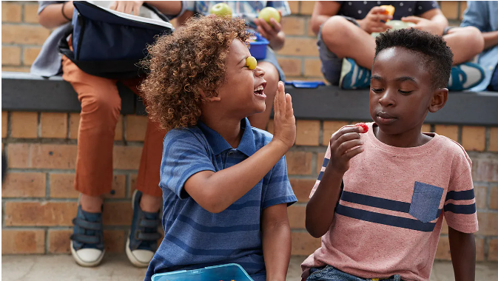
Activity for Children Aged 7-11 Years
The activity is Collaborative Storytelling
Collaborative storytelling involves providing children with a prompt or theme and allowing them to work together to create a story
For children aged 7-11 years this can involve a prompt such as "A group of friends go on an adventure" or "A mystery needs to be solved.”
(Campos et al., 2017)

Slide 4

Psychological Theory
According to Vygotsky's Sociocultural Theory, children learn through social interactions and cultural experiences
collaborative storytelling provides an opportunity for children to express their thoughts and emotions, develop their communication and teamwork skills, and learn from their peers.
(Rutta et al., 2020)

Slide 5

Benefits of Collaborative Storytelling
For Children Aged 7-11 Years
Collaborative storytelling helps to:
Develop critical thinking, communication
Problem-solving skills (Jennings, 2017)
promotes creativity, empathy, and social skills(Gesell, 2021).
Develop narrative skills (Sun et al., 2017)
Understanding of different perspective

Slide 6
Preparation for Collaborative Storytelling
Before starting the activity, the children should be given a prompt or theme to work with, and they should be encouraged to brainstorm ideas together(Erickson, 2018)
Each child can then take turns to contribute to the story, with the facilitator helping to keep the story on track and encouraging the children to listen to each other's ideas.

Slide 7

Extension Activities for Collaborative Storytelling
After completing the collaborative storytelling activity, the children can be given the opportunity to illustrate their story or create a play based on it.
This extension activity helps to develop their creative skills, imagination, and confidence (Catala et al.,2017).

Slide 8
Conclusion
Collaborative storytelling is an age-appropriate creche activity that provides both entertainment and developmental benefits for children aged 7-11 years old.
This activity is based on psychological theory and literature, ensuring it is effective and beneficial for children.

Slide 9
REFERENCES
Campos, F., Blikstein, P. and Azhar, A., 2017, June. The Conference of the Birds: A Collaborative Storytelling Environment for Literacy Development. In Proceedings of the 2017 conference on interaction design and children (pp. 729-732).
Catala, A., Theune, M., Gijlers, H. and Heylen, D., 2017, June. Storytelling as a creative activity in the classroom. In Proceedings of the 2017 ACM SIGCHI Conference on Creativity and Cognition (pp. 237-242).
Erickson, E., 2018. Effects of storytelling on emotional development.
Gesell, A., 2021. Child development. Prabhat Prakashan.
Jennings, S., 2017. Creative storytelling with children at risk. Taylor & Francis.
Ong, D.T., De Jesus, C.R., Gilig, L.K., Alburo, J.B. and Ong, E., 2018. A dialogue model for collaborative storytelling with children. In Proceedings of the 26th International Conference on Computers in Education (pp. 205-210).
Rutta, C.B., Schiavo, G., Zancanaro, M. and Rubegni, E., 2020, June. Collaborative comic-based digital storytelling with primary school children. In Proceedings of the Interaction Design and Children Conference (pp. 426-437).
Sun, M., Leite, I., Lehman, J.F. and Li, B., 2017, June. Collaborative storytelling between robot and child: A feasibility study. In Proceedings of the 2017 Conference on Interaction Design and Children (pp. 205-214).
Setyarini, S., Muslim, A.B., Rukmini, D., Yuliasri, I. and Mujianto, Y., 2018. Thinking critically while storytelling: Improving children’s HOTS and English oral competence. Indonesian Journal of Applied Linguistics, 8(1), pp.189-197.

