Slide 1

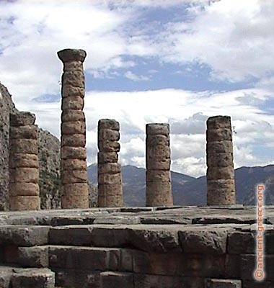
COSMOLOGY, MAGIC AND DIVINATION
Dr Crystal Addey
Seminar 2: Iamblichus’ On the Mysteries (De mysteriis)

Slide 2
Assignment 1: Critical Review
Assignment 1: Critical Review: Analysis of a Primary Source Document
One 2,250 word assignment (40% of marks). Write:
A Critical Review of Cicero’s Arguments against divination in De Divinatione (On Divination)
(use the Loeb edition of Cicero’s De Divinatione available through UWTSD database: Loeb Classical Library)
OR
A Critical Review of Iamblichus’ Arguments for Divination in De Mysteriis (On the Mysteries)
(use the translation by Emma Clarke, John Dillon and Jackson Hershbell 2003 if possible; if not, the translation by Thomas Taylor)

Slide 3
Assignment 1: Writing your critical review
Read the ancient source first: it is important to read Cicero’s De Divinatione (Books 1 and 2) or Iamblichus’s De mysteriis before you start.
Make notes on the ancient source.
Then read secondary sources (the modern works of scholars) on these works.
Why?
  The importance of examining the evidence directly
  The importance of developing your own views
  The importance of critical analysis

Slide 4
Assignment 1: Writing your critical review
Introduction:
What is the source?
Who created the source?
When was the source created?
Where was the source created?
Why was the source created?
Introduce Cicero or Iamblichus, their work and their historical and religious contexts.

Slide 5
Assignment 1: Writing your critical review
What arguments are given for or against divination?
What context do these arguments occur within? Hint: think about the dialogue form in each case. Why might dialogue be used? How important is the literary form? How does the use of dialogue relate to philosophy and to religious practices?
Read modern scholarly works on these ancient texts.
Include plenty of references (citations) and examples to support and illustrate your points.

Slide 6
Iamblichus’ De Mysteriis
Iamblichus, On the Mysteries, translated by Emma C. Clarke, John M. Dillon and J.P. Hershbell, Atlanta: Society of Biblical Literature, 2003.
Iamblichus, On the Mysteries and Life of Pythagoras, translated by Thomas Taylor, Dorset: Prometheus Trust, 2003 (available from Prometheus Trust with 20% discount for £13.60 (paperback) or £18.40 (Hardback): see www.prometheustrust.co.uk)
Thomas Taylor translation also available online (Section 3 = Book 3): http://www.archive.org/stream/iamblichusonmys00taylgoog#page/n9/mode/1up

Slide 7
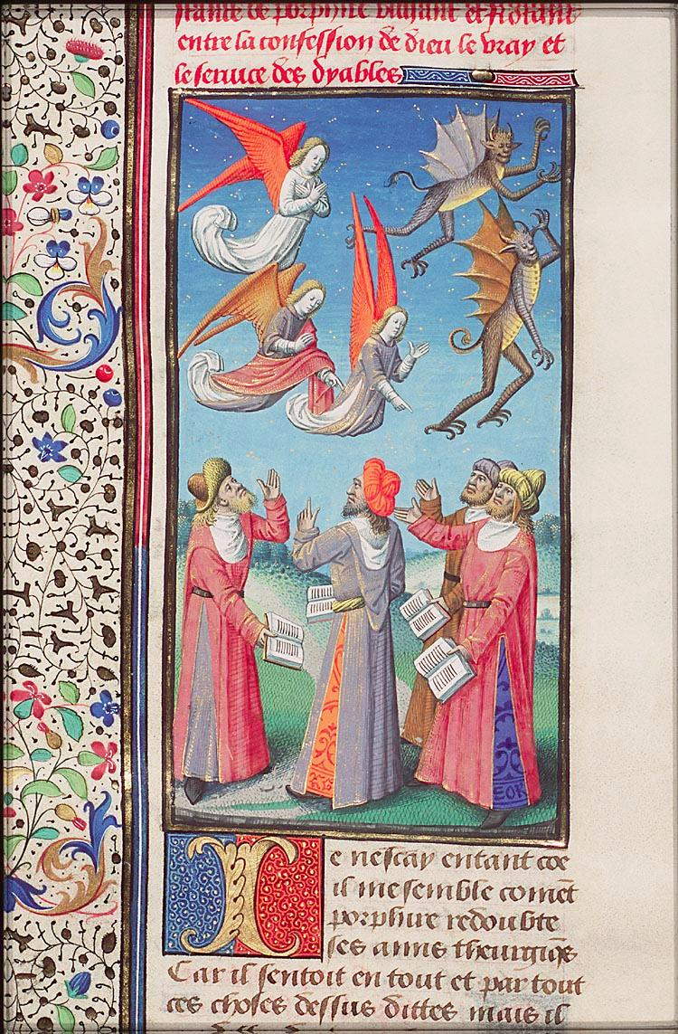
PATHS OF INITIATION: INTRODUCTION TO IAMBLICHUS’ DE MYSTERIIS AND PORPHYRY’S LETTER TO ANEBO
Image: Porphyry and his friends discussing theurgy. No. 420, The Hague, Museum Meermano-Westreenianum, 10 A 11, fol. 455v. (Augustine, La Cité de Dieu , illustrator Maïtre François, ca. 1475)
Notes:
The Contents of this manuscript:
Augustine, La Cité de Dieu (Vol. I). Translation from the Latin by Raoul de Presles
Place of origin, date:
Paris, Maïtre François (illuminator); c. 1475; 1478-1480
Material:
Vellum, ff. 467, 440x300 (270x185) mm, 46 lines, littera hybrida, Binding: 18th-century brown leather (c. 1769)
Decoration:
11 two-column miniatures (257/204x190/177 mm); 277 column miniatures (c. 120x80 mm); 11 illustrations in the margin (coats of arms); decorated initials with border decoration
Provenance:
made for Jacques d'Armagnac, duke of Nemours (1433-1477) and after his capture continued for Philippe de Commines (1447-1511), lord of Argenton (coats of arms in margin and on edge). Purchased in 1751 at the sale of J.-A. Crozat de Tugny (1696-1751) at Thiboust, Paris,by L.-J. Gaignat of Paris; purchased in 1769 at the Gaignat sale at G.F. De Bure le Jeune, Paris (cat. 1 Febr., no. 242) by Gerard Meerman (1722-1771) of Rotterdam, later The Hague; by descent to his son Johan Meerman (1753-1815); acquired between 1816 and 1824 by Willem H.J vanWestreenen van Tiellandt (1783-1848) of The Hague; by legacy to the kingdom of the Netherlands
Annotation:
Vol. II now: Nantes, BM, fr. 8

Slide 8
Late Antiquity: Intellectual, religious and cultural contexts
Greek and Egyptian ‘syncretism’
Blending and intertwining of Mediterranean cultures (partly through the political and social power of the Roman Empire)
Prominent role of initiation in Egyptian, Greek and Roman mystery cults
What about Iamblichus De Mysteriis and Porphyry’s Letter to Anebo?

Slide 9
Iamblichus’ De Mysteriis
Original title: “The Reply of the Master Abamon to the Letter of Porphyry to Anebo, and the Solutions to the Questions it Contains.”
Written under the guise of the Egyptian prophet Abamon as a reply to Porphyry’s Letter to Anebo.
The philosophical genre of Problems and Solutions.
A series of replies to a set of problems proposed by Porphyry about the nature of the gods and proper ways of worshipping them.

Slide 10
The debate between Porphyry and Iamblichus in the Letter to Anebo and De Mysteriis
Orthodox view: A hostile disagreement between Porphyry and Iamblichus. Porphyry launches a sceptical and scathing attack on theurgy and religious practices (following Plotinus’ approach).
Emma Clarke: “[The Letter to Anebo is] an epistle which launched a vicious attack on theurgy, more than likely aimed specifically at Iamblichus and his beliefs”; “It seems undeniable that the atmosphere between the Letter and On the Mysteries is manifestly hostile and betrays a considerable tension between the two philosophers.”

Slide 11
The Exchange between Porphyry and Iamblichus as Dialogue
The exchange between Porphyry and Iamblichus functions within two traditional genres of philosophy:
The genre of ‘Problems and Solutions’:
(Porphyry’s Questions on Homer; Collection of Questions on Rhetoric; Damascius’ Problems and Solutions on First Principles).
The genre of philosophical dialogue:
Platonic dialogue; ‘philosophy in action.’

Slide 12
Dialogue in Neoplatonism
Dialogue central to the teaching methods of the Neoplatonists.
Once I, Porphyry, went on asking him [i.e. Plotinus] for three days about the soul’s connection with the body, and he kept on explaining to me. A man called Thaumasias came in who was interested in general statements and said that he wanted to hear Plotinus speaking in the manner of a set treatise, but could not stand Porphyry’s questions and answers. Plotinus said, “But if when Porphyry asks questions we do not solve his difficulties we shall not be able to say anything at all to put into the treatise.” (Porphyry, Life of Plotinus, 13).

Slide 13
Porphyry’s Letter to Anebo
Not a scathing attack on religious practices, but a constructive, philosophical inquiry in the dialogue tradition, a philosophical questioning from master to pupil, or from philosopher to philosopher.
Identity of Anebo: Iamblichus calls him his student. The letter is aimed at Anebo, a student of Iamblichus or Iamblichus himself.
A deliberate attempt on Porphyry’s part to establish a form of Platonic dialogue. Porphyry knew the answers to his questions, but acts as a philosophical teacher to ‘draw out’ the philosophical explanations from his pupil / fellow philosopher.

Slide 14
Reassessing Porphyry
Porphyry’s interest in theurgy (lost commentary on the Chaldaean Oracles).
Positive view of religion in Philosophy from Oracles and On the Cave of the Nymphs.
Scholars: Philosophy from Oracles a credulous, superstitious work written early before he met Plotinus; Letter to Anebo a more ‘rational’ work written during or after his time with Plotinus (Joseph Bidez).
This view has now been dismissed.
Porphyry uses oracles in works written in his old age: the Life of Plotinus culminates in an oracle.

Slide 15
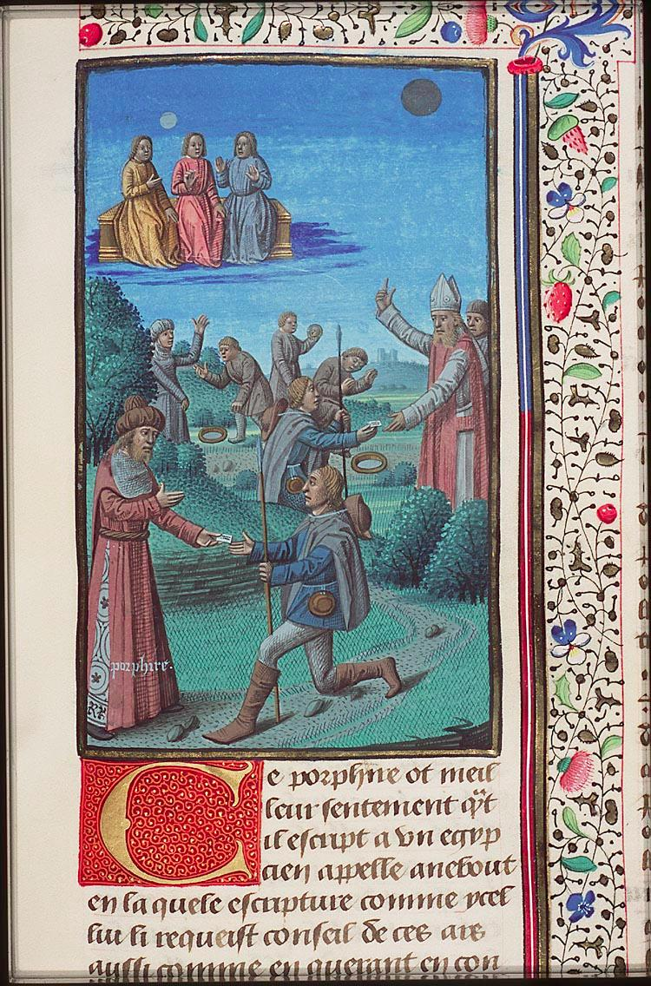
The Letter to Anebo
The sheer variety and broad spectrum of questions:
“Some questions, then, call for the
clarification of issues which have been
wrongly confused, while others concern
the reason why various things are the
way they are, and are thought of in such a way; others, again, draw one’s attention in both directions at once, since they contain an inherent contradiction; and still others call for an exposition of our whole mystical system. This being the case, they are taken from many perspectives, and from very various branches of knowledge [my italics]” (Iamblichus, De Mysteriis, 1.1 (4.5-9))
Image: Porphyry sending his letter to Anebo, and Anebo receiving it. No. 404, The Hague, Museum Meermano-Westreenianum, 10 A 11, fol. 439v.

Slide 16
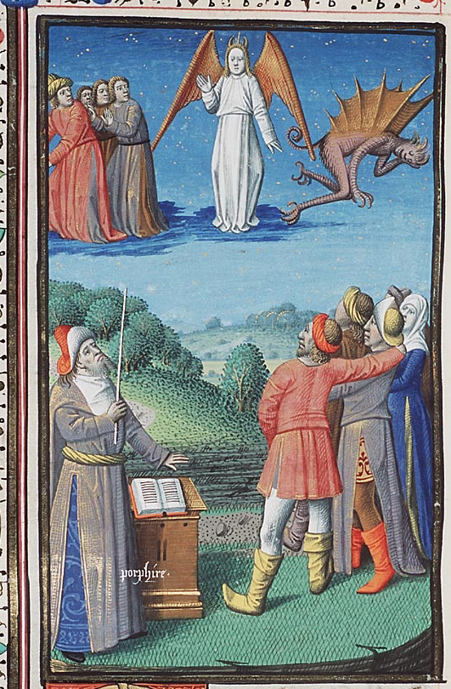
The Questions of the Letter to Anebo
Porphyry: Is divination caused by deceptive daimones?
“Moreover, there is an interpretation of the sacred operations even worse than this, attributing the cause of divination to “a certain kind of deceptive nature, both protean and versatile, which takes on the forms of gods, daemons, and ghosts of the dead”... In vain, then, do you introduce the opinion of the atheists that “all divination is accomplished by the evil daemon.” For such people do not deserve to be mentioned in discussions about the gods, and they are at the same time both ignorant of the distinction between truth and falsity, having been nurtured in the dark from the beginning, and not able to discern the principles from which these things come into being” (Iamblichus, De Mysteriis, 3.31 (175.12-176.1; 179.9-180.3)
The Christian nature of this question; the “atheists.”
Image: Porphyry pointing out bad & deceptive daimones. No. 403, The Hague, Museum Meermano-Westreenianum, 10 A 11, fol. 437v.

Slide 17
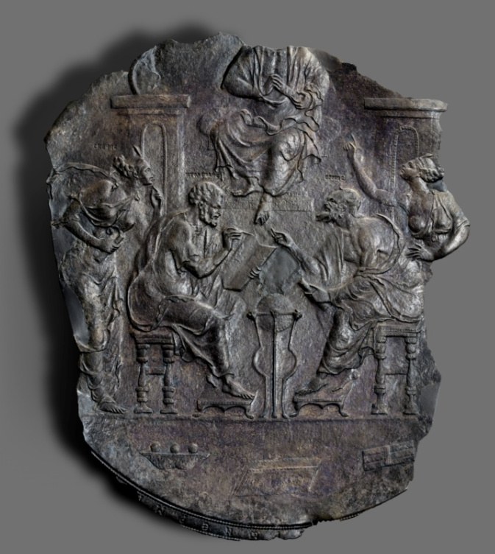
The Parallel between Iamblichus’ De Mysteriis and the Hermetica
The possibility of a parallel between the exchange of Porphyry and Iamblichus and the philosophical writings of the Hermetica, many of which were written in dialogue form for the purpose of philosophical paideia:
The Egyptian pseudonym adopted by Iamblichus.
Similarities in structure:
philosophical dialogue discussing
metaphysical and religious
phenomena.
Image: Ptolemy and Hermes confer. Silver plate with relief decoration,
500-600 CE. Open Content Program, J. Paul Getty Museum
Notes:
Image:Title:
Plate with Relief Decoration
Artist/Maker:
Unknown
Culture:
Byzantine
Place:
Eastern Mediterranean (Place Created)
Date:
500–600
Medium:
Silver
Object Number:
83.AM.342
Dimensions:
45 × 28 cm, 2.5475 kg (17 11/16 × 11 in., 5.6162 lb.)
Two seated philosophers, labeled Ptolemy and Hermes, engage in a spirited discussion on this fragmentary plate. A woman stands behind each man, gesturing and partaking in the exchange. The woman on the left is identified as Skepsis. Above the two seated men, an unidentified enthroned man is partially preserved. The scene on this plate has been interpreted as an allegory of the debate between Myth and Science: Ptolemy, the founder of the Alexandrian school of scientific thought, debating Hermes Trismegistos, a deity supporting the side of myth.
On technical, iconographic, and stylistic grounds, some scholars had questioned the authenticity of this plate and suggested that it may date instead to the 1500s A.D. More recent, detailed study of the plate, however, has confirmed its antiquity.

Slide 18
The Prologue of Iamblichus’ De Mysteriis
“It is to him [i.e. Hermes] that our ancestors in particular dedicated the fruits of their wisdom, attributing all their own writings to Hermes. And if we, for our part, receive from this god our due share of favour, such as we are capable of receiving, you, for your part, do well in laying before the priests questions about theology, such as they love to deal with, and which pertain to their expertise; and, at the same time, assuming that the letter sent to my student Anebo may be addressed equally well to me, it is reasonable for me to grant you a true reply to your enquiries.” (Iamblichus, De Mysteriis, 1.1 (2.1-7)
The divine patronage of Hermes: The status of himself as an exegete and his text as a symbolon in the chain of Hermes.
The “Hermaic chain”: Porphyry, Proclus
References to “the way of Hermes” and “the books of Hermes.”

