Slide 1
Case Study Presentation
Mohammed Moqbul Ali : student number 1713426, Abdul Rauf , 1711887and Mohammed Firuz Group 5
Developing Relationships and Workplace Achievement
BMSW5002
Date: 16/10/2019

Slide 2
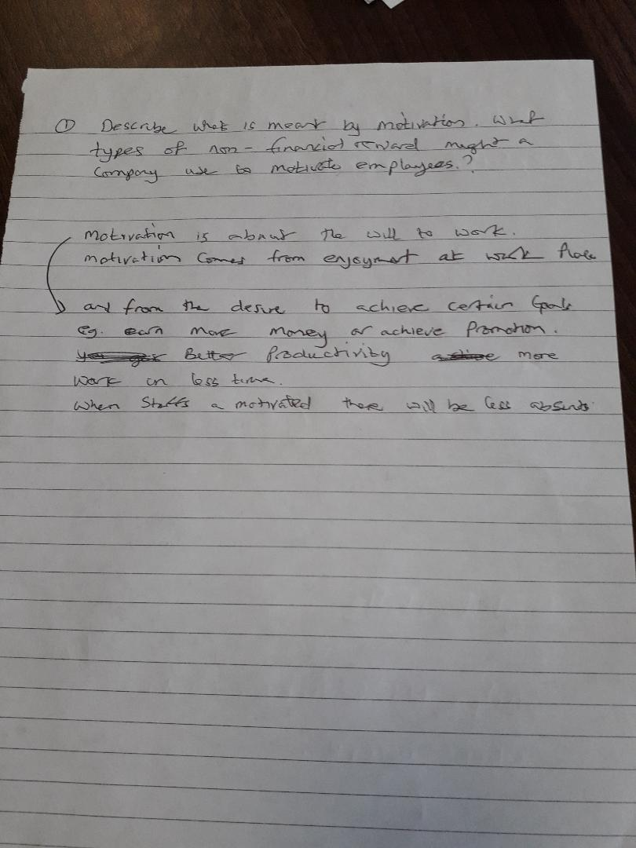
Question 2 by Abdul Rauf , 1711887

Slide 3
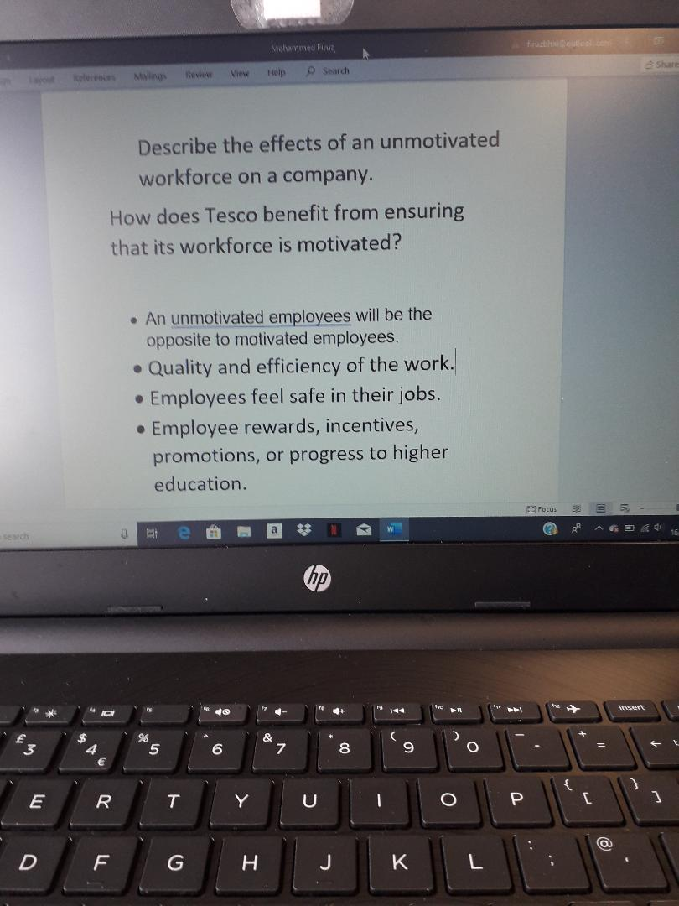
Question 2 by Mohammed Firuz, 1715436

Slide 4
Answer to question 3
Taylors motivational theory:
Taylor mentioned people purely worked for money
Little opportunity to develop within the company
No other factors like personal or working life
More than just simple pay
Employee not engage and they do not feel that they own the organisation
Tesco provides
Free share, high interest saving, pension scheme, employee discount, Christmas pay, gym membership , holiday discount and contact free phone.
Tesco employee are more engaged and they feel content in their work due to Tesco create good working environment where employee feel valued for increased communication and employees feedback .

Slide 5
Continuation:-
Taylors motivational theory does not have these apart from money:
Trustworthy leadership
Gratifying work and appreciation
Career advancement and stability
Respect for a good work-life balance
High-quality training and development
Proactive and regular communication
Camaraderie, peer motivation and an ‘open door’ policy

Slide 6
Continuation:-
Sense of belonging
Autonomy and having a sense of independence demonstrates trust
Empowerment to understand and practice self-accountability
Set clear objectives, expectations and rewards
Regular appraisal and feedback
Fairness
Provide meaningful ties to the company’s mission

Slide 7
References:
Armstrong, M. and Taylor, S. (2014). Armstrong's handbook of human resource management practice, 13th edition. London: Kogan Page.
Herzberg, F (1968) One more time: how do you motivate employees? Harvard Business Review, January–February, pp 109–20
https://www.businessballs.com/improving-workplace-performance/frederick-herzberg-motivation-theory/

Slide 8


Slide 9


