Slide 1

BMIH6007
International Meetings Management for the Hotel Industry
CroesoConnect 2025: A Celebration of Welsh Welcome & Wellness
Declaration
I have used Grammarly which is an AI tool to rectify any grammatical mistakes from this study. Other than this, I confirm that I have not used any AI too in the research and creation of this assignment. I confirm that I have not presented any AI generated materials as my own work. I also confirm I have copies of my draft, notes and other resources I used, which I may be asked to provide in evidence.
Module Lead: Kathryn Flynn
Student name: Ionica Costache
Student ID: 2246358

Slide 2


The proposed CroesoConnect 2025 event will operate as a three-day hybrid MICE and wellness-focused event located in North Wales during the Year of Croeso. The main goal of this event is to position Wales as a destination that attracts both business conferences and cultural wellness tourism. The event unites professional networking with wellness activities and local cultural immersion to showcase Wales' 'croeso' (welcome) and 'hwyl' (joy) values (Visit Wales, 2024).
The event will welcome international delegates from wellness tourism and MICE industries to experience cultural identity while generating sustained economic growth for the region (Rogers and Davidson, 2015).
Event Overview
Source: Visit Wales, 2024.

Slide 3




Event Concept and Theme
The main concept is a wellness and networking retreat with Welsh culture.
The theme is based on both the “sense of place” and the emotional experience of hospitality in Wales, which is rooted in heritage and natural landscapes (Thomas, Thomas and Powell, 2017).
This event is original in concept, with no direct equivalent currently in Wales.
Traditional food demonstrations
Activities iclude:
Folk music and bilingual storytelling
Guided forest bathing and Snowdonia hikes (Phillips, 2024)

Slide 4



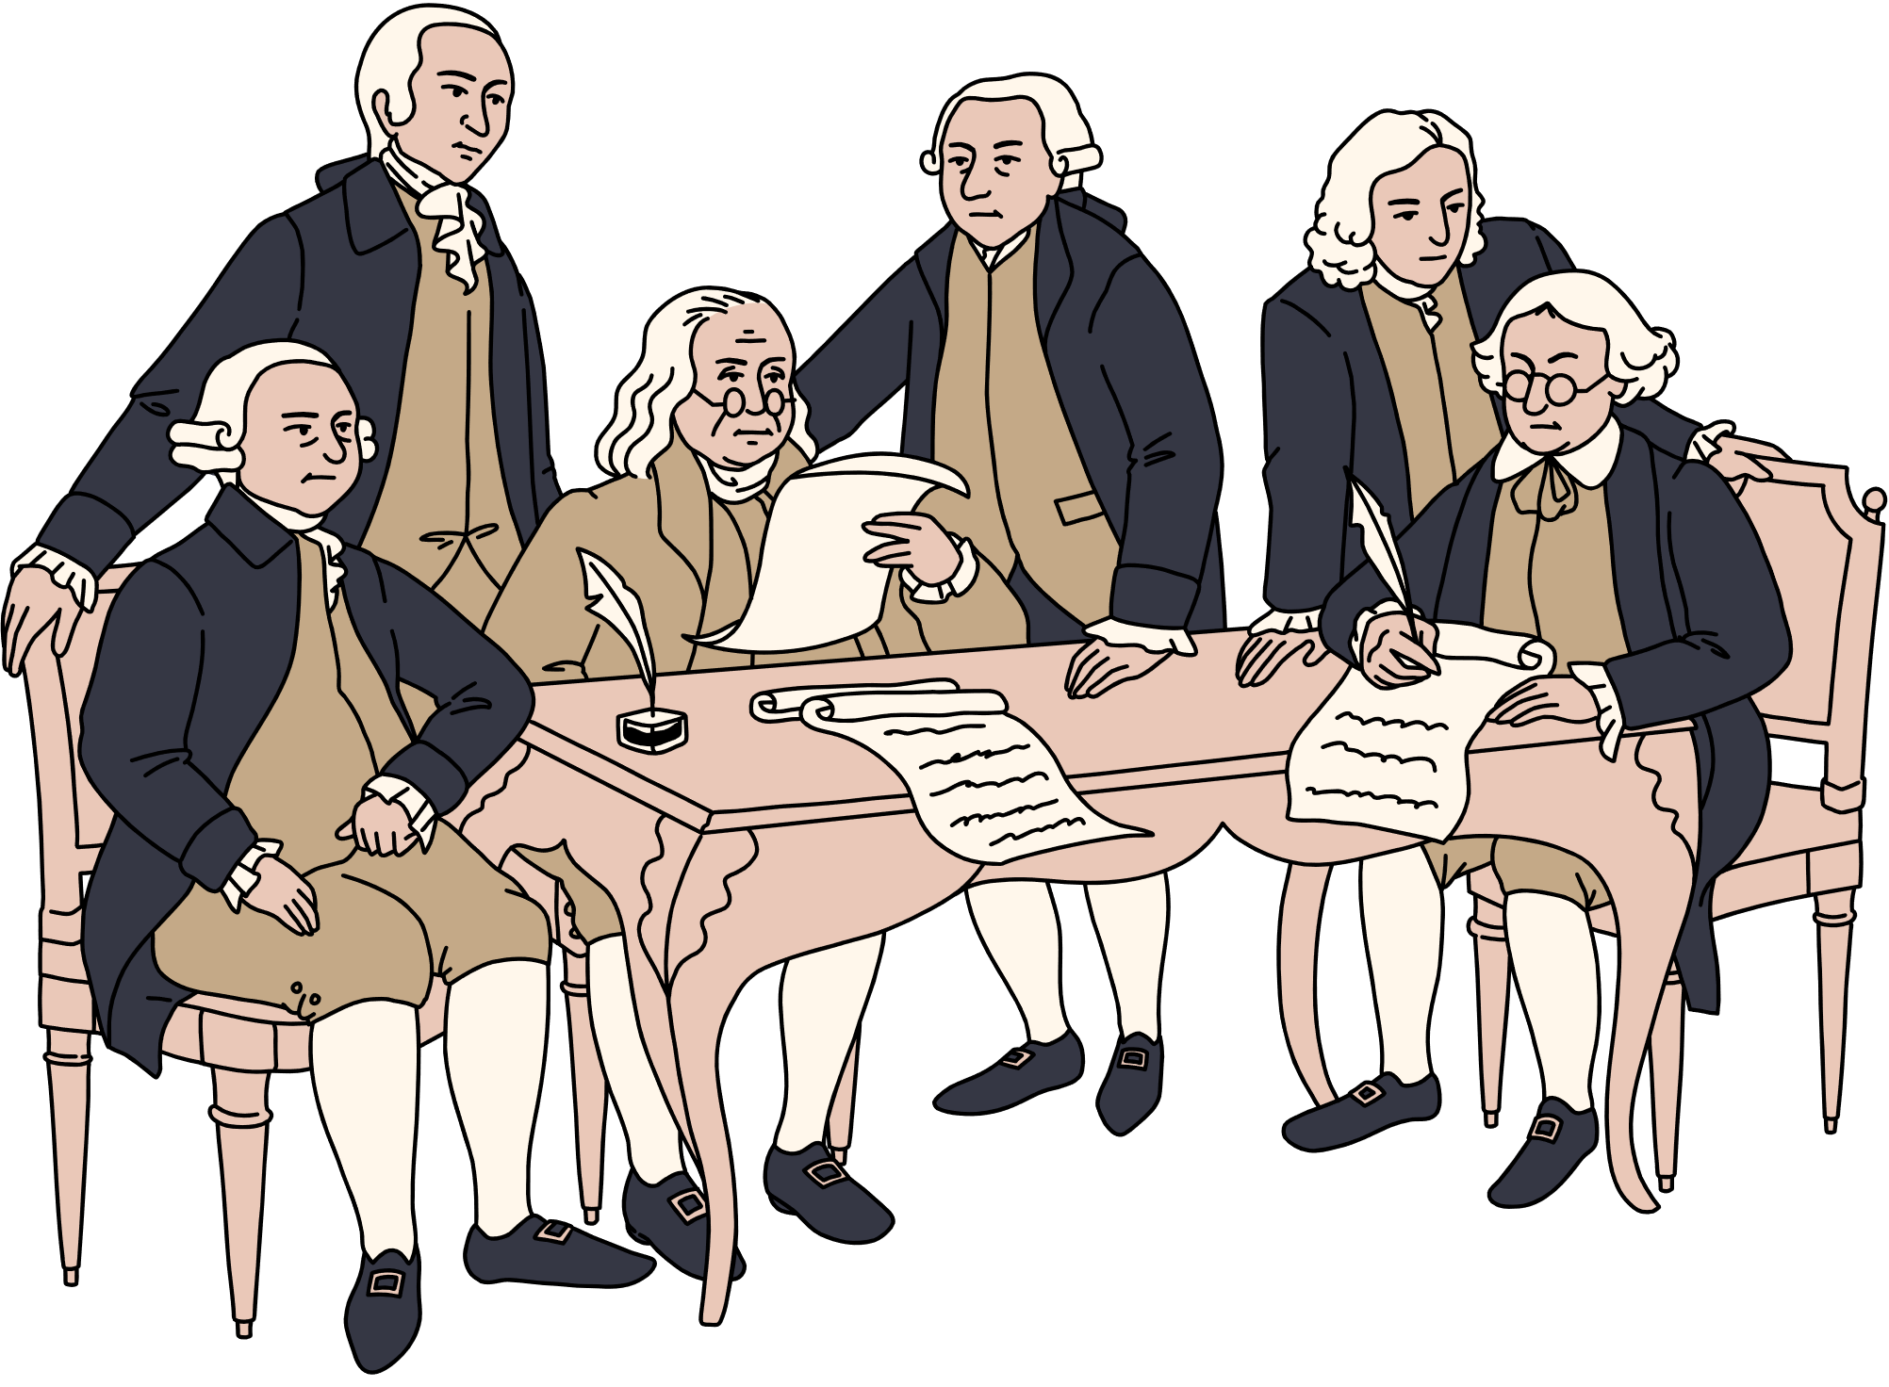
The target audience consists of professionals aged 30–60 from the UK, Germany, USA, Canada, and Japan who belong to mid- to high-income brackets (Parliament UK, 2023), (WK Information, 2025).
Target Market Analysis
The global wellness tourism market will reach $1.5 trillion by 2027 according to the Global Wellness Institute (2023) so uniting wellness with business operations matches current market requirements.
Wellness travel planners
Targeted audiences include:
Event Agencies
International MICE delegates

Slide 5
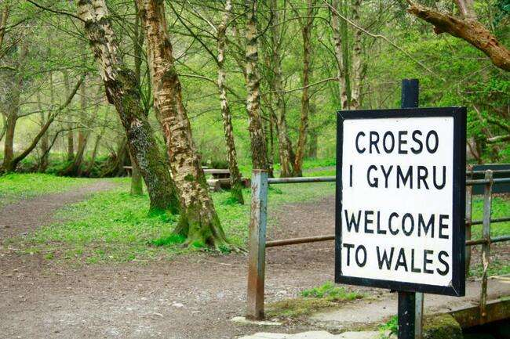
Demand & Supply
Wales has a strong but underdeveloped portfolio of MICE-ready venues and outdoor attractions (Thomas, Thomas and Powell, 2017).
CroesoConnect fills a niche by combining experiential wellness with cultural authenticity.
Main Competitors Include:
Global Wellness Summit (US-based) (Global Wellness Summit, 2025)
Nordic Wellness Expo (Sweden) (Nordic Wellness SE, 2025)
However, CroesoConnect’s hybrid format, Welsh-language integration, and location offer a competitive advantage (Santos et al., 2023).

Slide 6




Location and Venue Feasibility
The venue is accessible from major UK cities via Bangor Station and nearby airports, suitable for overseas delegates (Visit Snowdonia, 2024).
Hotel Portmeirion is proposed due to:
Unique architecture resembling an Italian village
Hotel Portmeirion
Scenic location on the Dwyryd Estuary
Onsite boutique accommodation, wellness gardens, and meeting rooms (Portmeirion Wales, 2025)

Slide 7

Resources & Staffing
Key operational requirements:
  Local bilingual guides and facilitators
  Wellness instructors and cultural performers (Silvers, 2012).
  Audio and Video technicians for hybrid broadcast (Ahmed et. Al, 2014)
Resources include:
  Event app for delegate interaction (Ahmed et.al, 2014)
  Tented outdoor spaces
  Transportation from regional hubs (Allen, Harris and Jago, 2022)
Partnering with Welsh service providers supports the local economy (Allen et al., 2021).

Slide 8

Budget & Funding Plan
IncomeAmount (£)
Ticket Sales
(200 x £350)
= £70,000
Sponsorship
= £20,000
Vendor Fees
= £5,000
Total Income
= £95,000
Expenses Amount (£)
Venue hire
= £15,000
Catering & drinks
= £12,000
Staffing & performers
= £10,000
Equipment & transport
= £8,000
Marketing & PR
= £6,000
Total Costs
= £51,000
Projected surplus: £44,000. Revenue will be supplemented by ticketing, sponsorship, and vendor exhibition fees (Armstrong, 2025).
Source: Eventflare (2025) and OECD (2025)

Slide 9
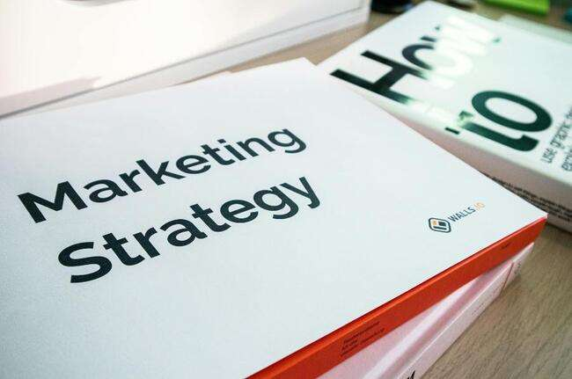
Multichannel Strategy
  LinkedIn and Instagram promotion
  Email marketing via wellness and MICE mailing lists
  PR coverage in Event Industry News and Wellness Traveller
  Collaborations with Visit Wales and regional DMOs
  (Fifield, 2024)
The integrated B2B and B2C approach aims to attract 200+ delegates and gain international exposure (Plotkin, Stanley and Harrison, 2024).

Slide 10
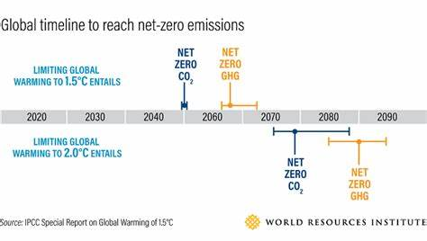

Risk, Legal and Sustainability
Health & Safety:
Full risk assessment for outdoor activities (e.g., Snowdonia hikes)
The site will have first aid facilities and an emergency response plan in place (Dickson and Gray, 2012).
Hybrid sessions will have COVID-safe protocols and sanitisation stations.
Legal Compliance:
Public liability insurance
Venue and performance permits
The event app will handle delegate data in compliance with GDPR regulations (Smith, 2012).
Sustainability Initiatives:
Zero single-use plastics
Locally sourced catering and ethical vendors
Digital delegate packs to reduce printing
Offset programme for travel-related carbon emissions (ISO, 2024)

Slide 11


S
W
O
T
Strengths
Weaknesses
Opportunities
Threats
Unique hybrid format
Cultural authenticity
Limited venue capacity
Seasonal weather risk
Wellness tourism boom
Interest in hybrid events
Economic uncertainty
International travel risks
A flexible contingency plan, including indoor wellness zones, will mitigate weather threats (Allen et al., 2021).

Slide 12

Conclusion
CroesoConnect 2025 is feasible, relevant, and timely (OECD, 2025) and it aligns with the goals of the Year of Croeso by:
  Enhancing Wales’ visibility as a MICE-wellness destination
  Engaging new global audiences
  Supporting local communities through tourism
Source: Visit Wales, 2024.
The next steps will include developing the operational timeline and stakeholder engagement plan (to be presented in Assignment 2).

Slide 13
References
Ahmed, A.M., Qiu, T., Xia, F., Jedari, B. and Abolfazli, S. (2014). Event-Based Mobile Social Networks: Services, Technologies, and Applications. IEEE Access, [online] 2, pp.500–513. doi:https://doi.org/10.1109/ACCESS.2014.2319823. (Accessed 02 May 2025).
Allen, J., Harris, R. and Jago, L. (2022). Festival & Special Event Management Interactive Wiley E-Text. S.L.: John Wiley.
Allen, J., O'Toole, W., Harris, R. and McDonnell, I. (2021) Festival and Special Event Management. 6th edn. Milton: Wiley.
Armstrong, S. (2025). From Planning to Execution. Super Gringo Books.
Dickson, T.J. and Gray, T. (2012). Risk Management in the Outdoors : a Whole of Organisation Approach for Education, Sport and Recreation. Cambridge ; Port Melbourne, Vic.: Cambridge University Press.
Evans, N.G. (2024). Strategic Management for Tourism, Hospitality and Events. 3rd ed. Taylor & Francis.
Eventflare. (2025). How to Budget Your Event Like a Pro. [online] Available at: https://eventflare.io/journal/how-to-budget-your-event-like-a-pro-a-step-by-step-guide [Accessed 8 May 2025].
Fifield, P. (2024). Marketing strategy. 6th ed. London: Routledge.
Global Wellness Institute (2023). Global Wellness Institute: 2023 Global Wellness Economy Monitor. [online] Global Wellness Institute. Available at: https://globalwellnessinstitute.org/industry-research/global-wellness-institute-2023-global-wellness-economy-monitor/. (Accessed: 06 May 2025).
Global Wellness Summit. (2025). Summit Mission & Values. [online] Available at: https://www.globalwellnesssummit.com/about-us/. (Accessed 08 May 2025).
HubSpot (2024) B2B Event Marketing Guide. Available at: https://www.hubspot.com/resources/b2b-event-marketing-guide (Accessed: 06 May 2025).
ISO (2024). ISO 20121:2024. [online] ISO. Available at: https://www.iso.org/standard/86389.html. (Accessed 17 May 2025).
Nordic Wellness SE (2025). Om Nordic Wellness. [online] Available at: https://nordicwellness.se/om-oss/. (Accessed 07 May 2025).
OECD. (2025). Implementing the OECD Recommendation on Global Events. [online] Available at: https://www.oecd.org/en/publications/implementing-the-oecd-recommendation-on-global-events_efa5cf5f-en.html [Accessed 12 May 2025].
Parliament.uk. (2022). Wales as a global tourist destination - Welsh Affairs Committee. [online] Available at: https://publications.parliament.uk/pa/cm5803/cmselect/cmwelaf/220/report.html. (Accessed 09 May 2025).
Phillips, M. (2024). An analysis of Welsh woodlands as sites of therapeutic experience and social engagement. [online] Available at: https://pure.aber.ac.uk/ws/portalfiles/portal/85169485/Phillips_Eleri.pdf. (Accessed 08 May 2025).
Plotkin, C.L. Stanley, J. and Harrison, L. (2024). Five fundamental truths: How B2B winners keep growing. [online] McKinsey & Company. Available at: https://www.mckinsey.com/capabilities/growth-marketing-and-sales/our-insights/five-fundamental-truths-how-b2b-winners-keep-growing. (Accessed 02 May 2025)
Portmeirion Wales. (2025). 4 Star Portmeirion Hotel | Where to Stay North Wales. [online] Available at: https://portmeirion.wales/stay/accommodation/portmeirion-hotel (Accessed 12 May 2025).
Rogers, T. and Davidson, R. (2015). Marketing Destinations and Venues for Conferences, Conventions and Business Events. Routledge. doi:https://doi.org/10.4324/9781315723716. (Accessed 04 May 2025).
Santos, E., Crespo, C., Moreira, J. and Rui Alexandre Castanho (2023). Brand and Competitiveness in Health and Wellness Tourism. Springer proceedings in business and economics, pp.707–721. doi:https://doi.org/10.1007/978-3-031-26829-8_44. (Accessed 08 May 2025).
Silvers, J.R. (2012). Professional event coordination. Hoboken, N.J.: John Wiley & Sons. [online]. Available at: Professional Event Coordination - Julia Rutherford Silvers - Google Cărți (Accessed at 01 May 2025).
Skift Research (2023) The Future of Wellness Travel. Available at: https://research.skift.com/report/the-future-of-wellness-travel/ (Accessed: 6 May 2025).
Smith, A. (2012). Events and Urban Regeneration. [online] Routledge. doi:https://doi.org/10.4324/9780203136997. (Accessed 18 May 2025).
Thomas, B., Thomas, S. and Powell, L. (2017) ‘The development of key characteristics of Welsh island cultural identity and sustainable tourism in Wales’, Scientific Culture, 3(1), pp. 23–39. doi: 10.5281/zenodo.192842. (Accessed 02 May 2025).
Visit Snowdonia (2024) Meetings and Incentives Guide. Available at: https://www.visitsnowdonia.info/business/meetings-and-incentives (Accessed: 6 May 2025).
Visit Wales (2024) Year of Croeso 2025. Available at: https://traveltrade.visitwales.com (Accessed: 6 May 2025).
WK Information. (2025). 2025 MICE Market Breakthrough: Reaching $1,337.14 Billion with Enhanced Event Experiences in U.S., China & Germany - WK Information. [online] Available at: https://www.wkinformation.com/market-reports/mice-market/ [Accessed 12 May 2025].

