Slide 1
BMHP5016
Principles of Health & Social Care
Person-Centered Care, professional standards and care planning
Week 3

Slide 2
Today’s learning
Professional standards, values and behaviour
Codes of Conduct
6 C’s of Care
Person-centered care
Care planning case studies
Referencing

Slide 3
We are now in week 3!
So you should have familiarised yourself with the Assignment Brief
Made a note of Assignment Deadlines
Emailed your lecturer the Wong et al (2018) writing activity for feedback
Pooled together relevant notes for your assignment – from your lectures and independent research
Read the Harvard Referencing Guide/explored CitethemRight/booked an appointment with the library team for help if needed
Referencing handbooks | UWTSD Intranet
Book an Appointment | UWTSD Intranet

Slide 4
Professional Attitude, Values, and Behaviours
Which skills did they discuss in the video?
The most important skills to have in the Health and Social Care industry - YouTube

Slide 5
Codes of Conduct
Professional Regulatory Bodies aim to ensure that proper standards are maintained by health and social care professionals and act when they are not.
These bodies fulfil similar functions for different professions across the UK.
Their main duties are to:
Maintain an up-to-date register of professionals;
Set and maintain standards for education, training and conduct
Investigate when these standards are not met or when a professional’s fitness to practice is in doubt.
What professional bodies do you know of?

Slide 6
Healthcare Professional Bodies
General Medical Council (GMC) - doctors.
Nursing and Midwifery Council (NMC) - nurses and midwives
General Dental Council (GDC) - dentists, dental nurses, dental technicians, clinical dental technicians, dental hygienists, dental therapists and orthodontic therapists.
General Optical Council (GOC) - optometrists, dispensing opticians, & businesses.
General Chiropractic Council (GCC) -chiropractors.
General Osteopathic Council (GOsC) - osteopaths.
General Pharmaceutical Council (GPC) - pharmacists, technicians & premises.
Health and Care Professions Council (HCPC) - regulates 15 healthcare professionals: Arts therapists, Biomedical scientists, Chiropodists / Podiatrists, Clinical scientists, Dieticians, Hearing aid dispensers, Occupational therapists, Operating department practitioners, Orthoptists, Paramedics, Physiotherapists, Practitioner psychologists, Prosthetists / orthotists, Radiographers, and Speech and language therapists, Social workers.

Slide 7
Social Care Professional bodies
Health and Care Professions Council (HCPC) - The HCPC is the regulator of the social work profession and social work education in England.
Social Care Wales (SCW) - The SCW is the social care workforce regulator in Wales.
Scottish Social Services Council (SSSC) - The SSSC is the regulator of the social work profession and social work education in Scotland.
Codes of Conduct & Professional values, attitude and behaviour.
Code of Conduct for healthcare support workers and adult social care workers
https://www.skillsforhealth.org.uk/images/services/code-of-conduct/Code%20of%20Conduct%20Healthcare%20Support.pdf
Nursing: Code of Conduct available from the link below;
https://www.nmc.org.uk/

Slide 8


NMC Code
Professional standards of practice and behaviour for nurses, midwives and nursing associates
https://www.nmc.org.uk/standards/code/
https://www.nmc.org.uk/standards/code/read-the-code-online/
Key areas:
Prioritise people
Practise effectively
Preserve safety
Promote professionalism and trust
(NMC,2020)

Slide 9
Professional values, attitude and behaviour
Code of Conduct for healthcare support workers and adult social care workers
1. Be accountable by making sure you can answer for your actions or omissions.
2. Promote and uphold the privacy, dignity, rights, health and wellbeing of people who use health
and care services and their carers at all times.
3. Work in collaboration with your colleagues to ensure the delivery of high quality, safe and
compassionate healthcare, care and support.
4. Communicate in an open, and effective way to promote the health, safety and wellbeing of people
who use health and care services and their carers.
5. Respect a person’s right to confidentiality.
6. Strive to improve the quality of healthcare, care and support through continuing professional
development.
7. Uphold and promote equality, diversity and inclusion.
https://www.skillsforhealth.org.uk/images/services/code-of-conduct/Code%20of%20Conduct%20Healthcare%20Support.pdf

Slide 10
Referencing activity
Lets reference a code of conduct
What type of source is it?
Who is the author?
What year was it produced?
Can you access citethemright and create the reference in the correct format?
Cite Them Right (uwtsd.ac.uk)

Slide 11
6 C’s of Care
The 6 Cs of Care are a set of core values developed by the NHS England as part of the Compassion in Practice strategy (2012) to promote high-quality, person-centred care across health and social care settings.
https://www.youtube.com/watch?v=Vnn1TlRlpG4

Slide 12
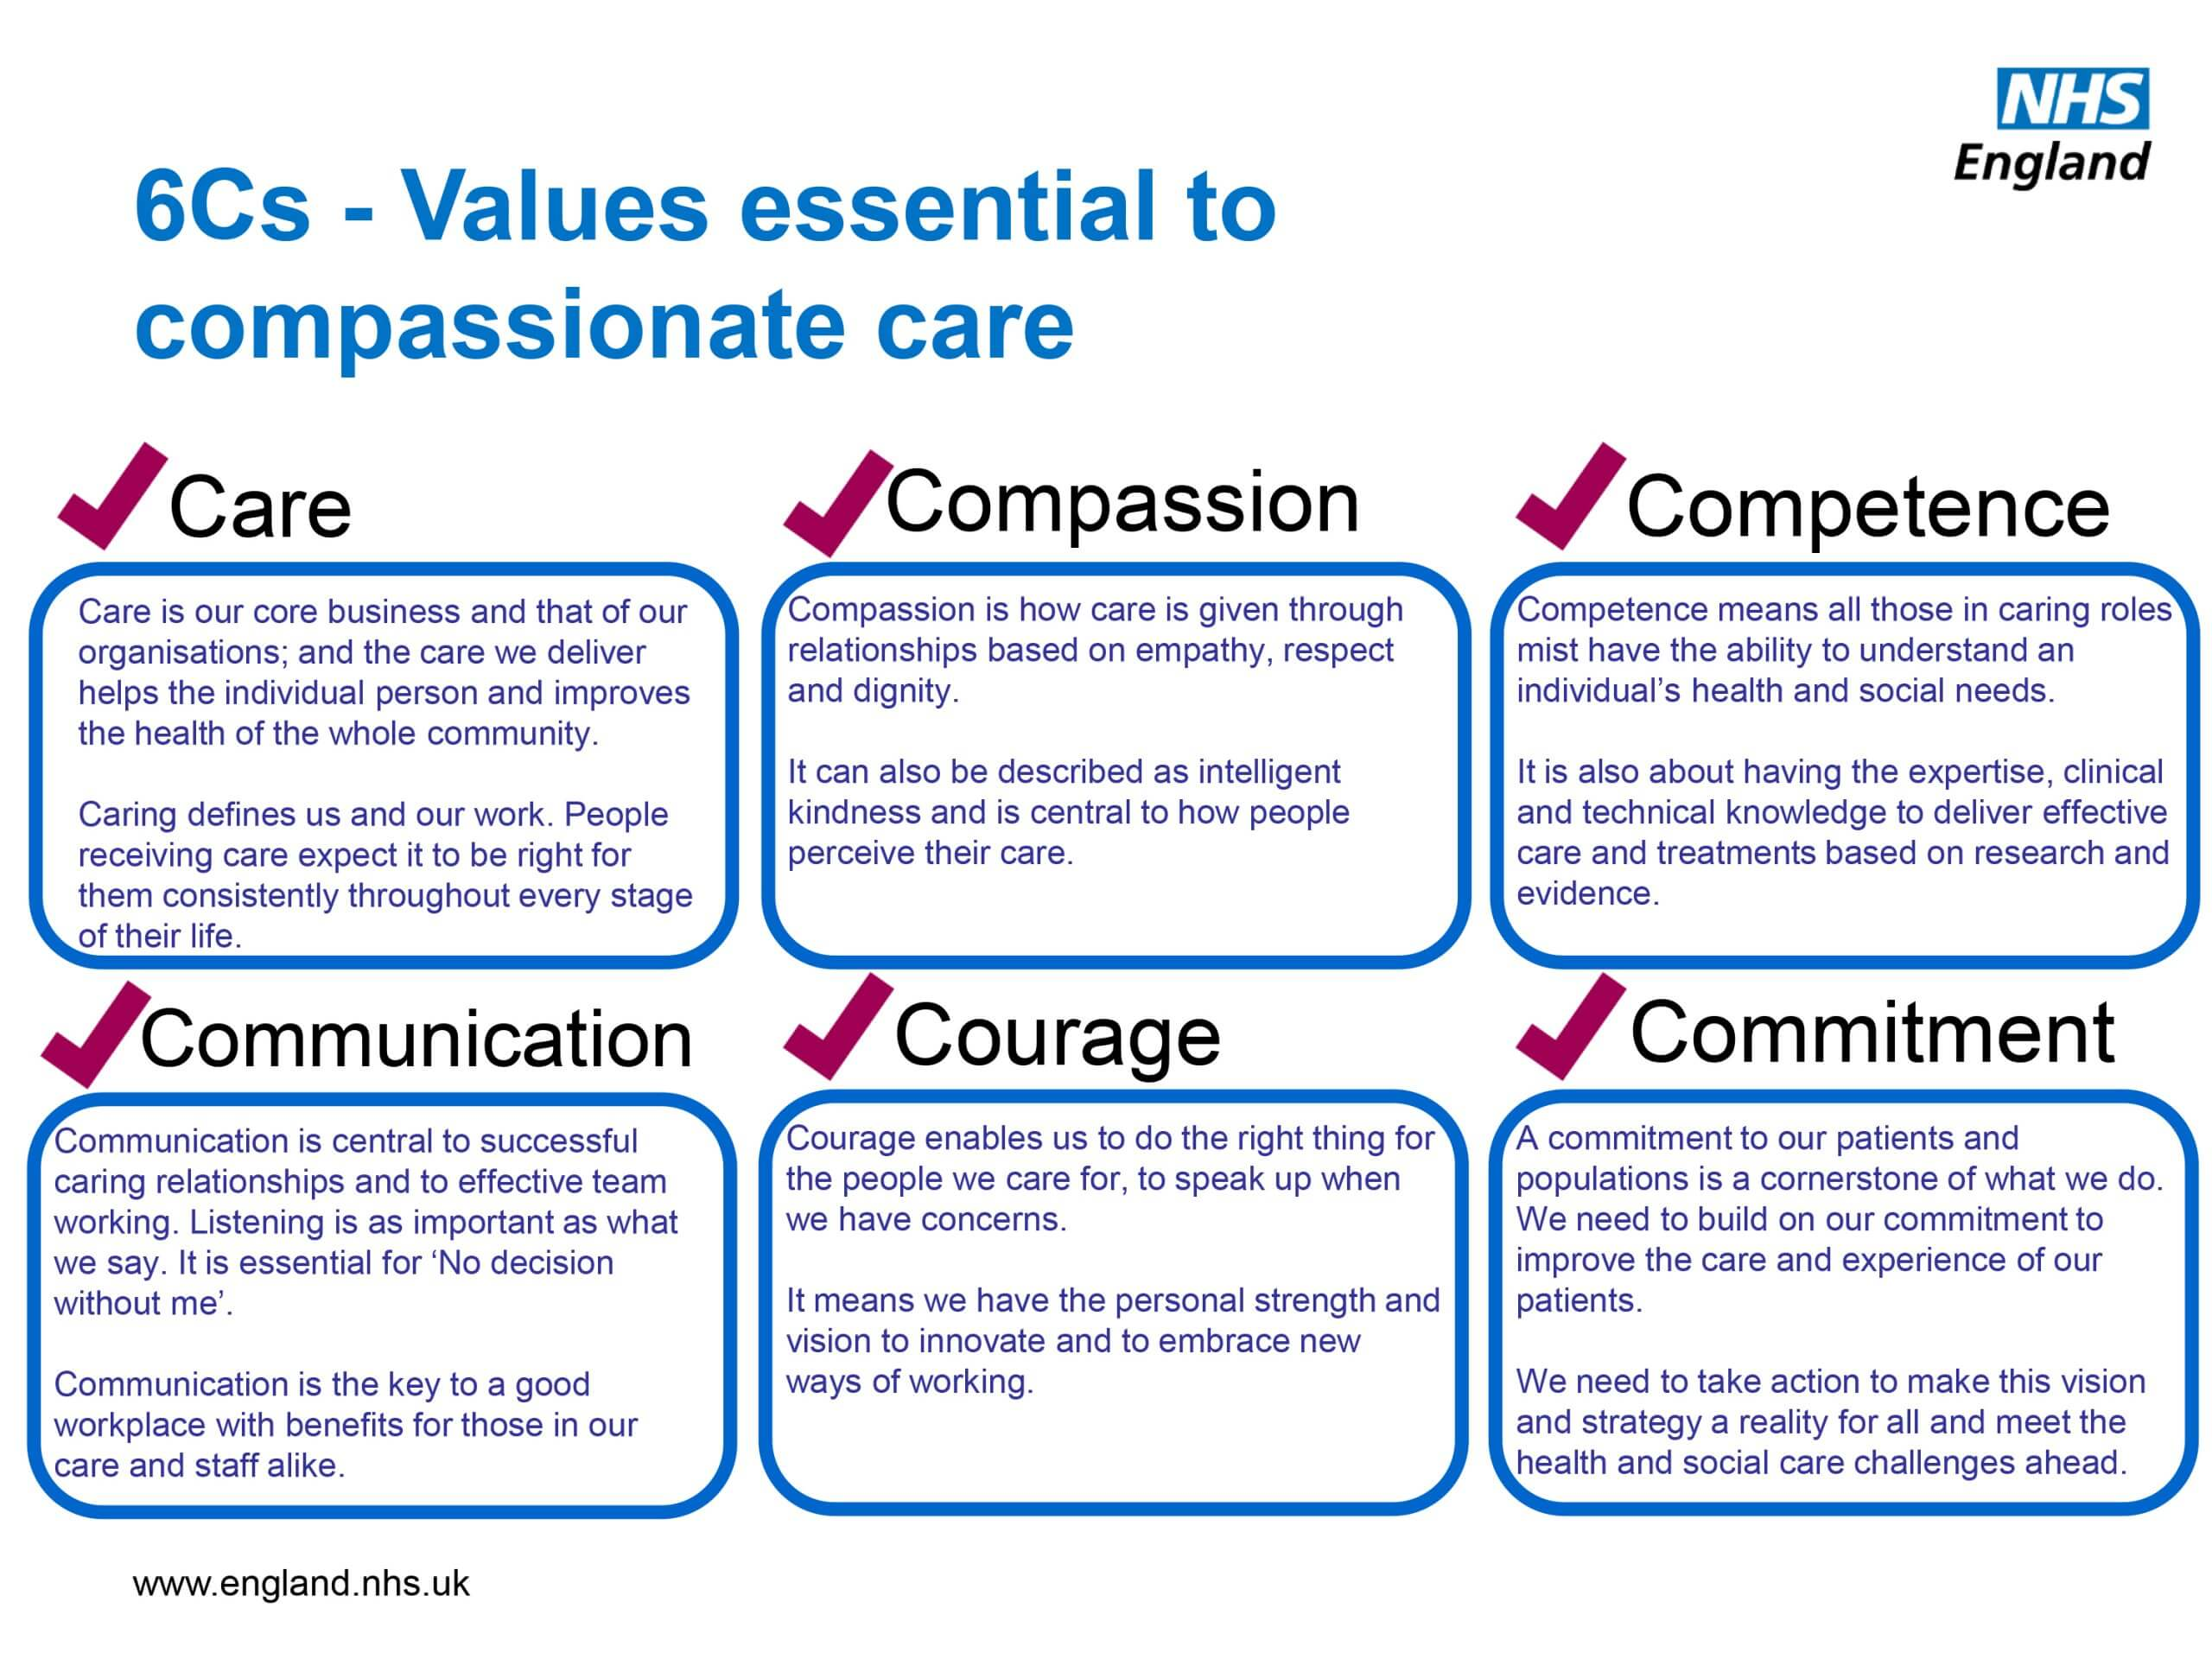

Slide 13
How can we uphold these values?
Care
  Creating a personalised care plan for a resident with dementia that respects their cultural background and daily routine.
Compassion
  Offering comfort and reassurance to a patient who is feeling anxious before a medical procedure.
Competence
  Attending regular training on manual handling, medication administration, or safeguarding procedures.
Communication
  Using simple language and visual aids to explain a treatment plan to a service user with learning difficulties.
Courage
  Reporting a colleague who is not following proper hygiene or safety protocols, even if it is uncomfortable to do so.
Commitment
  Volunteering to support a new health promotion initiative in the community outside of scheduled hours.

Slide 14


Slide 15

What is Person Centered Care?
Research and share your ideas on the whiteboard

Slide 16
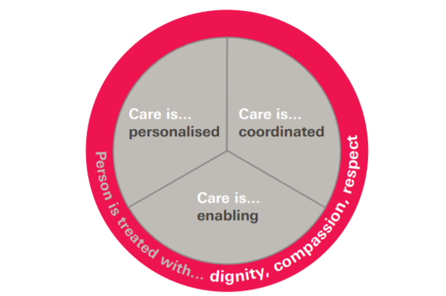

Figure 1: The four principles of person-centred care
Source: (The Health Foundation, 2016)
Notes:
Another definition of person-centred care

Slide 17
Framework for person-centred care
The Health Foundation (2016) has identified a framework that comprises four principles of person-centred care:
Affording people dignity, compassion and respect
Offering coordinated care, support or treatment
Offering personalised care, support or treatment
Supporting people to recognise and develop their own strengths and abilities to enable them to live an independent and fulfilling life
https://www.youtube.com/watch?v=6Dk3CV-Wt38&feature=emb_logo

Slide 18
Person centred care into practice
Core of person-centred care is the relationship between people, which is built from meaningful communication, and is strongly influenced by how we say things, how we listen and our non-verbal communication
Conversation to engage with people
Conversations to enable and support people
Conversations with people to collaboratively manage highest complexity and significant risk
(Health Education England, 2017)

Slide 19
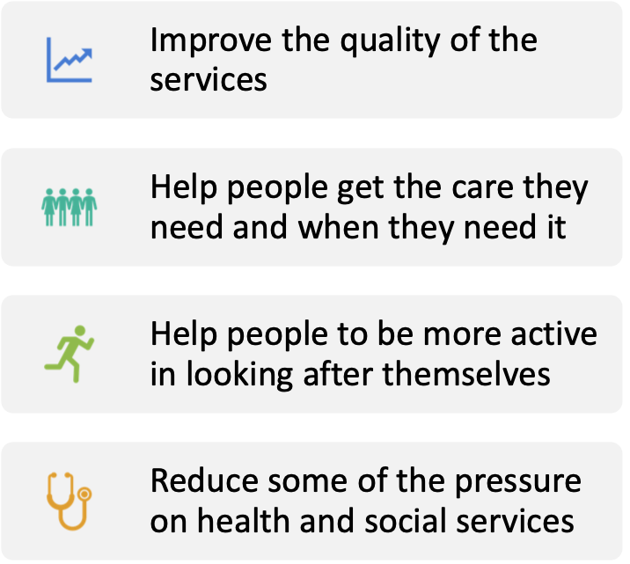
Why is Person-Centered Care important?

Slide 20
Person centred care into practice
There are different aspects of person-centred care, including:
Respecting people’s values and putting people at the centre of care
Considering people’s preferences and expressed needs
Coordinating and integrating care
Working together to make sure there is good communication, information and education
Making sure people are physically comfortable and safe
Providing emotional support
Involving family and friends
Making sure there is continuity of care between and within services
Making sure people have access to appropriate care when they need it

Slide 21
What is it not?
Assuming that you know what patient might want or see as important without asking them
Assuming the first thing that the patient mentioned is the most important or only thing that is important
Professionals deciding what they need to talk about
Seeing patients as just my problem/condition or just as a carer
Seeing patients as incapable of making changes
Judging patients and their choices
Focusing only on the medical perspective of their story
Not allowing patients to express their feelings, ideas and opinions

Slide 22

Patient-centered care planning
Health professionals write care plans through:
Assessment
Goal setting
Intervention identification
Collaboration
Patient involvement
Documentation, regular review
Communication
Implementation
Evaluation

Slide 23
Make notes on what makes a good care plan & relevant legislation
Care and Support Planning and The Care Act (youtube.com) _fq0Aghttps://www.youtube.com/watch?v=mQue-_fq0Ag
https://www.youtube.com/watch?v=mQue-_fq0Ag

Slide 24

Person-Centered Care
Case Study Activity
In pairs choose a case study from the Moodle Page and determine a person-centered care plan for the patient
Remember to include all four elements of the Person-Centered care Framework
Be ready to present your findings to the class

Slide 25

Homework
Research the term ADVOCACY
Find credible literature to explain how advocacy is used in health and social care
You can access the Library’s AI Research Assistant to help you locate credible literature
librarysearch.uwtsd.ac.uk/discovery/researchAssistant?vid=44WHELF_UWTSD:44WHELF_UWTSD_VU1
Keep a note of this to add to your assignment

Slide 26
References for partnership and patient centred care
Arnstein, S. (1969). ‘A Ladder of Citizen Participation’, Journal of the American Institute of Planners, 35 (4), pp. 216 – 224.
Audit Commission (AC) (1998). A Fruitful Partnership – Effective Partnership Working. London: AC. Available at: http://www.dhcarenetworks.org.uk/_library/Resources/ICN/A_Fruitful_Partnership.pdf (Accessed: 4 December, 2009).
Busse, R., Blumel, M., Scheller-Kreinsen, D. and Zentner, A. (2010). Tackling Chronic Disease in Europe: Strategies, Interventions and challenges: Observatory Series No. 20. Copenhagen: World Health Organisation/European Observatory on Health Systems and Policies: Available at: http://www.euro.who.int/__data/assets/pdf_file/0008/96632/E93736.pdf (Accessed: 12th October, 2011).
Coulter, A. (2011). Engaging Patients in Healthcare. Maidenhead: Open University Press/McGraw Hill.
Coulter, A., Roberts, S. and Dixon, A. (2013). Delivering Better Services for People with long-term conditions: building the House of Care. London: The King’s Fund. Available at: http://www.kingsfund.org.uk/sites/files/kf/field/field_publication_file/delivering-better-services-for-people-with-long-term-conditions.pdf (Accessed: 3rd September, 2014).
DH (2004). Chronic Disease Management: A compendium of information. London: DH. Available at: http://webarchive.nationalarchives.gov.uk/20130107105354/http://www.dh.gov.uk/prod_consum_dh/groups/dh_digitalassets/documents/digitalasset/dh_074612.pdf (Accessed: 27th March, 2015).

Slide 27
Brooker, D. (2007) Person-Centred Dementia Care : Making Services Better. London: Jessica Kingsley Publishers (Bradford Dementia Group Good Practice Guides). Available at: https://search-ebscohost-com.ezproxy.uwtsd.ac.uk/login.aspx?direct=true&db=nlebk&AN=180478&site=ehost-live (Accessed: 16 June 2020).
The Health Education England (2017). A core skills education and training framework Person-Centred Approaches. [online] Available at: https://www.skillsforhealth.org.uk/images/pdf/Person-Centred-Approaches-Framework.pdf?s=form (Accessed on 17th June 2020)
The Health Innovation Network (n.d.). What is person-centred care and why is it important? [online] Available at: https://healthinnovationnetwork.com/system/ckeditor_assets/attachments/41/what_is_person-centred_care_and_why_is_it_important.pdf (Accessed on 17th June 2020)
The health Foundation (2016). Person-centred care made simple. [online] Available at: https://www.health.org.uk/sites/default/files/PersonCentredCareMadeSimple_0.pdf (Accessed on 17th June 2020)

Slide 28
Department for Health and Home Office. (2003). The Victoria Climbié Inquiry. Report of an Inquiry by Lord Laming (Cm 5730). London: The Stationery Office. Available at: https://www.gov.uk/government/uploads/system/uploads/attachment_data/file/273183/5730.pdf (Accessed: 12th February, 2017).
Goodwin, N., Smith, J., Davies, A., Perry, C., Rosen, R., Dixon, A., Dixon, J. and Ham, C. (2012). A Report to the Department of Health and the NHS Future Forum: Integrated care for patients and populations: Improving outcomes by working together. London: The Kings Fund/Nuffield Trust. Available at: http://www.kingsfund.org.uk/document.rm?id=9405 (Accessed:14th February, 2012).
Henwood, M. and Hudson, B. (2009). ‘Keeping it Personal: Supporting People with Complex and Multiple Needs’, Journal of Integrated Care, 17 (3), pp. 8 – 15.
Integrated Care Network (ICN) (2009). What is Integrated Care. London: ICN. Available at: http://www.dhcarenetworks.org.uk/Integration/icn/Topics/Browse/whatIs/ (Accessed: 5 March, 2010).
Jelphs, K., Dickinson, H. and Miller, R. (2016). Working in Teams (2nd edn.). Bristol: Policy Press.
Kooiman, J. (2000). ‘Societal Governance: Levels, Modes, and Orders of Social-Political Interaction’, in Pierre, J. (ed.). Debating Governance, Oxford: Oxford University Press, pp. 138 – 163.
Leutz, W.N. (2005). ‘Reflections on Integrating Medical and Social Care: Five Laws Revisited’, Journal of Integrated Care, 13 (5), pp. 3 – 12.
Leutz, W.N. (2009). ‘Partnership working: key concepts and approaches’, in Glasby, J. and Dickinson, H. (Eds.). International Perspectives on Health and Social Care: Partnership Working in Action. Oxford: Wiley-Blackwell, pp. 42 – 55.

Slide 29
Nolte, E., Conklin, A., Adams, J., Brunn, M., Cadier, B., Chevreul, K., Durand-Zaleski, I., Elissen, A., Erler, A., Flamm, M., Frølich, A., Fullerton, B., Jacobsen, R., Knai, C., Krohn, R., Pöhlmann, B., Parkinson, Z. S.,Sarria Santamera, A., Sönnichsen, A. and Vrijhoef, H. (2012). Evaluating chronic disease management: Recommendations for funders and users. Cambridge: Rand Europe. Available at: http://www.rand.org/content/dam/rand/pubs/technical_reports/2012/RAND_TR1213.pdf (Accessed: 5th September, 2014).
Oliver, D., Foot, C. and Humphries, R. (2014). Making our health and care systems fit for an ageing population. London: The King’s Fund
Rittel, H. and Webber, M. (1973). ‘ Dilemmas in a General Theory of Planning’, Policy Sciences, 4, pp. 155 – 169.
Sullivan, H. and Skelcher, C. (2002). Working across boundaries: Collaboration in public services. Basingstoke: Palgrave.
Wellard, S. (2010) ‘Globalisation of Chronic Illness Research’, in Kralik, D., Paterson, B., and Coates, V. (Eds). Translating Chronic Illness Research into Practice. Oxford: Wiley-Blackwell, pp. 1 – 16
Welsh Assembly Government (WAG) (2007). Designed to Improve Health and the Management of Chronic Conditions in Wales: An integrated model and framework. Cardiff: WAG. Available at: http://new.wales.gov.uk/dhss/publications/health/strategies/chronicconditions/chronicconditionse.pdf?lang=en (Accessed: 2nd November, 2011).
WHO (2002). Innovative Care for Chronic Conditions: Building Blocks for Action: Global Report. Geneva: WHO. Available at: http://www.improvingchroniccare.org/downloads/who_innovative_care_for_chronic_conditions.pdf (Accessed: 7th March, 2012).

Slide 30
REFERENCES & ESSENTIAL READINGS
Akhtar, F (2013) Mastering Social Work Values and Ethics (Mastering Social Work Skills) Jessica Kingsley Pub London
Bartley, M (2016) Health Inequality: An Introduction to Concepts, Theories and Methods 2nd Edition Polity Press; London
Guy-Evans, O. (2023). Bronfenbrenner’s ecological systems theory. (online) Simply Psychology. Available at: https://www.simplypsychology.org/Bronfenbrenner.html.
https://www.cqc.org.uk/what-we-do/how-we-do-our-job/fundamental-standards
https://www.skillsforhealth.org.uk/images/services/code-of-conduct/Code%20of%20Conduct%20Healthcare%20Support.pdf
https://www.skillsforhealth.org.uk/images/services/code-of-conduct/Code%20of%20Conduct%20Healthcare%20Support.pdf
https://www.hse.gov.uk/
https://www.nmc.org.uk/standards/code/
https://www.nmc.org.uk/standards/code/read-the-code-online/

