Slide 1


DIGITAL FORENSIC INVESTIGATION REPORT: CASE QT-AI-2025-THEFT
Investigation into Insider Threat & Corporate Espionage at Quantum Tech
Presenter: Harshsinh Mahendrasinh Padhiyar
Date: December 18th, 2025
Classification: CONFIDENTIAL / LEGAL PRIVILEGE

Slide 2

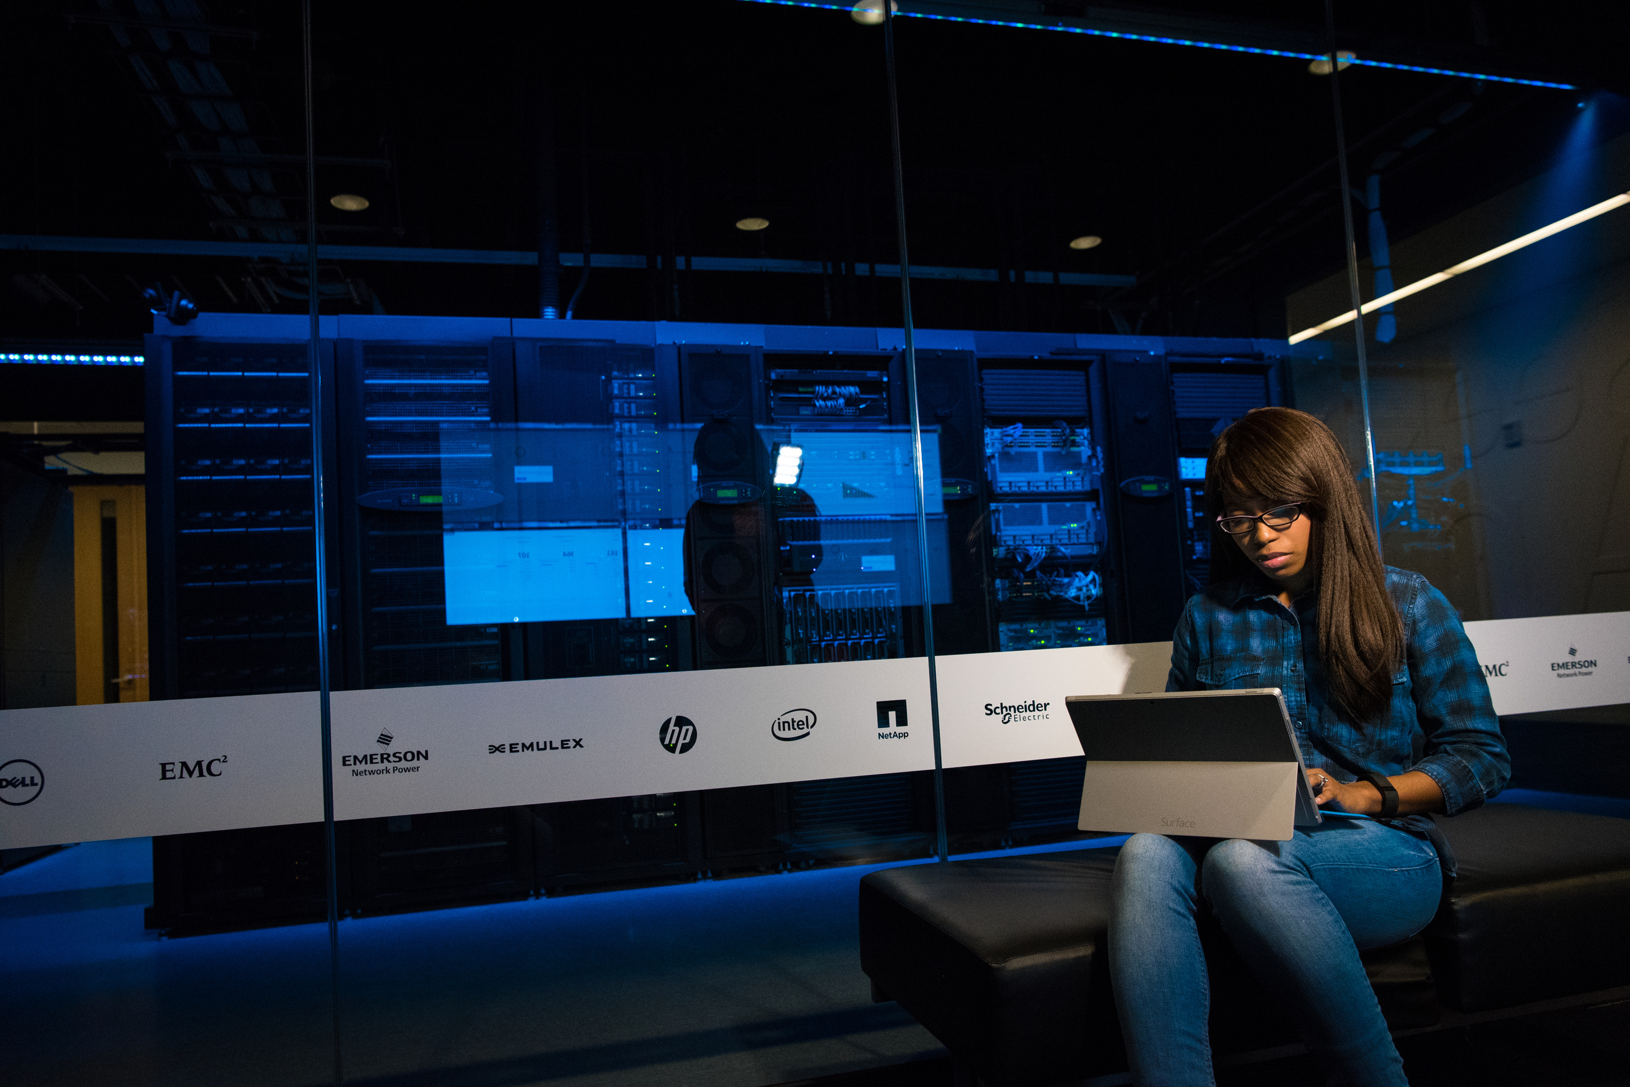
INTRODUCTION
  Incident: Suspicious access to the "QT-AI-2025" Neuro-AI technology database.
  Allegation: Senior Engineer "Emma" conspired to sell proprietary IP to a rival organization, NexGen Circuits.
  Investigation Scope: Acquisition and analysis of 5 digital exhibits (mobile devices and storage) to establish attribution, intent, and timeline.
  Key Finding: Confirmed conspiracy to sell trade secrets for 5 million ("5M") involving an insider, a broker, and a buyer.

Slide 3
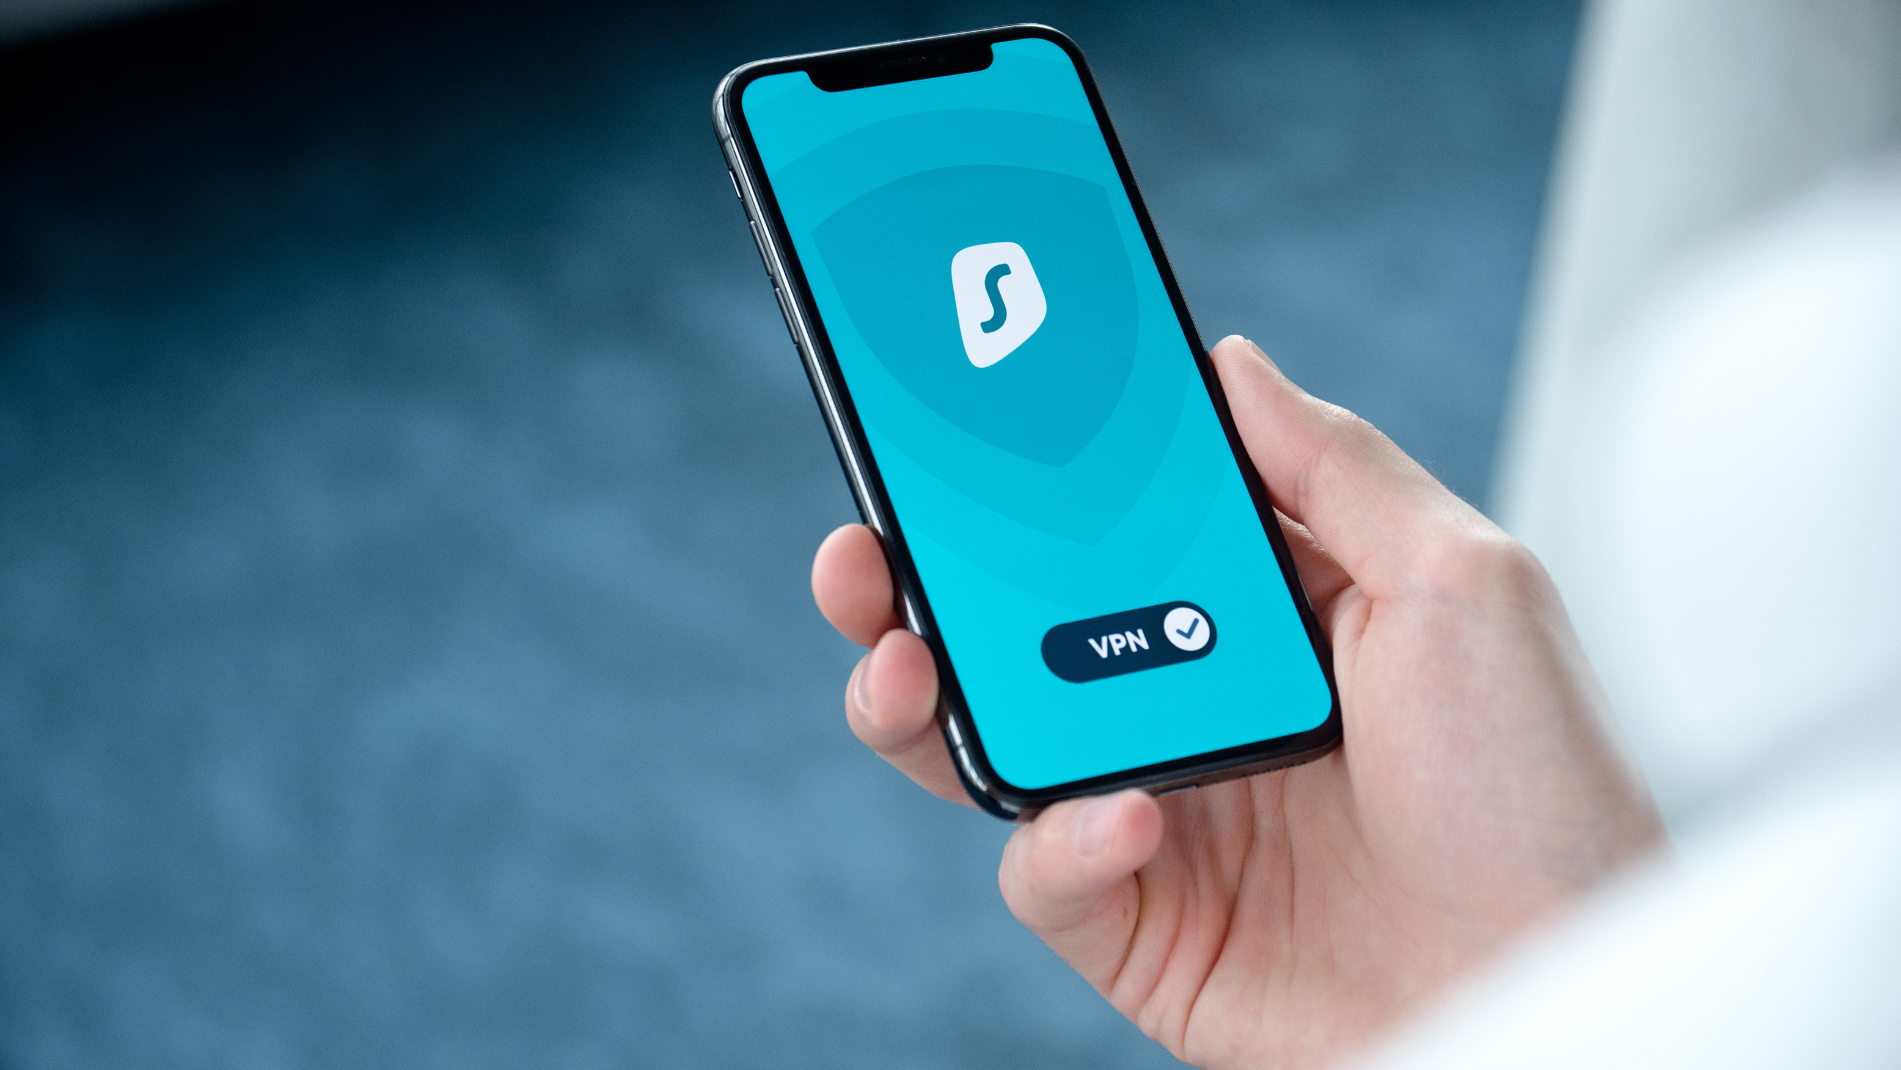
METHODOLOGY & INTEGRITY
Standards: Investigation strictly followed ACPO (Association of Chief Police Officers) Guidelines to ensure court admissibility.
Preservation:
  Network Isolation (Faraday bags/Airplane Mode) to prevent remote wiping.
  Write-blockers are used for USB storage to preserve metadata.
  MD5/SHA256 Hashing is used to verify the integrity of evidence throughout the process.
Tools Used:
  Cellebrite UFED: For physical/file system extraction.
  Autopsy: For keyword searching and correlation.

Slide 4
Evidence Inventory
Exhibit ID | Description | Make/Model | Owner (Attributed) | MD5 Hash Value
EV-01 | Smartphone | Huawei P Smart (POT-LX1) | Emma | 366c031fcb2a2b305139a185b8ed29c7e9b6cc2c5b419bc1efaffa7220cc3483
EV-02 | Smartphone | Ulefone Note 14 | Joe Marsh | d6da540e5072f5757106709c6ef1a04ffd7c589d0299dd8e77454f3fdccd711e

Slide 5
Exhibit ID | Description | Make/Model | Owner (Attributed) | MD5 Hash Value
EV-03 | Smartphone | Samsung Galaxy A13 | Norman (alias Kate Oleary) | 065a47cc7db9a4024f9b8ad2dfba27c102ea8f71aca89455259e281540964635
EV-04 | Smartphone | Nokia C2 | Unidentified | c1b69eb203dabcdafff34c65e36a4ac70b7121c2e8ecae6d73a7f30d1e6d203e
EV-05 | Storage Device | USB Flash Drive | Emma | DB033FB301C9BC43FD7C1FBB8F15B51CC99C0C9866226F5DBE433BB075755F91

Slide 6
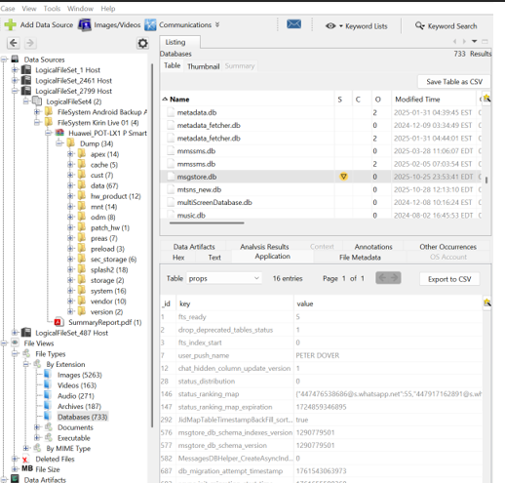
THE SUSPECT NETWORK
Emma (The Insider)
  Senior Engineer at Quantum Tech.
  Used the alias "Peter Dover" on WhatsApp.
  Motive: Financial gain from selling "Neuro based AI product".
Joe Marsh (The Broker)
  Facilitated logistics and negotiations.
  Traveled to Paris and Glasgow to secure the deal.
Norman Smith (The Buyer)
  Operated via a proxy device registered to "Kate Oleary".
  Requested data in "chunks" to avoid security filters.

Slide 7
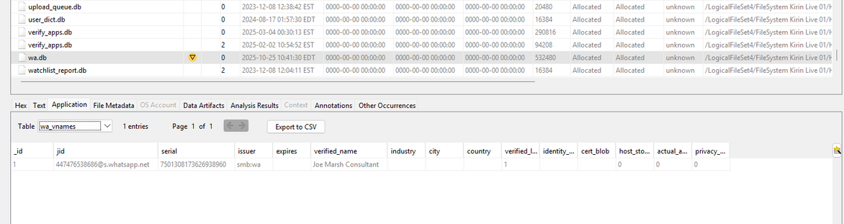
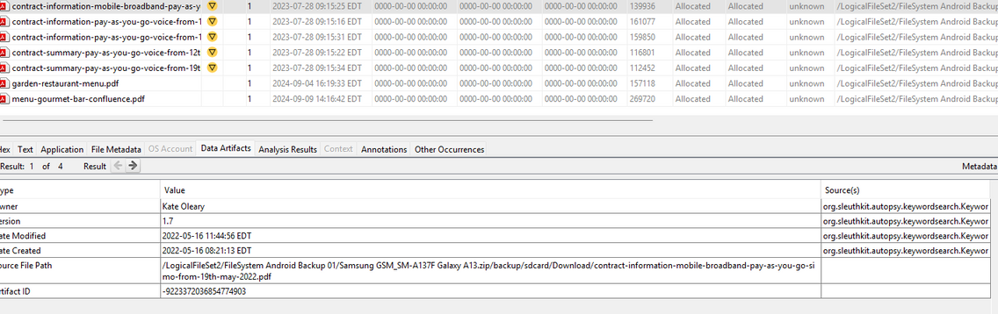
THE SUSPECT NETWORK
Joe Marsh (The Broker)
  Facilitated logistics and negotiations.
  Traveled to Paris and Glasgow to secure the deal.
Norman Smith (The Buyer)
  Operated via a proxy device registered to "Kate Oleary".
  Requested data in "chunks" to avoid security filters.

Slide 8
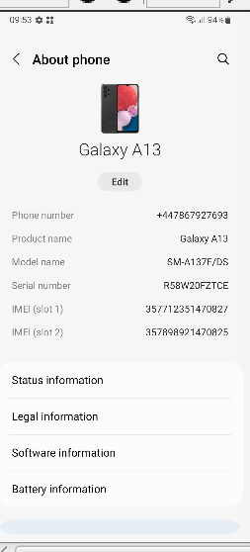
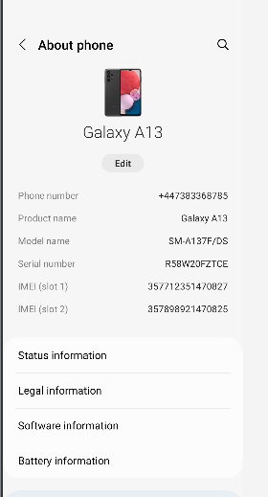
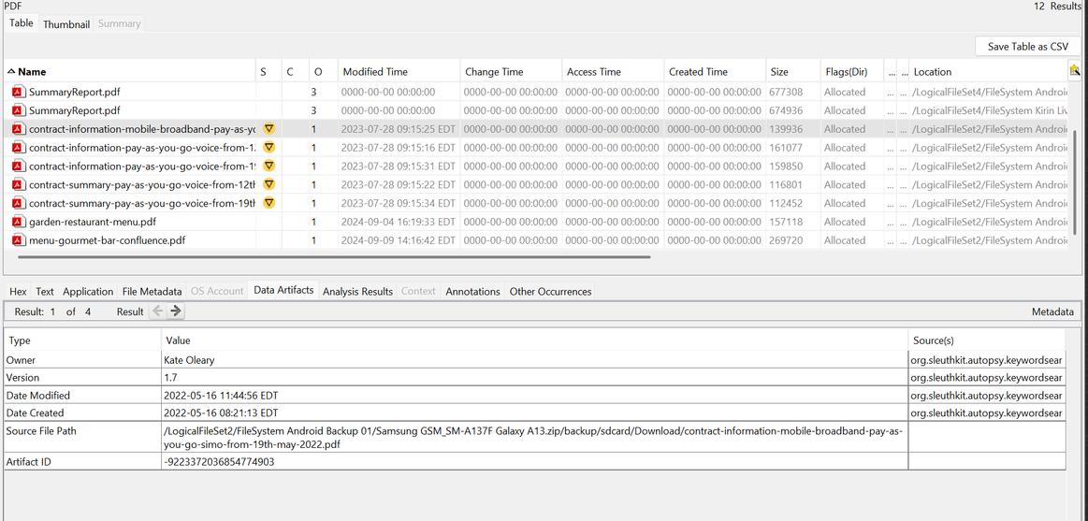
Trying to Hide his Identity by changing his number and using Kate Oleary

Slide 9
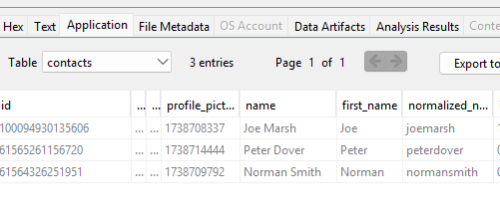
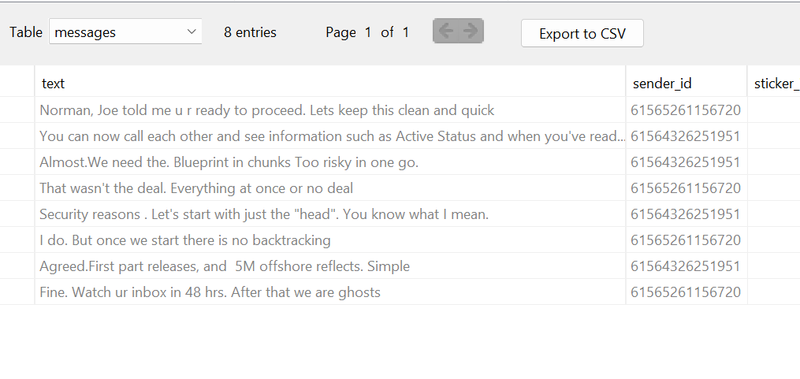
THE SUSPECT NETWORK
Emma (The Insider)
  Senior Engineer at Quantum Tech.
  Used the alias "Peter Dover" on WhatsApp.
  Motive: Financial gain from selling "Neuro based AI product".
Norman Smith (The Buyer)
  Operated via a proxy device registered to "Kate Oleary".
  Requested data in "chunks" to avoid security filters.

Slide 10
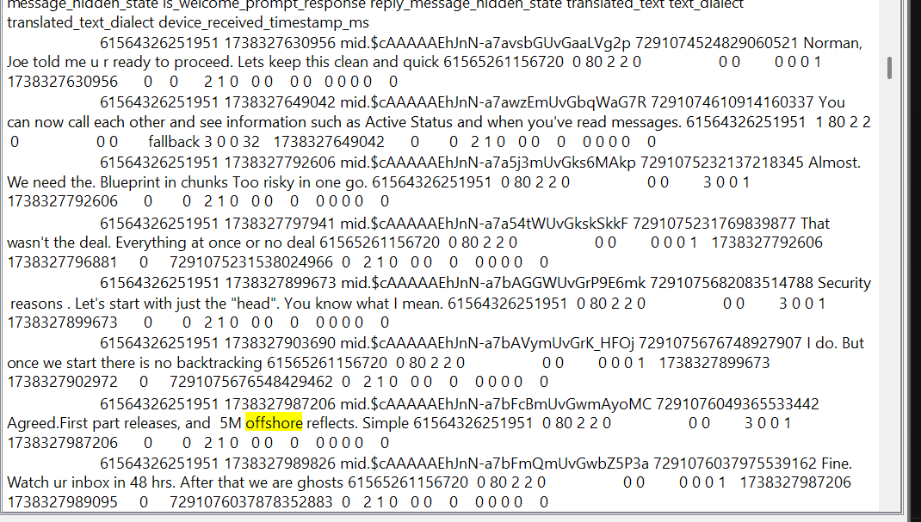
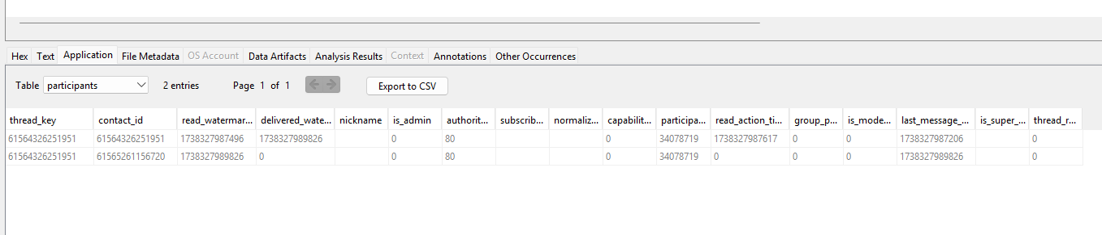
KEY FINDINGS – THE CONSPIRACY
Inception (Aug 21, 2024):
  Emma messages Joe: "I possess access to some very valuable information... I'm thinking about selling it".
The Deal:
  Price agreed at 5 Million ("5M").
  Payment method: Offshore arrangement.
Direct Negotiation (Friday, January 31, 2025 at 12:53:07 PM (UTC)):
  Emma and Norman cut out the intermediary (Joe) later in the timeline.
  Norman: "First part releases, and 5M offshore reflects".

Slide 11
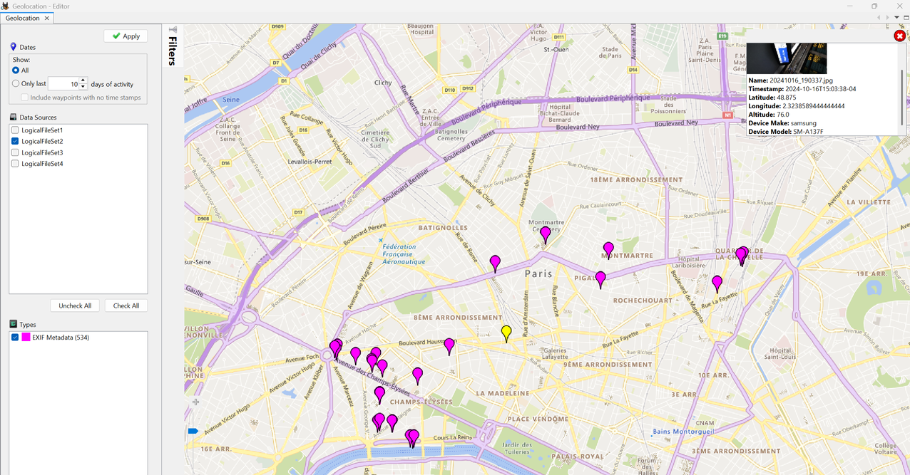
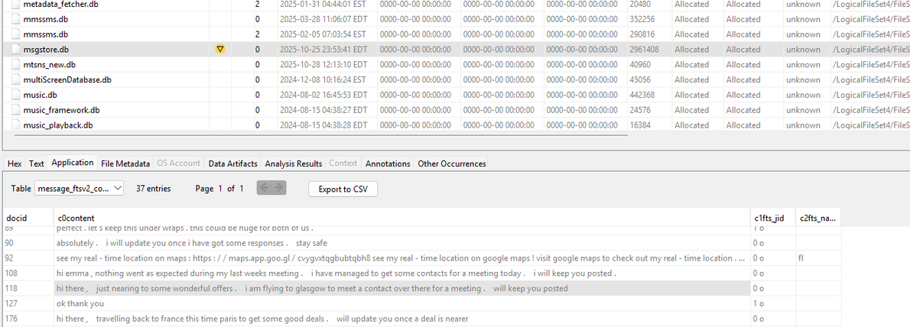
GEOLOCATION & CORROBORATION
  Digital Claim: On Oct 14, Joe messaged he was traveling to Paris.
  Physical Evidence: GPS metadata from the Buyer's phone (Samsung A13) placed it in Paris (48.8647° N, 2.3490° E) on Oct 16, 2024.
  Conclusion: The physical convergence of the Broker and Buyer confirms the meeting took place as discussed in the chats.

Slide 12

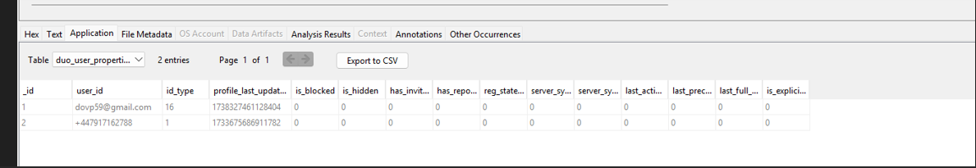
  Digital Aliases: Emma used the name "Peter Dover" and a non-corporate Gmail (doxp59@gmail.com).
  Data Compartmentalization: No patent files were found on Emma's phone; she strictly used the USB drive (EV-05) to keep her phone "clean".
  SIM Swapping: The Buyer's device changed phone numbers in October 2025 while retaining the same IMEI hardware, a tactic to dissociate from past call records.
ANTI-FORENSIC TACTICS (OPSEC)

Slide 13

CONCLUSION
Guilt Established: Forensic analysis confirms a premeditated conspiracy to steal and sell the QT-AI-2025 patent.
Attribution:
  Emma: Source of the data theft via USB.
  Marsh: Logistics support.
  Smith: Financier and Buyer.
Status: All three suspects are linked to the crime despite encryption and obfuscation attempts.

Slide 14
  Legal Action:
    File criminal charges for Theft of Trade Secrets and Conspiracy.
    Freeze assets and bank accounts linked to "Kate Oleary" to stop the 5M transfer.
  Corporate Remediation:
    Immediate: Terminate Emma’s accounts and revoke VPN/Cloud access.
    Policy Change: Implement "Block All" policy for USB/Removable media on engineering workstations.
    Monitoring: Deploy EDR agents to detect large file copies to external volumes.
RECOMMENDATIONS

Slide 15
THANKYOU
Take Charge of Your Privacy Today

