Slide 1
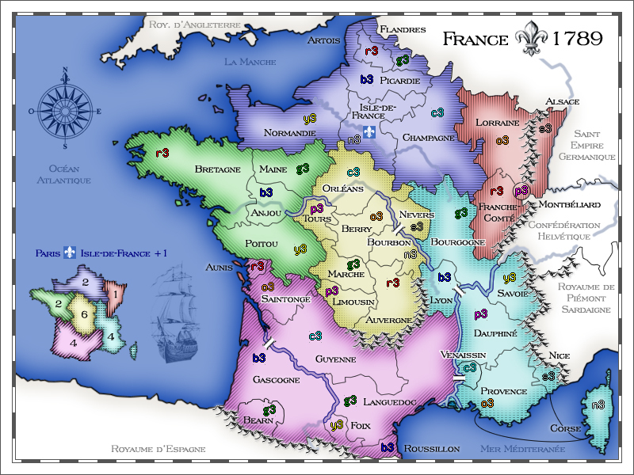
18TH CENTURY FRANCE; PART I – POLITICS AND SOCIETY

Slide 2
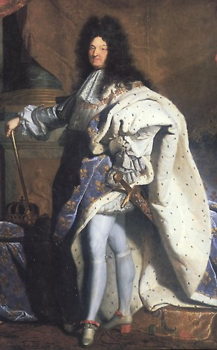
THE FRANCE OF LOUISE XIV
THE SUN KING - ‘L’ETAT C’EST MOI’ (I AM THE STATE)
Reign from aged four (1643-1715); first under protectorate and alone from 1661
Through his Court he embodied the authority of the State

Slide 3
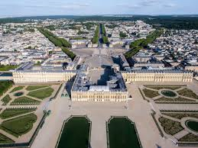
Versailles

Slide 4
ABSOLUTE MONARCHY
Court splendour and patronage of the arts
Control of nobles through honours and favours
Able monarch; generally competent rule
Quest for territorial gain and constant warring sowed seeds of future problems
Constant challenge from neighbours determined to curtail French territorial ambitions
War of Spanish succession 1701-14 did curtail French hegemony in Europe – Austrian Habsburg gains in Italy and the Netherlands

Slide 5
WAR
Unchallenged and God-given Royal authority and control of nobles allowed Louis to organise for war
Imposition of taxes; control of Army and Navy; network of judicial control through efficient administration structures (forging of a public servant identity)
Creation of a standing army to match the wealthy Republics (Venice; United Provinces)
Building the infrastructure for war – roads

Slide 6
LIMITS OF ABSOLUTISM
Powerful monarchs like Louis were a hard act to follow – bad government and insecurity following accession of heirs
Tyrannical and arbitrary rule made enemies - nobles and provinces: e.g. Revoking the Edict of Nantes (1685) and the tolerance towards Hugeunot /Calvinist population
Bribery and corruption flourished; nepotism; selling of offices; tax on right of inheriting office (La Paulette)

Slide 7
LIMITS OF ABSOLUTISM
By the 18th century, privilege, corruption, inefficiency, rife in France
Financial incompetence (private financiers and tax farming) brought France to the brink of bankruptcy – unable to meet expense of court and incessant war
In Britain central control of credit through the Bank of England, and more efficient tax collecting regime, allowed access to expanding world markets and overseas influence

Slide 8
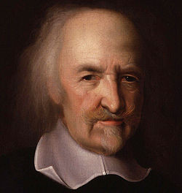
IDEAS OF GOVERNMENT
1. Thomas Hobbes, right, (1588-1679) English empirical philosopher
Favoured strong government through atheisitic Social Contract between King and state (as citizens);
2.Bishop Bosseut (1627-1704); Royal power derived from God, but with obligations - rule of law, property rights

Slide 9
THE THREE ESTATES
Competing authorities led to inefficient government throughout France, between: the generalities (divisions in the country by Royal decree); the landed estates (ran by the nobility); the parlements (law courts with censorship powers
Reform – generally blocked by the self interest of the nobility
1770s – growing conflict between the monarchy and parlements

Slide 10
THE THREE ESTATES
1. FIRST ESTATE – THE CLERGY: exempt from taxes; extensive land and property; influential through out society; social responsibility – alms, infirmaries, education.
Roman Catholic church split between: JANSENIST (doctrinally, ‘salvation by grace’); JESUIT (doctrinally, man a free agent, ‘salvation by effort’) – latter enjoyed influence in the French court

Slide 11
JANSENIST VS JESUIT
Split became increasingly politicised:
Jansenists asserted independence from Rome (Gallicanist)
Jesuits urged strong papal rule (Ultramontanist)
Jansenist growing popular stance gained support from parlements and eventually Royal approval (1764) for the suppression of the Jesuits
Both orders highly critical of Enlightenment thought and ideas.

Slide 12
THE THREE ESTATES
2. SECOND ESTATE – THE NOBILITY, grouped as: Noblesse d’Epee (Nobility of the sword – feudal, High Nobility), and Noblesse de Robe (new Nobility, evolved out of privilege)
Gradual blurring of both, but distinction between rich and poor nobility remained
Poor nobility strong in the provinces; rich nobility dominated the court and the salons (brushed with Enlightenment thinkers)
Paradox between those upholding privilege and those advocating reform and liberty

Slide 13
THE THREE ESTATES
3. THIRD ESTATE - ALL OTHER GROUPS; from Bourgeois to lowly peasant
Bourgeois – livelihood derived from commerce or property
Peasant France – largest group; generally free and emancipated – owned 40-50% of land; however, local seigneur claims on sales and commodities (the mill, bakery, oil press)
Peasant France fractured between landless and owner-occupiers; dogged by bad harvests, food shortage, riot and disorder, brigandage – but social stability remained solid due to family/neighbourhood ties

Slide 14

PART II – THE ENCYCLOPEDIE

Slide 15
DEFINITION
ENCYCLOPEDIE OU DICTIONNAIRE RAISONNE DES SCIENCES, DES ARTS, ET DES METIERS
‘A SYSTEMATIC DICTIONARY OF THE SCIENCES, ARTS, AND CRAFTS’
AIM: To promote a rational scientific reconstruction of knowledge and society;
To purvey and collect original works, views, theories, ideas.
To change the way people think

Slide 16
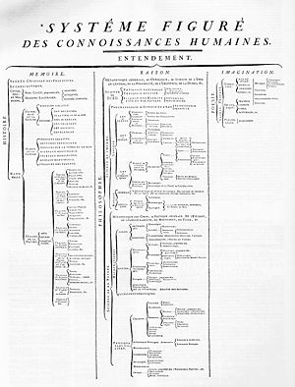
THE ENCYCLOPEDIE
Launched 1745
Published 1751-1772
17 volumes of text; 11 volumes of plates
18,000 pages; 75,000 entries;
20 million words;
4,250 copies produced

Slide 17
NATURE
Attracted ‘brothers in arms’ opposed to absolutism of Louis XV
Despite censors did not ‘go underground’ and paradoxically enjoyed Royal approval
Sub-divided into three ‘branches of knowledge – Memory/History; Reason/Philosophy (including religion); Imagination/Poetry
‘Knowledge of God’ placed near ‘Black Magic’, courting controversy
Theological issues on periphery – medieval classification set aside for one espousing scientific research

Slide 18
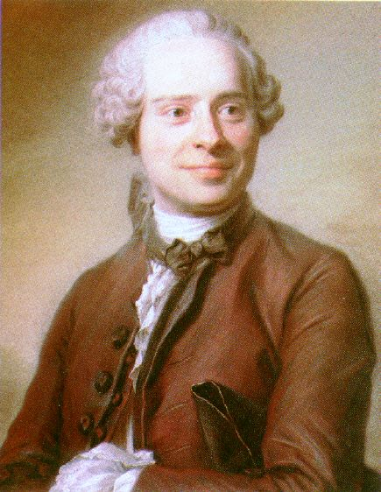
CENSORSHIP
1751 – Vol I with D’Alembert’s (pictured) Preliminary Discourses; Jesuits and Jansenists attack
1752 – first wave of censorship(instigated by the King); Madame Pompadour encourages continuation
By 1757 – censorship rife; atmosphere of repression

Slide 19
DEFIANCE!
Despite threats of imprisonment or worse, Diderot et al continued to work in Paris
Publications went through many trials and tribulations up to 1772 and completion
Proved a commercial success for publishers (but not contributors); work for 1000 engravers/binders/printers
Half the demand from outside France; cheaper editions extended readership – absence of copyright laws

Slide 20
CONTRIBUTORS
Enlightened and educated; philosophy and beliefs around:
Deism – knowledge attained through reason not revealed
Progressives – belief in scientific, technical, medical progress
Reform-minded – championed liberty and justice
Not necessarily democrats or egalitarians

Slide 21
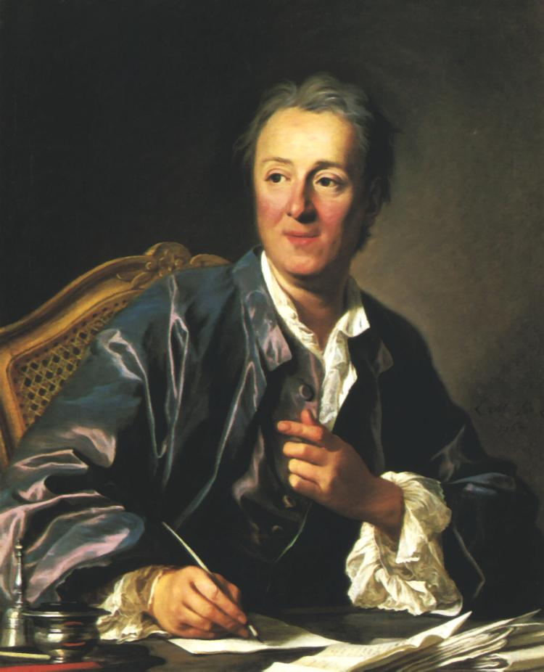
CONTRIBUTORS
DENIS DIDEROT (1713-84)
Regarded as most profound of all Enlightenment writers
Studied law after eschewing the priesthood
Prolific but cautious (many posthumous publications)

Slide 22
CONTRIBUTORS
Baron de Montesquieu (1689-1755) noble, political philosopher
Jean-Baptiste D’Alembert (1717-1783) mathematician and philosopher
Jean-Jacques Rousseau (1712-1778) writer and philosopher
Louis de Jaucourt (1704-1779) scholar, polymath
Francois Marie Arouet – Voltaire (1694-1778)

Slide 23
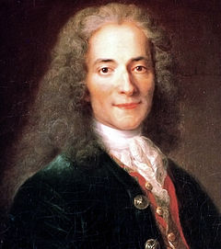
VOLTAIRE
Early recognition as talented writer; also censorship, imprisonment, exile (England 1726-9)
Tragedian – Oedipe (1718); Zaire (1732); Mahomet (1742)
Critique of Roman Catholic church – bigotry and intolerance

Slide 24
TIMELINE - VOLTAIRE
1725: dispute with local dignitary; imprisonment in Bastille; exile
1726-9 : exile in England; befriends Swift and Pope; admires constitutional monarchy and political/religious freedoms
1734: publishes Letters Concerning the English Nation – criticise French abuses, attracted more trouble
1744-50: avoids trouble by settling in the independent Duchy of Lorraine with mistress Emile

Slide 25
TIMELINE - VOLTAIRE
1744-50: forges links with French court; ambivalent relationship, critical but enjoyed patronage
1750-53: in Berlin under the patronage of Frederick the Great, but leaves under a cloud
1753: return to Paris denied, retreats to Geneva, Lausanne and finally Ferney; begins ‘country gentleman’ period (the Patriarch of Ferney)
1753 - works tirelessly, and keeps open house for visitors; contributes to Encyclopedie

Slide 26

CANDIDE (1759)
Most famous literary work of 18th century
Central premise: Critique of Optimism – ‘the bright side of life’ and philosophical optimism ‘the best of possible worlds’
Vehicle: allegory and savage irony

Slide 27
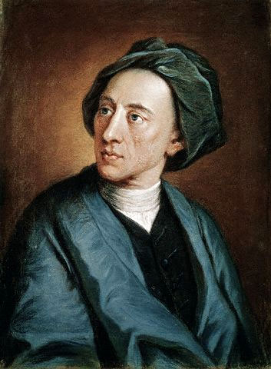
BEST OF POSSIBLE WORLDS
Alexander Pope (1687-1744) Essay on Man (1732-4): Theodicy:- God is omnipotent, omniscient, omni-benevolent ,despite pain and oppression, because he created ‘the best possible’

Slide 28
POPE contd...
Man’s limited knowledge precludes the whole picture – ‘the scheme of things’ if known to man would show evil things as good!
Optimism at the general order of things, including human nature
Human nature = Harmony; Passions curbed by reason; inequalities compensated (pauper blessed with hope; wealthy dogged by fear (of robbery)
Health and peace through moderation and virtue

Slide 29
VOLTAIRE ON OPTIMISM
Critique developed gradually, including the concept of providence (pre-ordained will of God)
Optimism useless to those in real distress; 1749-59 private and public events convinced him that optimism unviable
Private: 1749 Emile died in childbirth
Public: 1755 Lisbon Earthquake – huge loss of life, city destroyed, and:
Conflict: the Seven Years War 1756-63

Slide 30
SEVEN YEARS WAR
All major powers involved; two camps: (1) Britain, Prussia, Brunswick, Portugal; (2) Austria, France, Russia, Sweden, Spain
Casualties: 900,000 – 1.5 million!
French dominance of Europe curtailed; Britain emerged as dominant colonial power; reflection of the internal financial structures; Britain through East India Company dominate trade to India

Slide 31
REASONS FOR WAR
Hangover from ‘War of Austrian Succession’ (1740-48); Austria rearmed and hoped to reverse Prussian gains in Silesia
Austria forging alliances with France and Russia
Hanoverian lands threatened by France
Prussian-British alliance = strongest sea power focussed on colonies; land power on Europe
Heated colonial struggle between France and Britain

Slide 32
THEATRES
1. North America – clash between British westward expansion and French concerns in Mississippi and Pennsylvania (latter heavily fortified by France; hegemony in Canada)
2. French and British concerns in the Mediterranean; Caribbean; India
3. Threat of invasion – activity in the Channel and along the French coast
But in respect of Voltaire and his critique of optimism, the war = a European affair

Slide 33
EUROPEAN THEATRE
Prussia surrounded by France, Russia and Austria
Frederick II takes the initiative by invading Saxony and Bohemia; Russia invades East Prussia; France invades German lands
Prussians repulse enemy on all sides – Frederick’s reputation as military commander enhanced
1758 – standstill in Europe on all sides

Slide 34
EUROPEAN THEATRE
1759-60: Prussia lose initiative; Berlin occupied in October 1760 by Russians and Austrians; Prussia recovers but threat remains
1762: turning point, Peter III new Tsar (Prusso-phile); Russian troops withdraw and sue for peace; Frederick repulse Austrians from Silesia
1763: Peace of Paris between Britain and France; Treaty of Hubertusberg – pre-war status quo maintained, Prussia keep Silesia
Prussia had repulsed three powerful neighbours; her reputation grew as most powerful German state

Slide 35
CANDIDE contd...
Voltaire saw the devastation of German lands as the work of man (unlike Lisbon)
Response was Candide as a vehicle for ‘Freewill’ to solve evil i.e. God cannot on one hand allow ‘freewill’ while also prevent wrong doing
A world with freewill is better than one without

Slide 36
CANDIDE
Fast moving and irreverent
Candide’s misadventures with Pangloss; New World adventures with Cacambo; returns to Europe a wealthy man but witnesses suffering
Philosophy centred around John Locke’s (1632-1704) ‘Tabula Rasa’ (Blank Sheet); Candide is free of ideas but ready to learn through empirical research and experience; gradually fills the blank sheet
Initially he follows optimism of Pangloss but then:

Slide 37
CANDIDE AND CYNICISM
Eldorado and the mutilated negro slave – Candide questions Pangloss optimism
Seven years war; Lisbon earthquake; The Inquisition; Jesuit regime in Paraguay; execution of Admiral Byng over the loss of Minorca to the French (Voltaire pleaded for clemency)
Targets: Optimism; organised religion of all denominations; brutality of war – Frederick’s expansionist policy (although he was first to read a copy!); treatment of women (Cunegond’s suffering and resilience); Parisian society and the aristocracy; even Rousseau’s ‘noble savage’.

Slide 38
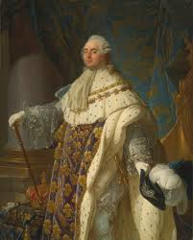
Louis XVI

Slide 39
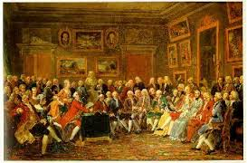
Salons

Slide 40
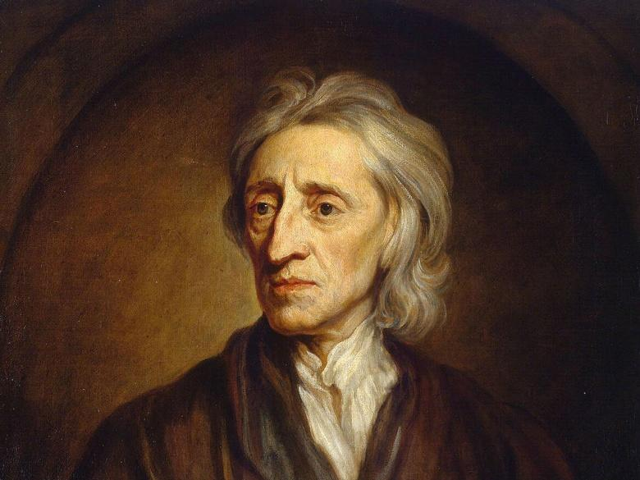
John Locke 1632-1704

