Slide 1
Module Title: Professional Career Development within H&SC
Module Number: LCHS 4009 (LON)
Assignment No: ASSIGNMENT 1
Student Name: Cathy Salumu
Student ID: 2441715
Lecturer’s Name: Odette Jack

Slide 2
Acknowledge use of AI
On this page state whether you have or have not used AI. Include the AI source if you have!

Slide 3
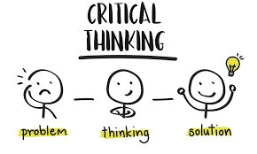
Introduction
This presentation is to address the topic of the significance of communication in health and social care.
The following presentation will also define communication, state why it is relevant in healthcare, present a model which supports its usage and offer, in practical terms, an example of its application in practice.
Notes:
This presentation is to address the topic of the significance of communication in health and social care. The following presentation will also define communication, state why it is relevant in healthcare, present a model which supports its usage and offer, in practical terms, an example of its application in practice.

Slide 4

Communication
What is communication?
Definition: Communication is a skill of conveying ideas effectively, logically, and cohesively about what to believe or what to do. (O'Toole, 2024).
Everyday Practice:
Communication in everyday life is the process of conveying assumptions, analysing information in different ways, and making evidence-based decisions and solutions to problems.
Applicability in Health and Social Care:
Communication plays an essential role in healthcare, as it makes sure that professionals analyse the situation carefully, do not commit mistakes, and make decisions that focus on the patient and his or her health, contributing to improved care quality.
Notes:
What is communication?
Definition: Communication is a skill of conveying ideas effectively, logically, and cohesively about what to believe or what to do. (Paul and Elder, 2014).
Everyday Practice:
Communication in everyday life is the process of conveying assumptions, analysing information in different ways, and making evidence-based decisions and solutions to problems.
Applicability in Health and Social Care:
Communication plays an essential role in healthcare, as it makes sure that professionals analyse the situation carefully, do not commit mistakes, and make decisions that focus on the patient and his or her health, contributing to improved care quality.

Slide 5

Importance of communication in professional practice
What is the significance of this skill for healthcare workers?
Promotes Effective and Safe Care (O'Toole,2024)
Achieves Good Quality Outcomes:
Real-World Example:
Within the emergency room environment, communication assists healthcare providers in evaluating symptoms in a fast manner, eliminating diagnoses, and selecting the right treatment plan that will lead to effective and timely care.
Notes:
What is the significance of this skill for healthcare workers?
Promotes Effective and Safe Care (Hadley and Boon, 2022)
Achieves Good Quality Outcomes:
Real-World Example:
Within the emergency room environment, communication assists healthcare providers in evaluating symptoms in a fast manner, eliminating diagnoses, and selecting the right treatment plan that will lead to effective and timely care.

Slide 6
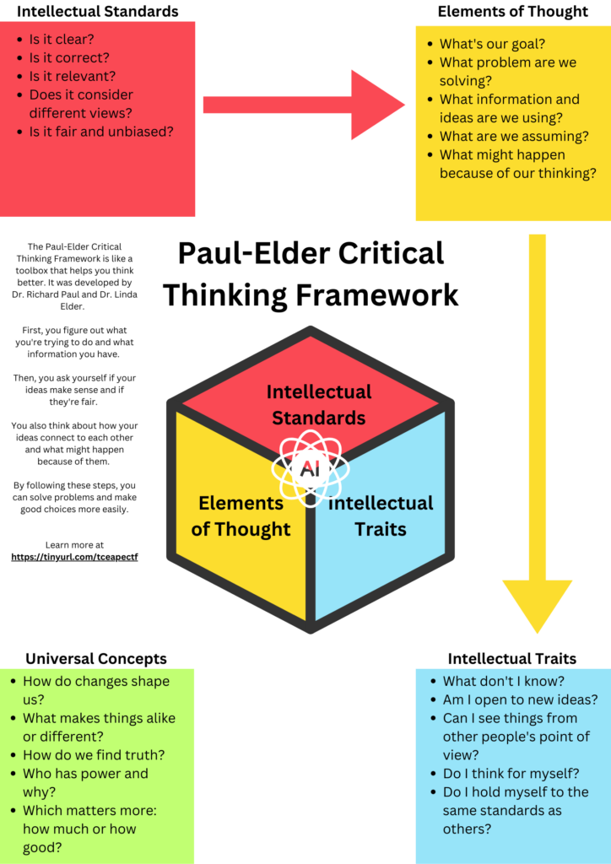
Framework or Model that is associated with communication
Framework: The Paul-Elder communication Framework.
Overview:
This model focuses on the growth of intellectual standards and skills, which are useful in the analysis and evaluation of information by professionals.
Key Stages:
Clarity: Making sure that the problem or situation is well understood.
People: Checking the facts and then making a decision (Al-Worafi,2023).
Relevance: The information utilised has to be relevant to the problem under consideration.
Depth: This involves taking into account the depth of the situation, given the complexity of the situation.
Application in Practice:
In medical practice, this model assists practitioners in addressing issues methodically. T
Notes:
Framework: The Paul-Elder communication Framework.
Overview:
This model focuses on the growth of intellectual standards and skills, which are useful in the analysis and evaluation of information by professionals.
Key Stages:
Clarity: Making sure that the problem or situation is well understood.
People: Checking the facts and then making a decision (Facione, 2021).
Relevance: The information utilised has to be relevant to the problem under consideration.
Depth: This involves taking into account the depth of the situation, given the complexity of the situation.
Application in Practice:
In medical practice, this model assists practitioners in addressing issues methodically. T

Slide 7
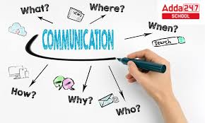
Communication Into Practice.
Communication in the Health and Social Care: An example.
Job Position: ICU Registered Nurse.
Case: A patient has shown up with confusion, difficulty breathing, and dizziness, who is critically ill.
The application of Communication:
Evaluation: The nurse gathers the appropriate information, including medical history, vital signs and lab data (Zhang et al.,2025).
Decision-Making: The nurse makes a judgment based on the Paul-Elder framework that requires a situation to be evaluated, all potential causes should be considered, and the most probable diagnosis has to be given priority.
Impact on Care: Communication will result in proper diagnosis, which guarantees the timely treatment and enhances the chances of patients recovering.
Notes:
communication into Practice.
communication in the Health and Social Care: An example.
Job Position: ICU Registered Nurse.
Case: A patient has shown up with confusion, difficulty breathing, and dizziness, who is critically ill.
The application of communication:
Evaluation: The nurse gathers the appropriate information, including medical history, vital signs and lab data (Ask and Søraa, 2023).
Decision-Making: The nurse makes a judgment based on the Paul-Elder framework that requires a situation to be evaluated, all potential causes should be considered, and the most probable diagnosis has to be given priority.
Impact on Care: communication will result in proper diagnosis, which guarantees the timely treatment and enhances the chances of patients recovering.

Slide 8

The role of communication in my future career.
What is the importance of Communication to My Career?
Employability:
Since I am interested in healthcare, Communication will help me make better decisions and provide better patient care, improve collaboration, and become a leader in a healthcare facility (Kumar et al, 2023).
Strengths and Areas of Development: My strengths in this respect are Communication, which I will enhance by practising and learning more in this area.

Slide 9
Conclusion
To sum up, communication is a necessary competence in health and social care. It helps healthcare managers to make knowledgeable and logical judgments that put patient safety first, improve the quality of care, and are associated with favourable results.

Slide 10
References List
Al-Worafi, Y. M. (Ed.). (2023). Comprehensive healthcare simulation: Pharmacy education, practice and research. Springer Nature.
Kumar, R., Jain, V., Han, G. T. W., and Touzene, A. (Eds.). (2023). Immersive virtual and augmented reality in healthcare: an IoT and blockchain perspective. CRC Press.
O'Toole, G. (2024). Communication-E-Book: Core Interpersonal Skills for Healthcare Professionals. Elsevier Health Sciences.
Zhang, J., Lu, W., Xing, C., Zhao, N., Al-Dhahir, N., Karagiannidis, G. K., and Yang, X. (2025). Intelligent integrated sensing and communication: A survey. Science China Information Sciences, 68(3), 131301.

