Slide 1

Pyrotechnics
Sam, Josh and Stan

Slide 2
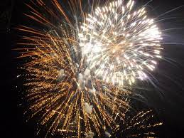
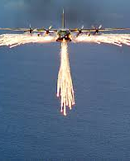
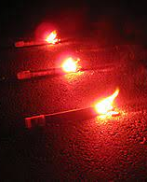
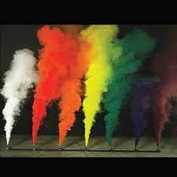
What are pyrotechnics?
Translated from Greek it means the art of fire.
Compositions are designed to release smoke, light, heat and noise, dependent on their application.
Compared to explosives and propellants, they react at a slower rate as their effects are visible

Slide 3
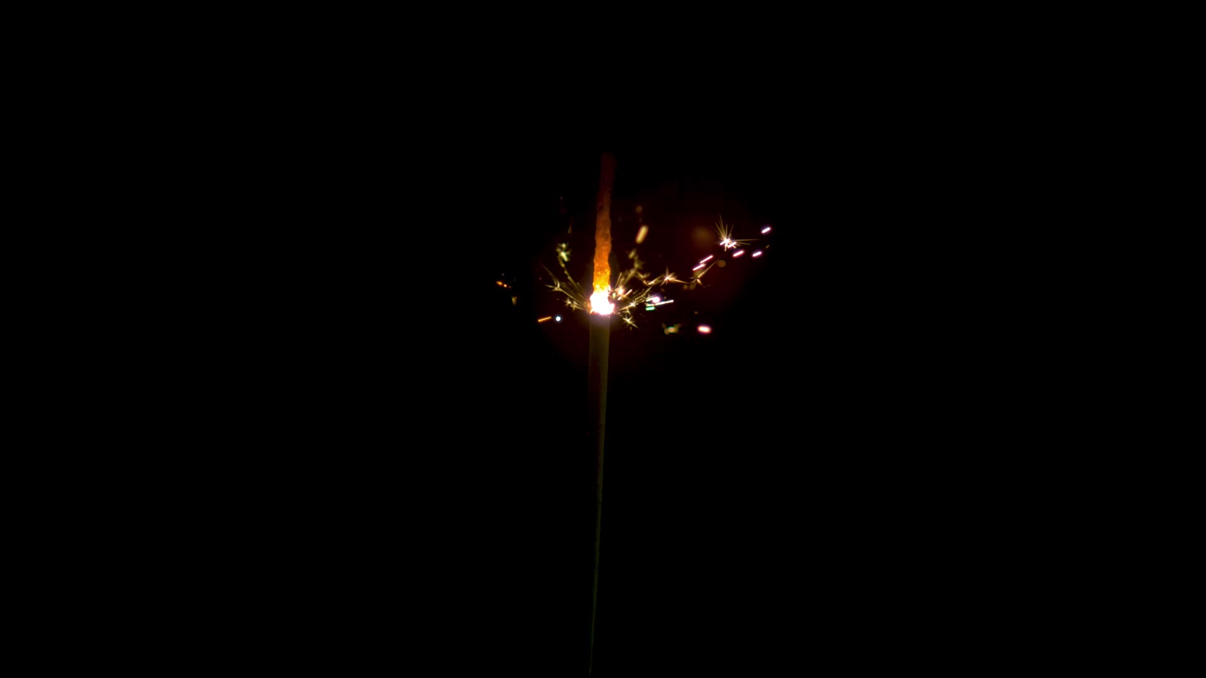
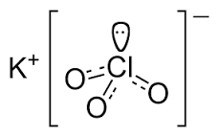
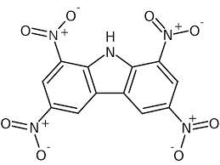
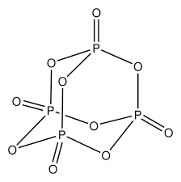
Types of pyrotechnic compositions
Fe₂O_{3(s)} + 2 Al → 2 Fe_{(l)} + Al₂0_{3(s)}
∆H = -850 kJ
Thermite
Potassium chlorate
Primer composition
2n Mg + (C₂F₄)_{n} → 2n MgF_{2(s)} + 2n C
∆H = -1438 kJ/mol
MTV
Tetranitrocarbazole + Potassium nitrate
Delay composition
Phosphorus pentoxide
White smoke

Slide 4
Effects
Effect | Military application | Chemical Composition
Heat | Incendiary ammunition | Zirconium/crepe rubber
Illumination | Illuminating Flare | Magnesium/sodium nitrate (NaNO3)/resin (binder)
Flame | Rocket Ignitor | Boron/KNO3/binder
I.R. Decoy | Anti-heat seeking weaponry | Magnesium/Teflon/Viton
Smoke | Visual obscuration | Red phosphorous/KNO3/resin
Sound | Distraction | -
Delay | Delay of effect | Barium chromate (BaCrO4)/antimony trisulfide/potassium perchlorate

Slide 5
Factors
Stoichiometry
Particle size
Avoiding material degradation during storage

Slide 6
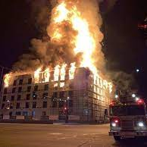
Storage

Slide 7

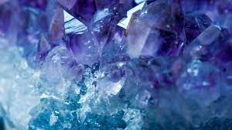
Pyrotechnics Safety
Pyrophoric Zr
Thermite
AlFe₂O₃
Explosives Reg 2014
Pyrotechnic safety articles regulations 2015
Fireworks regulations 2004

Slide 8


Thank You

