Slide 1
Mechanical Design and Materials
Dr. Alastair Clarke
alastair.clarke@smu.ac.uk

Slide 2
Overview
Drawings & Tolerances
Fits
Thread Systems
Fasteners
    Threaded Fasteners
    Welding
    Circlips etc
Materials
Design Principles
    Manufacturability
    Single and Double Shear
    Designing for Fatigue

Slide 3
Drawings & Tolerances
Drawings need:
  Material – just to put steel is not enough!!
  Specific and general tolerances
      Tolerances = cost of part
  Sensible dimensions
      e.g. not 12.873mm
  All the information required to make the part correctly
      Hole information – is a hole tapped, reamed, drilled etc?
      Any secondary views or cross sections needed to fully define the component
Drawn to British Standards for engineering drawing

Slide 4
Drawings & Tolerances
General Tolerance
  Applied to dimensions where no specific tolerance is shown
  +/- 0.25mm for machined components
  Drawing must be annotated to show general tolerance
Specific tolerance for parts which require better than the general tolerance
  Shown as part of the dimension

Slide 5
Drawings & Tolerances
Dimension plus bilateral tolerance
    25.50 ± 0.08
Dimension plus unilateral tolerance
    67.40
Upper and Lower Limits
    i.e.
+ 0.12
- 0.00
35.76
35.56

Slide 6
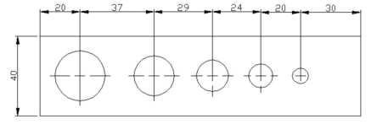
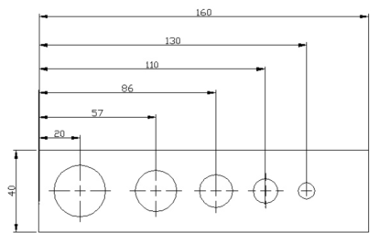
Drawings & Tolerances
General Tolerance = 0.25mm
X
Distance X could be out by up to 1.25mm or 0.25mm depending on how dimensions are drawn – consider which dimensions are important and dimension accordingly
X

Slide 7
Fits
The shaft and hole is a common design problem
  e.g. bearings, location pins, pegs, spindles
  May require
    tight fit for location
    loose fit for ease of assembly
ISO system of limits and fits gives recommended tolerances (BS 4500)
  Gives deviation by which hole may be larger than the nominal size and deviation by which shaft may be smaller than nominal size
  e.g. H7-h6
  H7 is holes tolerance, h6 is shaft tolerance
  Allocates largest part of tolerance to hole

Slide 8
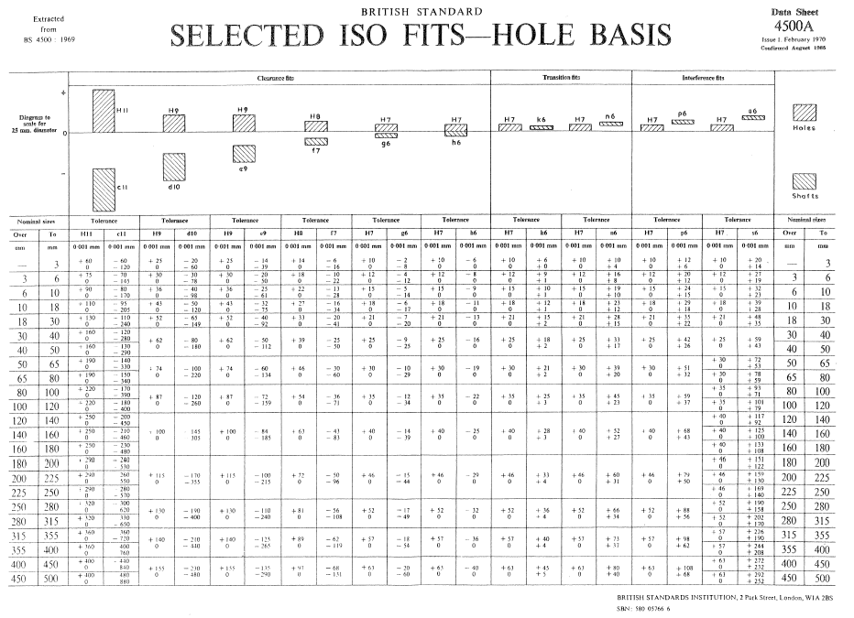

Slide 9
Fits
Easy Running Fit
  H11-c11, H9-d10, H9-e9
  Where significant clearance is required, e.g. for ease of assembly
Close Running Fit
  H8-f7, H8-g6
  Small amount of clearance, e.g. for sliding spigot fits
Sliding Fit
  H7-h6
  Locational fit where close fitting items slide together
  Can still be freely assembled & disassembled
Push Fit
  H7-k6
  Accurate location – e.g. dowel pins

Slide 10
Fits
Drive Fit
  H7-n6
  Tighter than Push Fit – may require pressing together
Light Press Fit
  H7-p6
  For permanent, accurate assembly
  Parts need pressing together, but doesn’t overstress hole
Press Fit
  H7-s6
  Tightest practical fit – e.g. for bearing bushes
Shrink Fits – not usually required

Slide 11
Fits
Most of the hole fits we will be using are H7
A reamed hole meets this tolerance
The plain shank of a socket screw will locate accurately into a reamed hole
Annotate drawing to specify reamed hole

Slide 12
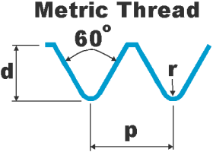
Thread Systems
What is Metric Coarse, UNF, UNC???
All terms you will hear in FS work
Different types of thread

Slide 13
Imperial Thread Systems
The two common types in FS work are
    UNC – Unified Coarse thread
      Most commonly used
      Avoids stripping threads when bolting into softer materials
    UNF – Unified Fine thread
      Bolt made with UNF thread has greater tensile strength than same diameter bolt with UNC thread
      Also used if screwing into thin materials
Specified by bolt diameter and thread eg.
    ¼”-20 UNF = ¼” diameter, with a unified fine thread, which has 20 teeth per inch
    Tables of threads in Zeus book etc.

Slide 14
Metric Thread Systems
Again, two series in common use
    Metric Fine
    Metric Coarse
    Similar advantages/uses as UNF and UNC
Specified by diameter and pitch
    i.e. M12 x 1.75 is 12mm diameter, with a 1.75mm pitch thread
    if pitch is not specified, then the coarse series is assumed
    Table of threads on handout

Slide 15
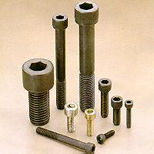
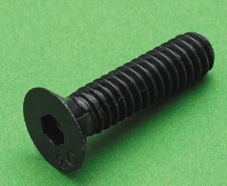
Fasteners
Socket Head Cap Screws
Suitable for all high tensile applications
Smaller head than hex head bolts
Also in low head version
Countersunk Socket Head Screws
Use where bolt head cannot project above surface
Taper gives large contact area under head

Slide 16
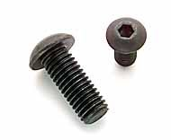
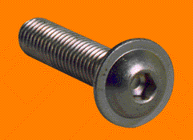
Fasteners
Button Head Screws
Low profile head
Use in materials too thin to countersink
Flange Button Head Screws
Use to cover large diameter holes in thin metal
Spreads load on softer materials

Slide 17
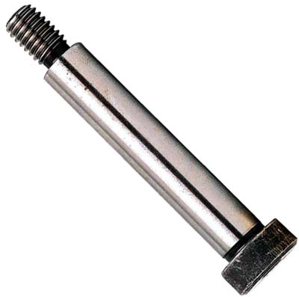
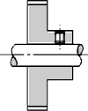
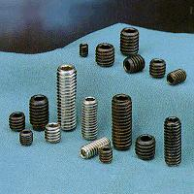
Fasteners
Shoulder Screws
Ground shank
Use for pivots, accurate location etc.
Socket Set Screws
a.k.a. “Grub Screws”
Fasten collars, sleeves, gears, knobs etc on shafts.
Locate machine parts

Slide 18
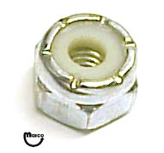
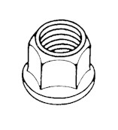
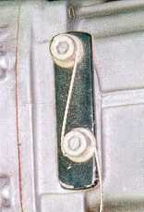
Fasteners
Locking of threaded fasteners
  Nylock nuts
  K nuts
  Lock nut
  Lock-wiring

Slide 19
Fasteners
DESIGN TABLES
Unbrako Technical Brochure
0247 658 5050
www.spstech.com
unbrako.uk@spstech.com

Slide 20
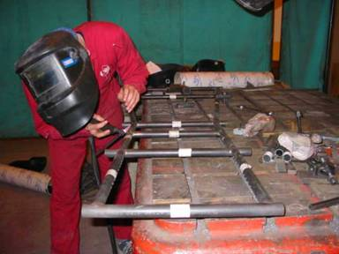
Welding
2 main types of welding are relevant to our work:
      MIG (Metal Inert Gas)
      TIG (Tungsten Inert Gas)

Slide 21
TIG Welding
Generates heat by arc struck between non-consumable tungsten electrode and workpiece
Filler rod can be added to molten puddle
Very clean, high quality welds
  Shielded by inert gas (argon)
  No flux – slag inclusions less likely
  Less porosity – slow process, so impurities have time to escape from molten puddle
Very narrow HAZ – less distortion, cracking etc
Needs clean surface, well fitting parts
Relatively slow process
Can weld aluminium (with square wave set)

Slide 22
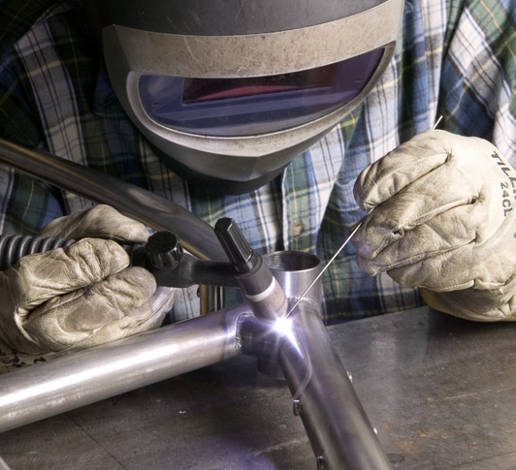
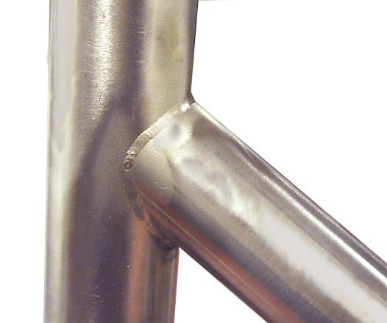
TIG Welding

Slide 23
MIG Welding
Generates heat by arc struck between consumable wire-fed electrode and workpiece
Quick process, easier than TIG
Requires less accurate weld preparation than TIG
Spatter thrown off from arc
Possible to produce good looking weld but with little penetration – not obvious until failure!
Bigger HAZ, but quick speed can limit distortion
Build up of metal usually occurs due to constant electrode feed requiring post-welding machining or grinding

Slide 24
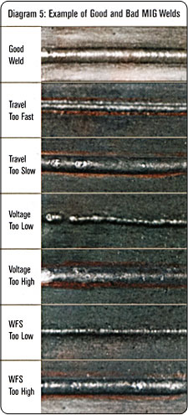
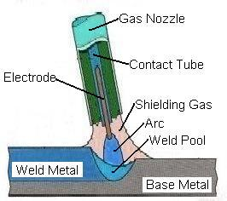
MIG Welding

Slide 25
Other assembly methods
Press or push fits
Bolted
Riveted
Glued (Loctite), i.e. Bearings
Pinned
  Roll pins, dowel pins etc
Circlips/Spring Clips
  Avoid placing circlip groove in stressed areas
  Design groove “by the book”
      Cirteq Technical Manual
      www.cirteq.com
      sales@cirteq.com 01535 633333

Slide 26
Automotive Materials
Correct choice of materials can
    Save weight
    Improve component performance (e.g. fatigue)
    Reduce failures
    Improve ease of manufacture
    Allow use of heat treatment or surface protection
Three main classes of interest
    Steels
    Aluminium Alloys
    Composites
FIA document – “Recommended Materials”

Slide 27
Steels
Machined Components
  EN1A – Free Cutting Mild Steel
      Yield Strength = 215 MPa
      Low carbon mild steel
      Use in lowly stressed applications
      Cheap, easy to machine
  EN16T – free cutting medium carbon
      Yield Strength = 700 MPa
      Medium strength machined parts
      Shafts, crankshafts, con rods etc

Slide 28
Steels
Machined Components
  EN24T – High Strength Alloy Steel
    Heat treat to wide range of strengths
    Yield Strength = 650 Mpa
    Use for high strength components
    Good in reversed stress cycles
    Equivalent to SAE 4340 (see Carroll Smith – “Engineer to Win”)
  VAR 300M – through hardening steel
    High strength machined components, i.e. axles, drive shafts etc
    Awkward to machine
    Yield Strength = 1670 MPa

Slide 29
Steels
Machined Components
  EN36C – Carburising Steel
    can be case hardened to give hard surface with tough core – gears, drive shafts etc.
    Yield Strength = 950 MPa

Slide 30
Steels
Fabricated Components
  SAE 4130
    Use for stressed steel fabrications, e.g. fabricated uprights, wishbones
    Must heat treat to obtain required properties
    Yield Strength = 830 MPa when heat treated
  SAE 1020
    Use for less stressed structures
    Yield Strength = 350 MPa
  T45 tube
    Ideal for wishbones, roll cages etc
    Minimum Yield Strength = 620 MPa
    No heat treatment needed to obtain these properties

Slide 31
Aluminium Alloys
  2014 A T6
    High strength alloy
    Suitable for general machined components
    Yield Strength = 420 MPa
  5251 H3
    For fabrications
    eg radiator tanks and swirl pots

Slide 32
Aluminium Alloys
  6082 T6
    Suitable for medium strength applications
    e.g. wheel rims
    Yield Strength = 270 MPa
  7075 T6
    Very high strength – highly stressed parts
    Yield Strength = 505 MPa
  www.matweb.com

Slide 33
Design Principles
Manufacturability
  Can a part be made easily and cost effectively
    In the university?
    By an external company or sponsor?
  Consider manufacturing methods
  Consult technicians / advisors if you’re unsure
Factor of safety
  Varies for different parts
  Typically FOS > 2

Slide 34
Design Principles
Single and Double Shear mountings
  Double Shear = Good
  Reduces shear stress on bolt

Slide 35
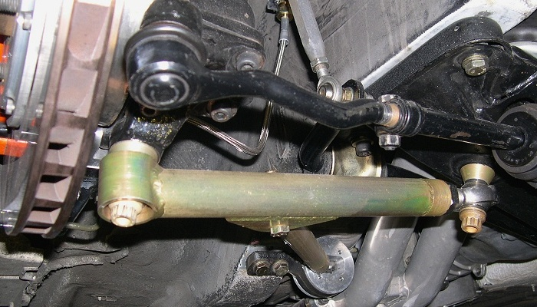
Design Principles
Single and double shear mountings
  Single Shear = Bad
  Increases stress on bolt

Slide 36
Designing for Fatigue
Loads on car are fluctuating (due to acceleration, braking, cornering etc)
Fatigue must be considered
S-N curves, Endurance Limits etc. covered in Materials
Fatigue cracks originate at stress raisers

Slide 37
Designing for Fatigue
Typical Stress Raisers
    Poor surface finish
    Holes
    Abrupt change of section
    Sharp edges
    Grooves in stressed sections
    Corrosion

Slide 38



Designing for Fatigue
Typical Stress Concentration Factors
Sharp Corner
Medium Radius
Large Radius
K=3.9
K=1.6
K=1.1
Bearing Shoulders
Bad
Better
Good

Slide 39
Designing for Fatigue
Reference
Carroll Smith, “Engineer to Win”
Chapter 7: Metal Fatigue – or why things break”

Slide 40
Conclusions
Think carefully when designing parts
Consider manufacturability
Talk to the technicians, fellow students & advisors
If in doubt – ASK!

