Slide 1
End of life care support
Presentation by Parisle Edwards 2010405
BSc health and social care
Living with care: the older person
Joanne Davies
Component 1

Slide 2
What is end of life care?
For people who are in the last months or years of their life.
Making your last days as comfortable as possible and dying with dignity.
People providing your care should ask about your wishes and preferences.
You can express where you would like your end of life care.
Care home
Hospice
In the hospital
In your own home
NHS, 2023

Slide 3
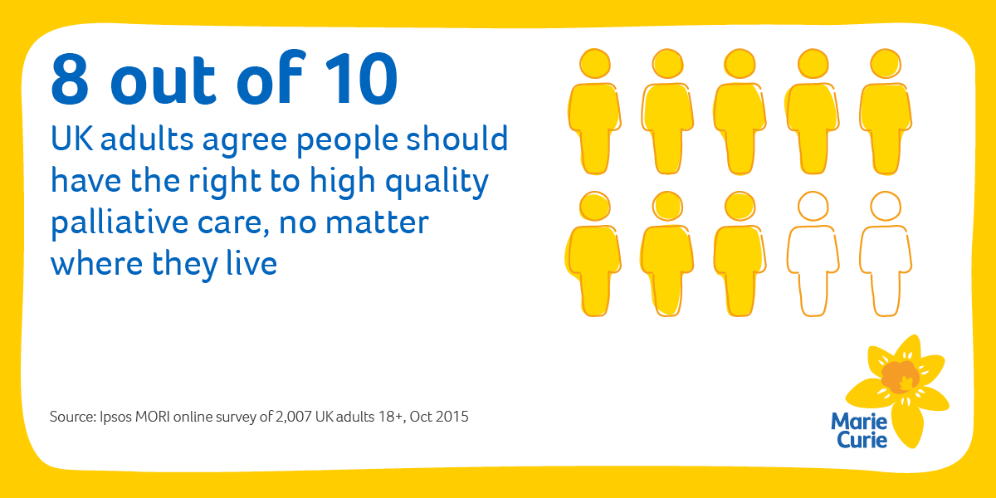
Palliative care
Specialised medical care for people living with serious illness such as cancer or heart failure.
Will receive medical care for their symptoms or palliative care along with treatment intended to cure their serious illness.
Improving the quality of life of anyone facing a life threatening condition.
Emotional, physical and spiritual care.

Slide 4
Support and care in different settings.
Care home – trained staff will be able and available to look after you day and night.
Hospice– focuses on comfort and quality of life of a person with a serious illness. (NIH, 2021)
Own home – go can arrange for community nursery’s to come to your home and provide care there, also can have regular cares provided by family members or yourself. (NHS, 2021).
Hospital care – nine in ten people use urgent care services such as attending A&E and almost as many use planned hospital care, such as outpatient. (The Nuffield trust, 2022).

Slide 5
Needs and availability of end of life care
The demand for hospice and palliative care is growing as a result of the increase of ageing population. Klinger (2020).
This a lack of trained health care professionals and resources, more of a support for unpaid carers.
Palliative and end of life care is a neglected global health issue, while palliative care is increasingly recognised as a human right, it is estimated that just 14% of the people who need palliative care globally receive it.( BMC palliative care, 2021).
Lack of recourse and lack of training and education on the matter.

Slide 6
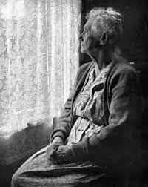
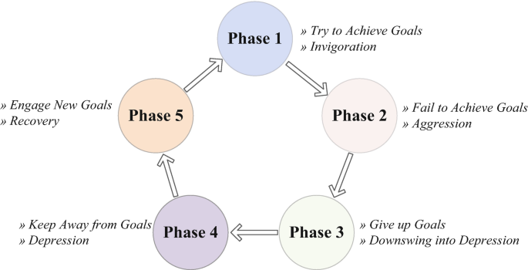
Disengagement theory
This theory claims that it is natural and acceptable for older adults to withdraw from society and personal relationships as they age. Disengagement theory was the first theory of ageing development by social scientists. (Libre texts social scientists, 2021).

Slide 7
Acts and legislations
The human rights at 1998 imposes an obligation to facilitate a good death the ability to diagnose dying and by overcoming identifiable hurdles. 1998 the act has several important implications. (Thebmj, 2011).
Compassion and dignity.
Right to life.
Freedom from torture and inhuman or degrading treatment.
The care act – to ensure that health partners work together to create an integrated approach to care and support. New rights to support for carers.(city of York council, 2014).

Slide 8
Living wills and DNR’
Everyone has a right to a living will and plan which sort of care they would like to receive in their last days, its put in place if there came a time when the person is unable to make or communicate their decisions. (Age uk, 2022).
Allows to refuse treatment.
Legally binding carers must follow your instructions.
A DNR is setup before and emergency occurs, allows you to choose whether or not you want CPR in an emergency. It does not have other instructions for giving medication. (MedlinePlus, 2020).
Giving and elder person CPR could actually make things worse so the elder person and their support system would need to discuss options whether a DNR should be put in place or not.
Talk about the pros and cons with doctors.

Slide 9

Euthanasia
Both euthanasia and assisted suicide are illegal under English law. (NHS, 2020).
The painless killing of a patient suffering from an incurable and painful disease or in irreversible coma. (Dictionary, no date).
Euthanasia is legal in Belgium, the Netherlands and Luxembourg. (European Parliament, 2017).
A lot of people from around the world suffering from incurable disease feel like they have run out of option and will travel to a country where euthanasia is legal to have the painless procedure done.
Forms of euthanasia – active and passive euthanasia, voluntary and involuntary euthanasia, indirect euthanasia, assisted suicide. (BBC, 2014).

Slide 10
Arguments for and against euthanasia
FOR:
We need it! Allowing dying with dignity.
We want it! Patient has a right to choose when to die.
We can control it! Assisted suicide can be safely regulated.
Against:
Alternative treatments are available! We do not need to kill the patient to kill the symptoms.
There is no right to be killed and the slipper slope of assisted suicide is real! By giving doctors the power to decide when a patients life is worth it or not.
We could never truly control it! Doctors don’t always report cases.

Slide 11
Recommendations
End of life care recommendations.
Be present and be involved with the dying person, if you’re a carer get to know them, get to know their likes and interest to make them the most comfortable, where possible ask them about their past life and any accomplishments so they can reminisce on their old life as its coming to and end.
Provide physical contact.
Set a comfortable mood.
Play music or their favourite film or show (NIH, 2017).

Slide 12
CONCLUSION
End of life care is given to the older generation who have a terminal illness or just old, any person coming towards end of life has many options from the choice of living wills and DNRS euthanasia.
Palliative care focuses more on the elderly with illness. When the end of life care the person can decide where they would like to die wether that’ll be a home, care home or hospital, they have a choice, protected by human rights act and care act.
The human rights act protects the elderly with these type of decision making as they should be ensured to have a “good death”.

Slide 13
Reference list
BMC palliative care (2021)
Priorities and opportunities for palliative and end of life care in United Kingdom health polices: a national documentary analysis
Available at: https://bmcpalliatcare.biomedcentral.com/articles/10.1186/s12904-021-00802-6
(Accessed: 1st march 2023)
National institute on aging what are palliative care and hospice care (2021)
End of life
Available at:https://www.nia.nih.gov/health/what-are-palliative-care-and-hospice-care
(Accessed: 1st march 2023)
NHS (2021)
Care in a care home
Available at:https://www.nhs.uk/conditions/end-of-life-care/care-in-a-care-home/
(Accessed: 28th February 2023)
NHS (2022)
What end of life care involves
Available at: https://www.nhs.uk/conditions/end-of-life-care/what-it-involves-and-when-it-starts/
(Accessed: 1st march 2023)
Christopher A. Klinger, (2020)
Gaps in hospice and palliative care research
Available at:https://www.ncbi.nlm.nih.gov/pmc/articles/PMC7661142/
(Accessed: 27th February 2023)
The Bmj (2011)
A good death is possible in the NHS
Available at: https://www.bmj.com/rapid-response/2011/10/29/human-rights-act-1998-imposes-obligation-facilitate-good-death
(Accessed: 2nd march 2023)
The Nuffield trust (2022)
End of life care: what it is, how is it provided, and what are the challenges?
Available at:https://www.nuffieldtrust.org.uk/resource/end-of-life-care-explained-what-is-it-how-is-it-provided-and-what-are-the-challenges
(Accessed: 2nd march 2023)

Slide 14
Reference list
Assisted suicide (2023)
Arguments for and against suicide and euthanasia
Available at: https://care.org.uk/cause/assisted-suicide/arguments-for-and-against-assisted-suicide-and-euthanasia
(Accessed 26th February 2023)
City of York council (2023)
The care act 2014
Available at: https://www.york.gov.uk/CareAct
(Accessed: 27th February 2023)
Each other (2017)
Why human rights are essential to end of life care
Available at: https://eachother.org.uk/human-rights-approach-essential-end-life-care/
(Accessed 1st march 2023)
European Parliament (2017)
Euthanasia cares in Europe: increasing Eu support or sick people and their families.
Available at: https://www.europarl.europa.eu/doceo/document/E-8-2017-001484_EN.html
(Accessed: 26th February 2023)
Libre texted social scientists (2021)
Disengagement theory
Available at: https://socialsci.libretexts.org/Bookshelves/Sociology/Introduction_to_Sociology/Book%3A_Sociology_(Boundless)/18%3A_Aging/18.03%3A_The_Functionalist_Perspective_on_Aging/18.3A%3A_Disengagement_Theory
(Accessed 26th February 2023)
MedlinePlus (2020)
Do-not-resuscitate order
Available at: https://medlineplus.gov/ency/patientinstructions/000473.htm
(Accessed: 2nd march 2023)
NHS ( 2020)
Euthanasia and assisted suicide
Available at: https://www.nhs.uk/conditions/euthanasia-and-assisted-suicide/
(Accessed 26th February 2023)

Slide 15
REFERENCE LIST
BBC (2014)
Forms of euthanasia
https://www.bbc.co.uk/ethics/euthanasia/overview/forms.shtml
(Accessed: 2nd march 2023)
Marie curie (2015)
Palliative care debate in the House of Lords – what could it mean?
Available at: https://www.mariecurie.org.uk/blog/palliative-care-debate/51956
(Accessed: 2nd march 2023)
National institute on ageing (17th November 2022)
Providing care and comfort at the end of life
https://www.nia.nih.gov/health/providing-comfort-end-life
(Accessed: 1st march 2023)
Springer link (2019)
Disengagement theory
Available at: https://link.springer.com/referenceworkentry/10.1007/978-3-319-69892-2_645-1
(Accessed 1st march 2023)
The MSAG (2019)
Ethics questions asked at medical interviews – euthanasia
Available at:https://themsag.com/blogs/medical-school-interviews/ethics-questions-asked-at-medical-interviews-euthanasia
(Accessed: 2nd march 2023)
Wikipedia (2022)
Disengagement theory
Available at: https://en.wikipedia.org/wiki/Disengagement_theory
(Accessed: 2nd march 202)

