Slide 1
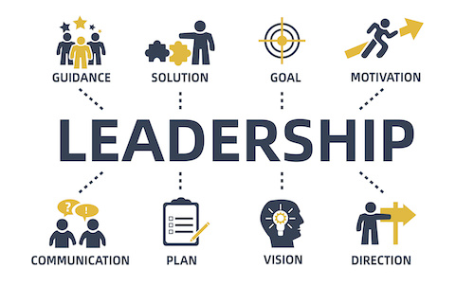


HPGC7002 Empowerment & Leadership
Theme 3: Schwartz and Communication Ethics
Ken Dicks ken.dicks@uwtsd.ac.uk

Slide 2
Value orientations
This topic will involve a discussion of personal and cultural values.
What do you understand the term to mean?
Values are concepts that have ultimate significance and are of long-term importance (e.g. equality of all human beings). When people from different cultures come together to communicate, their messages are guided by and reflect their fundamental value orientations.
Value orientations are the means society uses to solve the universal problems of everyday life (i.e. the things it considers to be important
However, having different value orientations can cause problems for communication.

Slide 3
Schwartz’s cultural value theory
Shalom Schwartz, a US born (1940) Jewish sociologist and social psychologist
Developed his theories in the 1970’s and 1980’s by building on Hofstede’s theories of values.
One key development by Schwartz is the focus on ‘pro-social’ behaviour and altruism.
What do you understand these two terms to mean?

Slide 4
Pro-social behaviour
Pro-social behaviour is defined as actions that benefit other people or society as a whole (Twenge, Ciarocco, Baumeister, & Bartels, 2007, p. 895).
It refers to "voluntary actions that are intended to help or benefits another individual or group of individuals" (Eisenberg and Mussen, 1989, p. 56).
While the recipient is benefited by one’s prosocial actions, these actions may also be costly to the doer (Benabou, 2005, p. 1).
Intension to act pro-socially may lead one to help others at the cost of his own self (Simpson, 2008, p. 37)
All cited in Kar, S (2018)
N.B It is seen as the opposite of anti-social behaviour

Slide 5
Altruism
term introduced by Auguste Comte (19th century philosopher)
It refers to “behaviour that takes account of the interests of others, usually treated as in opposition to egoism, selfishness, and individualism”. (Scott, 2014)
“Studies have focused on blood donation; acts of bravery in wars and other conflicts; spontaneous acts of helping strangers in public situations compared to help offered to family and friends; the willingness of citizens to tax themselves for the benefit of others; participation in voluntary non-profit organizations; and giving money to charities”.
Scott, J. (2014)

Slide 6
Altruism
People who do voluntary work generally give altruistic reasons for becoming involved in such activities (such as a desire to help others).
But self-oriented reasons are often simultaneously present, such as the desire to gain work experience, enjoyment of social contacts, and an interest in the particular activity in question.
For some people, involvement in charity work confers the prestige, power in the community, and self-fulfilment that others obtain from employment.
The same applies to Companies altruistic actions
Scott, J. (2014)

Slide 7
Schwartz’s cultural value theory
Schwartz argued that there are seven types of values on which cultures can be compared:
Conservatism / Embeddedness
Intellectual autonomy
Affective autonomy
Hierarchy
Mastery
Harmony
Egalitarian commitment
Based on (Schwartz, 1999)

Slide 8
Schwartz’s cultural value theory
He argues that every culture displays these values to a greater or lesser extent:
Conservatism / embeddedness
Relates to social order, respect for tradition, obedience
Intellectual autonomy
Relates to broadmindedness, curiosity, openness to difference
Affective autonomy
Relates to pleasure, new experiences, living an exciting life
Based on (Schwartz, 1999)

Slide 9
Schwartz’s cultural value theory
Hierarchy
Relates to humbleness, deference, respect for authority
Mastery
Relates to ambition, daring, expertise
Harmony
Relates to unity with others, unity with nature, peaceful society
Egalitarian commitment
Relates to social justice, equality, equity
Based on (Schwartz, 1999)

Slide 10
Schwartz’s cultural value theory
These seven cultural value types were then summarized into three dimensions related to universal issues confronting all societies:
1) autonomy versus embeddedness.
2) hierarchy versus egalitarianism.
3) mastery versus harmony.
Based on (Schwartz, 1999)

Slide 11
Autonomy versus embeddedness
Involves the nature of the relation between individuals and the group.
In autonomous cultures, people are more independent; they find meaning in their own uniqueness; they are encouraged to express their own preferences, traits, feeling, and motives.
In cultures that are oriented towards embeddedness view the person as an entity embedded in the collectivity and finds meaning in life largely through social relationships. Identifying with the group and participating in its shared way of life are important.
Based on (Schwartz, 1999)

Slide 12
Hierarchy versus egalitarianism
Refers to how societies guarantee responsible behaviour that will preserve the social fabric.
Cultures that value hierarchy view the unequal distribution of social, political, and economic power as legitimate and desirable, preferring compliance with obligations and rules.
Cultures that value egalitarianism believe that responsible social behaviour can be induced by encouraging people to recognize one another as moral equals who share basic interests, and by encouraging voluntary cooperation with others that transcend selfish interests.
Based on (Schwartz, 1999)

Slide 13
Mastery versus harmony
Refers to how humankind relates to nature and surroundings.
Mastery cultures encourage people to actively control and change the world, and to exploit it in order to advance personal or group interests.
Harmonious cultures with nature encourages acceptance and fitting harmoniously into the environment, as humans are viewed as an integral part of nature; unity with nature, protecting the environment, and a world of beauty are valued.
Based on (Schwartz, 1999)

Slide 14
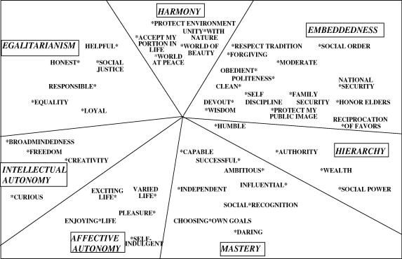
Communication between people with very different cultural values will be problematic.

Slide 15
Intercultural communication ethics
What is your understanding of the term ethics?
Ethics is concerned with what is right or wrong, good or bad and the standards and rules that guide our behaviour.
Communication ethics is concerned with how we enact communication and the consequences of our communication behaviours.

Slide 16
Approaches to communication ethics
Ethical universalism believes that there is a universal ethical principle that guides behaviour across all societies at any time.
Ethical relativism denies the existence of a single universal set of values and norms and instead propose that values and norms are relative.
Communicative ethics approach recognizes that humans are products of their culture but are capable of critically reflecting upon and changing the norms and values into which they have been socialized.

Slide 17
Principles of ethical communication
Mutuality: we should locate a common space based on reciprocal understanding of each other’s perspectives.
Non-judgmentalism: we should be willingness to express ourselves openly and be open minded to others’ behaviours.
Honesty: we should see things as they are rather than as we would like them to be.
Respect: we should develop sensitivity to understand and acknowledge other people’s needs and wants.

Slide 18
Principles of ethical communication
All of the principles of ethical communication above apply to communicating with people from different cultural backgrounds
Although we may not use Hofstede’s or Schwartz’s models we need to be aware that our own cultural practices may mean that we do not communicate effective or ethically
We will look at this issue in more depth in the rest of this Theme.

Slide 19
Principles of ethical communication
Other sources of information on ethical communication include;
The Riverdale and Yonkers Society for Ethical Culture in New York
https://www.rysec.org/10-basics-of-ethical-communication/
Oxford Research Encyclopaedias
https://oxfordre.com/communication/view/10.1093/acrefore/9780190228613.001.0001/acrefore-9780190228613-e-58

Slide 20
Approaches to communication ethics
Ethical universalism believes that there is a universal ethical principle that guides behaviour across all societies at any time.
Ethical relativism denies the existence of a single universal set of values and norms and instead propose that values and norms are relative.
Communicative ethics approach recognizes that humans are products of their culture but are capable of critically reflecting upon and changing the norms and values into which they have been socialized by cultural norms.

Slide 21

Cultural norms and Communication Ethics
Therefore communicative ethics implies that the practitioner should be aware of the norms that they have acquired by socialisation
We will now spend a little time reflecting on the following;
What cultural rules and norms were given to you as part of your socialisation?
How do these affect the way that you communicate?
Guided Study: Cultural Norms – Reflective Exercise
Take a moment to think about these questions.

Slide 22
Cultural norms and Communication Ethics
Therefore communicative ethics implies that the practitioner should be aware of the norms that they have acquired by socialisation
We will now spend a little time reflecting on the following;
What cultural rules and norms were given to you as part of your socialisation?
How do these affect the way that you communicate?
Guided Study: Cultural Norms – Reflective Exercise
Take a moment to think about these questions.

Slide 23

Cultural Differences and Communication
We have questioned the validity and usefulness of both Hofstede’s and Schwartz’s models of cultural diversity
However, there can be little doubt that there are indeed cultural differences in the way that we communicate as we have seen in the examples
Using the sources mentioned above or other sources you have found, develop your own personal checklist of communication ethics to inform your future practice.
Guided Study Activity: Personal Communication Ethics

Slide 24
References
Barger, K. (2018) ETHNOCENTRISM: What is it? Why are people ethnocentric? What is the problem? What can we do about it? Indianapolis: Indiana University Available at: http://www.iupui.edu/~anthkb/ethnocen.htm [Accessed 11/12/2020]
Goldin-Meadow, S (2010) Gesture’s role in creating and learning language Enfance Vol. (3): pp. 239–255. Available at: https://www.researchgate.net/publication/236078646_Gesture's_role_in_creating_and_learning_language [Accessed 11/12/2020]
Johnson, H. & Johnson, K (1998) Encyclopaedic Dictionary of Applied Linguistics Blackwell Publishers
Kar, S. (2018) ‘Pro-social tendency among adolescents: an exploratory study’ Slovak Journal for Educational Sciences / Pedagogika Vol. 9 Issue 4, pp.196-205 https://search.ebscohost.com/login.aspx?direct=true&db=eue&AN=132815572&site=ehost-live [Accessed: 11/12/2020]
Liu, S.; Volcic, Z.; Gallois, C.; (2015). Introducing Intercultural Communication - Global Cultures and Contexts, London: Sage
Mervis, C.B. and Velleman, S.L. (2011) Children with Williams Syndrome: Language, Cognitive, and Behavioral Characteristics and their Implications for Intervention Perspectives on Language Learning and Education Vol. 18 Iss. 3 pp. 98–107 Available at: https://www.ncbi.nlm.nih.gov/pmc/articles/PMC3383614/ [Accessed 11/12/2020]

Slide 25
References
Saxton, M. (2010). Child Language: Acquisition and development. Thousand Oaks, (CA): SAGE Publications Ltd
W. Schramm and D. F. Roberts (eds), The Process and Effects of Mass Communication. Urbana, IL: University of Illinois Press. p. 24.
Scwartz, S. (1999) ‘A theory of cultural values and some implications for work’ Applied psychology: an international review Vol.48 (1), pp. 23–47 Available from: https://search.ebscohost.com/login.aspx?direct=true&db=bth&AN=4423136&site=ehost-live [Accessed 11/12/2020]
Scott, J. (Ed.) (2014) A Dictionary of Sociology (4th ed.) Oxford: OUP
Shannon, Claude and Weaver, Warren (1949) The Mathematical Theory of Communication. Urbana, IL: University of Illinois Press. p. 5.
USNLM (2019) Williams Syndrome Available at: https://ghr.nlm.nih.gov/condition/williams-syndrome#resources [Accessed 11/12/2020]
Wardhaugh, R., Fuller, J. (2014). An Introduction to Sociolinguistics, Blackwell

