Slide 1
Riverdale Nursing Home
(Improving Staff Communication with Microsoft Teams)
Module: LCHS4007
Lecturer Name: Masud Siddiqui
Group 5
Members:
  Marriam Abid: (2539707)
  Sabahat Nasir: (2539709)
  Tayaba Naz: (2535118)
  Paulo Alexandre Bucor: (2420352)
Notes:
Good morning everyone.my group name is ---.Today we are presenting our recommendations for using Microsoft 365 at Riverdale nursing home.
As a group we have reviewed and matched five workplace tasks to the most suitable Microsoft tools for improved communication and efficiency.
My presentation focuses on staff communication at Riverdale Nursing Home. I will explain why Microsoft Teams is the most suitable Microsoft 365 tool for communication, how it can improve collaboration between staff members working across different shifts and buildings, and discuss its advantages and limitations.

Slide 2

Riverdale Nursing Home - Current Challenges
At Riverdale Nursing Home, communication occurs between:
Challenges
• Missed messages due to information overload
• Duplication of work
• Delays in sharing resident information
• Inconsistent communication methods
• Carers and senior carers
• Nurses
• Administrative staff
• Staff working across two separate buildings and multiple shifts
Notes:
At Riverdale nursing home effective communication and using the right tool for staff communication is important because carers, nurses and administrative staff need to share information about residents, urgent announcements, care updates and shift handovers to achieve organisational objectives.
The case study highlights several communication problems, including missed messages, duplicated work, and inefficiencies caused by staff working across two buildings and different shifts. Poor communication in health and social care environments can negatively affect care quality and patient safety. According to the Nursing and Midwifery Council (2018), clear communication is a professional responsibility and fundamental to safe practice.

Slide 3

Workplace Task:
Staff Communication at Riverdale Nursing Home
Communication
Communication is the process of sharing information, messages and opinions between people to improve understanding, decision making and quality of operations support effective teamwork,.
Staff Communication in a care setting
Within a health care setting, communication is the exchange of instructions, concerns, ideas and updates between healthcare staff, residents, families and other professionals to provide safe, effective and person centred care.
(University, n.d.)
Notes:
Communication is the exchange of information,emotions and ideas to support effective teamwork,decision making and quality of care.
Staff communication plays a vital role in a nursing home. At riverdale nursing home communication is important because carers,nurses and administrative staff need to share information about residents, announcements, care updates and shift handovers to achieve organisational objectives.
Employees need to exchange information quickly and accurately to ensure residents receive safe and consistent care. At Riverdale, staff work across two buildings and different shifts, making effective communication even more important. Poor communication can lead to missed messages, duplicated work, and potential risks to resident wellbeing.
Staff communication is a critical operational activity within Riverdale Nursing Home. Employees must exchange information regularly regarding resident care, medication administration, safeguarding concerns, and organisational updates.

Slide 4
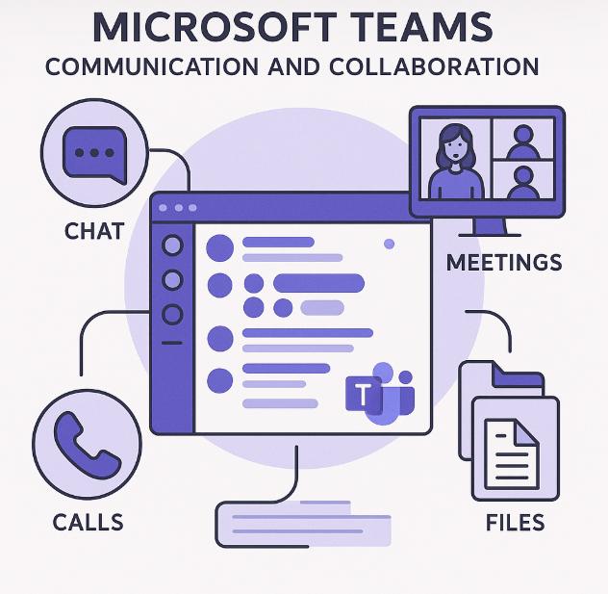
Recommended Microsoft 365 Tool for Riverdale Nursing Home: Microsoft Teams
Microsoft Teams will work as a centralised platform for Riverdale for collaboration, communication and sharing information.
Teams would allow senior carers at Riverdale to connect, work together remotely and stay updated on important notifications or changes (NHS England, 2023).
(K2 Enterprise, 2025)
Notes:
Microsoft Teams is a simple tool for communication and collaboration. Teams allows employees to communicate through chat, calls, video meetings, and shared channels. Since Riverdale already uses Microsoft 365, staff can access Teams easily without additional software costs.
It allows users to send messages, create a group chat, shares file in one place and hold meetings.
Unlike email-based communication, Teams enables real-time interaction through instant messaging, group conversations, video meetings, and dedicated communication channels. This makes it particularly suitable for Riverdale Nursing Home, where staff need immediate access to information while working across different buildings and shifts.
The platform also integrates with other Microsoft 365 applications, allowing communication and information sharing to occur within a single digital environment.
Key Features
• Instant messaging and group chat
• Team channels for organised discussions
• Voice and video conferencing
• File sharing and collaboration
• Mobile and desktop accessibility
• Integration with other Microsoft 365 applications

Slide 5

Suitability of Microsoft Teams for Riverdale Nursing Home
As suggested by NHS (2023), I believe for Riverdale Nursing Home staff, Microsoft Teams can:
Support real-time communication – avoid lost messages
Support communication across multiple locations – connecting multiple sites
Support work allocation – effective shift handovers and sharing care updates
Support effective record keeping - Reduces reliance on paper notes and verbal messages
Notes:
Microsoft Teams is suitable because it provides a central location for all workplace communication. Staff can quickly share information and receive updates regardless of their location. Dedicated channels can be created for nursing staff, carers, administration teams, or specific topic s, helping communication remain organised and easy to follow.
Microsoft Teams directly addresses the communication challenges identified in the Riverdale case study.
The platform centralises communication into one system rather than relying on multiple methods such as verbal handovers, telephone calls, handwritten notes, or emails. Staff can communicate instantly and access previous conversations when required.
For example, if a resident's care plan changes during the day shift, nursing staff can immediately communicate this update through Teams. Night staff can then review the information before beginning their duties, reducing the risk of communication errors.

Slide 6
Efficiency improvement at Riverdale Nursing Home
Instant messaging to reduce delays in communication
Group chats which allows information to reach multiple staff members simultaneously.
Remote meetings feature which enables connection between different buildings
Communication history which can be reviewed when needed (NHS England, 2023).
Notes:
Teams improves efficiency by allowing information to be shared instantly. Instead of relying on phone calls, paper notes, or verbal messages, staff can communicate through one platform.
One of the main advantages of Microsoft Teams is its ability to improve both efficiency and communication simultaneously.
Currently, Riverdale experiences duplicated work and missed information. Teams helps address these issues by ensuring that all staff have access to the same information through a shared platform.
Communication channels can be organised according to departments or functions, allowing relevant information to reach the correct employees quickly. The ability to review previous messages also supports accountability and reduces misunderstandings.
As a result, staff spend less time searching for information and more time focusing on resident care.

Slide 7
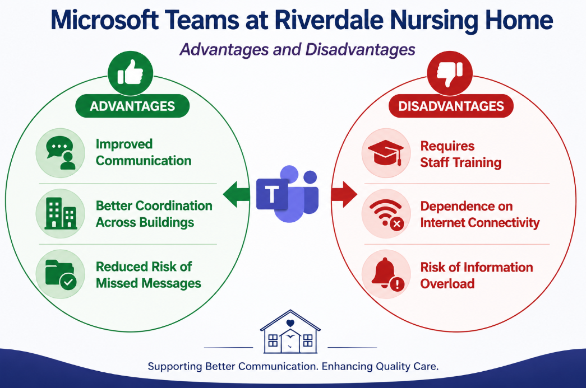

Slide 8
Conclusion
Effective communication is essential for safe and high-quality care for a nursing home like Riverdale.
Microsoft Teams is the most suitable tool for staff communication at Riverdale Nursing Home.
Teams will improve collaboration, information sharing, and communication efficiency.
Teams will help reduce missed messages and support coordinated care across different shifts and buildings of Riverdale.

Slide 9
References
Booth, R. (2025). Microsoft has ‘ripped off the NHS’, says MP amid call for contracts with British firms. [online] the Guardian. Available at: https://www.theguardian.com/society/2025/nov/19/microsoft-nhs-uk-contracts-public-sector-procurement [Accessed 5 Jun. 2026].
K2 Enterprise. (2025). Microsoft Teams – The Ultimate Communication And Collaboration Tool. Available at: https://www.k2e.com/articles/microsoft-teams-the-ultimate-communication-and-collaboration-tool/ [Accessed 6 Jun. 2026].
NHS England (2023). NHS England» Microsoft Teams and remote working. [online] www.england.nhs.uk. Available at: https://www.england.nhs.uk/long-read/microsoft-teams-and-remote-working/ [Accessed 6 Jun. 2026].
University, T. (n.d.). Know the Differences Between External and Internal Communication. Available at: https://mcomms.telkomuniversity.ac.id/en/s2-communication-external-internal-communication/ [Accessed 6 Jun. 2026].

Slide 10
Secure File Storage and Sharing in Riverdale nursing home
LCHS4007l DIGITAL SKILLS & RESERCH METHODS
Focus Tool: Microsoft OneDrive
Student Name: Sabahat Nasir
Student ID: 2539709
Lecturer: Masud Siddiqui

Slide 11

RIVERDALE NURSING HOME CONTEXT
I
Care Environment:
24/7 Operations:
Riverdale operates around the clock across two separate physical buildings.
Diverse Staff Ecosystem:
Employs nurses, care assistants, senior carers, and clinical administrators.
Critical Need:
Immediate and efficient access to resident profiles is vital to prevent medication discrepancies and ensure safe shift handovers (NHS England, 2024).
(Carehome.co.uk, 2026)

Slide 12


THE CURRENT CHALLENGES IN RIVERDALE
01
02
03
Duplicated Work
Missed Messages
Inefficiency
Staff often recreate care plans because physical folders are missing or outdated in Building B.
Critical dietary or medication updates fail to reach the next shift due to scattered local files.
Administrative staff spend hours hunting for policy documents across isolated computers.

Slide 13




TASK FOCUS:
SECURE FILE STORAGE & Sharing
I
Core Requirement at Riverdale:
Medical Records: Digitizing sensitive resident health histories.
Administrative Audits: Storing compliance and staff records.
Care Policies: Centralizing shift-handover documents.
Cross-Building Sharing: Instant access for nurses in Buildings A and B.

Slide 14

Recommended Tool for Secure File Storage & Sharing in Riverdale
MicroSoft One Drive
The core task in Riverdale nursing home involves digitizing physical record folders—including personal hydration graphs, nutritional updates, and medical care plans—into a unified cloud environment (Storing information using a data cloud, 2022).
(PCMag UK, 2026)

Slide 15

How OneDrive Data Sync will Works in Riverdale Nursing Home
01
03
Document Saved
A carer updates a resident's daily clinical file on a Building A device.
Cloud Secured
Updates are synchronized and held securely within the enterprise cloud.
One Drive
Auto-Discovery
OneDrive background client detects local changes and initiates secure upload.
Live Updates
Nurses in Building B receive refreshed files immediately on their tablets.
02
04

Slide 16



WHY ONEDRIVE IS SUITABLE for RIVERDALE NURSING HOME
Enterprise Encryption
OneDrive utilizes AES-256 bit encryption at rest and TLS 1.2 in transit, satisfying UK NHS data standards (NHS England, 2024). Critical data remains secure and inaccessible to unauthorized devices.
Allows admins to restrict medical file access to authorised nurses. Supports "Need to Know" patient-identifiable rules in line with Caldicott principles (The MDU, 2022).
Tracks and stores document edits. Senior care managers can restore older file versions instantly, avoiding conflicting clinical observations (Microsoft, 2025).
GDPR Compliance
Real-Time Collab
Active Version History
01
02
03

Slide 17

EFFICIENCY IMPROVEMENTS IN RIVERDALE NURSING HOME
I
Eliminates Duplication: One file shared via a link rather than multiple email attachments.
Continuity of Care: Carers in Building B receive dietary updates from Building A instantly.
Anytime Access: Night shift workers access documents via tablets or mobiles without needing physical keys to filing cabinets.
(In-House Health, 2026)

Slide 18
Key Platform Advantages
Cloud Mobility
Staff on night shifts gain instant access to care plans using authorized mobile tablets, reducing delayed updates.
Real-Time Edits
Enables joint logs and easy recovery. Restores accidently deleted notes easily with comprehensive version history.
Strict HIPAA / GDPR Alignment:
Robust business associate agreements keep data safe (Microsoft, 2025).

Slide 19
LIMITATIONS & MITIGATIONS
Solutions
Limitations
Internet Dependency: Wi-Fi outages may block access to "live" files.
Staff Training: Non-tech-savvy staff may find cloud structures confusing.
Solutions
Offline Sync: Enable "Always keep on this device" for critical care policies.
Cheat Sheets: Provide quick-reference guides near staff PCs for basic OneDrive navigation.

Slide 20

Conclusion
We recommend establishing Microsoft OneDrive as the core storage backbone in Riverdale nursing home, directly linked with Teams channels and digital Forms.
This cohesive system enables incident logs submitted via Forms to auto-save into secure OneDrive directories, ensuring complete HIQA audit compliance (NHS England, 2024).

Slide 21
References
Microsoft (2025) Privacy security, and compliance in Microsoft OneDrive. Microsoft Q&A. Available at: https://learn.microsoft.com/ (Accessed: 6 June 2026).
NHS England (2024) Cloudstorage and data guidance - Cloud Centre of Excellence. Available at: https://digital.nhs.uk/ (Accessed: 6 June 2026).
Storing information using a data cloud and protecting patient data (2022) The MDU. Available at: https://www.themdu.com/ (Accessed: 6 June 2026).
University of Cambridge (2016) Security Guidance for Microsoft OneDrive for Business (UIS). Available at: https://help.uis.cam.ac.uk/ (Accessed: 6 June 2026).
Microsoft OneDrive Reference:PCMag UK (2026) Microsoft OneDrive. Available at: https://uk.pcmag.com/file-sync-backup/1433/microsoft-onedrive/ (Accessed: 14 June 2026).
Carehome Reference:Carehome.co.uk (2026) What is a nursing home. Available at: https://www.carehome.co.uk/advice/what-is-a-nursing-home (Accessed: 14 June 2026).
LinkedIn Reference:In-House Health (2026) Nursing technology: what’s next. Available at: https://www.linkedin.com/pulse/nursing-technology-whats-next-in-house-health-dkg3f (Accessed: 14 June 2026).

Slide 22


MICROSOFT WORD IN RIVER DALE NURSING HOME
WRITING CARE- RELATED DOCUMENTS/ DOCUMENTATION
TAYYABA NAZ - 2535118
LECTURER – MASUD SIDDIQUI
This Photo by Unknown Author is licensed under CC BY-SA-NC

Slide 23
Riverdale Care Home provides nursing and residential care for older adults
The Care Home is rated Good by CQC, and the care home focuses mainly on person-centered care
Individual care plans are made based on individual needs and circumstances at Riverdale
The current challenge they face is :
* Keeping Care plans and risk assessments up to date as residents change
Making sure all documentation is completed accurately and with consistency by all staff
* Maintaining high-quality records to support care and CQC compliance
RIVERDALE NURSING HOME CONTEXT AND THE CURRENT CHALLENGE THEY FACE

Slide 24

WHAT DOES CARE RELATED DOCUMENTATION INVOLVE AND WHAT IT MEANS FOR RIVERDALE NURSING HOME ?
Nursing Homes must protect residents’ personal information and maintain confidentiality (Information Commissioner’s Office (ICO) 2026)
Care related documentation is to write down information about residents and keeping records up to date.
At Riverdale Nursing Home this can help record medication given and personal care needs and much more to keep everything concise and in order.
Care related documentation would be important in Riverdale Nursing Home as it can help keep residents safe and allows staff to communicate with each other which Word can help with.

Slide 25
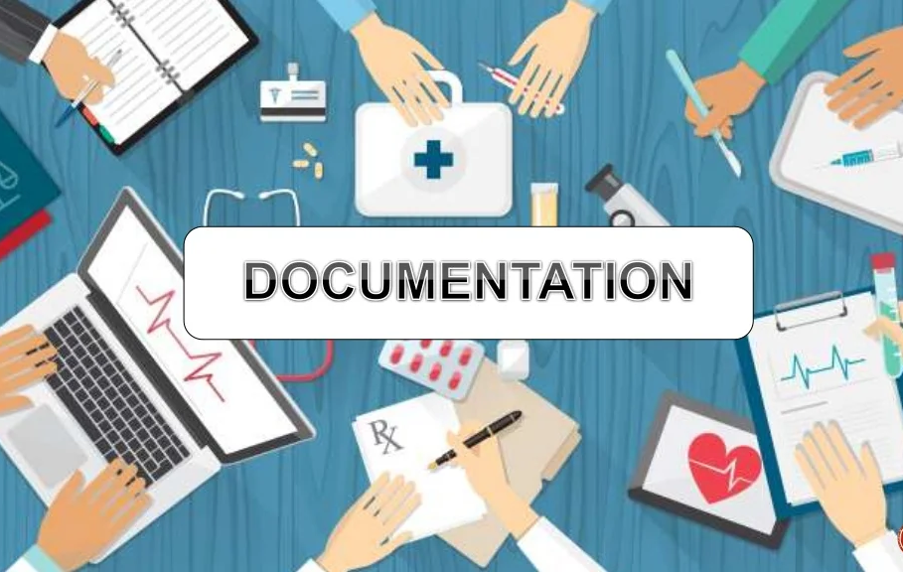
HOW CAN RIVERDALE NURSING HOME USE MICROSOFT WORD FOR CARE DOCUMENTATION .
Microsoft Word would allow staff to record daily care notes for residents across the whole nursing home.
Microsoft Word would help staff keep risk assessments up to date for all residents at Riverdale.
Microsoft Word would help staff share information during changeovers between shifts.
Microsoft Word would allow staff to update documents quickly when a resident’s needs change.

Slide 26

HOW MICROSOFT WORD ALLOWS FOR EFFICIENCY AND COMMUNICATION?
Microsoft Word saves time at Riverdale Nursing Home by using simple templates for care plans and reports.
Microsoft Word helps staff at Riverdale Nursing Home find information easily because documents are stored in one place.
Microsoft Word helps staff at Riverdale Nursing Home’s work more efficiently by reducing the time needed to complete care records.
Microsoft Word helps Riverdale Nursing Home staff avoid mistakes by keeping all care information written and clear.

Slide 27
ADVANTAGES AND LIMITATION OF USING MICROSOFT WORD FOR CARE RELATED DOCUMENTATION IN RIVERDALE NURSING :
Advantages of using Word for Care related documentation: | Limitation s of using Word for Care related documentation:
Helps protect confidential information | Backups are not automatic so manual saving is required which takes time
You can store documents securely in one place | There could be a risk of unauthorised access if not stored properly
You can use passwords to protect files for extra security | Files can be harder to manage if multiple staff have access
Easy to edit and update if information changes of patient | Word is not designed for care management so it cannot provide reminders or patient record updates

Slide 28

REFERENCE LINKS :
Care Quality Commission (2023) Riverdale Care Home Inspection Report. Available at: Riverdale Care Home - Care Quality Commission
Riverdale | Care Home in Chesterfield
NHS (n.d.) Riverdale Care Home. Available at: NHS Riverdale Care Home Profile
Microsoft Corporation (2026) Microsoft Word. Available at: Microsoft Word
Care Docs (n.d.) Care Plans. Available at: CareDocs Care Plans

Slide 29


Slide 30
Paulo Bucur
Student ID: 2420352 Lecturer: Masud Siddiqui

Slide 31

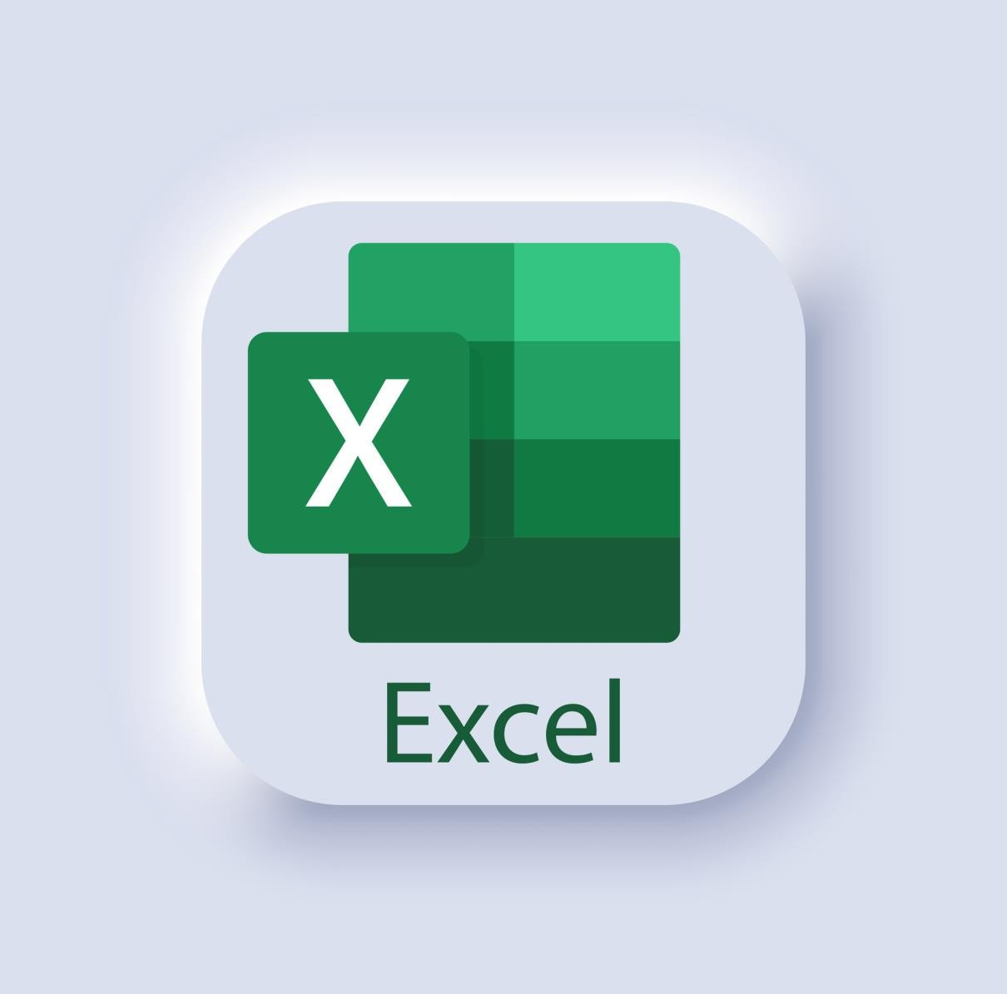
Microsoft Excel

Slide 32

What is microsoft Excel?
Microsoft Excel is a spreadsheet program used to organize, store, and manage data in rows and columns. It helps people keep information neat and easy to find.
It can perform automatic calculations using formulas such as adding totals or working out averages. This saves time and reduces mistakes.
It is widely used in workplaces like nursing homes for tasks such as rotas, schedules, and record keeping. It helps staff stay organized and efficient.

Slide 33

How is microsoft Excel usefull in making staff scheduling/rotas?
Organizes staff shifts in a clear table format.
Improves efficiency and workforce planning.
Can be shared through Microsoft 365 for easy access.
Uses colour coding to improve readability.
Calculates hours
worked automatically using formulas.
Helps reduce scheduling mistakes and missed shifts.
Tracks carers, senior carers, nurses, and administrative staff.
Check hours Excel can add p work hours and overtime for you.
Makes Rota updates quick and easy.

Slide 34

Why microsoft excel is the best tool in a nursing home?
Staff Rotas
Excel can be used to create work schedules showing which staff members are working each shift. This helps managers make sure there are always enough carers and nurses on duty.
Medication Tracking
Excel can be used to keep track of when medications are due, although many nursing homes use specialized care software for this. Spreadsheets can help with monitoring and
Appointments and Activities Excel can be used to keep track of residents' medical appointments, visits from healthcare professionals, and planned social activities.
reporting.

Slide 35

Why microsoft excel is the best tool in a nursing home?
Reports and Data Analysis
Managers can use Excel to create charts and reports showing things like staffing levels, training completion, budgets, or stock usage. This helps with planning and decision-making.
Excel can also be used to record staff attendance, including sickness, holidays, and other absences. This allows managers to identify staffing shortages and arrange cover when needed. In addition, training records can be stored in Excel, helping managers monitor when staff have completed mandatory training such as first aid, health and safety, infection control, and safeguarding.
Another benefit is that Excel makes information easy to update, sort, and search. For example, managers can quickly find staff contact details if they need to arrange a shift change or emergency cover. By keeping all this information organised in one place, Excel helps the nursing home run more efficiently and ensures residents receive consistent care.

Slide 36
How Microsoft Excel improve efficiency and communications
Automatic calculations – Excel can work out total hours worked and staffing levels using formulas, saving time, and reducing mistakes.
Easy updates – Information like shift changes or absences can be updated instantly and shared with staff.
Backup and security – Excel files can be saved and backed up, reducing the risk of losing important information compared to paper records.
Improved communication between staff – Shared Excel files allow managers and employees to access the same rota, helping everyone stay informed about when they are working and reducing confusion.
Faster decision-making – Managers can quickly view all staffing information in one place, helping them make quicker decisions about cover, holidays, and shift changes.
Better planning for busy periods – Managers can analyses rotas to see patterns, helping them prepare for busy times like weekends or holidays by scheduling enough staff in advance.

Slide 37
Reduced errors in planning – Because Excel uses structured rows, columns, and formulas, it helps reduce mistakes such as double-booking staff or missing shifts.
Efficient shift adjustments – When changes happen, such as sickness, emergencies, or last-minute leave, managers can quickly edit individual cells instead of rebuilding the entire rota. This improves flexibility and ensures staffing problems are solved quickly.
Supports fair workload distribution – Excel helps managers balance shifts evenly between staff members, ensuring no one is overloaded with too many night shifts or long working hours, which supports staff wellbeing and retention.
Advantages of using Microsoft Excel for Rotas
Reduced administrative workload – Excel allows managers to reuse templates and copy earlier schedules, meaning they do not have to design rotas from scratch each time. This saves time and reduces workload for administrative staff.
Improved accuracy and reduced human error – Built-in formulas and structured tables help prevent mistakes such as double-booking staff, missing shifts, or incorrect hour calculations, improving the overall reliability of the rota system.

Slide 38
Can become confusing with large data – In a busy nursing home with many staff, spreadsheets can become large and complicated, making it harder to read and increasing the chance of mistakes.
Security risks – Excel files stored on computers or shared drives can be accessed by unauthorized people if not properly protected, which could expose staff personal information.
Disadvantages of using Microsoft Excel for rotas
File corruption or loss risk – If a file becomes damaged or not saved properly, important rota data could be lost, causing major disruption to scheduling.
Time-consuming for complex schedules – While Excel is faster than paper, creating incredibly detailed rotas (with rotations, night shifts, and cover rules) can still take a lot of time.
Lack of automatic alerts – Excel does not warn managers if staffing levels are too low or if legal working hour limits are exceeded unless carefully programmed.

Slide 39
REFERENCES
Wikipedia Contributors (2019). Microsoft Excel. [online] Wikipedia. Available at:
https://en.wikipedia.org/wiki/Microsoft_Excel.
NHS (2022). What are the confidentiality rules. [online] NHS Digital. Available at:
https://digital.nhs.uk/data-and-information/looking-after-information/data-security-and-information-
governance/codes-of-practice-for-handling-information-in-health-and-care/a-guide-to-confidentiality-
in-health-and-social-care/a-guide-to-confidentiality/what-are-the-confidentiality-rules.
NHS (2023). Care homes - Social care and support guide. [online] nhs.uk. Available at:
https://www.nhs.uk/social-care-and-support/care-services-equipment-and-care-homes/care-homes/.
NHS England (2019). NHS England Confidentiality Policy. [online] NHS England. Available at:
https://www.england.nhs.uk/publication/confidentiality-policy/.
NHS website (2024). Care services and care homes. [online] nhs.uk. Available at:
https://www.nhs.uk/nhs-services/care-services-and-care-homes/.
Microsoft Corporation (2026). Transforming UK healthcare with digital innovation. [online]
Microsoft.com. Available at: https://www.microsoft.com/en-gb/emea/business/advancing-healthcare-
nhs/?msockid=3d92855f74336304187e90dc70336d78 [Accessed 5 Jun. 2026].
Booth, R. (2025). Microsoft has ‘ripped off the NHS’, says MP amid call for contracts with
British firms. [online] the Guardian. Available at:
https://www.theguardian.com/society/2025/nov/19/microsoft-nhs-uk-contracts-public-sector-procurement [Accessed 5 Jun. 2026].
•

Slide 40
THANK YOU

Slide 41

Riverdale Nursing Home:
Staff Training with Microsoft PowerPoint
Code and Title:
Group Name:5
Student Name and Student Number
Lecturer Name
Date
Notes:
Good morning/afternoon. My presentation focuses on staff training at Riverdale Nursing Home. I will explain why Microsoft PowerPoint is the most suitable Microsoft 365 tool for delivering staff training, how it can improve learning and communication among employees, and discuss its advantages and limitations within the nursing home environment.

Slide 42
The Workplace Task – Staff Training
Staff training is a process of teaching employees how to do their duties better.
Training topics at Riverdale may include:
  Medication administration
  Infection prevention and control
  Safeguarding vulnerable adults
  Manual handling procedures
  Health and safety requirements
Regular training supports compliance with care standards and regulations.
(Health and Safety Executive, 2024)
Notes:
Staff training is an essential activity in Riverdale Nursing Home because employees must provide safe and effective care to residents. Training helps staff stay updated on procedures, policies, and legal requirements. Examples include medication management, safeguarding, infection control, and health and safety practices. Effective training contributes to better quality care and reduces the risk of errors.

Slide 43
Recommended tool – PowerPoint For Riverdale Nursing Home
Chosen Tool: Microsoft PowerPoint
Creates professional training presentations.
Combines text, images, diagrams, and videos.
Easy to share with staff across different shifts and buildings.
Supports consistent delivery of training materials.
Available within Microsoft 365 already used by Riverdale.
(Microsoft, 2025)
Notes:
I have selected Microsoft PowerPoint because it is specifically designed for presenting information in a structured and engaging format. Trainers can create visual learning materials using text, graphics, videos, and animations. Since Riverdale already uses Microsoft 365, PowerPoint can be accessed easily by staff without requiring additional software.

Slide 44
Suitability Of PowerPoint For Riverdale Nursing Home
Provides clear and organised learning content.
Visual elements improve understanding and retention.
Standardised training materials reduce inconsistencies.
Can be updated quickly when procedures change.
Supports both face-to-face and online training sessions.
(Mayer, 2021)
Notes:
PowerPoint is suitable because healthcare staff often need information presented clearly and consistently. Visual learning methods can improve knowledge retention. Standardised slides ensure all employees receive the same information regardless of their shift or location. Trainers can also quickly update presentations when regulations or procedures change.

Slide 45
Improvement In Efficiency At Riverdale Nursing Home
Delivers the same training message to all staff.
Reduces time spent repeating explanations.
Supports communication across multiple buildings.
Riverdale context:
A PowerPoint presentation on infection control can be delivered to all carers and nurses, ensuring consistent guidance throughout Riverdale.
Notes:
PowerPoint improves efficiency because one presentation can be reused for multiple training sessions. This saves preparation time and ensures consistency. For example, infection control training can be presented to staff working in both buildings, helping everyone follow the same procedures and reducing communication gaps.

Slide 46
Advantages And Limitations Of PowerPoint For Riverdale Nursing Home
Advantages
Limitations
Easy to create and edit.
Visually engaging.
Supports multimedia content.
Widely recognised and accessible.
Limited interaction compared with specialist e-learning platforms.
Learning effectiveness depends on presentation quality.
Staff may need additional discussion or practical demonstrations.
(Microsoft, 2025)
Notes:
PowerPoint offers many advantages, including ease of use, accessibility, and the ability to include multimedia content. However, it is not a complete training solution on its own. Some topics, such as manual handling, require practical demonstrations. Additionally, presentations must be regularly updated to ensure information remains accurate and relevant.

Slide 47
Conclusion
Microsoft PowerPoint is the most suitable tool for delivering structured training content at Riverdale nursing home.
It improves consistency, communication, and efficiency.
Its benefits outweigh its limitations when supported by practical training activities.
Notes:
In conclusion, Microsoft PowerPoint is an effective tool for staff training at Riverdale Nursing Home. It enables consistent delivery of information, supports communication across different teams, and improves efficiency. While practical training remains important, PowerPoint provides a strong foundation for delivering essential learning content to staff.

Slide 48
References
Health and Safety Executive (2024) Health and Safety in Care Settings. Available at: https://www.hse.gov.uk Accessed on: [04 June 2026].
Mayer, R.E. (2021) Multimedia Learning. 3rd edn. Cambridge: Cambridge University Press. [04 June 2026].
Microsoft (2025) Microsoft PowerPoint Support and Features. Available at: https://www.microsoft.com [04 June 2026].

Slide 49
Recomendation for Riverdale Nursing Home in Implementation of Microsoft 360 tools
To maximize the success of this digital overhaul, Riverdale Nursing Home should integrate these tools into a cohesive ecosystem rather than using them in isolation:
Store all Word care documents and Excel staff rotas securely within OneDrive folders.
Link those OneDrive folders directly into Microsoft Teams channels so carers can access them instantly on mobile tablets during handovers.
Deploy PowerPoint training slides via Teams meetings to ensure night-shift and day-shift workers receive identical instruction without unnecessary travel.

Slide 50

Reflective Summary
"Digital integration is not merely about using software. It is about deploying multimedia tools to ensure standardized, compassionate, and highly efficient core."
— Adapted from Patterson (2019)

