Slide 1


A Childs Experience Between The Ages
0 -5 Will Affect The Rest Of Their Lives
Name: Jordan Glasgow
Student Number: 1918303
Module Code: BMHP_4019
Module Name: Psychology in Health and Social Care
Lecturers Name: Rebecca Kavanagh And Dr Mark Gallagher-Reed

Slide 2

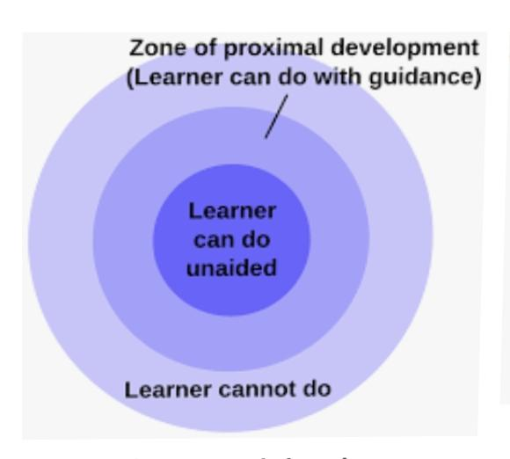
A Childs experience between the ages
0 -5 will affect the rest of their lives
INTRODUCTION
This poster offers a critical description of play and cognitive learning studies and an analysis of the two key theoretical structures which have influenced it. A dominant influence throughout this field before recently was that of Piaget (1936), for whom the approach to play developed an essential factor of his wider cognitive development theory. Although the current research of Piaget (1936) seems far from eliminated, the lack of a cultural and social element in his approach created a platform for Vygotsky's influence (1978), whose theory of development has progressively arisen as the preferred alternative structure Children's development makes it easy to recognize what babies are trying to say from the physical action to verbal sound being linked to expressing feelings, all these emotional and physical changes that arise in an infant from infancy to childhood. During this process, a child transitions from reliance on its parents/guardians to expanded independence. Children's development is profoundly impacted by genetic factors that chromosomes pass on from their parents & events during fetal life.
Interesting Facts
Ages 0-3 months are also referred to as the cognitive milestones in the growth of every infant and represent all the essential steps forward in the potential developmental success of a child. Babies have always been thought of as plain, passive entities in human history.
Activity for parents and newborns
In this activity, we would like to adapt Vygotsky, (1978) theory in a much more creative manner to infants. Our activity will therefore concentrate on the notions of freedom of speech and expression as well as stimulation all through the process. We will split it into 2 separate steps related to the proximal development zone theory.
The Cognitive Development Theory of Vygotsky, (1978) argues that intellectual development is central to social interaction. The theory of Vygotsky (1978) consists of concepts such as components that are relevant to culture and interdependence among both thought and behaviour, and the Zone of Proximal Development.
The first stage would consist of an operation without the support of adults/parents. This activity is aimed at encouraging young children to start developing their consciousness as well as the space surrounding them and can aid with cognitive development and other basic motor skills. You can start with something as simple as placing some rice in a container, putting the lid back on and leaving it within reach of the infant. within the babies reach and seeing how the child in turn reacts to the bottle does the child reach out for it, does the child attempt to shake the bottle of rice or does the child pay the rice shaker no mind? This is because they still have not been taught what to do with it. How will this help aid my baby’s cognitive development, you may find yourself asking please refer to bullet points below.
Jean Piaget was a Swiss biologist who later became a cognitive and child psychologist (1896-1980). He is well-known for offering a cognitive development process theory to describe the growth of thought in humans from infancy to adulthood. We are already deeply engaged in the learning process from the moment we were born. The cognitive approach of Piaget, (1936) is by far the most influential developmental cognitive development theory. He indicated that children go through different developmental phases, and they think qualitatively differently from the previous stage at each stage. Older kids are capable of concepts that are just beyond smaller children.
•This practice makes children realize that language plays a vital role in cognitive growth.
•This activity is directed at awakening the curiosity of infants in their bodies and understanding what their physical strengths are.
•To encourage children how knowledge can be a basis for developing for future.
Stages of Development:
There are four Phases of Piaget, (1936) cognitive constructionism In a series of four stages, cognitive function comes to life. Each step is related to age and is unique. Each step is irregular and more sophisticated than the previous one.
Sensorimotor - Babies just act - they're not thinking. 0- 2 years
Preoperational - toddlers start thinking, but they are constrained through their own world views. 2 years – 7 years
Concrete operational - kids began to use logical reasoning to come to conclusions, but they would be strictly limited to the here and now. 7 years - 12 years
Formally operational - transformation to a complete, adult-like mode of thinking 12 years plus
A baby develops ability to think, comprehend, interact, recognize and visualize via play. Baby play is about you and back-and-forth exchanges. It's important to give infants freedom to examine their surroundings and test them. Reading, attempting to play with toys, trying to stack bricks, banging stuff and more are some of the suggestions for infant cognitive development.
When small children are in this zone of proximal development, supplying them with the required assistance and resources offers a child what they need to achieve the new task or ability. Such processes, directions, techniques, and resources are known as scaffolding. Eventually, the scaffolding will be removed, and the child would be able individually to complete the task.
In the second part of this activity an adult/parent should actively interact with the baby and show them that with the use of their hand they can reach for the bottle of rice and even make the bottle of rice make sound with the correct hand motions this engages the baby attention and should in turn allow for the infant to want to recreate the sound they can hear coming from the rice bottle shaker.

Slide 3
Annotated Bibliography
App.nova.edu. 2021. [online] Available at: https://app.nova.edu/toolbox/instructionalproducts/itde8005/weeklys/CH4Piaget.pdf [Accessed 13 Feb.. 2021].
This article that I read provided me an interpretation of how Jean Piaget looks at the cognitive development as well as the four stages he utilizes to look at how a child progresses, and the various age brackets it occurs in.
Kendra Cherry. (April 28, 2020). The Zone of Proximal Development as Defined by Vygotsky. Available: https://www.verywellmind.com/what-is-the-zone-of-proximal-development-2796034#:~:text=The%20zone%20of%20proximal%20development%20is%20a%20concept,guidance%20or%20in%20collaboration%20with%20more%20cap. Last [accessed 19 Feb. 2021.]
After reading through Kendra Cherry’s article, it gave me wider understanding of Vygotsky, (1978) take on The Zone of Proximal Development and it further allowed me to explain the inner workings Vygotsky Theory in my poster.
McLeod, S., 2020. Lev Vygotsky's Sociocultural Theory. [online] Simplypsychology.org. Available at: <https://www.simplypsychology.org/vygotsky.html> [Accessed 14 Feb.2021].
This article helped me understand Vygotsky's philosophy of how he looks at the creation of cognition and his numerous ideas and beliefs. And in this, as well as a child in search of community, language and thought, social contact plays a significant role.
Thomas, R. Murray, (2016 ). Comparing theories of child development, 5th ed.. Available: https://psycnet.apa.org/record/2001-06979-000. Last [accessed 17 Feb. 2021 ]
Based on this article I was able to compare the differences between multiple child development theories and choose the two I thought mirrored each other best in comparison
whilst still allowing for me to show case their uniqueness .

Slide 4
Annotated Bibliography
Piaget, J., 2015. Language and thought of the child. [Place of publication not identified]: Routledge. Accessed on 14 Feb.,2021
This website is where I found the picture of the babies that I used for my poster
https://www.dhs.wisconsin.gov/newbornscreening/committee-structure.htm
Accessed on 11th Feb.2021
This website is where I found the picture for my cover page that I used for my poster
https://i.pinimg.com/736x/e6/1f/9b/e61f9b134c883a1e5d1049c6d88378f1--kids-behavior-attachment-parenting.jpg

