Slide 1
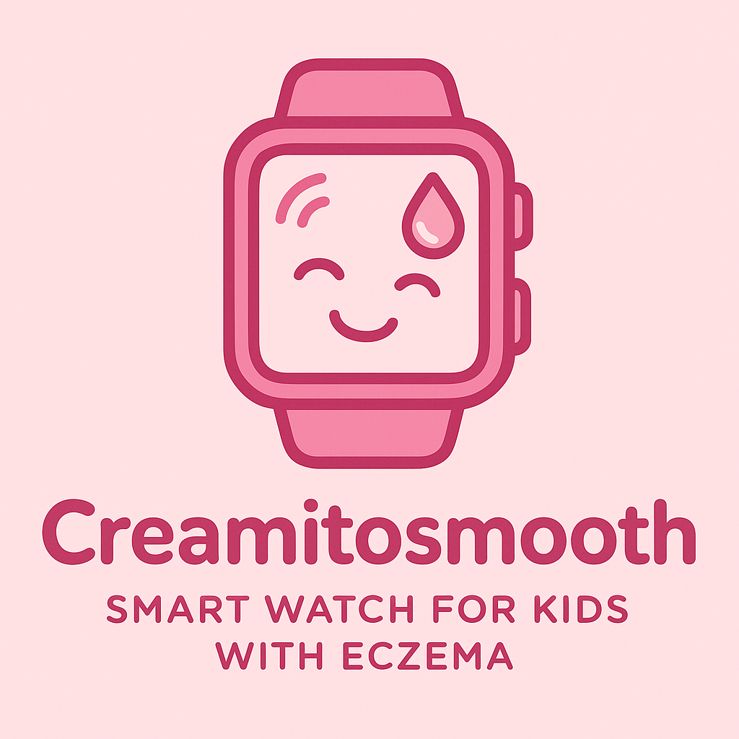


A Smartwatch for Children with Eczema: Promoting Timely Emollient Use through Digital Health Innovation

Slide 2


About Eczema
Eczema, also known as atopic dermatitis, is a common, non-contagious skin condition that causes the skin to become dry, itchy, and irritated. Often referred to as “the itch that rashes” (Nemeth et al., 2022), this long-term condition tends to flare up unpredictably, making it challenging to manage and to assess treatment effectiveness (Langan et al., 2024).

Slide 3

ECZEMA in numbers
2.6%
Of the global population is affected by eczema.
86%
Children with eczema report loss of sleep.
1 in 10
Adults in the UK have eczema
26%
Children missed 1-2 days of school per month due to eczema.
1 in 5
Children in the UK have eczema
£257 million
Spent by the NHS treating eczema in 2020.
References: National Eczema Society (2025); British Journal of Dermatology (2023) & Dawson, 2023.

Slide 4

Why?
Managing eczema is demanding, often requiring multiple daily treatments which take up to 2+ hours daily affecting routines and social life (Murray, 2020).
Patients struggle to maintain consistent use of emollients due to inconvenience, fear of side effects, forgetfulness, or limited understanding of their condition (Tier et al., 2021).
Research shows that adherence to topical treatments can drop by around 70% within just a few days of starting a regimen (Krejci-Manwaring et al, 2007).
Effective management therefore relies not only on medical treatment but also on behavioural support.

Slide 5
About
the smartwatch
Hydration and dryness sensors detect early signs of eczema flare-ups.
AI reminders schedule emollient application at optimal times.
Interactive interface designed for children - gamification
Data sharing with parents or healthcare professionals
Purpose:
Encourages routine adherence, improves eczema management, and empowers children to take part in their own care.

Slide 6
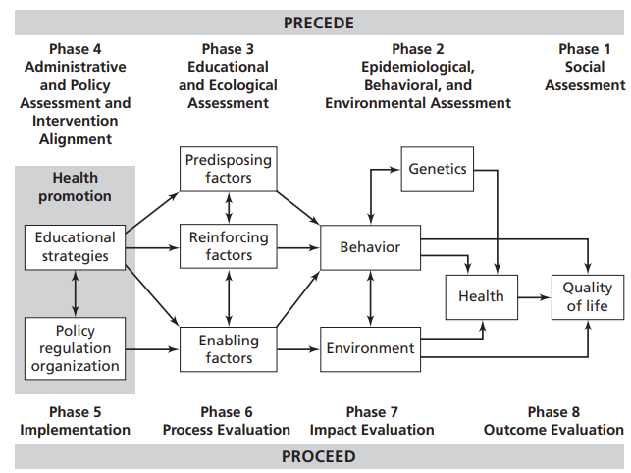
Application
Introduction to the PRECEDE-PROCEED Model:
Applying health behaviour theory is vital when designing health interventions, as most current health issues are influenced by behavioural risks and protective factors (Gielen et al., 2008).
A planning model works like a blueprint. It provides a step-by-step structure for designing, implementing and evaluating an intervention (Crosby et al., 2011).
The PRECEDE-PROCEED Model is one of the most widely used planning models in public health (Porter, 2016).
PRECEDE (Steps 1–4): PLANNING
Stands for: Predisposing, Reinforcing and Enabling Constructs in Educational/Environmental Diagnosis and Evaluation
Focuses on assessment and understanding factors influencing the health problem
PROCEED (Step 5 onwards): EVALUATION
Stands for: Policy, Regulatory and Organisational Constructs in Educational and Environmental Development
Focuses on implementing and evaluating the intervention
REFERENCE: (Gielen et al., 2008).

Slide 7
PRECEDE-PROCEED Model vs Creamitosmooth
PRECEDE Stage | Application
Social | Sleep loss, itching, missing school and concentration issues in school.
Epidemiological | 1 in 5 UK children affected; adherence low.
Behavioural/Environmental | Forgetting emollients, lack of routine= flares.
Educational/Ecological | Predisposing: low knowledge, children rely on parents. Enabling: lack of reminders/tools. Reinforcing: no rewards or feedback.
Administrative & Policy | NICE guidance, parental consent, data protection.
PROCEED Stage | Application
Implementation | Smartwatch sends reminders, hydration alerts, gamified rewards
Process Evaluation | App engagement, reminder completion, device use.
Impact Evaluation | Flare frequency, adherence percentages.
Outcome Evaluation | Better Quality of life, better sleep, fewer GP visits.
References: (National Eczema Society,2025); (British Journal of Dermatology, 2023);
(Torrelo et al, 2013); (Bass et al, 2015) & (Dawson, 2023).

Slide 8
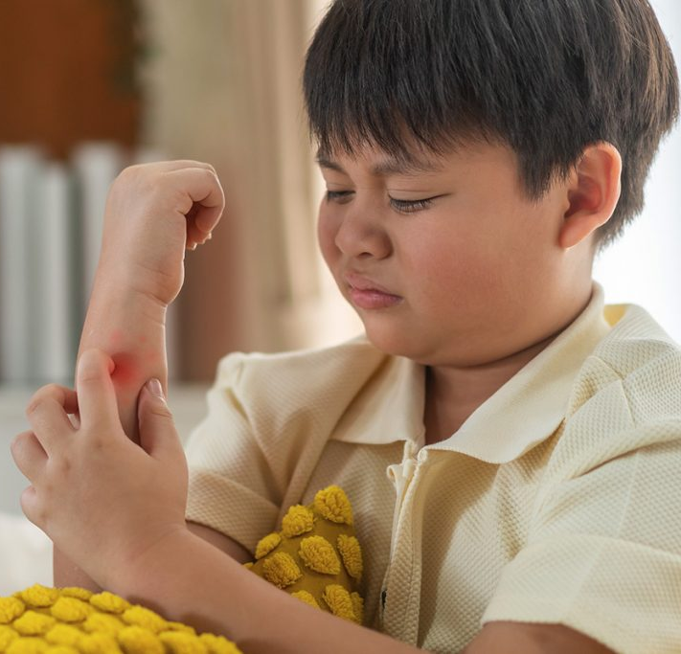


STAKEHOLDERS
Stakeholder | Role
Families & children (primary users) | Co-design, testing, adherence
Primary care teams | Referral, monitoring, clinical oversight
Schools & teachers | Supporting routine use, school-time applications (Greener, 2016)
National Eczema Society and other eczema charities | Recruitment, educational content (National Eczema Society, 2025)
Regulators: MHRA, ICO | Device safety, data protection compliance (ICO, 2025 & UK Government, 2024)

Slide 9
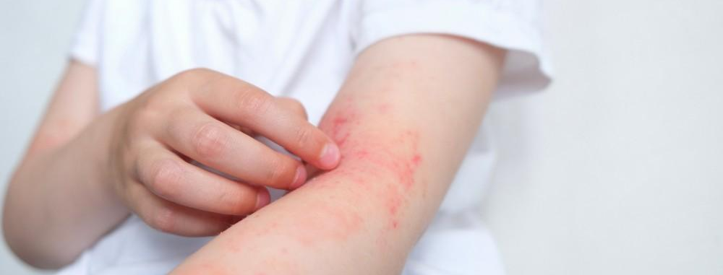
BARRIERS
Barriers | How to overcome them
Privacy concerns (children’s health data) | Parental consent, clear privacy notice, compliance with ICO Children’s Code (ICO, 2025)
Smartwatch accuracy / false alerts | Clinical validation study, conservative thresholds, clinician review pathway (NICE, 2023)
Digital divide / cost | NHS funding, school-loan scheme for devices (NHS, 2024)
Children Acceptability (comfort, irritation...) | Hypoallergenic straps, clip-on option
Increased GP workload / unnecessary alerts | Parent-first alerts, automated self-care advice
Legal & Ethical Issues
Consent
  Children under 13 require parental consent for digital services
  Follow UK GDPR & ICO Age-Appropriate Design Code (ICO, 2023).
Data minimisation & purpose limitation
  Only collect necessary information; retention policy; clear opt-out option for the families (ICO,2023).
Device safety & claims
  If data informs treatment decisions, the smartwatch becomes a regulated medical device under MHRA rules (UK Government, 2024).

Slide 10
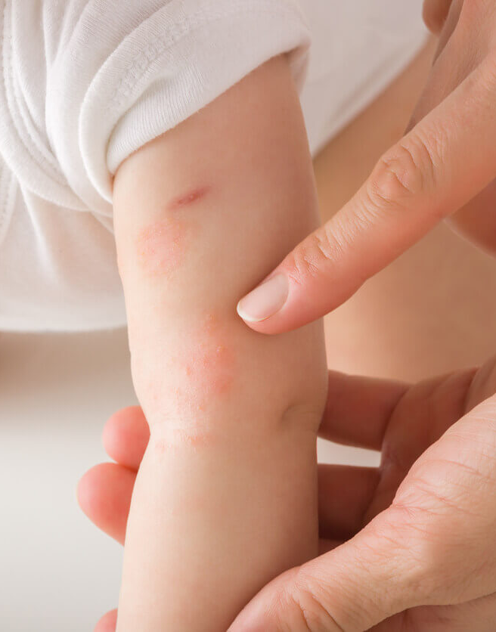
BENEFITS
For parents and children:
Improved adherence leading to fewer flares (Torrelo et al, 2013)
Better sleep & quality of life for children and carers (Bass etal, 2015)
Empowers children learn to self-care via gamification (Mettarikanon et al., 2025)
For the NHS:
Early detection & reduced escalation leading to fewer GP visits
Important data for clinicians & research: anonymised trends reveal adherence patterns
Harsh pal
2432312

Slide 11

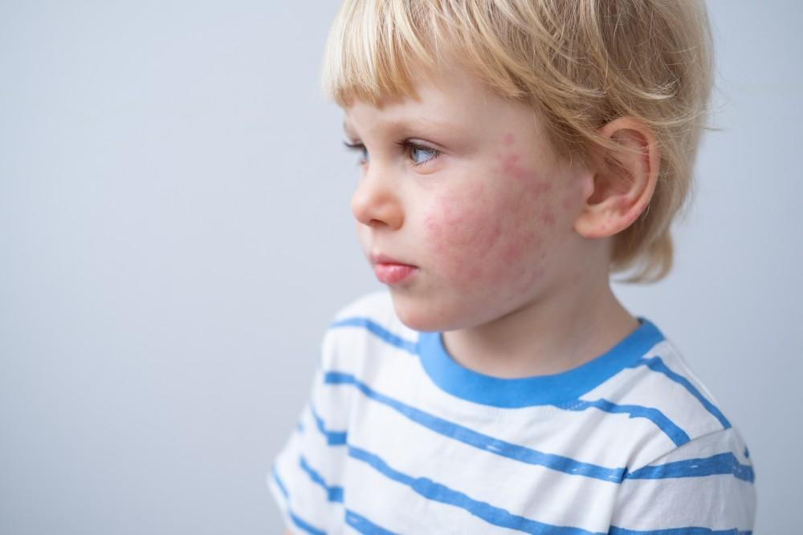
IMPLICATIONS FOR POLICY, RESEARCH & EDUCATION
Policy: Evidence of benefits could support NHS funding for device lending or partial reimbursement.
Could influence NICE guidelines to include digital tools alongside standard eczema care.
Research: Trials would be required for symptom improvement, adherence to emollient routines, healthcare use & cost-effectiveness, equality - digital access for all children.
Education: Train GPs and nurses on using the smartwatch and app. Teach children and parents how to use the device safely. Include digital self-care modules in school health programs.
Harsh pal
2432312

Slide 12
Benefits: Potential Benefits
Harsh pal
2432312
Benefits
The smartwatch promotes consistent emollient application, improving adherence and reducing flare-ups among children with eczema (Torrelo et al., 2013).
Children experience fewer itching episodes, leading to better sleep and reduced irritability (Bass et al., 2015).
Gamified features encourage children’s engagement and long-term behavioural change towards skin care (Mettarikanon et al., 2025).
Parents gain confidence in managing eczema as the device provides reminders and progress updates (National Eczema Society, 2025).
By maintaining hydration levels, the smartwatch helps in preventing severe flare-ups, thereby improving daily functioning (Langan et al., 2014).
Supports a sense of autonomy and responsibility among children in self-managing their condition (Mettarikanon et al., 2025).

Slide 13
Benefits: Expected Outcomes
Harsh pal
2432312
Benefits
Enhanced treatment adherence through timely AI reminders and hydration alerts (Tier et al., 2021).
Fewer clinical visits as early detection prevents severe eczema escalation (NHS Digital, 2024).
Reduction in emotional and psychological stress for both children and caregivers due to improved symptom control (Bass et al., 2015).
Improved academic performance and attendance due to better sleep and comfort (Greener, 2016).
Consistent monitoring creates a dataset that allows parents and clinicians to track progress over time (Crosby & Noar, 2011).
Overall improvement in quality of life and treatment satisfaction (Torrelo et al., 2013).

Slide 14
Benefits: Policy Implications
Harsh pal
2432312
Benefits
Demonstrating cost-effectiveness and improved outcomes could justify NHS support or reimbursement for digital eczema devices (NICE, 2023).
Supports integration of digital health interventions under NHS Digital’s real-world monitoring initiatives (NHS Digital, 2024).
Encourages future NHS and NICE guidelines to incorporate wearable digital tools for eczema management (UK Government, 2024).
Provides policymakers with evidence for equitable access to child-friendly health technologies (Porter, 2016).
Supports the UK's digital health innovation strategy and promotes technology-enabled self-care (NHS Digital, 2024).

Slide 15
Benefits: Education and Research Implications
Harsh pal
2432312
Benefits
Healthcare professionals can use smartwatch data to personalised eczema treatment and identify non-adherence (Greener, 2016).
Digital health training modules could be introduced for healthcare staff to improve understanding of data-driven care (NHS Digital, 2024).
Incorporating eczema awareness and digital self-care programs into schools enhances children’s knowledge and early management (National Eczema Society, 2025).
Anonymised adherence data could advance dermatology research and clinical practice insights (Langan et al., 2014).
Supports future research on gamification and digital engagement among paediatric patients (Mettarikanon et al., 2025).
Encourages academic partnerships for ongoing evaluation and improvement of digital eczema tools (Crosby & Noar, 2011).

Slide 16
Conclusion: Summary of Presentation
Harsh pal
2432312
Conclusion
The smartwatch for children with eczema uses hydration sensors and AI reminders to promote timely emollient application (Torrelo et al., 2013).
By integrating behavioural change theory and gamification, it enhances long-term adherence and engagement (Gielen et al., 2008).
It empowers young patients and supports parents through shared monitoring and feedback (Bass et al., 2015).
The approach aligns with NHS goals for digital innovation in child healthcare (NHS Digital, 2024).
The project demonstrates how technology and theory-driven design can improve chronic disease management in children (Porter, 2016).

Slide 17
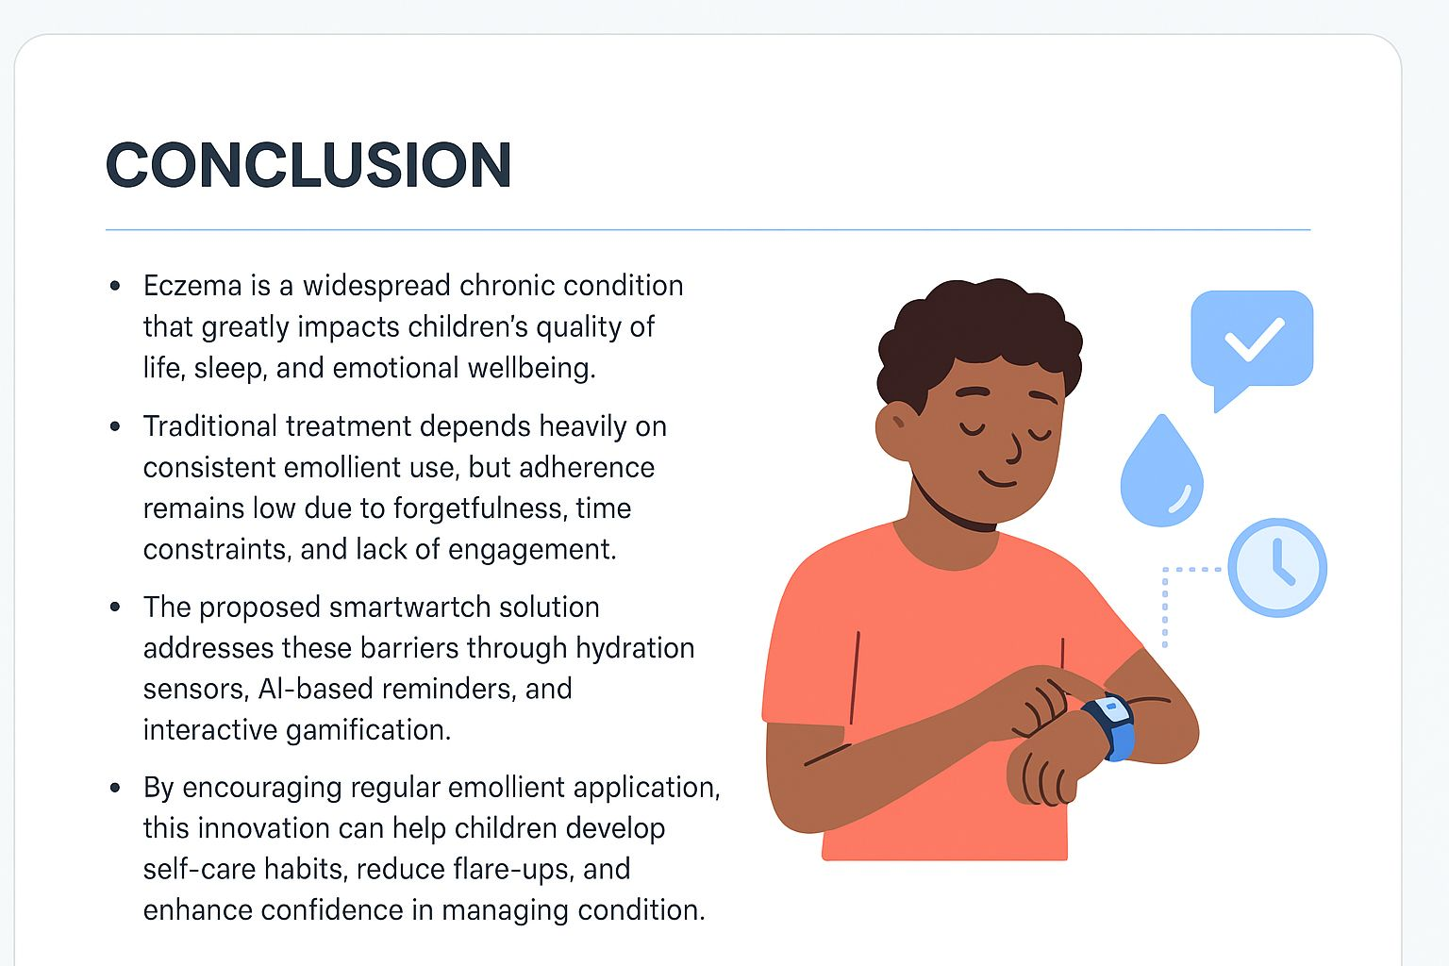
Harsh pal
2432312

Slide 18
Conclusion: Need for the Intervention
Harsh pal
2432312
Conclusion
Eczema requires strict daily care, and adherence rates often drop within days of starting treatment (Krejci-Manwaring et al., 2007).
Children experience sleep loss, school absence, and emotional challenges due to inconsistent treatment (Dawson, 2023).
Parents often lack time and reminders to maintain the child’s skincare schedule (Tier et al., 2021).
Digital interventions provide structure, motivation, and educational reinforcement to maintain treatment consistency (Mettarikanon et al., 2025).
Therefore, this smartwatch meets a significant behavioural and health management need (National Eczema Society, 2025).

Slide 19
Conclusion: Consequences of Not Using the Intervention
Harsh pal
2432312
Conclusion
Without consistent care, eczema flare-ups worsen, leading to higher NHS costs and reduced quality of life (Dawson, 2023).
Children may develop social withdrawal, anxiety, or reduced academic focus due to visible skin symptoms (Greener, 2016).
Parents face increased stress and loss of productivity managing unpredictable flare-ups (Bass et al., 2015).
Lack of real-time adherence data limits clinicians’ ability to adjust treatment effectively (NHS Digital, 2024).
Missed opportunities for prevention and early management can escalate into chronic skin damage (Torrelo et al., 2013).

Slide 20
Conclusion: Future Plans – Research Development
Harsh pal
2432312
Conclusion
Conduct longitudinal trials to evaluate the smartwatch’s effect on symptom reduction and adherence (Bass et al., 2015).
Use collected data to study behavioural trends and digital health literacy in children (Mettarikanon et al., 2025).
Investigate the role of gamification and AI feedback in maintaining long-term engagement (Gielen et al., 2008).
Publish results to inform NHS and NICE about integrating digital eczema management tools (NICE, 2023).
Develop partnerships with academic and clinical institutions to ensure continuous improvement (Porter, 2016).

Slide 21
Conclusion: Future Plans – NHS Integration
Harsh pal
2432312
Conclusion
Collaborate with NHS Digital to pilot the smartwatch under real-world monitoring frameworks (NHS Digital, 2024).
Develop standardised evaluation protocols to assess digital tool effectiveness in eczema management (UK Government, 2024).
Ensure compliance with MHRA safety regulations and UK GDPR for children’s data protection (ICO, 2025).
Promote NHS endorsement for digital adherence tools through cost-benefit analysis (NICE, 2023).
Establish multidisciplinary support systems combining technology, policy, and healthcare training (Porter, 2016).

Slide 22
Conclusion: Future Plans – Education and Awareness
Harsh pal
2432312
Conclusion
Organise parent and professional workshops to promote digital eczema management literacy (Greener, 2016).
Introduce smartwatch-based self-care modules in primary and secondary school health programs (National Eczema Society, 2025).
Create digital safety campaigns educating families about responsible technology use (ICO, 2025).
Integrate eczema education within GP and nurse training curricula to improve care continuity (NHS Digital, 2024).
Encourage community-level outreach programs promoting awareness and inclusivity in digital health (Porter, 2016).

Slide 23
Conclusion: Final Remarks
Harsh pal
2432312
Conclusion
The eczema smartwatch bridges the gap between child health needs and digital health innovation (Torrelo et al., 2013).
Combining behavioural theory, technology, and education, it offers a holistic model of chronic disease care (Gielen et al., 2008).
By empowering children and supporting parents, it contributes to improved long-term outcomes (Bass et al., 2015).
The intervention aligns with NHS and NICE objectives for preventive, patient-centred digital healthcare (NICE, 2023).
Future collaboration among clinicians, educators, and policymakers will maximise its sustainability and social impact (Porter, 2016).

Slide 24
References
British Journal of Dermatology (2023) ‘A study about how many people around the world have atopic dermatitis’, 190(1), p. e6. Available at: https://doi.org/10.1093/bjd/ljad462
Dawson, A. (2023) The Costs of Atopic Dermatitis. Sanofi UK. Available at: https://www.sanofi.co.uk/assets/dot-uk/pages/images/skin-in-the-game/cost-of-ad-pdf.pdf
Nemeth, V., Syed, H.A. and Evans, J. (2022) ‘Eczema’, in StatPearls. Treasure Island (FL): StatPearls Publishing. Available at: https://www.ncbi.nlm.nih.gov/books/NBK538209/
Langan, S.M. et al. (2014) ‘How are eczema ‘flares’ defined? A systematic review and recommendation for future studies’, British Journal of Dermatology, 170(3), pp. 548-556.
Murray, G. (2020) ‘Psychosocial burden and costs in patients with atopic dermatitis’, Irish Skin Foundation. Available at: https://irishskin.ie/2020/11/02/psychosocial-burden-and-costs-in-patients-with-atopic-dermatitis/
National Eczema Society (2025) Information and advice. Available at: https://eczema.org/information-and-advice/
Krejci-Manwaring, J., Tusa, M. G., Carroll, C., Camacho, F., Kaur, M., Carr, D., ... & Feldman, S. R. (2007) ‘Stealth monitoring of adherence to topical medication: adherence is very poor in children with atopic dermatitis’, Journal of the American Academy of Dermatology, 56(2), pp.211-216.
Tier, H. L., Balogh, E. A., Bashyam, A. M., Fleischer Jr, A. B., Spergel, J. M., Masicampo, E. J., ... & Feldman, S. R. (2021) ‘Tolerability of and adherence to topical treatments in atopic dermatitis: a narrative review’, Dermatology and Therapy, 11(2), pp.415-431.
Crosby, R., & Noar, S. M. (2011). What is a planning model? An introduction to PRECEDE‐PROCEED. Journal of public health dentistry, 71, S7-S15.
Porter, C. M. (2016). Revisiting Precede–Proceed: A leading model for ecological and ethical health promotion. Health Education Journal, 75(6), 753-764.
Gielen, A. C., McDonald, E. M., Gary, T. L., & Bone, L. R. (2008). Using the precede-proceed model to apply health behavior theories. Health behavior and health education: Theory, research, and practice, 4, 407-29.

Slide 25
References
National Eczema Society. (2025) What we do. Available at: https://eczema.org/what-we-do/ (Accessed: 2 November 2025).
Information Commissioner’s Office. (2025) Age‑Appropriate Design: Code of Practice for Online Services (Children’s Code) – Guidance for organisations. Available at: https://ico.org.uk/for-organisations/uk-gdpr-guidance-and-resources/childrens-information/childrens-code-guidance-and-resources/ (Accessed: 2 November 2025).
UK Government. (2024) Regulating medical devices in the UK. Available at: https://www.gov.uk/guidance/regulating-medical-devices-in-the-uk (Accessed: 2 November 2025).
Greener, M. (2016). Eczema at school: more than skin deep. British Journal of School Nursing, 11(5), 221-224.
NHS Digital. (2024) Monitoring the safety and effectiveness of digital technologies (real‑world monitoring). Available at: https://www.digitalregulations.innovation.nhs.uk/regulations-and-guidance-for-adopters/all-adopters-guidance/monitoring-the-safety-and-effectiveness-of-digital-technologies-real-world-monitoring/ (Accessed: 2 November 2025).
NICE (2023) Atopic eczema in under 12s: diagnosis and management (NICE guideline CG57). London: National Institute for Health and Care Excellence. Available at: https://www.nice.org.uk/guidance/cg57/ (Accessed: 2 November 2025).
Mettarikanon, D., Eden, C., & Tawanwongsri, W. (2025). The Role of Game-Based Learning in Dermatology: A Scoping Review on Patient Education. Frontiers in Communication, 10, 1636364.
Bass, A. M., Anderson, K. L., & Feldman, S. R. (2015). Interventions to increase treatment adherence in pediatric atopic dermatitis: a systematic review. Journal of clinical medicine, 4(2), 231-242.
Torrelo, A., Ortiz, J., Alomar, A., Ros, S., Pedrosa, E., & Cuervo, J. (2013). Health-related quality of life, patient satisfaction, and adherence to treatment in patients with moderate or severe atopic dermatitis on maintenance therapy: the CONDA-SAT study. Actas Dermo-Sifiliográficas (English Edition), 104(5), 409-417.

