Slide 1
Contemporary issues affecting hospitality industry
“Marriott Hotel”

Slide 2

What is globalization?
Globalization is the speedup of exchange and movement in all the planet. One of the effect is that globalization increases and promotes interaction between countries and population in all the world.

Slide 3
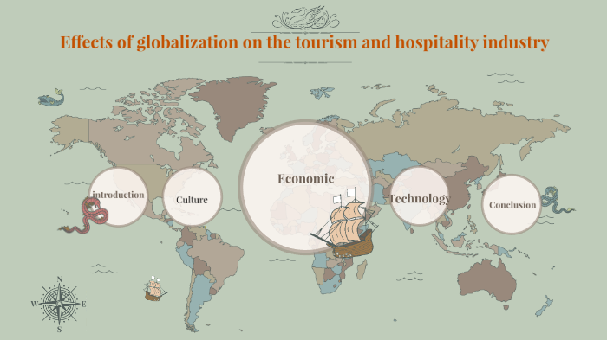

Slide 4
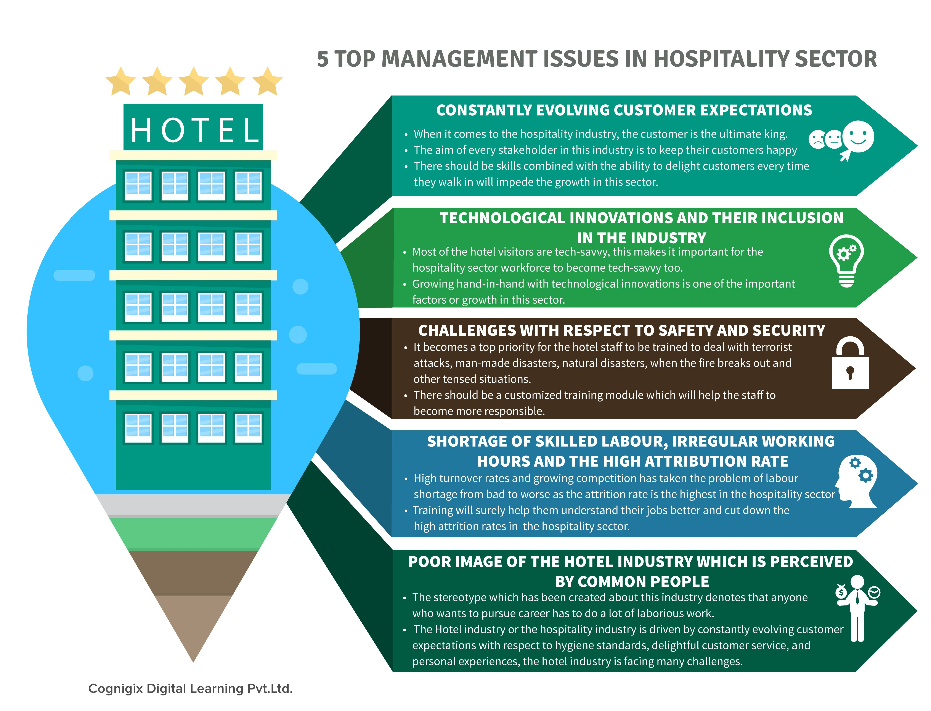
General contemporary issues
contemporary issues in hospitality

Slide 5

Marriott Hotel
-Marriott app and website
-Long hold times
-Poor customer service

Slide 6
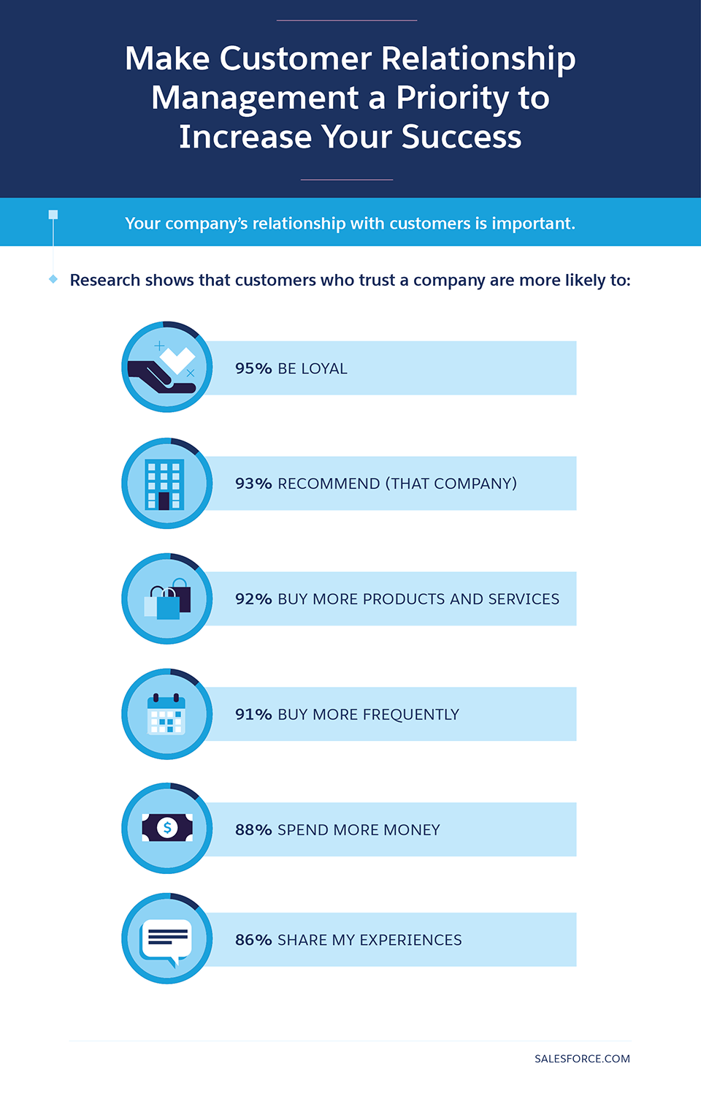
Conclusion and recommendation
-Customer service
-Long hold times
-Marriott website
-Cost, revenue
Controls
-Human capital
- Social Media

Slide 7
references
Frangos, N. (2015). The 4CI’s (Contemporary Issues) in the Hospitality Industry. [Online] Hospitality Net. Available at: https://www.hospitalitynet.org/opinion/4071106.html.
Mest, E., 2018. Minimum Wage | Hotel Management. [online] Hotelmanagement.net. Available at: <https://www.hotelmanagement.net/topic/minimum-wage> [Accessed 22 July 2020].
Parker, B., 2005. Introduction to Globalization and Business. London [etc.]: Sage.

